Slide 1
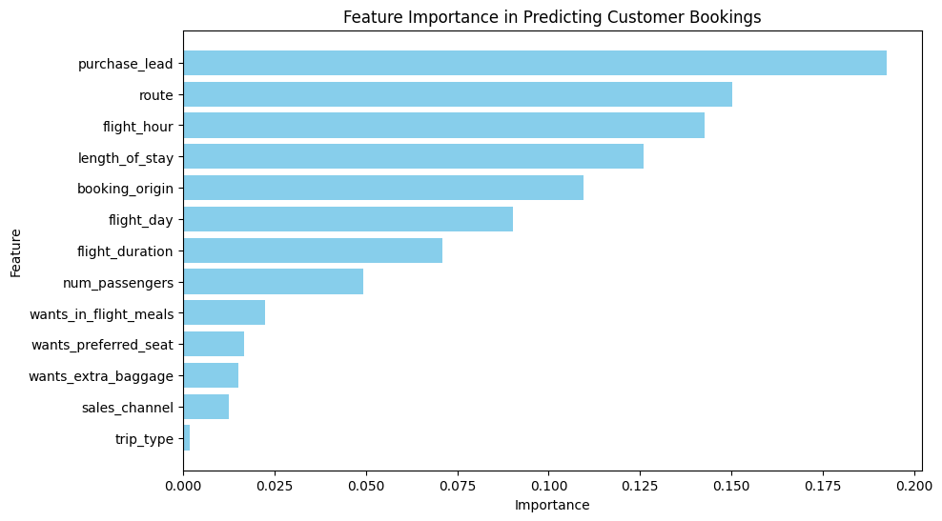
Customer Booking Prediction - Business Insights
📊 Key Business Insights:
🔹 Purchase Lead Time Matters: Customers who book far in advance are more likely to complete their bookings.
- Consider offering last-minute discounts to capture late-bookers.
🔹 Route and Flight Timing are Critical:
- Popular routes and specific flight hours strongly influence booking completion.
- Airlines can optimize pricing strategies based on peak hours.
🔹 Booking Origin and Stay Duration:
- Travelers from certain locations are more likely to complete bookings.
- Longer stays increase booking probability—offer extended stay promotions.
🔹 Additional Services Have Minimal Impact:
- Preferences like meals, baggage, and seat selection have little influence on final booking.
- Upselling strategies should be adjusted accordingly.

