Slide 1
Subject Area: Heart Attack Risk
– Database Normalization Course Project​
Muhammadjon Ibrohimov

Slide 2
Developed a normalized/denormalized data schema to analyze and visualize heart attack risk factors.
Data sourced from a clinical dataset with patient demographics, health metrics, diet, and risk factors.
Objective: Deliver strategic insights to support public health decisions.

Slide 3

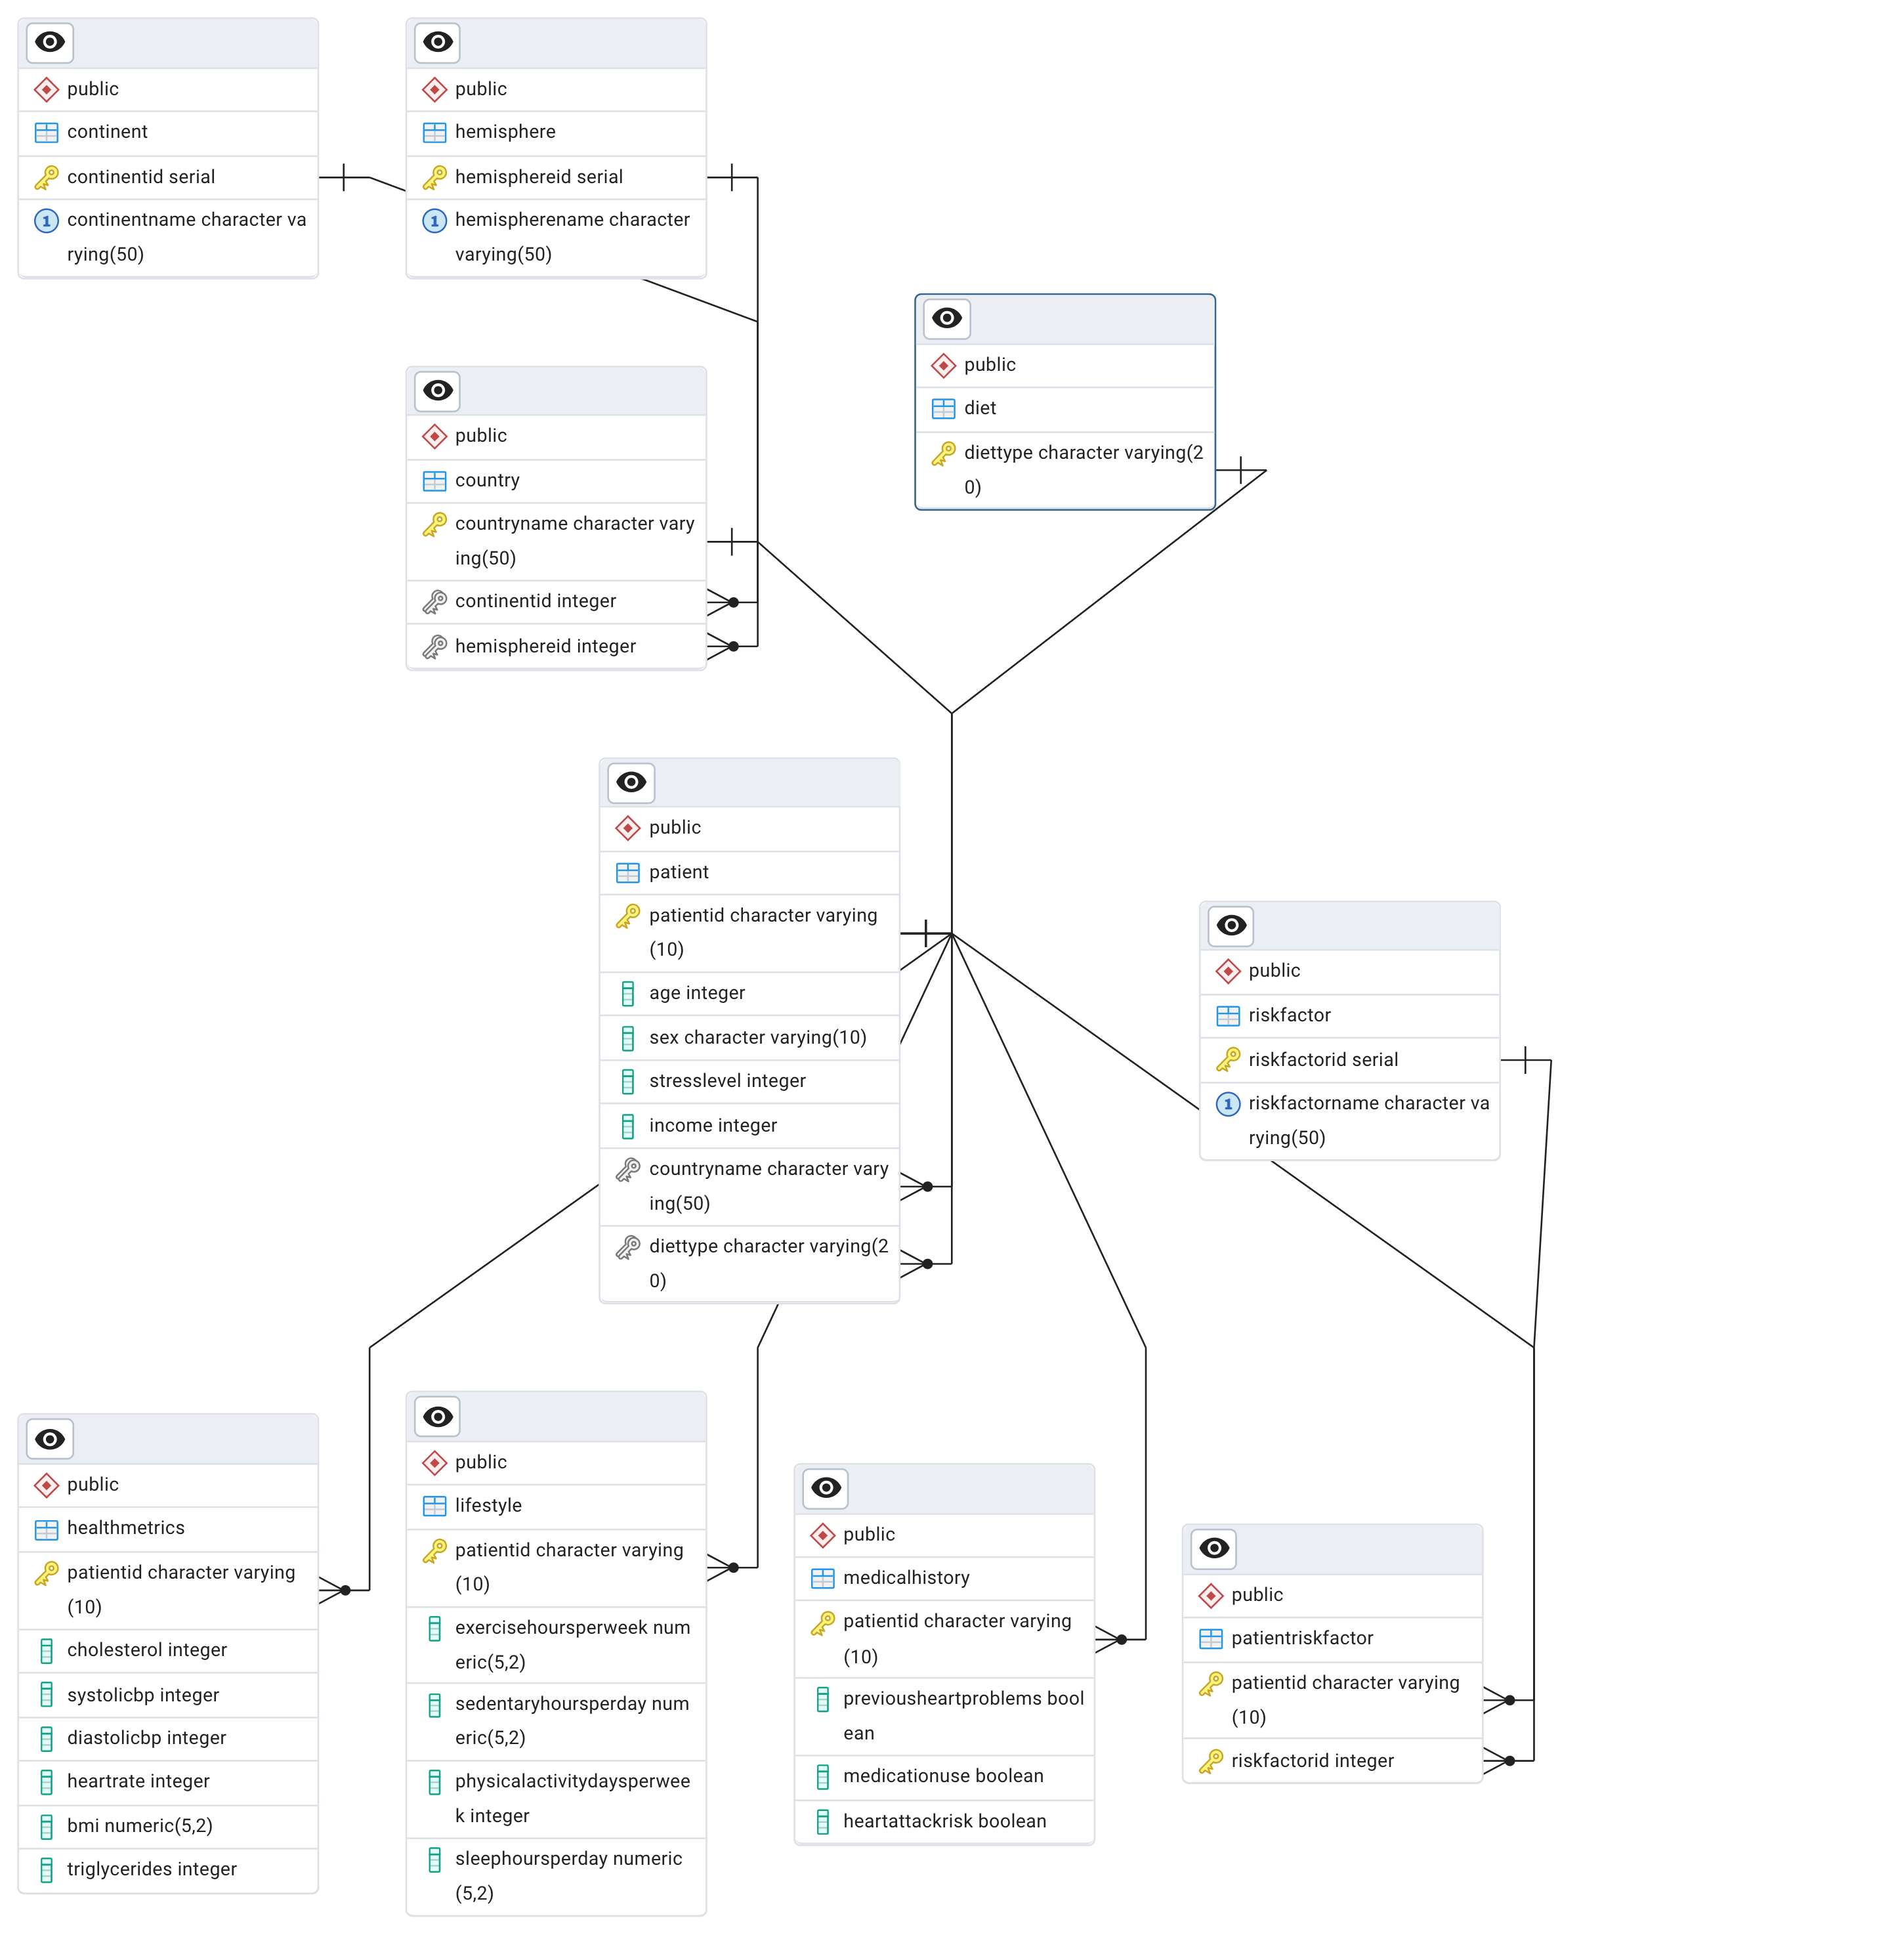
Entity Relationship Diagram: 3NF

Slide 4
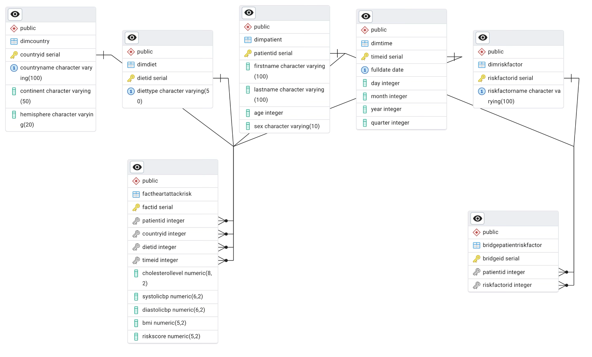
Star Schema

Slide 5
Data Migration
Created dimension and fact tables with proper constraints and surrogate keys.
Used staging tables to clean and load data via SQL scripts.
Handled many-to-many relations via a bridge table (Patient–RiskFactor).
Applied transformations (e.g., Blood Pressure split, BMI categorization) during insert.
-- Extract systolic and diastolic values from a 'BP' field like '120/80' SELECT split_part(blood_pressure, '/', 1)::INT AS systolic_bp, split_part(blood_pressure, '/', 2)::INT AS diastolic_bp FROM staging_table;

Slide 6
Analytical Queries Overview
Nine analytical queries were written using window functions and aggregations:
Top Countries by Risk, Diet vs. BMI, Stress vs. Cholesterol
Risk Factor Frequency, Hemisphere Comparisons, BMI Trends, etc.
Each query includes commentary and was visualized with charts for better clarity.

Slide 7
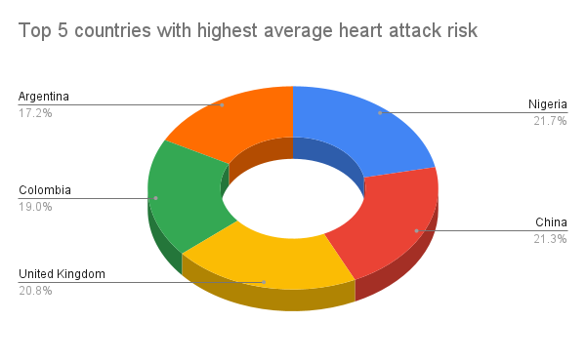
Data Visualizations
SELECT dc.CountryName,
ROUND(AVG(CASE WHEN f.HeartAttackRisk THEN 1 ELSE 0 END), 2) AS avg_risk
FROM FactHeartAttackRisk f
JOIN DimCountry dc ON f.CountryKey = dc.CountryKey
GROUP BY dc.CountryName
ORDER BY avg_risk DESC
LIMIT 5;

Slide 8
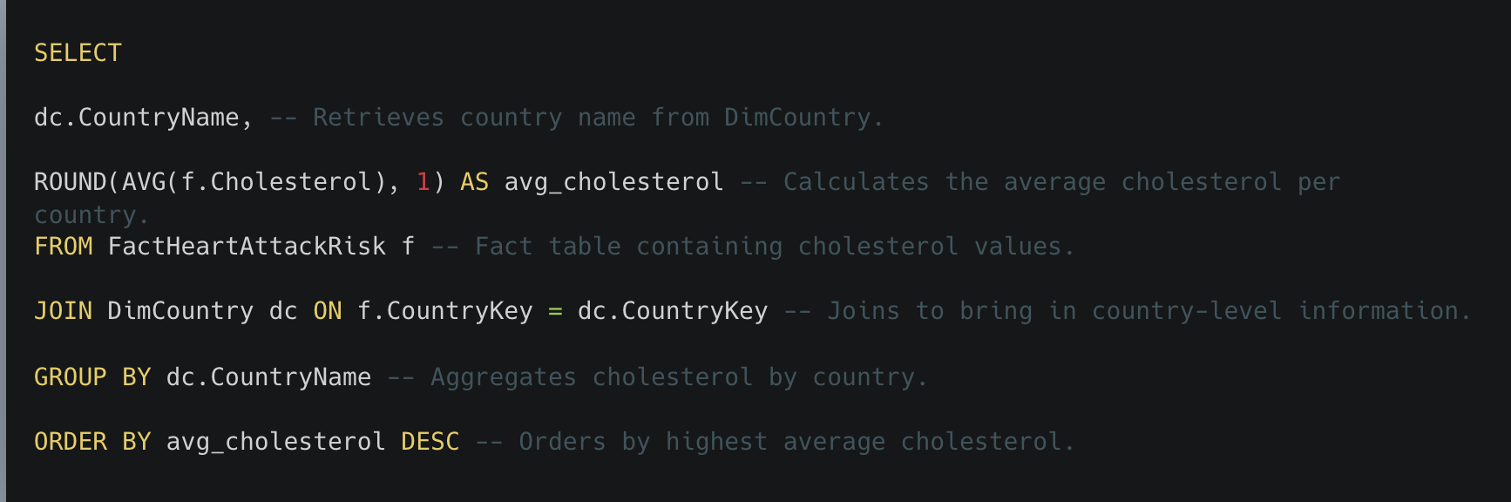
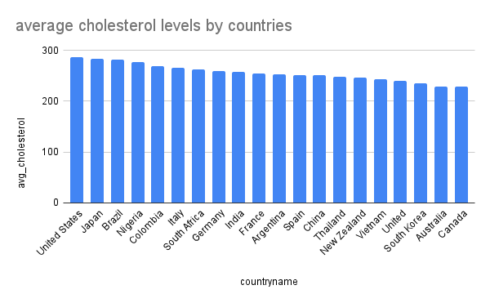

Slide 9
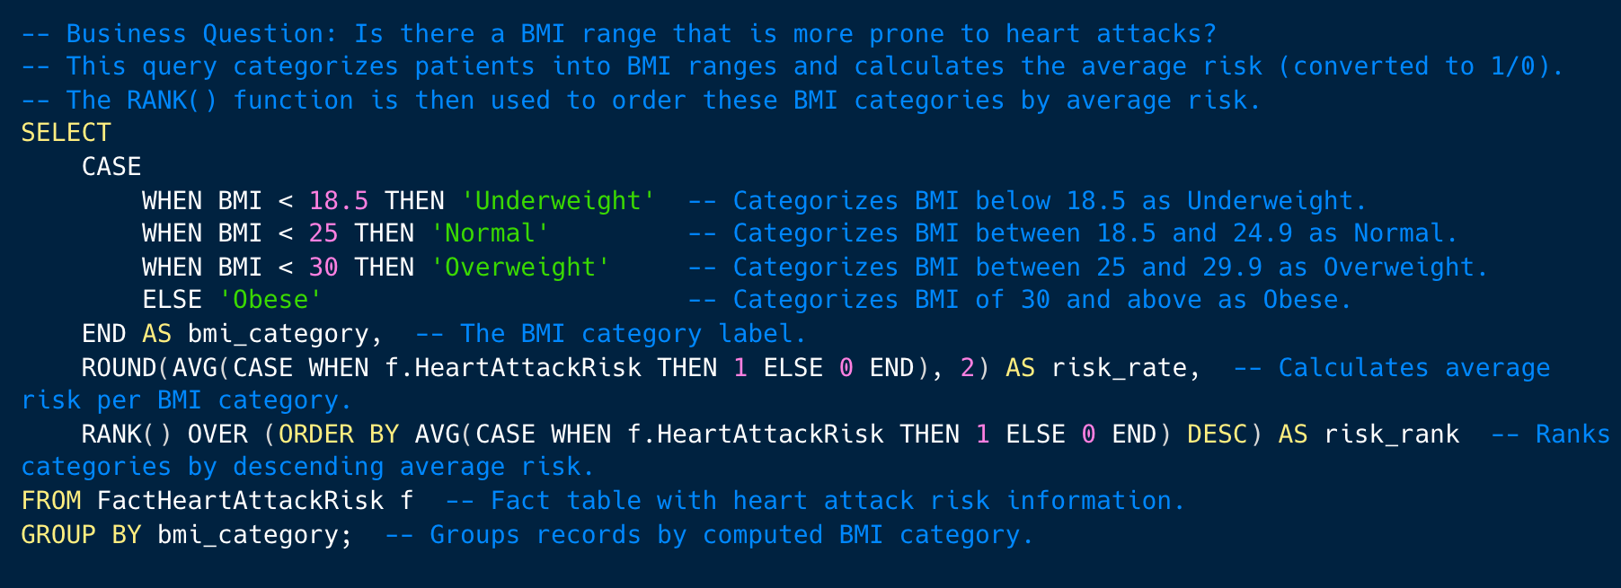
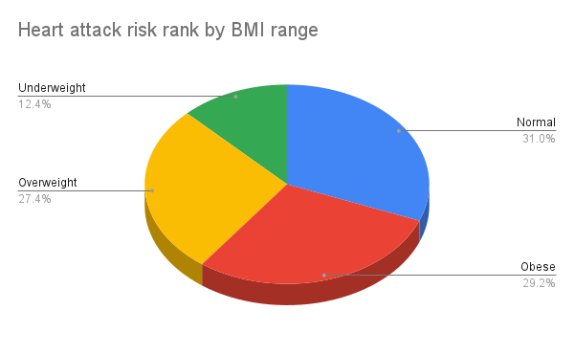

Slide 10
Development Challenges & Solutions
Challenge: Handling many-to-many risk factor relations.
Solution: Introduced a bridge table and used flag-based inserts.
Challenge: Ensuring clean data migration from raw CSVs.
Solution: Applied validation filters, ON CONFLICT rules, and casting.
Challenge: Complex SQL transformations (e.g., blood pressure).
Solution: Used functions like split_part and CASE to manage data.

Slide 11
🏅Project Achievements​
Designed a clean star schema with Kimball approach optimized for analytics.
Populated tables using a robust, commented SQL queries.
Wrote complex analytical queries with business insight.
Generated ready-to-present visual summaries from query outputs.

