Slide 1
Test of weighted ML undertainties

Slide 2
Goal
Test 2 methods for estimating the uncertainty of weighted ML fits
  Generate 2D data (M,phi)
    Signal Gaussian in M, background flat
  Use sPlot weights to subtract background (flat in phi)
  Fit cos2phi signal for different generated amplitudes and signal/backgrounds
  Produce pull distribution from 400 toy MC fits
Method 1 Multiply log likelihood by alpha=sumW/sumW2 (i.e. LHCb method)
Method 2 Correct covariance matrix using sumW2 (i.e. roofit method)

Slide 3
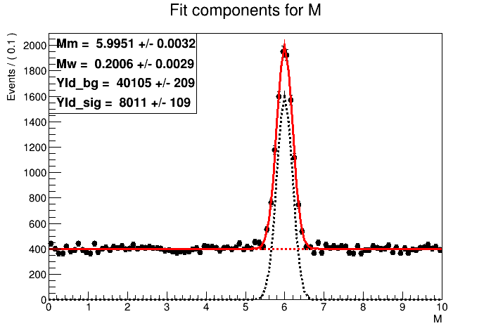
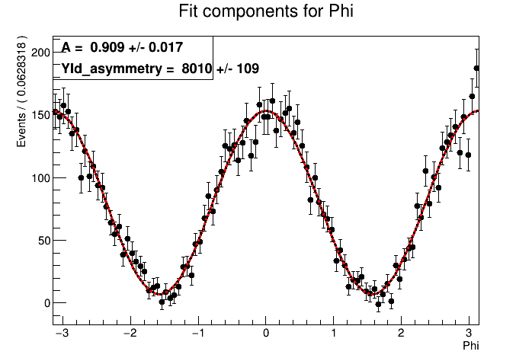
Sample fits
SPLOT fit to calculate weights.
From RooStats::sPlot class
Generated :
Mm=6, Mw=0.2
Yld_bg=40,000 (+Poisson fluctuation)
Yld_sig=8,000 (+Poisson fluctuation)
Cos2phi fit to signal weighted distribution
(Using roofit error calculation)
Generated A=0.92

Slide 4
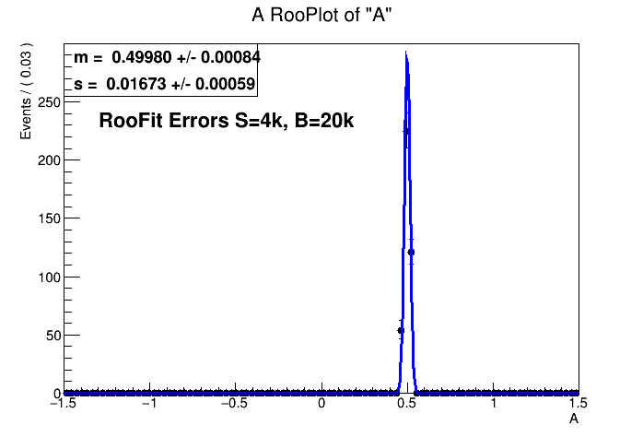
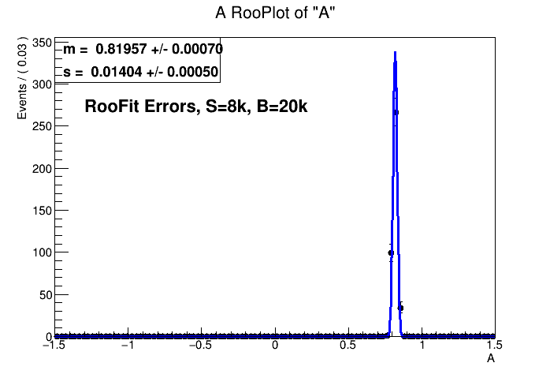
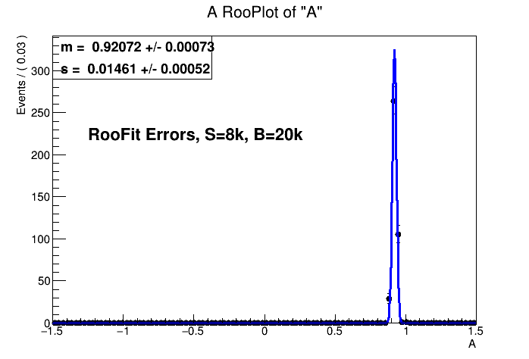
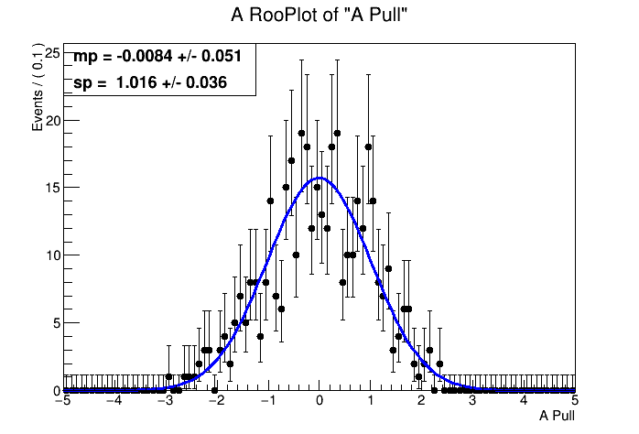
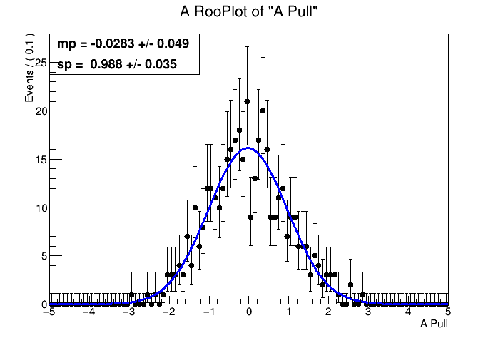
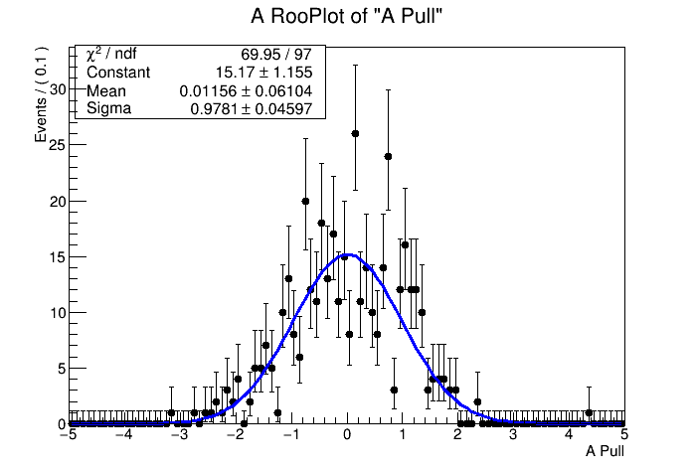
Results RooFit Errors Change A
A=0.5
A=0.82
A=0.92

Slide 5
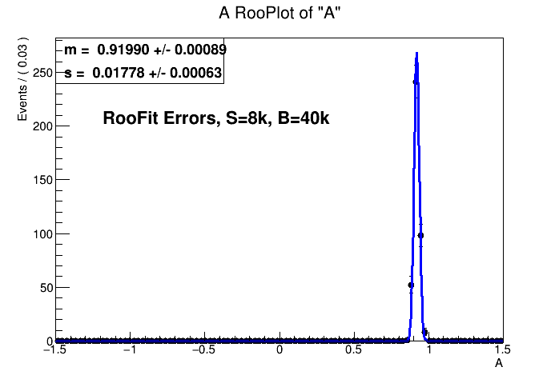
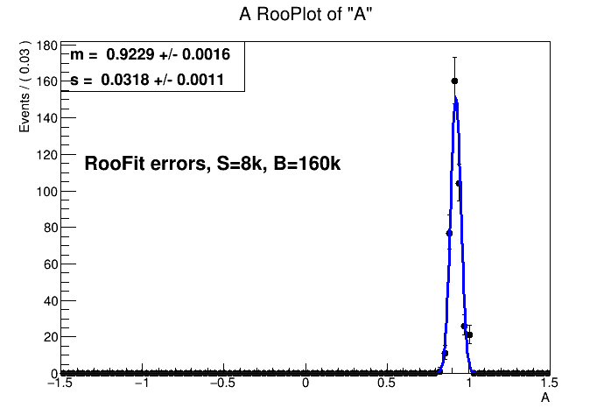
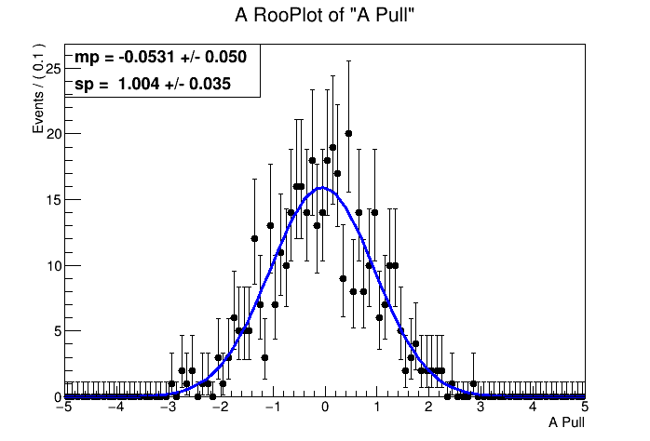
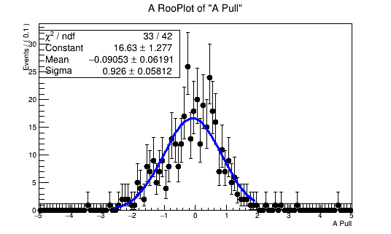
Results RooFit Errors Change B
A=0.5
A=0.82
A=0.92
Here the width is<1.
This is due to the par limit being within range with the larger sigma Rather than the
Uncertainty being incorrect
(I think)

Slide 6
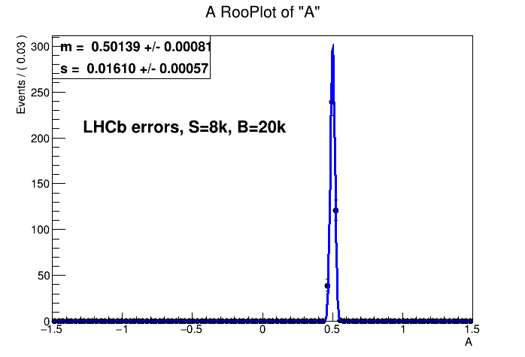
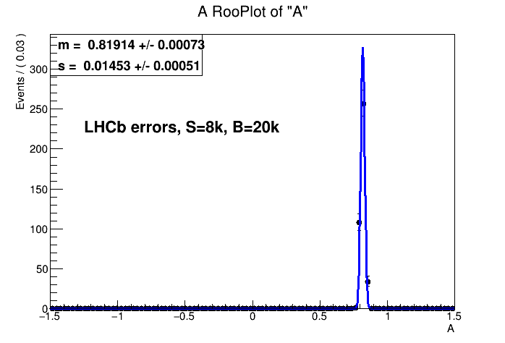
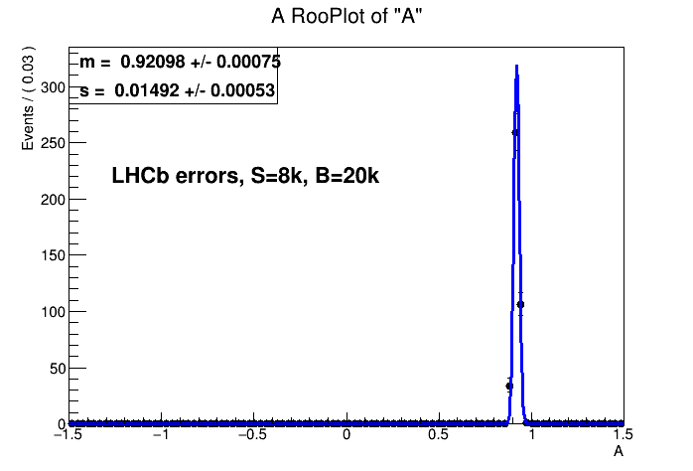
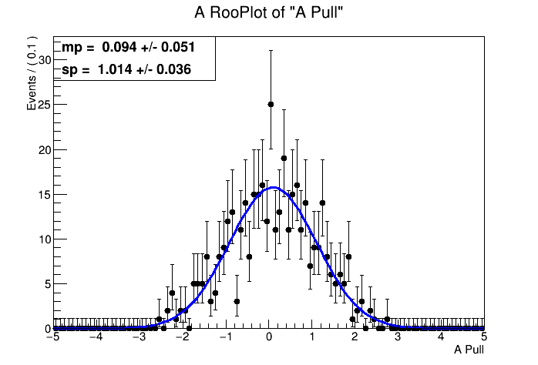
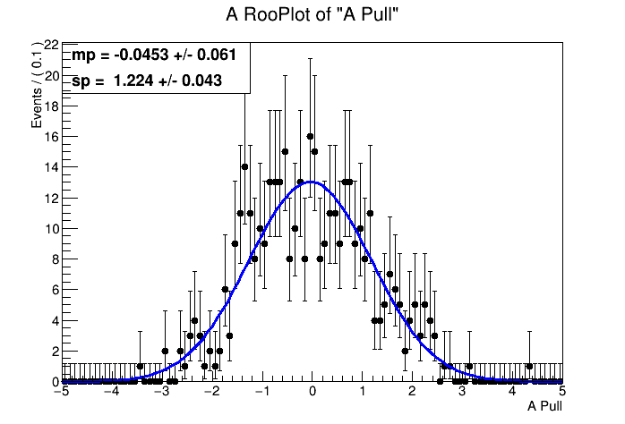
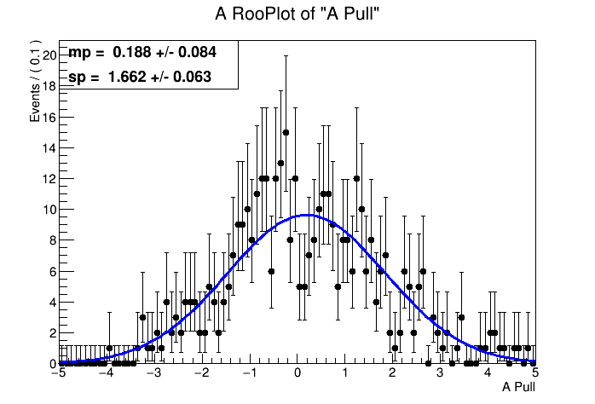
Results LHCb Errors Change A
A=0.5
A=0.82
A=0.92

Slide 7
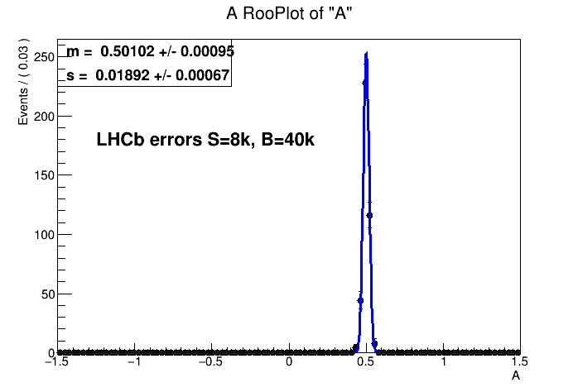
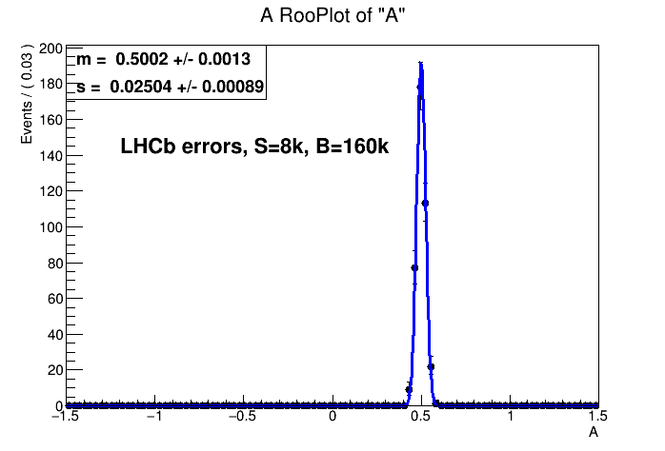
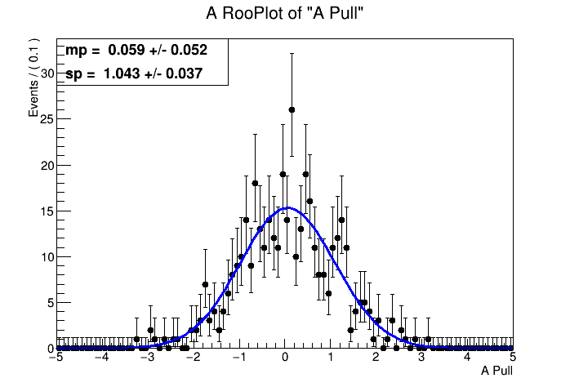
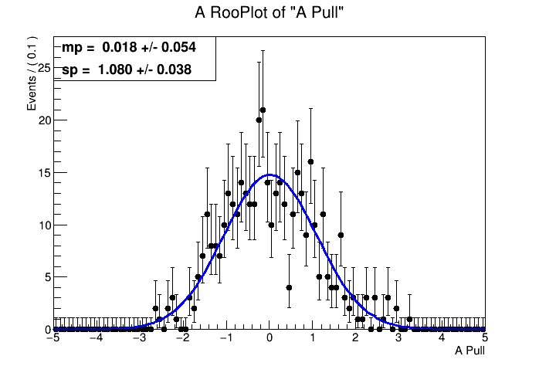
Results LHCb Errors Change B
A=0.5
A=0.82
A=0.92

