Slide 1
Project Title:
Small Business Sales & Profit Analyzer
Presented By –
MOUPRIYO JANA

Slide 2
Introduction to Business Analyzer
This presentation outlines the development of a comprehensive Small Business Sales & Profit Analyzer, covering its architecture, key features across four implementation milestones, and how it leverages AI for financial forecasting and reporting.
Basics of Business Analyzer It is an open-source, user-friendly web application that enables small business owners to log daily sales and expenses, automatically calculate profits, and generate insightful reports with interactive visualizations.
Why Business Analyzer? Small and micro-businesses lack affordable, easy-to-use tools for financial tracking, often relying on complex enterprise systems or manual methods that prevent informed decision-making.
Applications The Business Analyzer serves retail shops and online sellers by tracking daily sales, managing inventory, and consolidating multi-channel data for real-time profit monitoring.

Slide 3








Why Small Businesses Need Better Financial Management
Understanding the challenge and the solution
The Problem
Why This Solution
Real-World Applications
Small and micro-business owners struggle to track sales, expenses, and profit trends due to lack of affordable, easy-to-use tools. Enterprise ERP systems are too complex and costly for small shops or home-based businesses.
This project develops an open-source, user-friendly tool that allows business owners to log daily sales and expenses, automatically calculate profits, and generate weekly/monthly reports with clear visualizations.
Retail Shops - Track daily sales and inventory
Online Sellers - Manage multi-channel sales
Service Businesses - Track billable hours and expenses
Home-based Entrepreneurs - Affordable financial tracking

Slide 4



Project Objectives
The main objectives of this project are:
1
2
3
Enable Easy Financial Tracking
Generate Actionable Insights
Ensure Accessibility & Security
Provide a simple, intuitive interface for users to log transactions, categorize expenses, and track inventory in real-time without technical expertise.
Automatically calculate profits, generate weekly/monthly reports, and provide AI-powered forecasts to help business owners make data-driven decisions.
Offer an affordable, open-source solution with role-based access control and secure user authentication to protect sensitive business data.

Slide 5




PROJECT FEATURES
The main features of this project are:
Real-time Analytics
Smart Reporting
Track sales trends and profit margins instantly
Generate weekly/monthly reports automatically
AI Predictions
Inventory Management
Track inventory and calculate COGS
Forecast future sales and profits

Slide 6








Overview of Technology Stack & Tools
Frontend
Backend
Database
Deployment
Streamlit
Python
SQLite
Docker
Cloud Hosting
Python UI Framework
API Development
Data Storage
Containerization
Data Processing
Analytics & ML
Visualization
Authentication
Pandas
Scikit-learn
Plotly
JWT
NumPy
Prophet
Matplotlib
Data Manipulation
Predictions
Seaborn
Secure Sessions

Slide 7
Milestone 1 : Secure Authentication & Transaction Entry
Building the core authentication system and transaction logging interface
Objectives
Expected Output
1
Implement secure registration and login system using JWT authentication
SYSTEM COMPONENT 1
2
Create multi-business profile management for users to manage multiple businesses
User Authentication System
3
Build intuitive sales and expense input forms with quick transaction entry
Fully functional JWT-based authentication with secure login, registration, and session management. Multi-business profile support with role-based access control.
Technologies & Libraries
SYSTEM COMPONENT 2
JWT - Secure token-based authentication
SQLAlchemy - Object-relational mapping
Transaction Logging Interface
Streamlit - Interactive UI framework
Intuitive dashboard for quick transaction entry with real-time data logging, expense categorization, and receipt attachment capabilities.
SQLite - Database storage

Slide 8
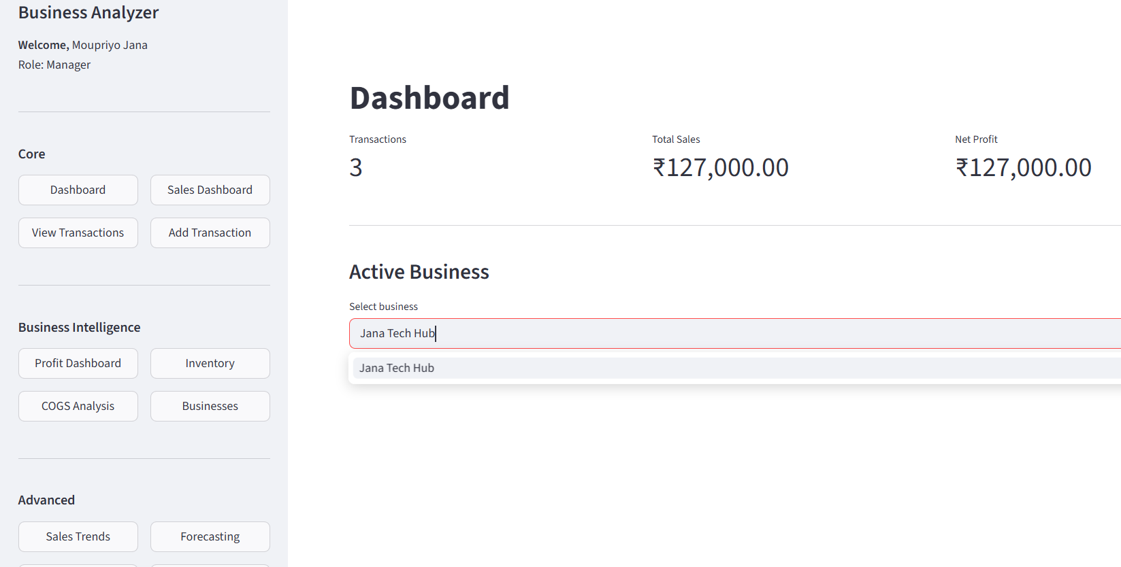
Snapshot :

Slide 9



Milestone 2 - Profit Calculation & Inventory Management
Core functionality for financial tracking and inventory management
Objectives
Technologies & Libraries
Expected Output
1
Implement automated profit calculation logic for daily, weekly, and monthly periods
Pandas - Data calculations
Profit Dashboard
Revenue, expenses, net profit visualization
SQLAlchemy - Data persistence
2
Add inventory tracking system with COGS (Cost of Goods Sold) computation
Plotly - Dashboard charts
Inventory System
SQLite - Database
COGS alerts and low-stock notifications
3
Create simple dashboard displaying daily totals, profit margins, and inventory status
Current Month Profit
+53,248
Low Stock Items
5 items identified

Slide 10
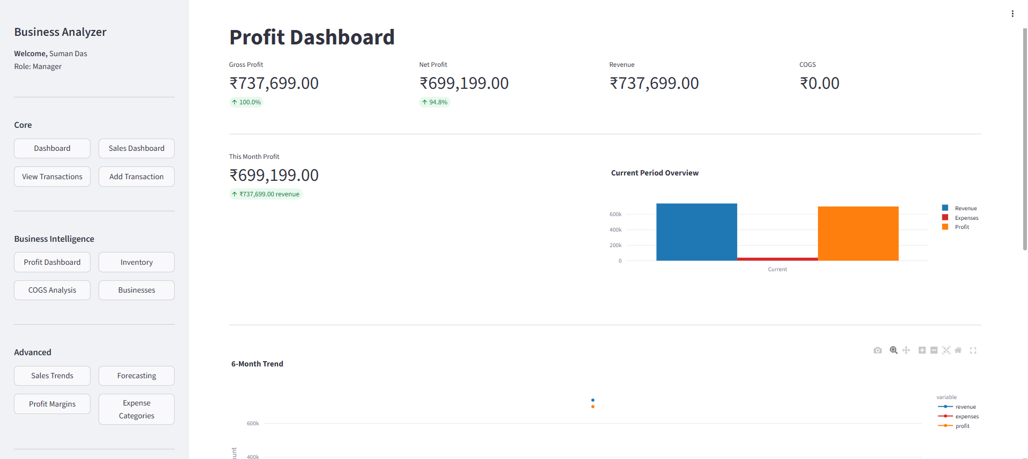
Snapshot :

Slide 11

Milestone 3 - AI-Powered Analytics & Forecasting
Advanced analytics, interactive visualization, and predictive modeling
Objectives
Technologies & Libraries
Expected Outputs
1
Create interactive charts for sales trends, profit margins, and expense categories with multi-metric visualization.
Interactive Analytics Dashboard with multi-metric trend lines
Prophet - Time-series forecasting
Scikit-learn - ML regression models
Plotly - Interactive visualizations
AI-Based Forecasting Interface with next month predictions
2
Implement AI-based forecasting using Prophet or Scikit-learn regression models for predictive analytics.
Pandas - Data manipulation
Category-wise expense breakdown with visual comparisons
3
Build category-wise expense breakdown views with trend analysis and comparative insights
32.5%
Profit Margin | Next
Month: +51,320

Slide 12
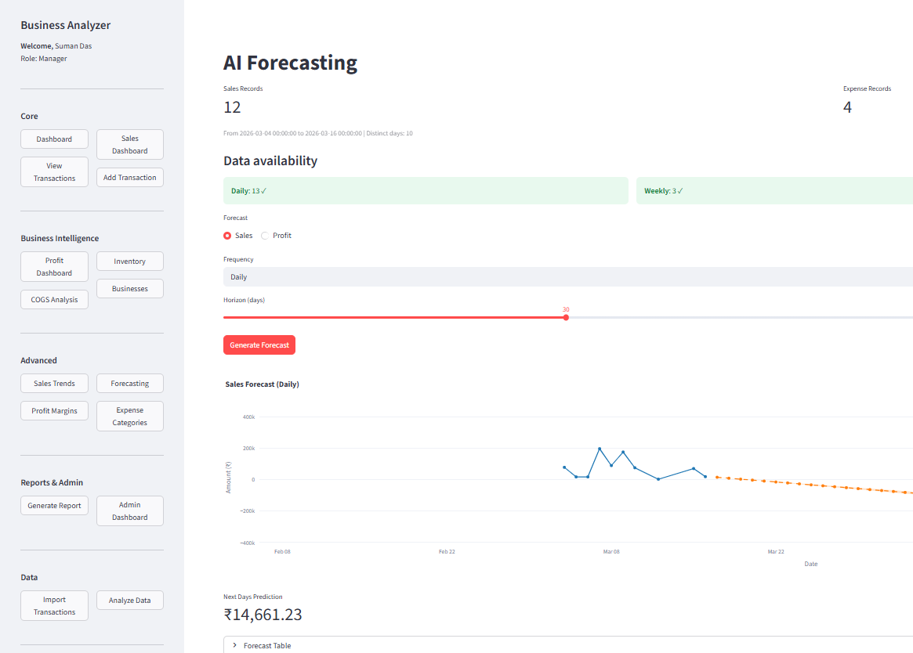
Snapshot :

Slide 13



Milestone 4 - Reports, Admin & Deployment
Final phase: Reports, Administration & Cloud Deployment
Objectives:
Build PDF and Excel report generation system with customizable date .
Implement email delivery functionality for automated report distribution.
Create comprehensive admin dashboard for system monitoring and user management.
Develop system settings configuration for currency and default preferences.
Technologies & Libraries:
FPDF2 – PDF report generation
OpenPyXL – Excel file creation
Docker – Containerization
Streamlit – Admin dashboard UI
Pandas – Report data preparation
Expected Outputs
Report Generation
Build PDF and Excel report generation.
Docker Containerization
Containerize application with Docker for consistent deployment across environments and easy scaling.
Admin Dashboard
Create comprehensive Admin dashboard for system monitoring, user management, and business profile administration.

Slide 14
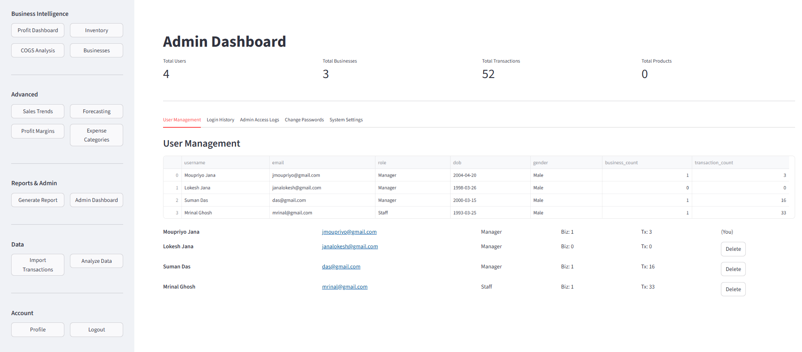
Snapshot :

Slide 15







Implementation Process
Architecture Layers
Structured approach across four development phases and architecture layers
Presentation Layer
Development Phases
Dashboard UI
Transaction Forms
1
Planning & Design
Inventory UI
Define requirements, design database schema, create UI mockups and system architecture
Admin Console
Application Layer
2
Development
Authentication Service
Build authentication, transaction logging, profit calculations, and core business logic
Transaction Service
Analytics Engine
3
Analytics & Reporting
Report Generator
Implement forecasting, create dashboards, generate reports, and add visualizations
Data Layer
Primary Database
4
Testing & Deployment
File Storage
Quality assurance, Docker containerization, cloud deployment, and documentation
Cache System
External Services
AI/ML Service (AI Forecast)

Slide 16










System Workflow Diagram
Six-step process from data entry to actionable insights
Authentication
Data Entry
Processing
Analytics
Visualization
Reporting
JWT Login
Sales Entry
Profit Calculation
AI Algorithms
Dashboards
PDF/Excel
Business Profiles
Expenses
COGS Computation
Trend Analysis
Charts
Email
Role-based Access
Inventory
Categorization
Forecasting
Metrics
Insights
Workflow Components
User Flow: Direct user interactions and data input
System Flow: Automated processing and analysis
Output Flow: Generated reports and insights

Slide 17









Technical & Operational Challenges & Solutions
Challenge 1: Data Accuracy
Solution
Ensuring correct profit calculations with multiple expense categories and inventory adjustments.
Implement automated validation rules, audit trails, and reconciliation checks.
Challenge 2: Real-time Performance
Solution
Handling large datasets with fast query response times for dashboard updates.
Database indexing, caching strategies, and optimized queries.
Challenge 3: User Authentication
Solution
Securing user accounts and preventing unauthorized access to business data.
JWT tokens, password hashing (bcrypt), role-based access control, session management.
Challenge 4: Scalability
Solution
Supporting growing number of users and businesses without performance degradation.
Microservices architecture, load balancing, horizontal scaling with Docker.

Slide 18








Future Enhancements & Long-term Impact
Future Enhancements
Long-term Impact
Mobile Application
iOS/Android apps for on-the-go transaction entry and real-time notifications
Empower Entrepreneurs
Thousands of small business owners gain access to affordable, professional-grade financial management tools
Advanced AI Features
Anomaly detection and automatic expense categorization using machine learning
Reduce Manual Work
Payment Gateway Integration
Automate accounting tasks by 80%, freeing entrepreneurs to focus on business growth and strategy
Connect with Stripe, PayPal for automatic transaction import
Multi-Currency Support
Data-Driven Growth
Enable international businesses to manage finances in multiple currencies
Enable informed decision-making through analytics, leading to improved profitability and sustainable business growth
Collaborative Features
Team access, approval workflows, and comprehensive audit logs

Slide 19
Conclusion
Impact of Business Analyzer – Empowers small business owners with affordable, professional-grade financial tools that automate manual accounting tasks, enabling data-driven decision-making and improved profitability.
Future Enhancement – The modular architecture allows for future enhancements including mobile applications, multi-currency support, payment gateway integration, and advanced AI features like anomaly detection.
Transforming Business Management – This project transforms how small businesses manage finances by combining ease-of-use with powerful analytics, helping entrepreneurs focus on growth rather than accounting.

Slide 20
THANK YOU FOR YOUR ATTENTION
Presentation Feedback
I hope you found this presentation informative and engaging
Mentor
MR. ANIL KUMAR
Presented By
Moupriyo Jana

