Slide 1
IT Service Desk – Monthly KPI Dashboard
MJ44 ProTech | Executive Summary

Slide 2
90-Day Plan:
• First 30 Days: Assess processes, review data, meet team, stabilize SLAs
• Days 31–60: Implement triage improvements, refine KB, optimize staffing model
• Days 61–90: Automate workflows, enhance reporting, introduce advanced self-service

Slide 3
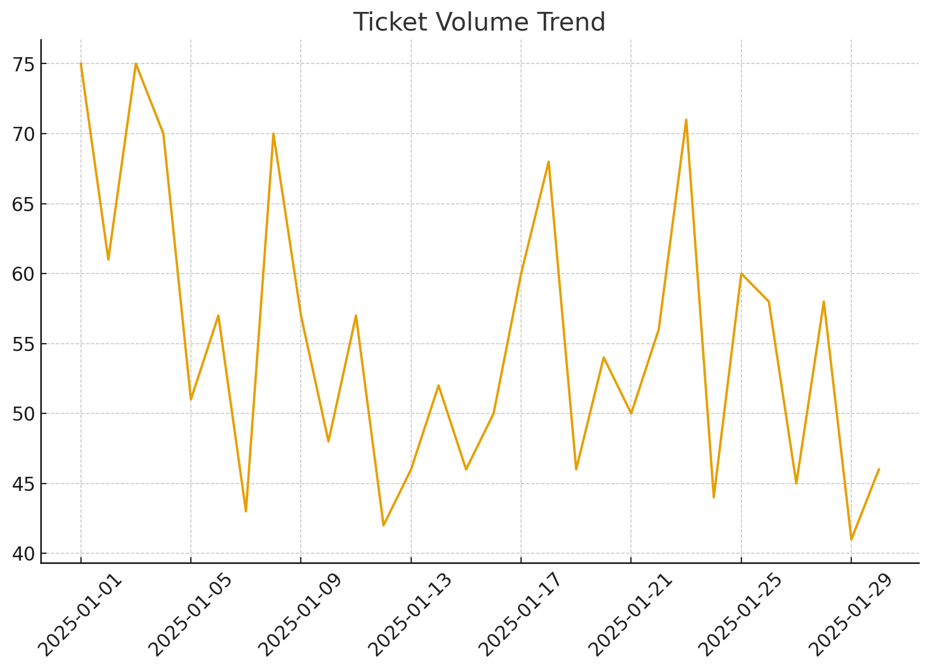
Ticket Volume Trend

Slide 4
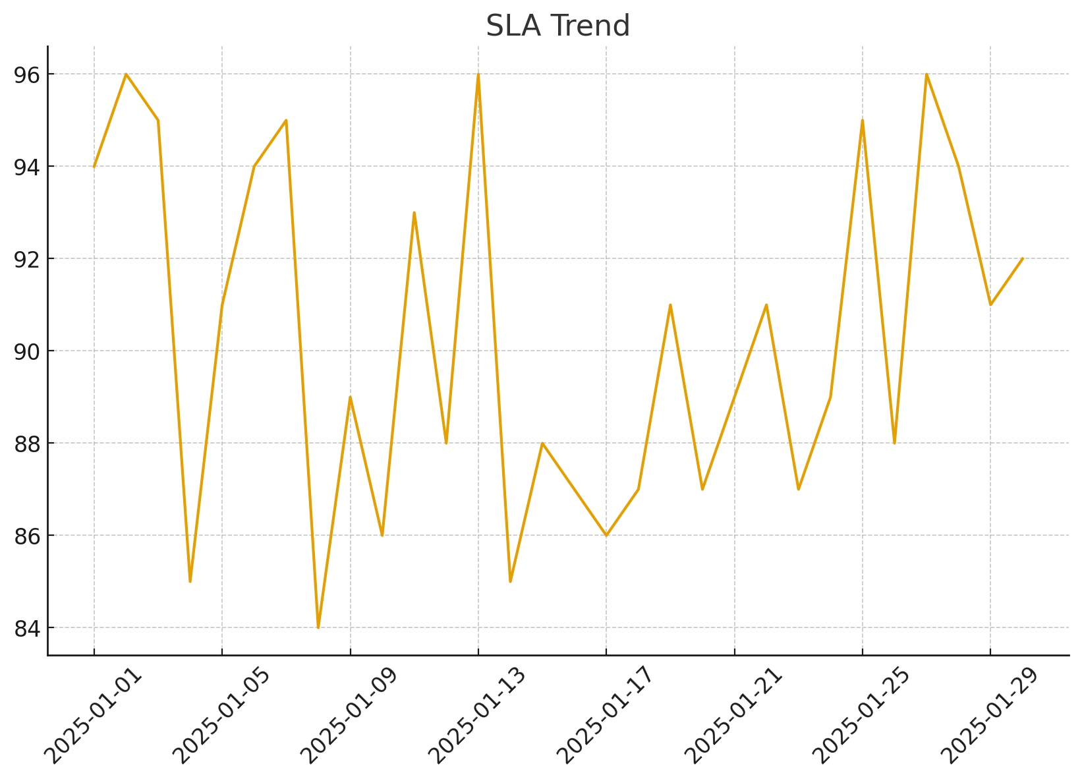
SLA Trend

