Slide 1


PROGRAMMING WORKSHOP
10.30.23
Programming Team

Slide 2
HOST / Profile
James
3+ years exp in Python Development
Tech Stack: Django, JS, React, MySQL
Backend Developer
Kurt
UI/UX Designer
Tech Stack: HTML, CSS JavaScript
Frontend Developer
Maxine
UI / UX Designer , Web Designer
Tech Stack: HTML, CSS
Frontend Developer
JC
Programmer
Tech Stack: HTML, CSS, JavaScript
Frontend Developer

Slide 3
OVERVIEW
INTRODUCTION
Setup Environment
BASIC I/O
Data Types
Variables
Arithmetic Operators
Strings
Decision Making
Booleans
Loops
Functions
Coding Challenges

Slide 4
QUICK Introduction
The first computer programming language was created in 1883.
1949 Assembly Language the first widely used in the Electronic Delay Storage Automatic Calculator.
1952 Autocode was a generic term for a family of early computer programming.
1957 Fortran – A computer programming language created by John Backus
1958 Algol stands for Algorithm Language
1959 COBOL stands for Common Business Oriented Language
1959 LISP stands for List Processing Language

Slide 5
QUICK Introduction
1964 BASIC stands for Beginner All-purpose Symbolic Instruction Code
1970 Pascal was named in honor of the French mathematician, physicist, and philosopher Blaise Pascal.
1972 Smalltalk allowed computer programmers to modify code on the fly
1972 C is considered by many to be the first high-level language.
1972 SQL stands for Structured Query Language.

Slide 6
WHAT IS C Language?
System Programming
Application Development
Embedded System
Game Development
Web Development
Databases
Compilers and Interpreters
Realtime System
And MANY MORE !

Slide 7
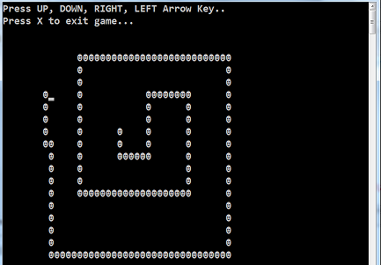


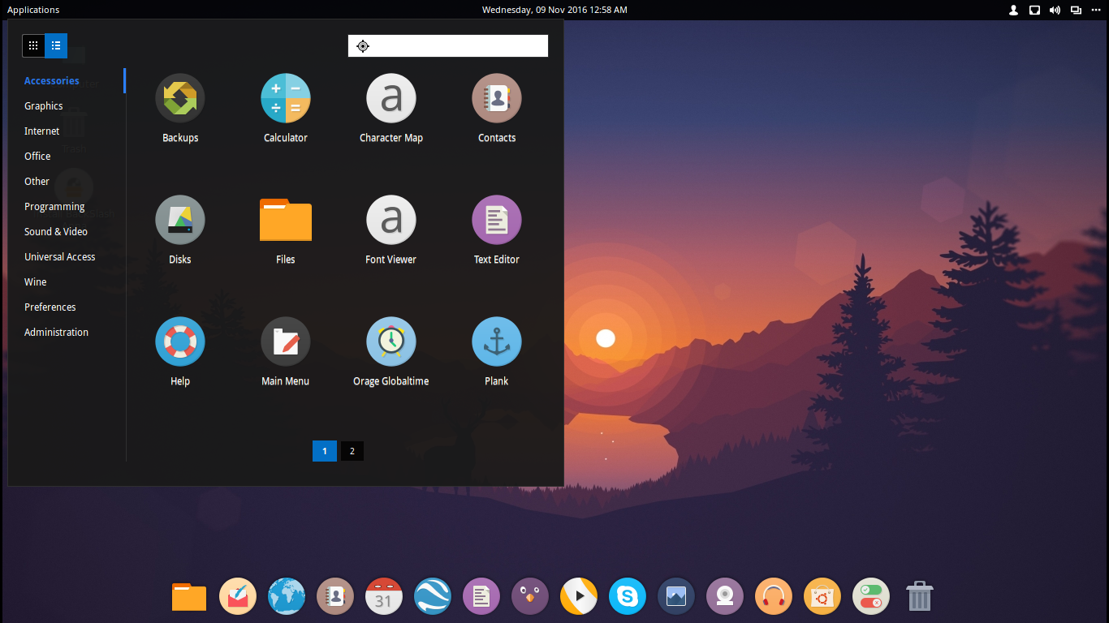
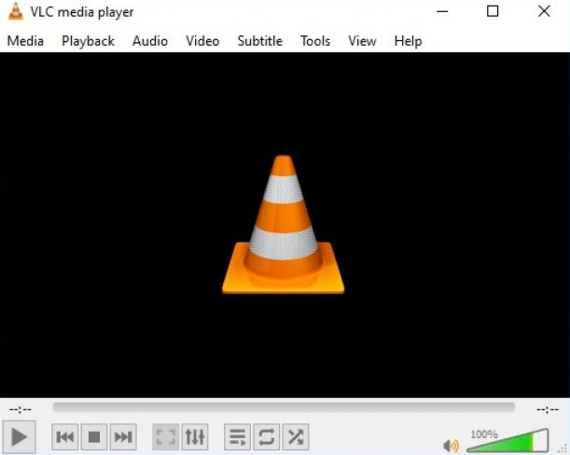

COOL THINGS C language CAN DO!

Slide 8
SETUP ENVIRONMENT
Search in gogol: ‘ Download Turbo C
Download
Install
Basic bro!

Slide 9
BASIC INPUT/OUTPUTS
DISPLAY “HELLO FUTURE ENGINEERS”
DISPLAY “I LOVE CPE”
COMMENT // this is comment
USER INPUT
NEW LINE \n
Getch () -> #include <conio.h>

Slide 10
DATA TYPES
Int – integer values
Float – floating-point numbers ( 4bytes = 32 bits)
Double - double-precision floating-point numbers. ( 8bytes = 64 bits)
Char – single character

Slide 11
VArIABLEs
DO’s
Must unique
Use English names
Avoid Abbreviations
Style ( CamelCase, Snake_case )
DON’Ts
Starting variable name with a number
Avoid special characters e.g -,&,*
Avoid underscore followed by uppercase

Slide 12
ARITHMETIC OPERATOR
Addition
Subtraction
Multiplication
Division
Performing MDAS
Increment and Decrement Operator

Slide 13
FORMAT STRING
String specifier
String Functions ( strlen, strcopy, strcat, strcmp )
Get user input using gets()

Slide 14
DECISION MAKING
Conditional Operator
IF ELSE Statement
Multiple Selection ( SWITCH CASES )

Slide 15
BOOLEAN
EITHER TRUE OR FALSE , 1 OR 0
&&
||
==
! =
% remainder

Slide 16
LOOP
While loops
Do While
For LOOPS

Slide 17
CODING CHALLENGES
1. Create a Simple Calculator
2. Calculate the Area of Triangle
3. Check if a number is Odd or Even

Slide 18
THE END!

