Slide 1
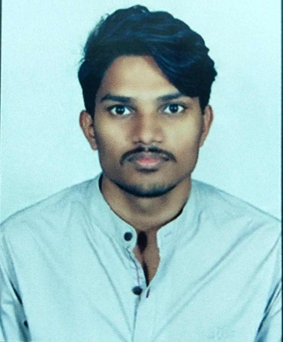
Manoj Imandi
Digital Specialist Engineer
Infosys Limited
Pune, India
Mobile : +91-9381759702
Email id : manoj.imandi@infosys.com
Current Location: Visakhapatnam
Base Location: Hyderabad
Training
Big Data
Gen AI
Pinnacle Data Science Specialization Program
Technical Skills
Programming Languages: Python
Database: MySQL
Big Data Technologies : Hadoop Framework , flume , Sqoop
Components of Data science : Time Series Analysis , Exploratory Data Analysis, Data Visualization using Python
Profile Summary and Education
Total IT Experience : 1.4 years (till date)
Worked on Time series models like ARIMA , SARIMA
Implemented different machine learning models like Roberta , Distilbert-base-cased-distilled-squad.
Education: BTech in Electronics and Communication Engineering Raghu Engineering College(A) - CGPA: 8.04
Experience Summary
Summary :
Ability to work on Machine Learning models
Skilled in model development
Key Responsibilities :
Implemented forecasting model for predicting the future event count
Also implemented a question & answering model to generate more than one result from the given context.
Key Strengths :
Machine learning : Implemented different predictive models for forecasting .
Data Analysis : Conducted exploratory Data Analysis to analyze the pattern .
Certification
Infosys Certified Data Science Practitioner Using Python
Infosys Certified Data Science using Python Professional-Part1
Infosys Certified Data Science using Python Professional-Part2

