Slide 1
Electricity Consumption Prediction With Sparse Data
Mamdouh Jaber

Slide 2
Task 1
Task 1
Given very limited data on house A (48)
Forecast the hourly consumption (horizon=1) for December (744) using 4 lags as the input
Evaluation
MAE and MAPE
Last observation used as baseline
Preparation
Reindex on hour index
Rescaling applied on Training set
4 lags created for nonsequential models (linear regression, dense NN)
Sequences of size 4 created for sequential models (ARMA, LSTM)
Validation set created using 20% of training examples

Slide 3
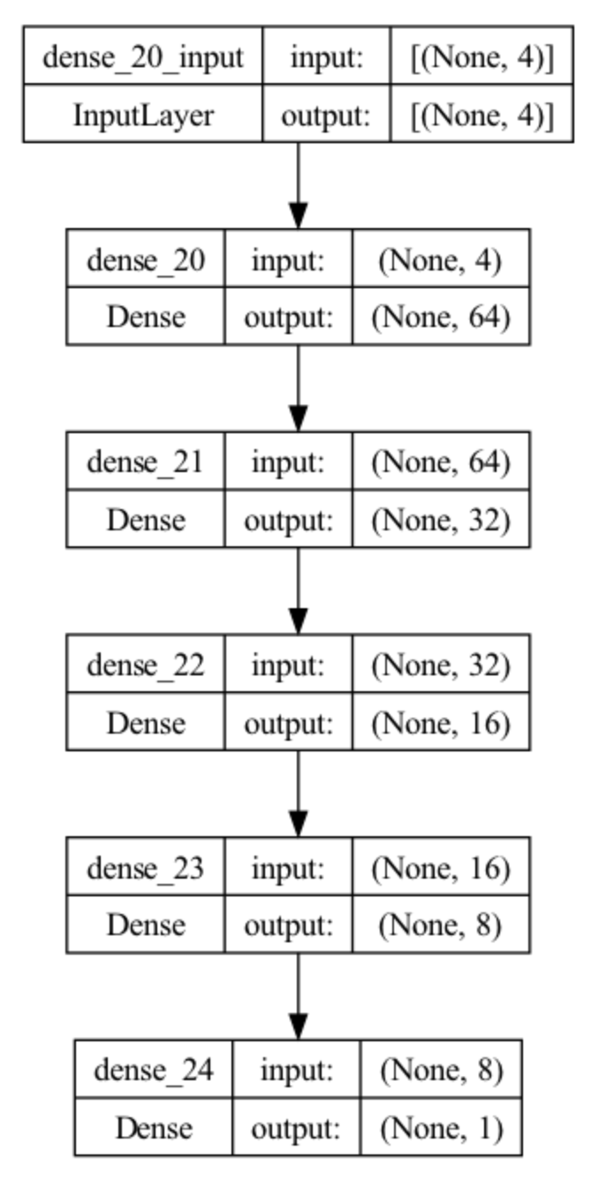
TASK 1: Nonsequential models
Linear Regression
Dense Neural Network
Keep adding layers until performance on validation set converges
Loss: MSE
Optimizer: Adam (LR=0.001)
Model | MAE (Train) | MAPE (Train) | MAE (Test) | MAPE (Test)
Baseline | 1.26 | 5.9% | 1.27 | 5.0%
Linear regression | 1.15 | 5.1% | 1.32 | 5.3%
Dense NN | 1.25 | 5.4% | 1.30 | 5.0%

Slide 4
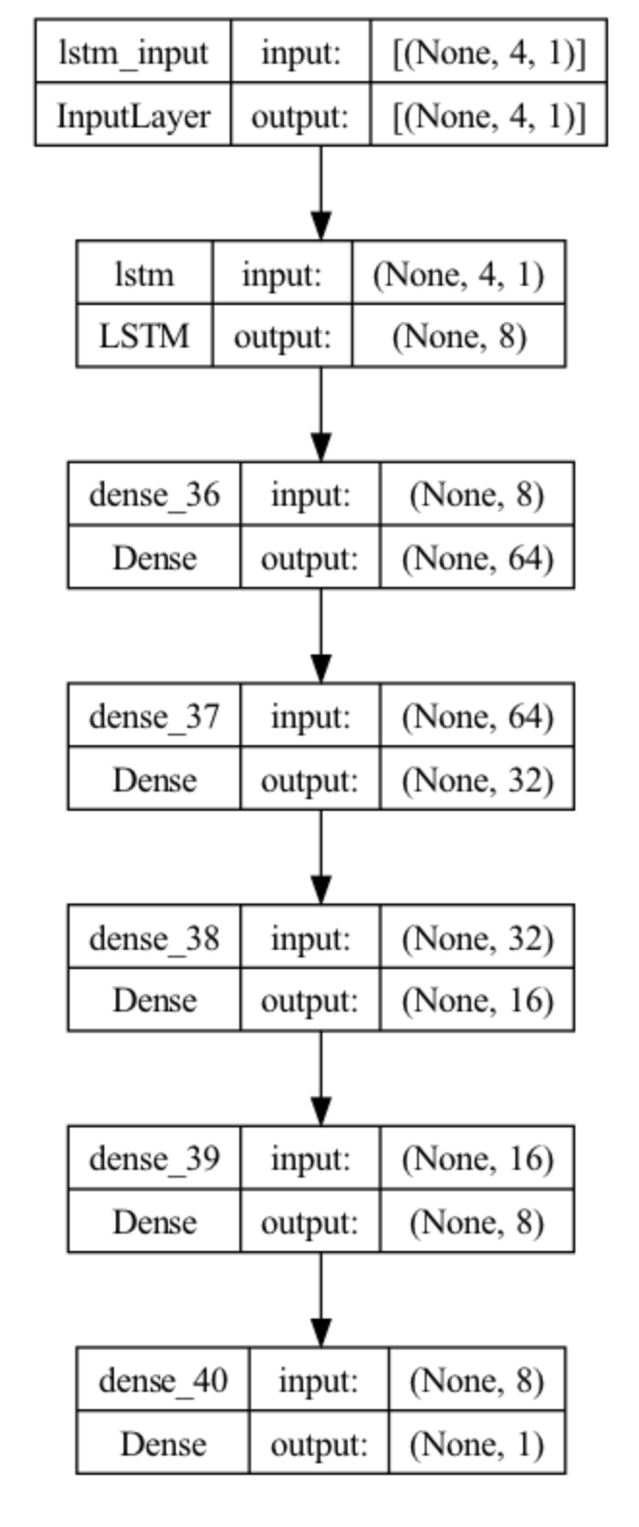
Task 1: Sequential Models
LSTM
LSTM layer added to the best dense NN
Loss: MSE
Optimizer: Adam (LR=0.001)
SARIMA
p=4, q=4, m=24
Model | MAE (Train) | MAPE (Train) | MAE (Test) | MAPE (Test)
Baseline | 1.26 | 5.9% | 1.27 | 5.0%
SARIMA | 1.23 | 5.7% | 1.35 | 5.3%
LSTM | 1.24 | 5.4% | 1.32 | 5.1%

Slide 5
Task 2
Task 2
Extra data provided on other houses (B, C, D) in the area
No data provided for December on other houses
Forecast the hourly consumption for December (744) using 4 lags as the input
Evaluation
MAE and MAPE
Last observation used as baseline
Preparation
Rescaling applied on each training set separately
4 lags created for dense NN
Validation set created using 20% of training examples from each set
Same training and validation set from task 1 used for finetuning

Slide 6
TASK 2: Neural Network
Model trained on B (January – November)
Model layers frozen except last 2
Last 2 layers finetuned using A (last 2 days November)
Model | MAE (Train) | MAPE (Train) | MAE (Test) | MAPE (Test)
Baseline | 1.26 | 5.9% | 1.27 | 5.0%
Dense NN (B) | 1.11 | 4.8% | 1.25 | 4.9%

Slide 7
TASK 2: Neural Network (Bag)
Model trained for each dataset (B, C, D)
Model finetuned for A
Predictions from each model averaged
Model | MAE (Train) | MAPE (Train) | MAE (Test) | MAPE (Test)
Baseline | 1.26 | 5.9% | 1.27 | 5.0%
Dense NN Bag | 1.05 | 4.5% | 1.12 | 4.6%

Slide 8
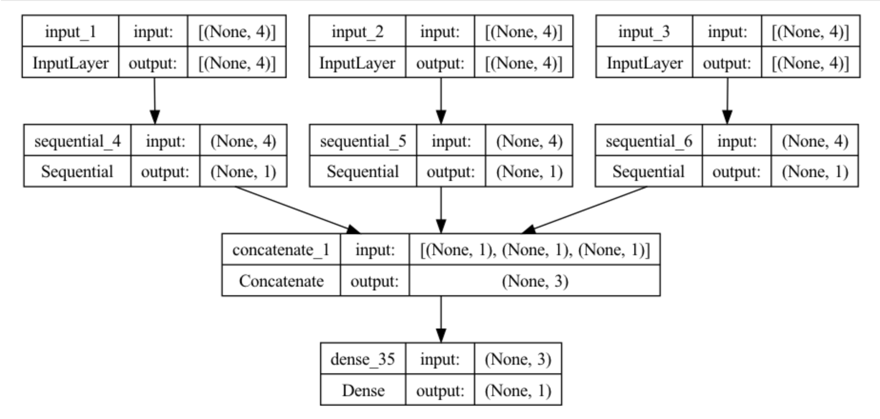
TASK 2: Neural Network (Bag + meta learner)
Predictions from finetuned models concatenated
Predictions passed into final linear regression model
Model | MAE (Train) | MAPE (Train) | MAE (Test) | MAPE (Test)
Baseline | 1.26 | 5.9% | 1.27 | 5.0%
Dense NN Bag + Stack | 0.92 | 4.0% | 1.03 | 4.2%

Slide 9
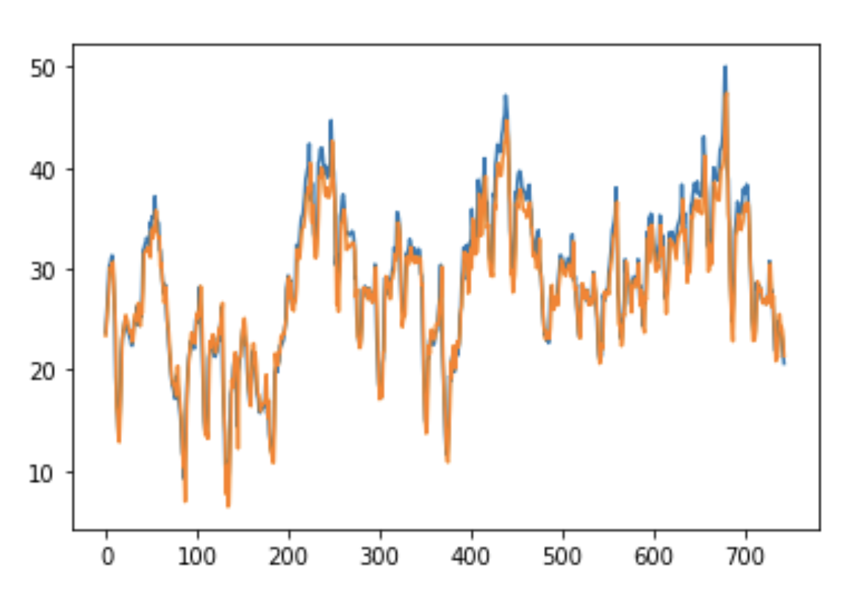
TASK 2: Neural Network (Bag + meta learner)

Slide 10
Final Performance
Model | MAE (Train) | MAPE (Train) | MAE (Test) | MAPE (Test)
Baseline | 1.26 | 5.9% | 1.27 | 5.0%
Linear regression | 1.15 | 5.1% | 1.32 | 5.3%
SARIMA | 1.23 | 5.7% | 1.35 | 5.3%
LSTM | 1.24 | 5.4% | 1.32 | 5.1%
Dense NN | 1.25 | 5.4% | 1.30 | 5.0%
Dense NN (B) | 1.11 | 4.8% | 1.25 | 4.9%
Dense NN Bag | 1.05 | 4.5% | 1.12 | 4.6%
Dense NN Bag + Stack | 0.92 | 4.0% | 1.03 | 4.2%

