Slide 1
Google Hacking
What is Google Hacking?
Google Hacking involves using the Google search engine to identify vulnerabilities in websites.

Slide 2
How?
Google supports a multitude of operators and modiﬁers that add a ton of power to google searching.
Ever used google's advanced search?

Slide 3
Some Basics
Google is case-insensitive
Searching for words within quotations will find them in that sequence only
e.g. “google hacking”
Google only gives you the first 200 hits

Slide 4
Google Bombing is not Google Hacking!
http://en.wikipedia.org/wiki/Google_bomb
A Google bomb or Google wash is an attempt to influence the ranking of a given site in results returned by the Google search engine.
Due to the way that Google's Page Rank algorithm works, a website will be ranked higher if the sites that link to that page all use consistent anchor text.

Slide 5
So What Determines Page Relevance and Rating?
Exact Phrase: are your keywords found as an exact phrase in any pages?
Adjacency: how close are your keywords to each other?
Weighting: how many times do the keywords appear in the page?
PageRank/Links: How many links point to the page? How many links are actually in the page?
Equation: (Exact Phrase Hit)+(AdjacencyFactor)+(Weight) * (PageRank/Links)
From: Google 201, Advanced Googology - Patrick Crispen, CSU

Slide 6
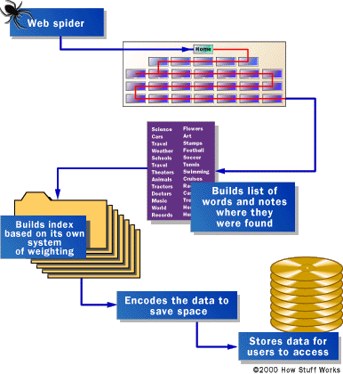
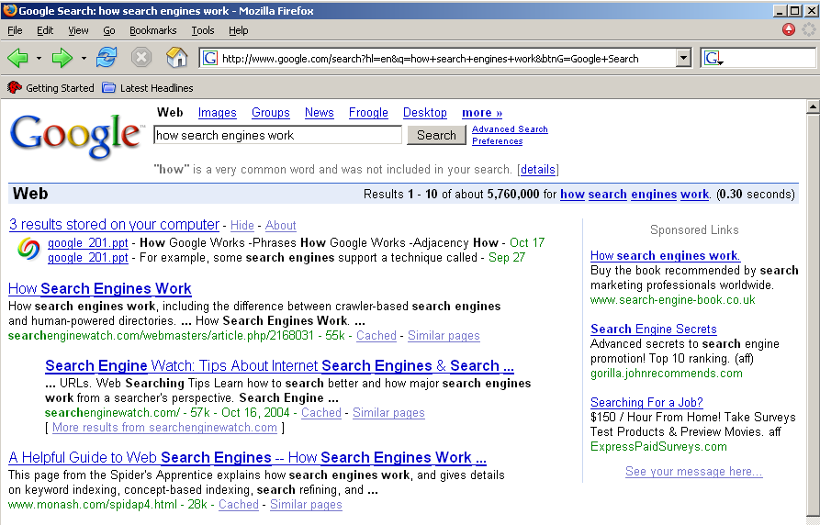
Anatomy of a Search
Server Side Client Side
http://computer.howstuffworks.com/search-engine1.htm

Slide 7
How Google Finds Pages
Are only connected web pages indexed?
NO!
e.g. Opera submits every URL viewed to Google for later indexing….

Slide 8
How Do I Get Results?
Pick your keywords carefully & be specific
Do NOT exceed 10 keywords
Use Boolean modifiers
Use advanced operators (next)
Google ignores some words*:
a, about, an, and, are, as, at, be, by, from, how, i, in, is, it, of,
on, or, that, the, this, to, we, what, when, where, which, with
*From: Google 201, Advanced Googology - Patrick Crispen, CSU

Slide 9
Google's Boolean Modifiers
AND is always implied
OR (recycle steel OR iron)
"-" = NOT: Dog -collie
"+" = MUST: Dog +sheepdog
the main use of + in searches is to force google not to ignore words such as a, are, is etc.
Use quotes for exact phrase matching:
"jack and Jill went up the hill"

Slide 10
Wildcards
Google supports word wildcards but NOT stemming.
"It's the end of the * as we know it" works.
but "Medical Psycho*" won't get you decent results on Medical Psychology or Medical Psychophysics.

Slide 11
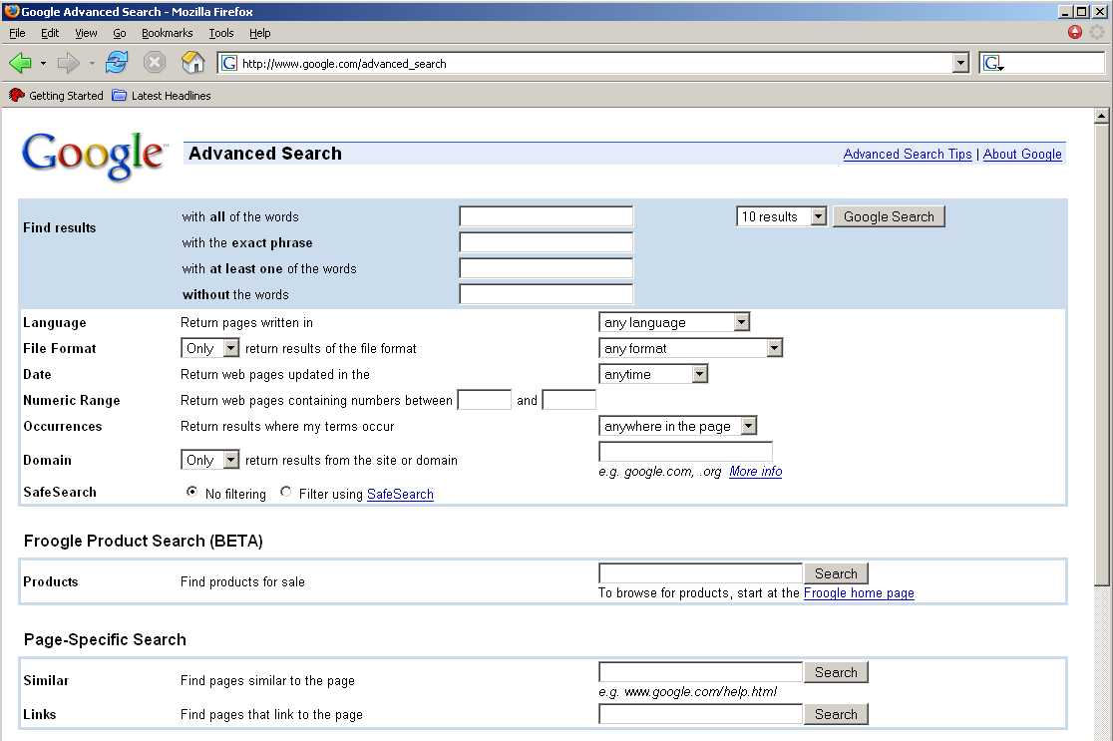
Advanced Searching
googleguide.com and…
Advanced Search Page: http://www.google.com/advanced_search

Slide 12
Advanced Operators (modifiers)
cache:
define:
info:
intext:
intitle:
inurl:
link:
related:
stocks:
filetype:
numrange 1973..2009
source:
http://www.googleguide.com/advanced_operators.html

Slide 13
Review: Basic Search
Use the plus sign (+) to force a search for an overly common word.
Use the minus sign (-) to exclude a term from a search. No space follows these signs.
To search for a phrase, supply the phrase surrounded by double quotes (" ").
A period (.) serves as a single-character wildcard.
An asterisk (*) represents any word—not the completion of a word, as is traditionally used.
Source: http://tinyurl.com/dnhc3

Slide 14
Advanced Operators/Modifiers
Google advanced operators help refine searches. Advanced operators use a syntax such as the following:
operator:search_term
Notice that there's no space between the operator, the colon, and the search term.

Slide 15
Google Directives
site:
The site: operator instructs Google to restrict a search to a specific web site or domain.
e.g. site:lists.opensuse.com
link:
show all sites linked to the site
search within hyperlinks for a search term.
e.g. link:www.cit.ie

Slide 16
Google Directives
related:
The related operator will return results that are “similar” to the page that was speciﬁed.
intitle:
show pages with the string in the title
inurl:
show pages with the string in the url
intext:
show pages with the string in the text

Slide 17
Google Directives
cache:
show the page's cache - Syntax: cache:URL
The cache operator will search through Google's cache and return the results based on those documents. You can alternatively tell cache to highlight a word or phrase by adding it after the operator and URL.
The results are loaded from google's cache for the page, which may have been taken a few days ago. - only 101k in size
images, however, are loaded from the original web site, not from the cache

Slide 18
Google Directives
cache: (contd.)
Turn off images and you can look at pages without being logged on the server!
Google being used as a mirror.
the fact that you looked at the site's cache will not be recorded in the site's logs
useful for finding recently removed pages
e.g. cache:www.rte.ie

Slide 19
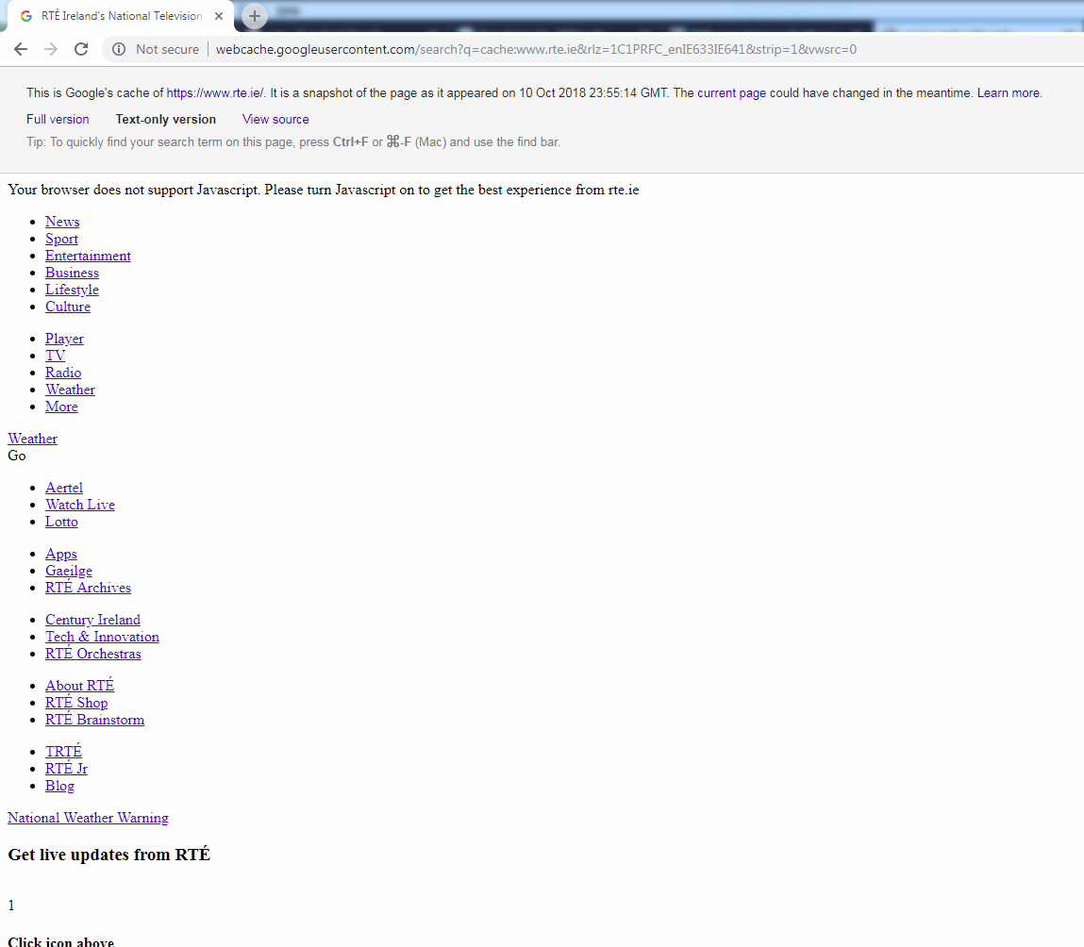

Slide 20
wayback machine
Has a more thorough archive of old views of websites than google's cache
Cached pages from billions of web pages over many years
at www.archive.org

Slide 21
Google Directives
info:
not very useful
This tag will give you the information that Google has on the given URL.
gives you the result of cache:, link: and related:
better to perform each separately

Slide 22
Google Directives
allintitle:
Syntax: allintitle: oper1 [oper2] [oper3] [etc..]
Google will restrict the results to those that have all of the words entered after the modiﬁer within the title.
every subsequent word must be in the title
NOTE: This modifier does not play well with others.
intitle:
Syntax: intitle:operator
Google will return only results that match the word or phrase entered after the modiﬁer within the title of the page.

Slide 23
Google Directives
allinurl:
Syntax: allinurl: oper1 [oper2] [oper3] [etc...]
This modiﬁer is similar to allintitle: in that it will use the rest of the query and look for all the words or phrases in the URL
NOTE: Also like allintitle:, this modiﬁer doesn’t play well with others.
inurl:
Syntax: inurl:operator
Here is the single operator version of allinurl:.
Will return anything that has the operator in the URL.

Slide 24
Google Directives
allintext:
Syntax: allintext: oper1 [oper2] [oper3] [etc...]
ignores links, urls and page titles
intext:
Syntax: intext:operator
ignores links, urls and page titles

Slide 25
Google Directives
ext:
same as filetype:
match files only with this file extension
such as doc, ppt, pdf, txt
find active content: asp, jsp, php, cgi etc
indicate active web content, and may be vulnerable
Don't include a period before the file extension.
Now start mixing and matching these modifiers and operators. The four most commonly used are intitle:, intext:, inurl:, and ﬁletype:

Slide 26
Bing Directive
ip:
Search by ip address
Shows all of the domains hosted on the address
See next slide

Slide 27
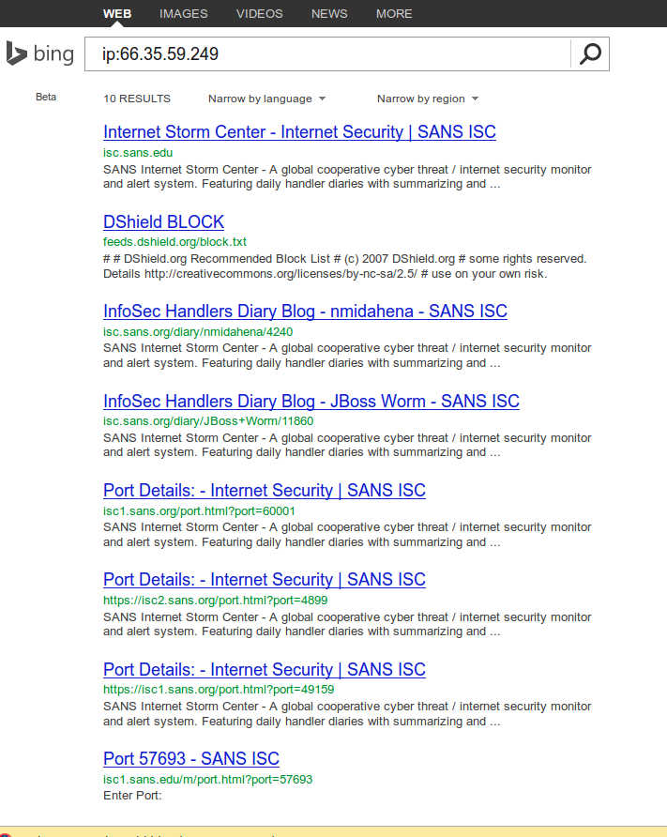

Slide 28
Google search examples
"display printer status" intitle:"Home"
locates printers
"#mysql dump" ﬁletype:sql 21232f297a57a5a743894a0e4a801fc3
21232f297a57a5a743894a0e4a801fc3 is the MD5sum for “admin”
"Network Vulnerability Assessment Report"
"Thank you for your order" +receipt ext:pdf
phone address e-mail intitle:"curriculum vitae"

Slide 29
Additional tips
robots.txt
contains files/directories that the server doesn't want google to display
The major search engine's crawlers honor this file and its contents.
site:www.whitehouse.gov robots.txt
or surf to www.whitehouse.gov/robots.txt
hackers often look in this file to see what an organisation does not want revealed
search:
"robots.txt" "disallow:" filetype:txt

Slide 30
Example Robots.txt
User-agent: *
Disallow: /images/
Disallow: /stats/
Disallow: /logs/
Disallow: /admin/
Disallow: /comment/
User-agent: Googlebot
Allow:
User-agent: BecomeBot
Disallow:
Disallow: /
Disallow: *
User-agent: MSNBot
Disallow:
Disallow: /
Disallow: *
By default tells others to not scan specific paths
Allows Google to scan
Tells BecomeBot and MSNBot to go away entirely.
Place the robots.txt in the root of your HTML documents directory.
See also
Removing Your Materials from Google How to remove your content from Google's various web properties.
http://hacks.oreilly.com/pub/h/220
Robots.txt generator http://tinyurl.com/7pc4k
Error in the above:
There should be an 'Noindex: /' line as well as the Disallow-line.

Slide 31
Fake GoogleBots
Exploit scripts sometimes use a fake user agent of "Googlebot"
most web applications are happy to be indexed by Google
Some applications will show more content to Google that is not readily displayed to normal users unless these users sign up, solve a captcha or even pay
Check: The IP address used by Google will reverse resolve to crawl-a-b-c-d.googlebot.com, where a-b-c-d is the IP address of googlebot.com

Slide 32
Index of
On a webserver, a folder directory, which is un-protected, will have the words “Index of” in the title of the web page.

Slide 33
Searches
using “index of” syntax to get a list of links to webserver which has got directory browsing enabled:
index.of /admin
index.of /passwd
index.of /password
index.of /mail
"index.of /" +passwd
"index.of /" +password.txt
"index.of /" +.htaccess

Slide 34
Johnny Long's Disclaimer
“Note that actual exploitation of a found vulnerability crosses the ethical line, and is not considered mere web searching.”

Slide 35
Directory Listings
Directory Listings
Show server version information
Useful for an attacker
intitle:index.of server.at
intitle:index.of server.at site:aol.com
Finding Directory Listings
intitle:index.of "parent directory"
intitle:index.of name size
Displaying variables
“Standard” demo and debugging program
“HTTP_USER_AGENT=Googlebot”
Frequently an avenue for remote code execution
http://somebox.someU.edu/~user/demo.cgi?cmd=`cat /etc/passwd`

Slide 36
Searching for vulnerable sites
“allinurl:winnt/system32/”
(without quotes) will list down all the links to the server which gives access to restricted directories like “system32” through web. If you find one then you might get access to the cmd.exe in the “system32” directory.

Slide 37
Searching for vulnerable sites
Using “inurl:.bash_history”
(without quotes) will list down all the links to the server which gives access to “.bash_history” file through web. This is a command history file.
This file includes the list of commands executed by the administrator, and sometimes includes sensitive information such as password typed in by the administrator.
If this file is compromised and if contains a encrypted *nix password then it can be easily cracked using say “John The Ripper”.

Slide 38
Searching for vulnerable sites
“inurl:config.txt”
(without quotes) will list down all the links to the servers which gives access to “config.txt” file through web.
This file might contain sensitive information, including the hash value of the administrative password and database authentication credentials.

Slide 39
Searching for vulnerable sites
[allintitle: "index.of /root”]
(without brackets) will list down the links to the web server which gives access to restricted directories like “root” through web.
This directory sometimes contains sensitive information which can be easily retrieved through simple web requests.

Slide 40
Searching for vulnerable sites
[allintitle: "index.of /admin”]
(without brackets) will list down the links to the websites which has got index browsing enabled for restricted directories like “admin” through web.
Most of the web application sometimes uses names like “admin” to store admin credentials in it. This directory sometimes contains sensitive information which can be easily retrieved through simple web requests.

Slide 41
Searching for vulnerable sites
intitle: "index of” .sh_history
intitle: "index of” .bash_history
intitle: "index of” /etc/shadow
intitle: "index of” passwd

Slide 42
GooPot
According to http://www.techtarget.com, "A honey pot is a computer system on the Internet that is expressly set up to attract and 'trap' people who attempt to penetrate other people's computer systems.“
For example, build a page that matches the query:
inurl:admin inurl:userlist
Then examine the referrer variable to figure out how the person found the page. This information can help protected normal sites.
http://ghh.sourceforge.net/

Slide 43
defending against google hacking
Keep your sensitive data off the web! Even if you think you're only putting your data on a web site temporarily, there's a good chance that you'll either forget about it, or that a web crawler might find it. Consider more secure ways of sharing sensitive data, such as SSH/SCP or encrypted email.

Slide 44
defending against google hacking
look for info leakage thru google yourself
remove unwanted items from google:
request URL re-crawl (www.google.com/addurl.html)
also there is an urgent URL form
see www.robotstxt.org for more info re non-google crawlers.
If you find any links to your restricted servers or sites in Google search result then they should be removed.
See http://www.google.com/remove.html

Slide 45
defending against google hacking
Disable directory browsing on the webserver.
Directory browsing should be enabled only for those web-folders for which you want to give access to anyone on internet.
Disable anonymous access in the webserver through the internet to restricted systems directory.

Slide 46
defending against google hacking
Install filtering tools like URLScan for servers running IIS as webserver.
Install latest security patches available for the applications and the operating system running on the servers.
For a linux webserver, consider using a chroot environment

Slide 47
defending against google hacking
If you want to be removed completely from google, get a request form at services.google.com/urlconsole/controller
fill out form, giving your URL
alter the page on your website (using robots.txt or a meta tag to indicate that you want it removed
Use an automated google Recon tool (next)

Slide 48
defending against google hacking
GHH is a “Google Hack” honeypot.
designed to provide reconaissance against attackers that use search engines as a hacking tool against your resources.
Can be used to gather statistics on would-be-attackers, report activities to appropriate authorities and temporarily or permanently deny access to resources.
http://ghh.sourceforge.net/gettingstarted.php

Slide 49
Automated Google Reconnaissance
several tools available.
use several on your websites
sitedigger at foundstone.com
wikto at sensepost.com
however, both require a Google SOAP API key, so that you can perform programmatic searches of google using the API, which has a limit of 1000 searches per day.
register for key at www.google.com/apis/index.html
Dec 2006, google stopped issuing SOAP API keys, as they want developers to move to AJAX API (but we have no tools that use this)

Slide 50
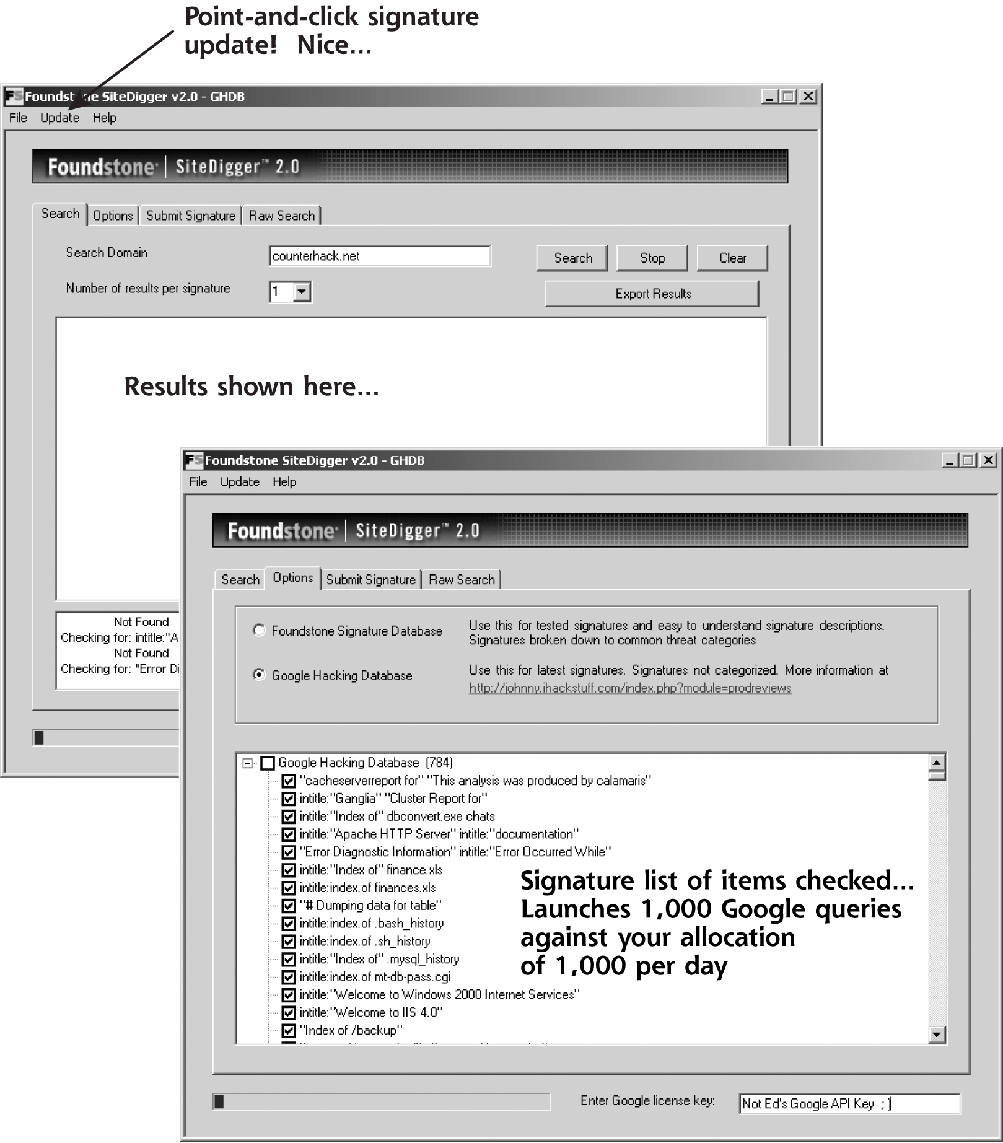
SiteDigger
User provides Google API key
One search…
Uses GHDB
Does 1k Google searches
Your daily limit
There’s always tomorrow…

Slide 51
Gooscan
“The gooscan tool, written by j0hnny, automates CGI scanning with Google, and many other functions.
Gooscan is a UNIX (Linux/BSD/Mac OS X) tool that automates queries against Google search appliances (which are not governed by the same automation restrictions as their web-based brethren). For the security professional, gooscan serves as a front end for an external server assessment and aids in the information-gathering phase of a vulnerability assessment. For the web server administrator, gooscan helps discover what the web community may already know about a site thanks to Google's search appliance.
For more information about this tool, including the ethical implications of its use, see http://johnny.ihackstuff.com.”

Slide 52
Goolag Scanner
released (Feb. 2008) by famous computer hacker group Cult of the Dead Cow (CDC)
a stand-alone Windows GUI-based application
CDC (famous for its anti-censorship stance) was established in the US in 1984 and its history includes declaring war on the Church of Scientology
CDC first shot to notoriety during the 1990s with the release of the BackOrifice tools which allowed low-level users to hijack and take control of Windows PCs.
http://goolag.org/index.html

Slide 53
Goolag Scanner
Uses a local GHDB database
But it violates Google's terms of reference
Google may block your IP address for 1 to 24 hours
Google may display a CAPTCHA when you search, used to prevent automated searching.
The CAPTCHA is to check if the scanning is being done by a human

Slide 54
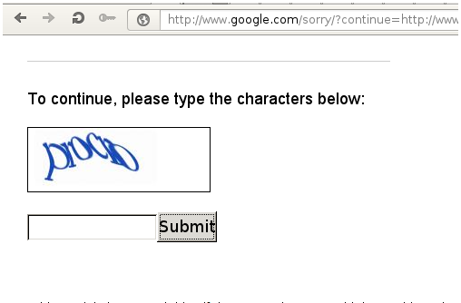
Google CAPTCHA

Slide 55
Google Alerts
Using this, you can schedule Google to inform you if there is now a new response to a Google search
You may need a Google account
Useful in penetration testing, as Google is usually used in the Recon phase early in the test, and you may need to know if updates have occurred as the test proceeds.

Slide 56
GHDB
GnuCitizen, a computer security consultancy, released Google Hacking Database Tool (GHDB), an online application that automates Google searches for files and other data associated with Web site vulnerabilities.
a Web-based version of Goolag Scanner
built on the top of Ajax technologies and JavaScript programming
always updated with the latest Google dorks/hacks, with no admin overhead (unlike Goolag, which is a compiled binary).
It runs inside the browser, which makes it cross-platform."
http://www.gnucitizen.org/ghdb/application.htm
GHDB at http://www.exploit-db.com/google-hacking-database-reborn/

Slide 57

defence method: CAPTCHA
Completely Automated Public Turing Test to Tell Computers and Humans Apart
http://www.captcha.net/
http://en.wikipedia.org/wiki/Captcha

Slide 58
Google Extras...
Translation and Language options - over 100 to choose from: http://www.google.com/language_tools
Stock Quotes - enter stocks:, example: stocks:GOOG
Newsgroups - http://groups.google.com
Calculator - "1024 minus 768" or "12 to the 10 power"
Froogle - http://froogle.google.com
Images - http://images.google.com
Spell Checking - just type it in: "convienence"
Blogger - http://www.blogger.com/start
Extras can be found at http://www.google.com/help/features.html

Slide 59
Using google as a proxy
google includes a language translation service, which will translate a foreign language page to your language
choose to translate a page from English to English
The website will think the request came from google.
not a very thorough anonymizer though
if the destination website sends a javascript or other tool to interrogate your ip address, the anonymity will be pierced.
check effectiveness of anonymizer at
www.all-nettools.com/toolbox

Slide 60
References
http://www.johnny.ihackstuff.com
home of google hacking database
“Google Hacking for Pen Testers” by Johnny Long
“Google Hacks” by Tara Calishain
http://www.googleguide.com/advanced_operators.html
Google Hacking Mini Guide by Johnny Long:
http://www.informit.com/articles/article.asp?p=170880&rl=1

Slide 61
References
Protect yourself from Google hacking:
http://tinyurl.com/8q3fg
Google:http://www.google.com
http://www.i-hacked.com/content/view/23/42/
HowStuffWorks:
http://computer.howstuffworks.com/search-engine1.htm
Search Engine Watch:
http://searchenginewatch.com
NSA's 643 page guide to Google Hacking:
http://www.nsa.gov/public_info/_files/Untangling_the_Web.pdf

Slide 62
Google Hacks
http://code.google.com/p/googlehacks/

