Slide 1

Machine Learning
Machine Learning
Lecture: Handling Categorical Data
Ted Scully

Slide 2
Data Pre-processing for Scikit Learn
Dealing with Outliers (Optional)
Dealing with Missing Values
Handling Categorical Data
Scaling Data
Handling Imbalance
Feature Selection
Dimensionality Reduction
Notes:
Noise would be incorrectly classified instances (basically errors in the data). If we happen to rely on a noisy instance in order to classify another instance then the new instance would also be incorrect.

Slide 3

Encoding Categorical Features
When dealing with categorical data, it is important to distinguish between nominal and ordinal values.
Ordinal values are variables that have a logical ordering. For example, a letter grade for a student, ‘A’, ‘B’, ‘C’, …
In contrast nominal features have no inherent ordering. For example, a features that report’s the colour of a car ‘Red’, ‘Blue’, etc.
In the example below we have two categorical features. Department being a nominal feature and Grade being an ordinal feature
Notes:
Noise would be incorrectly classified instances (basically errors in the data). If we happen to rely on a noisy instance in order to classify another instance then the new instance would also be incorrect.

Slide 4
Ordinal Variables
To make sure that our learning algorithms interpret the ordinal features correctly we need to convert the categorical string values into integers.
Unfortunately, the ordering of ordinal values is typically related to the domain and as such there is no automatic mechanism of encoding this information.
Therefore, you need to specify the mapping manually, which can be time consuming. In the example on the next slide we specify the mapping for the ordinal feature Grades.
This involves creating a dictionary to specify the direct mapping and using a dataframe method call map.
Notes:
Noise would be incorrectly classified instances (basically errors in the data). If we happen to rely on a noisy instance in order to classify another instance then the new instance would also be incorrect.

Slide 5

In the following examples we will use the dataframe below
import pandas as pd
import numpy as np
seriesA = pd.Series(['A', 'C', 'B'])
seriesB = pd.Series([21, 18, 19])
seriesC = pd.Series([4, 1, 1])
seriesD = pd.Series(['Computing', 'Biology’, Chemistry'])
df = pd.DataFrame({'Grade' : seriesA, 'Age' : seriesB, 'DegreeYear' : seriesC,
'Department' : seriesD})
print (df)

Slide 6
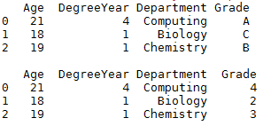
# continued from previous slide
grade_mapping = {'F':0, 'D':1, 'C':2, 'B':3, 'A':4}
df['Grade'] = df['Grade'].map(grade_mapping)
print (df)
Notice we create a dictionary that provides a mapping from letter grades to numerical values.
We then provide call the map method for the Grade column, which takes the dictionary as an argument.

Slide 7
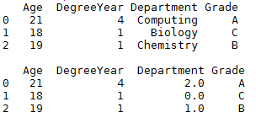
Nominal Values – Encode as Integer Values
For nominal values we could directly encode them into integer values using the OrdinalEncoder from Scikitlearn. After the transform operation the OrdinalEncoder will return an array of numerical values.
from sklearn.preprocessing import OrdinalEncoder
enc = OrdinalEncoder()
df["Department"] = enc.fit_transform(df[["Department"]])
print (df)
Notes:
Noise would be incorrectly classified instances (basically errors in the data). If we happen to rely on a noisy instance in order to classify another instance then the new instance would also be incorrect.

Slide 8
Encoding Categorical Features – Nominal Values
Inadvertently, we have now specified a ordering on a nominal categorical feature.
Although the Department feature has no specific ordering, a learning algorithm will view the encoding as an ordering. Notice that that Computing is closer to Chemistry then it is to Biology.
Notes:
Noise would be incorrectly classified instances (basically errors in the data). If we happen to rely on a noisy instance in order to classify another instance then the new instance would also be incorrect.

Slide 9
Encoding Categorical Features – Nominal Values
A common way of addressing this problem is to use a technique referred to as ‘one-hot encoding’.
One hot encoding transforms each categorical feature with n possible values into n binary features
In the example on the previous slide we could convert the Department feature into three new binary features: Computing, Biology and Chemistry.
Binary values can then be used indicate the presence of a particular department.
For example, a Computing sample would be encoded as Computing = 1, Chemistry = 0 and Biology = 0
Notes:
(Can specify the categories manually)
By default, the encoder derives the categories based on the unique values in each feature. Alternatively, you can also specify the categories manually.
. If there is a possibility that the training data might have missing categorical features, it can often be better to specify handle_unknown='ignore' instead of setting the categories manually as above. When handle_unknown='ignore' is specified and unknown categories are encountered during transform, no error will be raised but the resulting one-hot encoded columns for this feature will be all zeros (handle_unknown='ignore' is only supported for one-hot encoding):

Slide 10

One Hot Encoding
Scikitlearn provides a OneHotEncoder class that allows us to implement a One-Hot Encoder method.
Notes:
Noise would be incorrectly classified instances (basically errors in the data). If we happen to rely on a noisy instance in order to classify another instance then the new instance would also be incorrect.

Slide 11
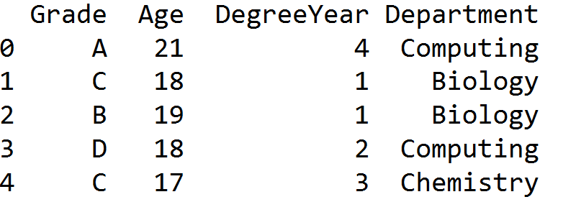
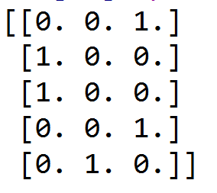
import pandas as pd
import numpy as np
from sklearn.preprocessing import OneHotEncoder
seriesA = pd.Series(['A', 'C', 'B', 'D', 'C'])
seriesB = pd.Series([21, 18, 19, 18, 17])
seriesC = pd.Series([4, 1, 1, 2, 3])
seriesD = pd.Series(['Computing', 'Biology', 'Biology', 'Computing', 'Chemistry'])
df = pd.DataFrame({'Grade' : seriesA, 'Age' : seriesB, 'DegreeYear' : seriesC,
'Department' : seriesD})
encoder = OneHotEncoder(sparse=False)
departmentEncoded = encoder.fit_transform( df[["Department"]] )
print (departmentEncoded)
Notice when we call fit_transform on the department column it returns the one-hot encoding of this column.

Slide 12
One-hot Encoding
The disadvantage of one-hot encoding is that if there are a very large number of unique values for a categorical feature, we will consequently end up with a very large number of additional features.
In turn this can lead to a very long training time or underperformance of some models due to the rapid increase in dimensionality.
One approach that is used to mitigate the impact of this is dimensionality reduction (techniques such as PCA), which can allow us to in some cases dramatically reduce the overall number of features.
Notes:
Noise would be incorrectly classified instances (basically errors in the data). If we happen to rely on a noisy instance in order to classify another instance then the new instance would also be incorrect.

Slide 13
Machine Learning
Machine Learning
Lecture: Scaling Data
Ted Scully

Slide 14
Data Pre-processing for Scikit Learn
Dealing with Outliers
Dealing with Missing Values
Handling Categorical Data
Scaling Data
Feature Selection
Handling Imbalance
Notes:
Noise would be incorrectly classified instances (basically errors in the data). If we happen to rely on a noisy instance in order to classify another instance then the new instance would also be incorrect.

Slide 15
Scaling Data
Feature scaling is a important step in pre-processing for machine learning. The majority of ML and optimization algorithms behave better if features are on the same scale.
The two most common data transformation techniques used are:
Normalising Data
Standardizing Data
Notes:
Decision trees and random forests are one of the few algorithms that are impacted by scaling in any way.

Slide 16

Normalising Data
Normalization is the rescaling of the features into the range between 0 and 1.
This can improve the performance for algorithms that assign a weight to features such as linear regression and in particular for algorithms that utilize geometric distance such as KNNs.
In the following dataset I print out the first few rows of the feature data. You will notice that the second feature has a much greater range than any of the other features.
Notes:
Noise would be incorrectly classified instances (basically errors in the data). If we happen to rely on a noisy instance in order to classify another instance then the new instance would also be incorrect.

Slide 17

Normalising Data
Scikit allows us to normalize all features using the MinMaxScaler class in sklearn.preprocessing.
Note the fit_transform function takes as input a NumPy array or a DataFrame.
It returns NumPy array as an argument.
from sklearn import preprocessing
scalingObj = preprocessing.MinMaxScaler()
newX = scalingObj.fit_transform(allValues)
Notes:
Normalization can be very sensitive to the presence of outliers

Slide 18
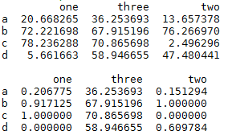
Normalising Data
import pandas as pd
from sklearn import preprocessing
Import numpy as np
seriesA = pd.Series(np.random.rand(4)*100, index=['a', 'b', 'c', 'd'])
seriesB = pd.Series(np.random.rand(4)*100, index=['a', 'b', 'c', 'd'])
seriesC = pd.Series(np.random.rand(4)*100, index=['a', 'b', 'c', 'd'])
df = pd.DataFrame({'one' : seriesA, 'two' : seriesB, three' : seriesC})
print (df)
scalingObj = preprocessing.MinMaxScaler()
df[['one', 'two']]= scalingObj.fit_transform( df[['one', 'two']] )
print (df)
In the example above we perform normalization on two columns from our dataframe object.
Notes:
Normalization can be very sensitive to the presence of outliers

Slide 19

Standardizing Data
Standardization facilitates the transformation of features to a standard Gaussian(normal) distribution with a mean of 0 and a standard deviation of 1.
The scaling happens independently on each individual feature by computing the relevant statistics on the samples in the training set.
Standardization of a dataset is a common requirement for dealing with dataset features with different ranges but also for many machine learning estimators such as clustering techniques , logistic regression, neural networks, SVMs.
One point to note is that standardization is less sensitive to outlier than normalization.
Input | Standardized | Normalized
0.0 | -1.33 | 0.0
1.0 | -0.80 | 0.2
2.0 | -0.26 | 0.4
3.0 | 0.26 | 0.6
4.0 | 0.80 | 0.8
5.0 | 1.33 | 1.0
Notes:
https://www.analyticsvidhya.com/blog/2016/07/practical-guide-data-preprocessing-python-scikit-learn/
Elements such as l1 ,l2 regularizer in linear models (logistic comes under this category) and RBF kernel in SVM in objective function of learners assumes that all the features are centered around zero and have variance in the same order.
Features having larger order of variance would dominate on the objective function as it happened in the previous section with the feature having large range.
Other learners like kNN with euclidean distance measure, k-means, SVM, perceptron, neural networks, linear discriminant analysis, principal component analysis may perform better with standardized data.

Slide 20
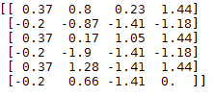
Standardizing Data
In the example below we standardize the training data from the iris data
The values for each attribute now have a mean value of 0 and a standard deviation of 1.
As with the MinMaxScaler object the StandardScaler can accept either a NumPy array or a Pandas dataframe.
from sklearn import preprocessing
scaler = preprocessing.StandardScaler()
newX = scaler.fit_transform(allValues)
If you apply MinMaxScaler or StandardScaler to a dataframe containing multiple features with different data types it will generate a warning.
The scaling is still perfomed. To view the datatypes of each column in a dataframe you can use df.info(). If you then wish to change the datatype of any column in a dataframe you can use pd.astype().
Notes:
Standardization of a dataset is a common requirement for many machine learning estimators: they might behave badly if the individual feature do not more or less look like standard normally distributed data (e.g. Gaussian with 0 mean and unit variance).
For instance many elements used in the objective function of a learning algorithm (such as the RBF kernel of Support Vector Machines or the L1 and L2 regularizers of linear models) assume that all features are centered around 0 and have variance in the same order
Standardize features by removing the mean and scaling to unit variance
Centering and scaling happen independently on each feature by computing the relevant statistics on the samples in the training set. Mean and standard deviation are then stored to be used on later data using the transform method.
Standardization of a dataset is a common requirement for many machine learning estimators: they might behave badly if the individual feature do not more or less look like standard normally distributed data (e.g. Gaussian with 0 mean and unit variance).
For instance many elements used in the objective function of a learning algorithm (such as the RBF kernel of Support Vector Machines or the L1 and L2 regularizers of linear models) assume that all features are centered around 0 and have variance in the same order. If a feature has a variance that is orders of magnitude larger that others, it might dominate the objective function and make the estimator unable to learn from other features correctly as expected.
This scaler can also be applied to sparse CSR or CSC matrices by passing with_mean=False to avoid breaking the sparsity structure of the data.

Slide 21
Normalising Data
import pandas as pd
import numpy as np
from sklearn import preprocessing
seriesA = pd.Series(np.random.rand(4)*100, index=['a', 'b', 'c', 'd'])
seriesB = pd.Series(np.random.rand(4)*100, index=['a', 'b', 'c', 'd'])
seriesC = pd.Series(np.random.rand(4)*100, index=['a', 'b', 'c', 'd'])
df = pd.DataFrame({'one' : seriesA, 'two' : seriesB, 'three' : seriesC})
print (df)
scaler = preprocessing.StandardScaler()
df[['one', 'two']]= scaler.fit_transform( df[['one', 'two']] )
print (df)
In the example above we perform standardization on two columns from our dataframe object.
Notes:
Normalization can be very sensitive to the presence of outliers

Slide 22
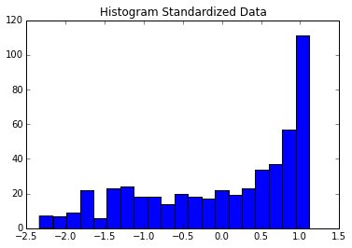
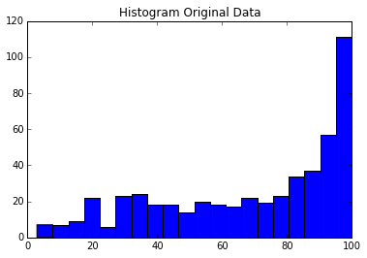
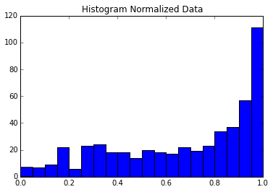
Unless you fully understand in-depth all the ML algorithms you use it can be very difficult to know if you should use normalization or standardization when scaling your data.
It is generally recommended that try both approaches to determine which provides the best accuracy value.
Notes:
The scaling impacts the overall range. However, it doesn’t impact frequency distribution (shape) of a set of continuous data.

Slide 23
Machine Learning
Machine Learning
Lecture: Feature Selection
Ted Scully

Slide 24
Data Pre-processing for Scikit Learn
Dealing with Outliers
Dealing with Missing Values
Handling Categorical Data
Scaling Data
Feature Selection
Handling Imbalance
Notes:
Noise would be incorrectly classified instances (basically errors in the data). If we happen to rely on a noisy instance in order to classify another instance then the new instance would also be incorrect.

Slide 25
Feature Selection
Feature Selection is the process of ranking or quantifying the contribution of each feature in a dataset in helping to predict the target regression value of class.
There are a broad range of feature selection techniques.
We will look at three methods of feature selection supported by Sci-kit Learn:
Univariate Feature Selection
Tree-Based Feature Selection
Greedy Backward Feature Selection
Notes:
Less redundant data means less opportunity to make decisions based on noise
Less misleading data means modelling accuracy improves
Less data means that algorithms train faster

Slide 26
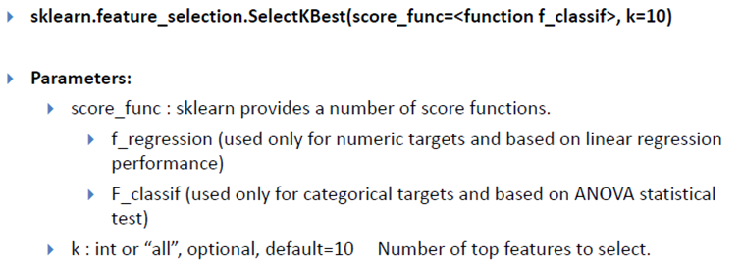
Univariate Feature Selection
Scikit learn has a number of uni-variate approaches to feature selection, which examine the relationship between the features and the class target or regression target.
The main univariate feature selection tools in sklearn are: SelectPercentile and SelectKBest. Both of these functions allow you to run statistical tests between the features and the target class.
Notes:
Anova is conceptually similar to multiple two-sample t-tests
To fit a linear regression model, we select those features which have a high correlation with our target variable MEDV. By looking at the correlation matrix we can see that RM has a strong positive correlation with MEDV (0.7) where as LSTAT has a high negative correlation with MEDV(-0.74).

Slide 27
Univariate Feature Selection
from sklearn import datasets
from sklearn.feature_selection import SelectPercentile
from sklearn.feature_selection import f_regression
boston = datasets.load_boston()
X = boston.data
y = boston.target
selector = SelectPercentile(f_regression, percentile=25)
selector.fit(X,y)
for n,s in zip(boston.feature_names, selector.scores_):
print ("Score : ", s, " for feature ", n)
Score : 88.1512417809 for feature CRIM
Score : 75.257642299 for feature ZN
Score : 153.954883136 for feature INDUS
Score : 15.9715124204 for feature CHAS
Score : 112.59148028 for feature NOX
Score : 471.846739876 for feature RM
Score : 83.4774592192 for feature AGE
Score : 33.5795703259 for feature DIS
Score : 85.9142776698 for feature RAD
Score : 141.761356577 for feature TAX
Score : 175.105542876 for feature PTRATIO
Score : 63.0542291125 for feature B
Score : 601.61787111 for feature LSTAT
These univariate tests have certain limitations. Some features may be unfairly penalized. Univariate feature selection can negatively bias against categorical data types or binary data types (especially categorical features with a limited range).
Also univariate selection techniques typically only measure linear relationships and clearly they cannot capture interaction between features.
Notes:
>>> x = [1, 2, 3] >>> y = [4, 5, 6] >>> zipped = zip(x, y) >>> list(zipped) [(1, 4), (2, 5), (3, 6)]
LSTAT: Percentage of lower status of the population
To fit a linear regression model, we select those features which have a high correlation with our target variable MEDV. By looking at the correlation matrix we can see that RM has a strong positive correlation with MEDV (0.7) where as LSTAT has a high negative correlation with MEDV(-0.74).
CRIM: Per capita crime rate by town ZN: Proportion of residential land zoned for lots over 25,000 sq. ft INDUS: Proportion of non-retail business acres per town CHAS: Charles River dummy variable (= 1 if tract bounds river; 0 otherwise) NOX: Nitric oxide concentration (parts per 10 million) RM: Average number of rooms per dwelling AGE: Proportion of owner-occupied units built prior to 1940 DIS: Weighted distances to five Boston employment centers RAD: Index of accessibility to radial highways TAX: Full-value property tax rate per $10,000 PTRATIO: Pupil-teacher ratio by town B: 1000(Bk — 0.63)², where Bk is the proportion of [people of African American descent] by town LSTAT: Percentage of lower status of the population MEDV: Median value of owner-occupied homes in $1000s

Slide 28
Tree Based Feature Selection
Decision trees work by reducing the level of uncertainty or impurity in the data and can use one of a range of metrics to do this (gini, entropy, etc).
They select the feature that provides the largest reduction in overall uncertainty.
Also for each feature we can quantify (measure) the reduction in uncertainty.
Tree based feature selection builds many trees and calculates the average reduction in uncertainty achieved by each feature across all the trees and uses this as a means of feature ranking.
The features with the largest reduction have the highest impact (the most important features).
Notes:
Extra-trees differ from classic decision trees in the way they are built. When looking for the best split to separate the samples of a node into two groups, random splits are drawn for each of the max_features randomly selected features and the best split among those is chosen. When max_features is set 1, this amounts to building a totally random decision tree.

Slide 29
Decision Tree
When building a decision tree, the algorithm will need to decide on what feature to use for each node in the tree. It examines all features and selects the feature that provides the largest reduction in overall uncertainty.
Put another way it select the feature that gives the greatest insight into the class.
Rain | Swell | Surf
Yes | Big | Yes
Yes | Small | No
No | Small | No
No | Big | Yes
Notes:
The higher the entropy, the more mixed up or the more uncertain the data is.
Swell has a low entropy level in this case because there is little uncertainty. Every time the swell is big then we surf. Entropy(Surf, Swell = Big) = Ent(2+, 0-) = 0
Every time the swell is big we go surf. There is quite a high level of certainty.
Rain for example has an entropy of 1 because it has quite a high level of associated uncertainty. Entropy(Surf, Rain = Yes) = Ent(1+, 1-) = 1. In other words when it was raining once we went surfing and once we didn’t go surfling. Therefore the influence of this variable on whether or not we go surfing is highly uncertain.

Slide 30
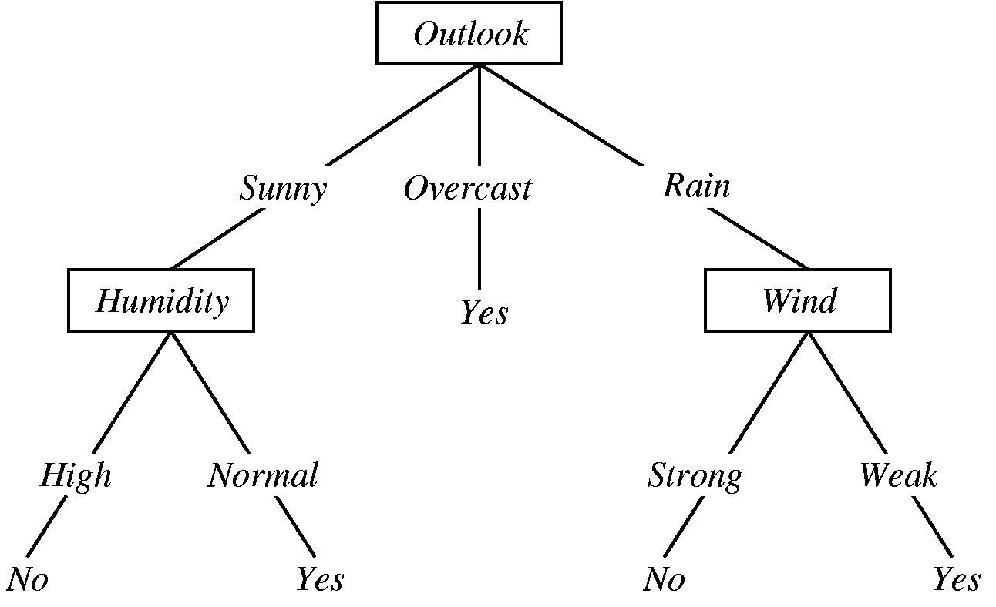
Ensemble Learning
When building a single decision tree every time it creates a new split it looks at the data available for that split and determines which feature provides the greatest reduction in uncertainly.
An Ensemble such as a Random Forest model will build many trees (you control the number of trees built).
It can then return the feature importance of each feature by averaging the reduction in uncertainty achieved by each feature across all trees generated.
The default measure of uncertainty used in a RF is the Gini index.
Notes:
Noise would be incorrectly classified instances (basically errors in the data). If we happen to rely on a noisy instance in order to classify another instance then the new instance would also be incorrect.

Slide 31
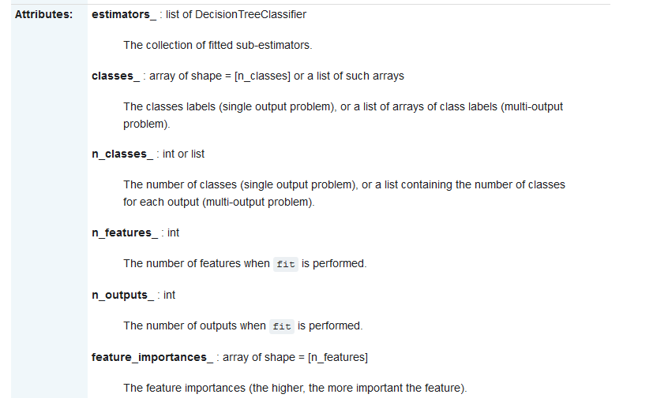

Slide 32
Tree – Based Feature Selection
Tree-based ensemble methods such as random forests can be effectively used for feature selection for classification problems.
from sklearn.datasets import make_classification
from sklearn.ensemble import RandomForestClassifier
# Build a classification task using 3 informative features
X, y = make_classification(n_samples=1000,
n_features=10,
n_informative=4,
n_redundant=0,
n_repeated=0,
n_classes=2,
random_state=0,
shuffle=False)
# Build a forest and compute the feature importance
forest = RandomForestClassifier(n_estimators=250, random_state=0)
forest.fit(X, y)
importances = forest.feature_importances_
for index in range(len(X[0])):
print ("Importance of feature ", index, "is", importances[index])
Feature ranking:
1. feature 0 (0.206926)
2. feature 1 (0.176586)
3. feature 3 (0.170126)
4. feature 2 (0.151502)
5. feature 7 (0.050760)
6. feature 5 (0.050182)
7. feature 9 (0.049881)
8. feature 4 (0.049276)
9. feature 8 (0.047586)
10. feature 6 (0.047175)
Notes:
feature_importances_ : array of shape = [n_features] - The feature importances (the higher, the more important the feature).

Slide 33
Greedy Feature Selection
Greedy feature selection automatically reduces the number of features involved in a learning model based on their effective contribution to the overall accuracy performance of the algorithm.
The RFECV class provides a greedy backward search that can provide you with information on the number of useful features, points them out to you and automatically transforms the X data, into a reduced variable set, as shown on the next slide.
Given an external estimator that assigns weights to features (e.g., the coefficients of a linear model) or that builds a feature importance array , recursive feature elimination (RFE) selects features by recursively considering smaller and smaller sets of features.
First, the estimator is trained on the initial set of features and the importance of each feature is obtained either through a coef_ attribute or through a feature_importances_ attribute.
Then, the least important feature is pruned from current set of features.
That procedure is recursively repeated on the pruned set until the desired number of features to select is eventually reached (or until all features have been ranked).
Notes:
Noise would be incorrectly classified instances (basically errors in the data). If we happen to rely on a noisy instance in order to classify another instance then the new instance would also be incorrect.

Slide 34
Workflow RFECV

Slide 35
Greedy Feature Selection
The basic syntax is as follows:
RFECV(estimator, step=1, cv=None, scoring=None)
Note you should select an estimator that should provide information about feature importance through a coef_ attribute or feature_importance
Returns
n_features_ : number of selected features (these are the number of features that gave the strongest result)
ranking_ : feature ranking such that ranking_[i] corresponds to the ranking position of the i-th feature (Best features ranked 1)
support_ : Boolean array containing a true if feature is selected (as rank 1), false otherwise
grid_scores_ : array of shape [n_subsets_of_features]
The scores such that grid_scores_[i] corresponds to the score of the i-th subset of features.
Notes:
Noise would be incorrectly classified instances (basically errors in the data). If we happen to rely on a noisy instance in order to classify another instance then the new instance would also be incorrect.

Slide 36
from sklearn.datasets import make_classification
from sklearn import model_selection
from sklearn.feature_selection import RFECV
from sklearn import linear_model
from sklearn.svm import SVC
# Build a classification task using 3 informative features
X, y = make_classification(n_samples=1000, n_features=25, n_informative=15,
n_redundant=2, n_repeated=0, n_classes=8,
n_clusters_per_class=1, random_state=0)
svm = SVC()
scores = model_selection.cross_val_score(svm, X, y, cv=10)
print ('Initial Result',scores.mean())
estimator = linear_model.LogisticRegression(multi_class='auto', solver ='lbfgs')
rfecv = RFECV(estimator, cv=10)
rfecv.fit(X, y)
# optimal number of features
print (rfecv.n_features_)
# ranking of each feature
print (rfecv.ranking_)
Create the classification dataset and assess the accuracy of a SVM Model.
Initial Result 0.836

Slide 37
from sklearn.datasets import make_classification
from sklearn import model_selection
from sklearn.feature_selection import RFECV
from sklearn import linear_model
from sklearn.svm import SVC
# Build a classification task using 3 informative features
X, y = make_classification(n_samples=1000, n_features=25, n_informative=15,
n_redundant=2, n_repeated=0, n_classes=8,
n_clusters_per_class=1, random_state=0)
svm = SVC()
scores = model_selection.cross_val_score(svm, X, y, cv=10)
print ('Initial Result',scores.mean())
estimator = linear_model.LogisticRegression(multi_class='auto', solver ='lbfgs')
rfecv = RFECV(estimator, cv=10)
rfecv.fit(X, y)
# optimal number of features
print (rfecv.n_features_)
# ranking of each feature
print (rfecv.ranking_)
Execute RFECV to rank features. Print the optimal number of features and the final numerical ranks of the features.
16
[ 1 1 3 1 1 1 5 2 1 1 1 1 1 1 1 1 4 10 1 6 9 1 1 8
7]

Slide 38
# select highest ranked features and build a new model
X = X[ : , rfecv.support_ ]
svm = SVC()
scores = model_selection.cross_val_score(svm, X, y, cv=10)
print ('Result after feature selection: ',scores.mean())
Use the Boolean mask array support_ to access the features that are ranked highest (as rank 1).
Rebuild the decision tree and assess the accuracy on the reduced dataset.
Result after feature selection: 0.879

