Slide 1
HW 10.1.2

Slide 2
Red: r = 0.6667
x = 0
Blue = -0.2

Slide 3
Red: r = 1.5
x = 0
Blue = 0.2

Slide 4
HW 10.2.2

Slide 5
Red: r = 0.5
x = 0
Blue = -0.3333

Slide 6
Red: r = 2
x = 0
Blue = 0.3333

Slide 7
HW 10.3.2

Slide 8
Red: r = 0.6667
x = 0
Blue = -0.2

Slide 9
Red: r = 0.923
x = 0.385
Blue = 0.2j

Slide 10
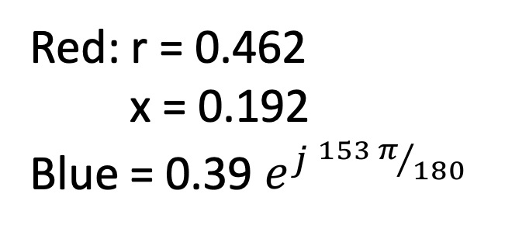
Red: r = 0.462
x = 0.192
Blue = 0.39 $e^{j {153 π}/{180 }}$

Slide 11
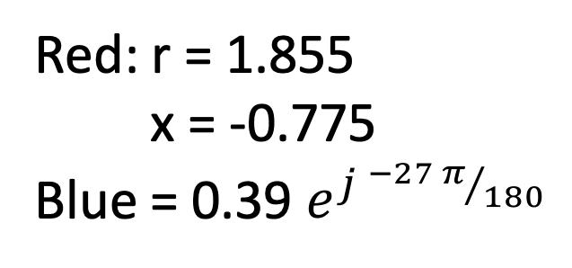
Red: r = 1.855
x = -0.775
Blue = 0.39 $e^{j {−27 π}/{180 }}$

