Slide 1
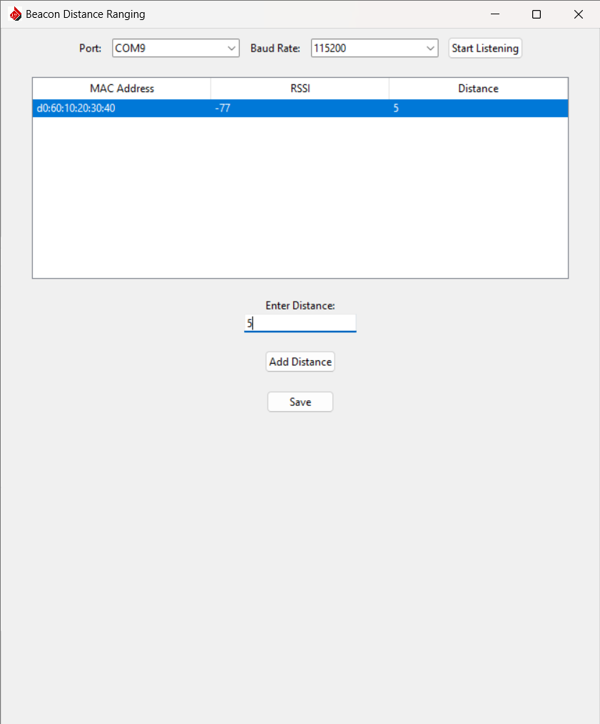
START
Select USB Port:
Baud 115200

