Slide 1
Image Classification using CNN
Dataset: CIFAR-10
Boda Likhith Raj (230002018)
Marpu Jagan Mohan(230002040)

Slide 2
PROBLEM DESCRIPTION
In this project, we address the problem of image classification using Convolutional Neural Networks (CNNs) on the CIFAR-10 dataset(10 Classes).
Image classification is the task of assigning a label or category to an input image based on its visual content.
In this work, we aim to design, train, and evaluate a CNN model capable of achieving high classification accuracy on CIFAR-10, while exploring ways to improve performance through model design and training strategies.

Slide 3
Novelty OF PAPER
Instead of a very deep and heavy network like Alex Net (which had 60 million parameters), we created a smaller CNN suited for the lower resolution (32×32) CIFAR-10 images.
Use of modern practices from AlexNet : We incorporated ideas like ReLU activation functions, dropout to reduce overfitting, and data augmentation (random crops and flips) which were pioneered effectively in AlexNet.
We designed a 7-layer CNN (5 convolutional layers + 2 fully connected layers) that balances model complexity and training efficiency, tailored for small 32×32 images of CIFAR-10.Unlike AlexNet, which uses large filters like 11×11, we use smaller 3×3 filters to better capture fine features in tiny images.

Slide 4
Novelty OF PAPER
Incorporation of Modern Techniques:
We use ReLU activation functions after each convolution, which speeds up training and avoids vanishing gradients — an idea first popularized by AlexNet.We also use MaxPooling layers to downsample feature maps and Flattening + Fully Connected layers to classify.
Overfitting Reduction:
Although we didn't include Dropout explicitly here, the smaller fully connected layers (1024 and 512 neurons) and aggressive downsampling help reduce overfitting for small datasets like CIFAR-10.

Slide 5
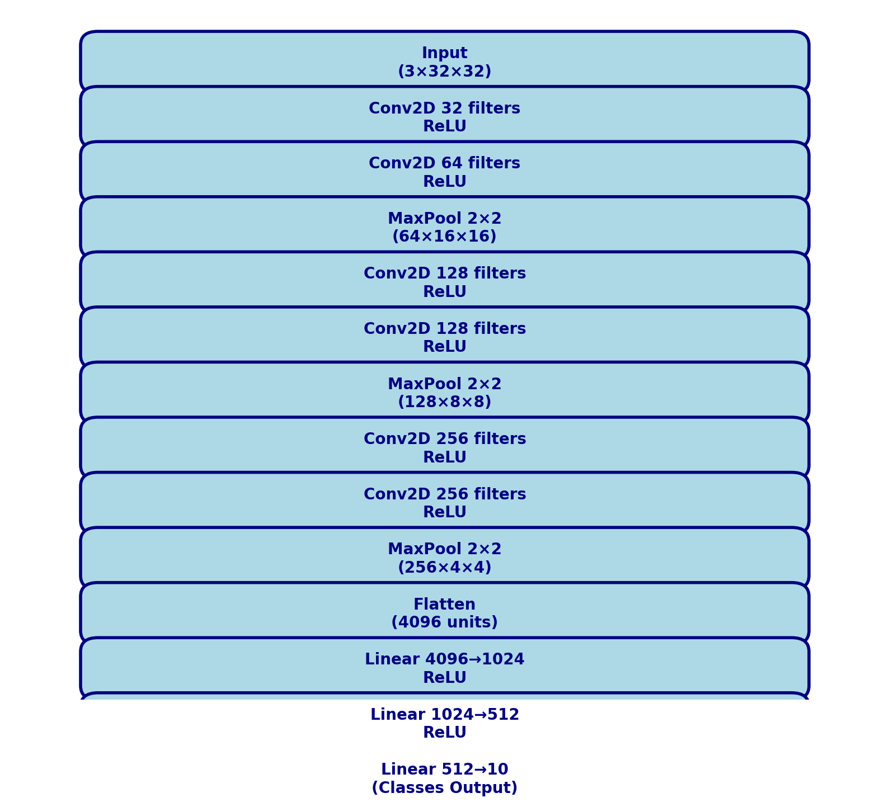
MODEL ARCHITECTURE

Slide 6
Filter used for convolution

Slide 7
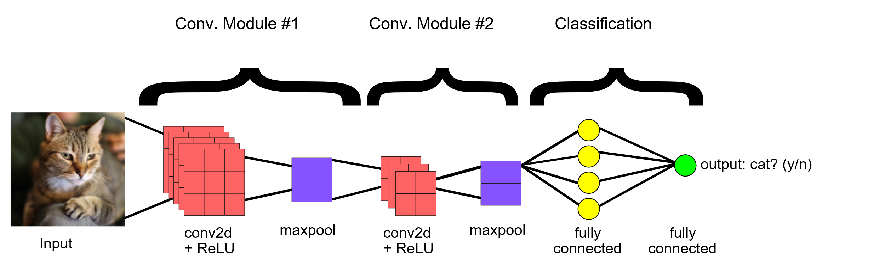

Relu activation function
Rectified Linear Unit (ReLU) transformation to the convolved feature, in order to introduce nonlinearity into the model.
$$f\left(x\right)=max⁡(0,x)$$

Slide 8
MAX POOLING
After ReLU comes a pooling step, in which the CNN downsamples the convolved feature (to save on processing time), reducing the number of dimensions of the feature map, while still preserving the most critical feature information.

Slide 9
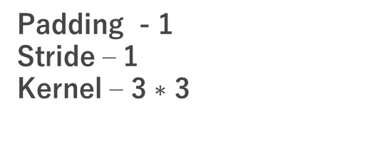
STRIDE AND PADDING
Padding consists in adding a few pixels on each (or a few) side of the picture with a zero value. By doing this, we can have an output that has exactly the same dimension is the output.
A stride in convolution is just like a by in a for loop: instead of going through every window one after the other, we skip a given amount each time.
Padding - 1
Stride – 1
Kernel – 3 $∗$ 3

Slide 10
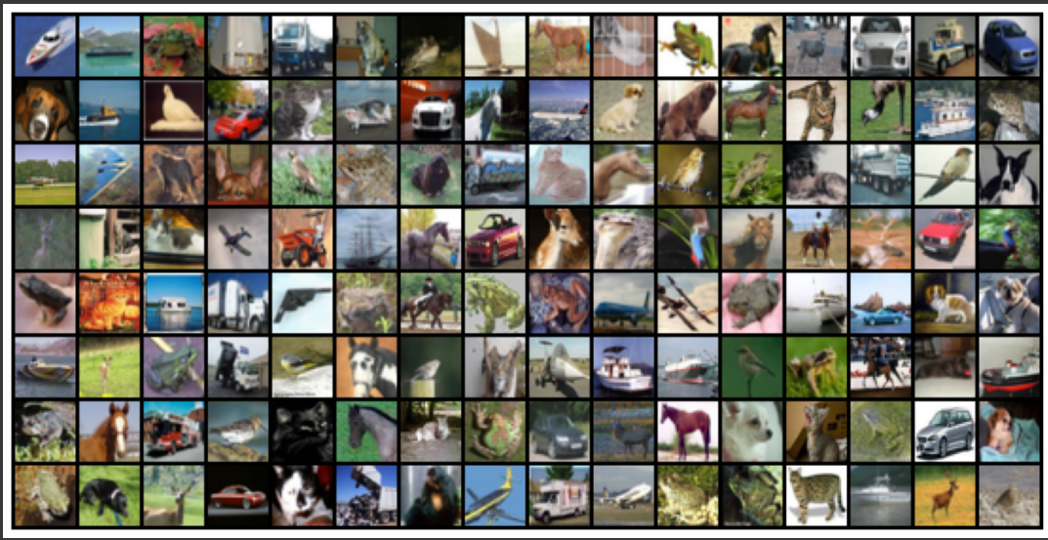
DATASET CIFAR -10

Slide 11
Unique features
Progressive Depth Doubling with Fixed Kernel Size Unique Aspect:
Channel depth doubles sequentially (32 → 64 → 128 → 256) while keeping a small, fixed 3x3 kernel in all conv layers.
Why It Matters :
Balances computational efficiency and feature richness.
Small kernels preserve spatial details without excessive parameters.

Slide 12
nETWORK CONFIGURATIONs
Element | Configuration
Optimizer | torch.optim.adam
Learning Rate | Passed as parameter (lr)
Loss Calculation | model.training_step(batch) (probably CrossEntropyLoss internally)
Training Steps | For each batch: forward pass → backward pass → optimizer step
Epochs | Passed as parameter (epochs)
Evaluation | Done at end of each epoch using validation set
Zero Gradients | optimizer.zero_grad() after each batch

Slide 13
PARAMETERS
Epochs used – 10
Optimisation function – Adam optimizer
Learning rate – 0.001
Training size = 45000
Validation size = 5000
Test size = 10000

Slide 14
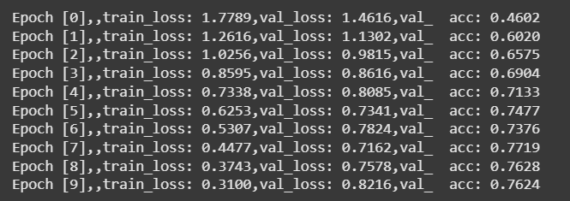
Results obtained

Slide 15
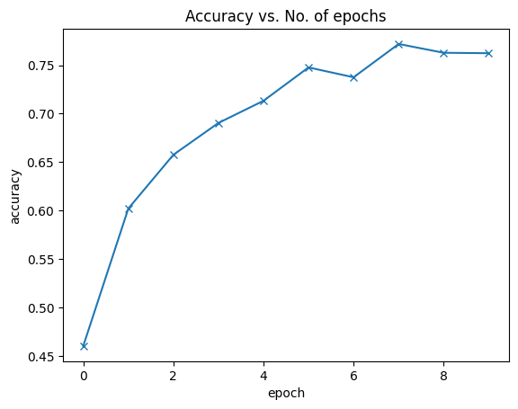
Results obtained
Maximum accuracy at 7 epochs

Slide 16
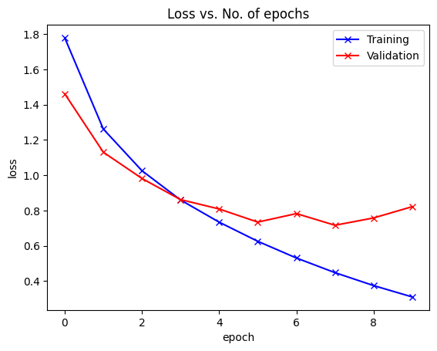
Results obtained

Slide 17
Challenges faced
Learning rate tuning is critical:
Too high → model diverges (loss increases)
Too low → model trains very slowly
Even though CIFAR-10 is small compared to ImageNet, training deep CNNs still requires:
Good GPU (else CPU training is very slow)
Long training time (many epochs needed for convergence)

Slide 18
Challenges faced
Choosing Right Model Complexity
If your model is too small, it won't have enough capacity to learn complex patterns → Underfitting.
If your model is too big, it will overfit easily → Overfitting.
Balancing depth and width (number of layers and neurons) is important!

Slide 19
Future improvement
Use More Advanced CNN Architectures
Problem: Our current model is simple and hand-built.
Improvement: Try deeper and modern architectures like:
ResNet (Residual Connections)
VGG-16 / VGG-19 (deeper layers with 3×3 convolutions)
DenseNet (feature reuse between layers)
Introduce Regularization Techniques
Problem: Large models easily overfit small data.
Improvement:
Add Dropout layers after fully connected layers.
Apply Weight Decay (L2 regularization).

