Slide 1
Advanced Programming
Fall 2021

Slide 2
Agenda
Programming paradigm
Introduction to Java
Java History
Java Characteristics

Slide 3
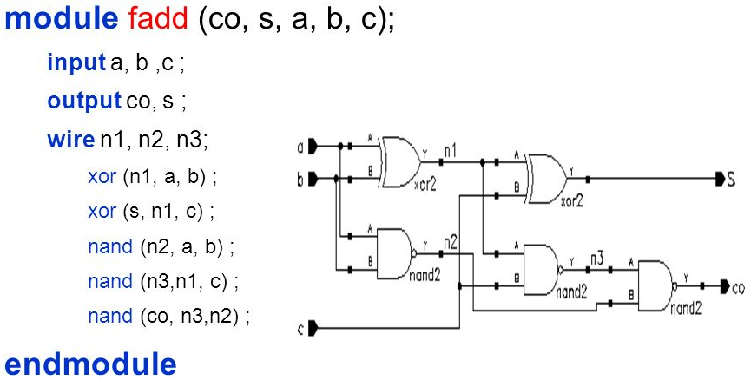
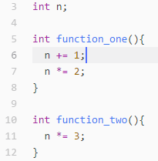
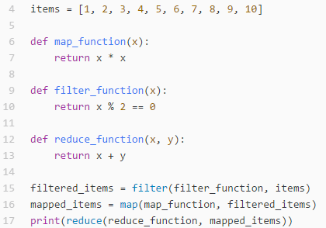
Programming paradigm
Imperative (C)
state the order in which operations occur
they allow side effects
Functional
disallows side effects
Declarative
do not state the order in which to execute operation

Slide 4
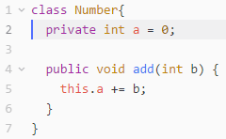
Programming paradigm
Object Oriented
code is organized into objects that contain state
States only modified by the code that is part of the object
Procedural
groups code into functions
Logic
largely based on formal logic

Slide 5
Java History
Java was created in 1991
by James Gosling in Sun Microsystems
Initially called Oak
in honor of the tree outside Gosling's window
Its name was changed to Java
because there was already a language called Oak.
Sun Microsystems released the first public implementation as Java 1.0 in 1995
Java syntax is similar to C and C++.

Slide 6
Java Motivation
The need for platform independent language
To be embedded in various consumer electronic products
like toasters and refrigerators
Platform independent?!
Hardware
Operating System

Slide 7
Java Motivation
At the same time, the World Wide Web and the Internet were gaining popularity.
Java could be used for internet programming.
Why?
Platform independence
Creation of Applets

Slide 8
The Java technology
A programming language
Java can create all kinds of applications
A development environment
A compiler (javac)
An interpreter (java)
A documentation generator (javadoc)
…
Compare it to C++

Slide 9
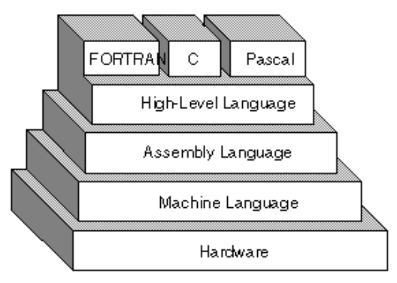
High-Level Languages

Slide 10
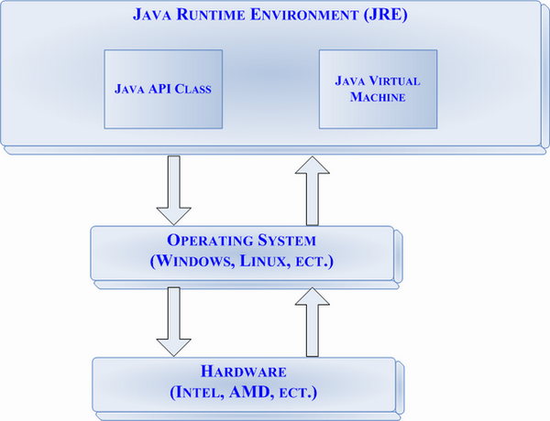
Java Virtual Machine

Slide 11
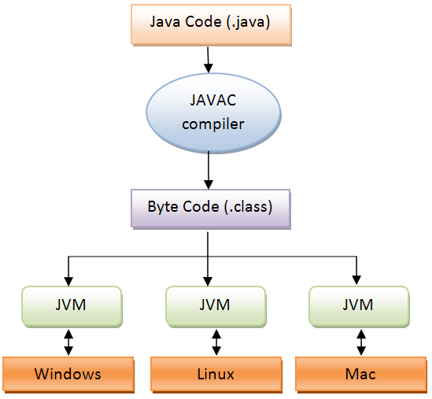
Compile and Execution Stages
Compare to C++ and Assembly
.NET Framework

Slide 12
Java is Popular
Some reports on programming languages popularity
According to
Job advertisements
Book sales
Finding code on the web
…

Slide 13
Characteristics of Java
Java is simple
Java is object-oriented
Java is architecture-neutral
Java is portable
Java is interpreted
Java is multithreaded
Java is secure
Java is robust

Slide 14
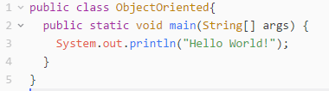
First Example
Create a file named First.java
Java class files have .java extension
Note to naming convention
Copy this lines to the file
Note: File name and class name should be the same.

Slide 15
Further Reading
Read Java page on Wikipedia
http://en.wikipedia.org/wiki/Java_(programming_language)
Google this terms and phrases:
Java
Java Mobile
JVM
Byte code
Java Sun
Java and C++
Java and C#

Slide 16
Assignment # 0
Download and install JDK
http://www.oracle.com/technetwork/java/javase/downloads/index.html
JDK 9
Write a program that prints your name on the console
Compile and run the program

Slide 17
Rules
Assignments
Project
Quizzes
TA Class
Midterm and Final Exam
Piazza

Slide 18
Topics
Introduction to java language
Java syntax, operators, conditions, loops, …
Strings
Arrays
Object Oriented Programming
Interface
Inheritance
Polymorphism
Software Quality
Refactoring
Test
Pattern
Advanced Java Programming
Exception Handling
Generics
Collections
Threads
Files and Streams
Networking
Reflection

Slide 19
References
Java How to Program (9th Edition)
Deitel & Deitel
Thinking in Java (Fourth Edition)
Bruce Eckel
Java cup

Slide 20

Any Question

