Slide 1
Advanced Programming
Fall 2020

Slide 2
Quiz
How a problem written in java run in computer?
Is a compiled java program runnable in other Operating systems?

Slide 3
Agenda
Review
First program in java
Variables
Methods
Conditions
Loops

Slide 4
Review
Java is
Simple
object oriented
Robust
And popular
Java is platform independent.
Write Once, Run Anywhere!

Slide 5
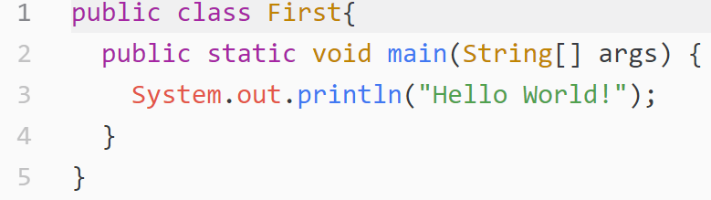
First Example
Create a file named First.java
Java class files have .java extension
Note to naming convention
Copy this lines to the file
Note: File name and class name should be the same.

Slide 6
First Example (2)
Run javac First.java
Run java First
We don’t use any IDE now.
To highlight compile and run stages.
Lets watch it in real world!

Slide 7
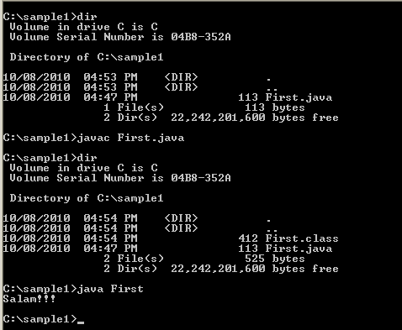
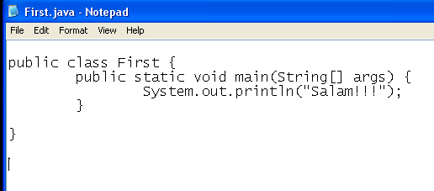
Overview of the Example
JAVACUP.ir
Contents redistribution is allowed if JAVACUP is noted as the source
7

Slide 8
Java Programs
A simple java program is a file
The file contains one class
The class name equal to the file name
The names are case sensitive
The class contains a main method
When we run the program, the main method is executed

Slide 9
Variables
What is a variable?
A piece of memory
Holds data
For example a number, string or Boolean
Java variables have a fixed size
Platform independence

Slide 10
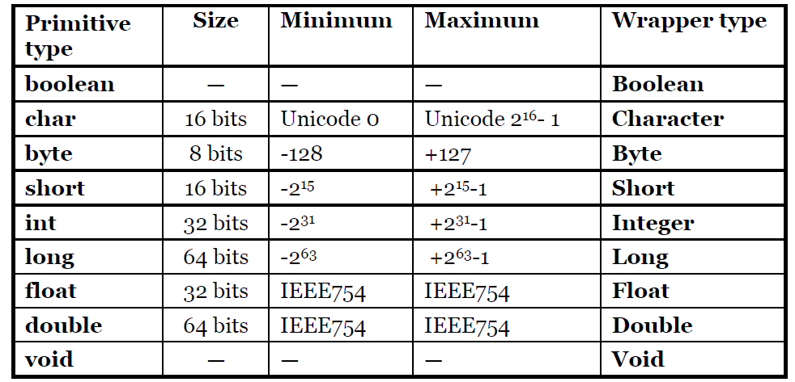
Java Primitive Types

Slide 11
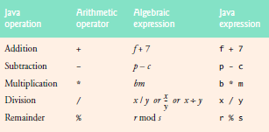
Arithmetic Operators

Slide 12
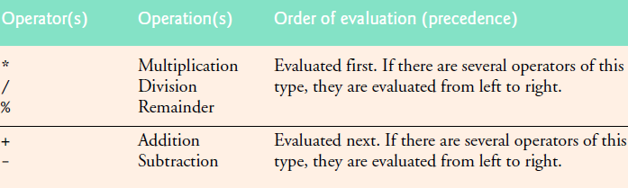
Operator Precedence
1 + 2 * 3 = ?
is treated as 1 + (2 * 3)

Slide 13
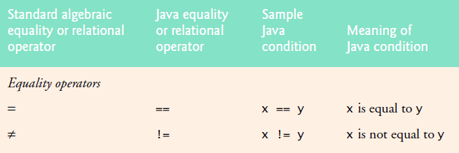
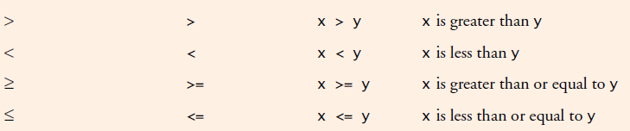
Equality and Relational Operators

Slide 14
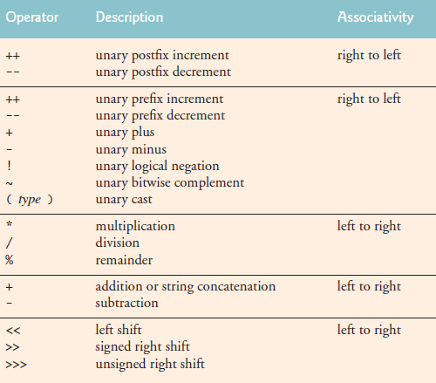
Operators

Slide 15
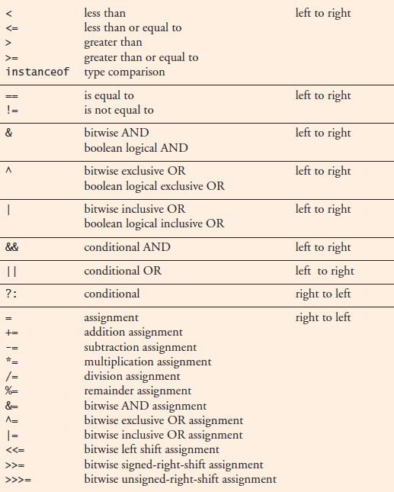
Operators

Slide 16
Associativity
When two operators with the same precendence the expression is evaluated according to its associativity.
x = y = z = 17
is treated as x = (y = (z = 17))
since the = operator has right-to-left associativty
72 / 2 / 3
is treated as (72 / 2) / 3
since the / operator has left-to-right associativity

Slide 17
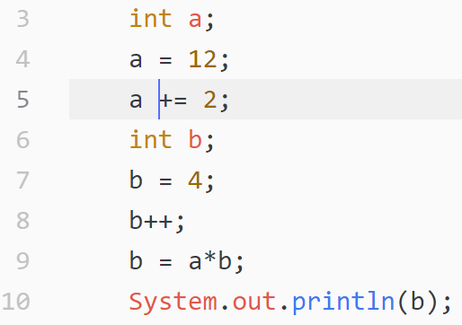
A simple program

Slide 18
Methods
A method is like a machine
Zero or more inputs
Zero or one output
Other names
Function
Procedure
method
Inputs
output

Slide 19
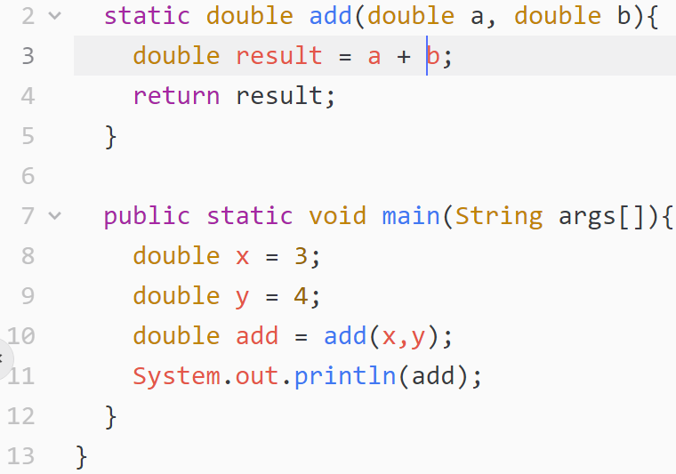
Example
Return type
Method name
Parameters

Slide 20
Parameter Passing
Local variables
Java passes the parameters by value

Slide 21
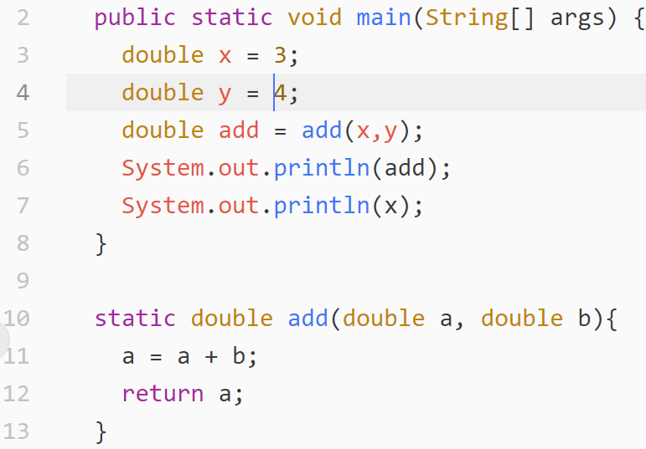
Call by Value

Slide 22
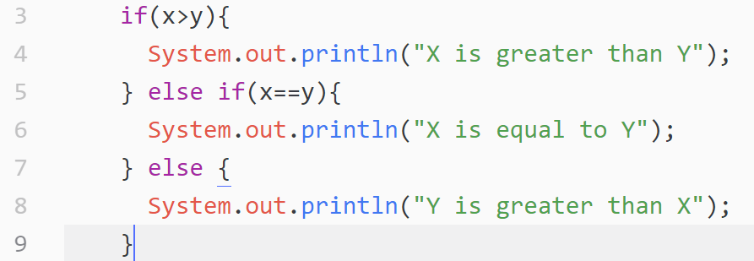
Conditions

Slide 23
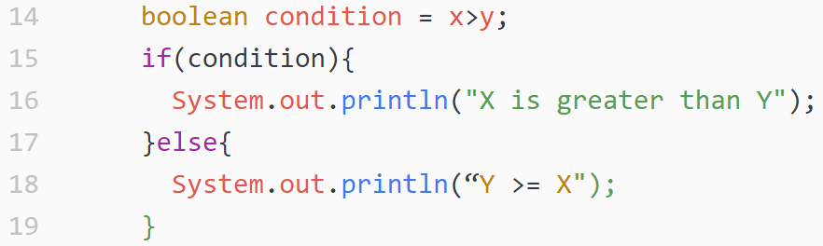
Conditions (2)

Slide 24
Loops
while
do-while
for

Slide 25
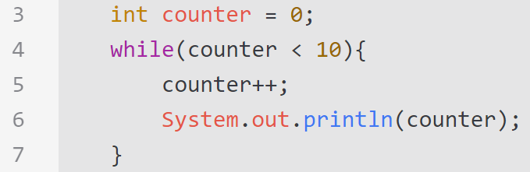
While Loop

Slide 26
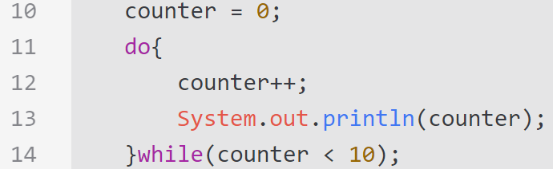
do-while Loop
do-while loop is executed at least one time

Slide 27
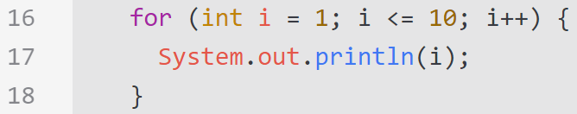
for

Slide 28
For Loop vs. While Loop
for (X; Y; Z) {
body();
}
X;
while(Y){
body();
Z;
}

Slide 29
For Loop vs. While Loop (2)

Slide 30
goto
goto is a reserved word in java
But forbidden!

Slide 31
References
Java How to Program (9th Edition)
Deitel & Deitel
Thinking in Java (Fourth Edition)
Bruce Eckel
Java cup

Slide 32

Any Question

