Slide 1
Advanced Programming
Fall 2020

Slide 2
Agenda
Review
User input
Scanner
Strong type checking
Other flow-control structures
switch
break & continue
Strings
Arrays
ArrayList, HashMap, LinkedList

Slide 3
Review
Variables
Primitive data types
Operators
Methods
Parameter passing
Call by value
Conditions
If, else, else if
Loops
while
do-while
for

Slide 4
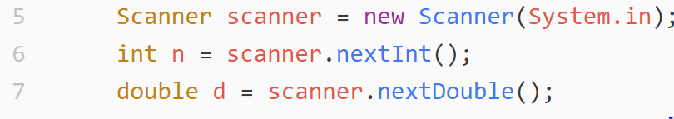
User Input
Print on console
System.out.println
How to read from console?
Scanner
Example:

Slide 5
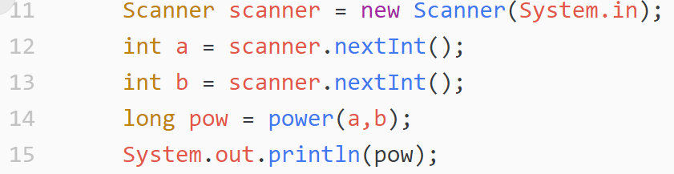
Example

Slide 6
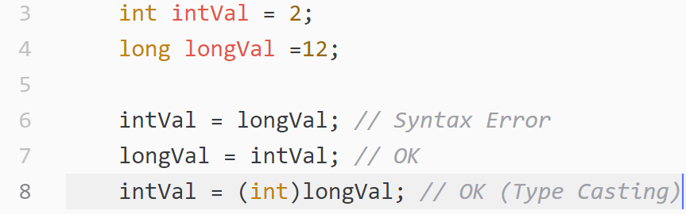
Type Checking
Java has a strong type-checking mechanism
Some assignment is not permitted

Slide 7
Direct Type Conversion
byte
char
The arrows are transitive
All other conversions need an explicit cast
boolean is not convertible
char is a special type
short
boolean
int
long
float
double

Slide 8
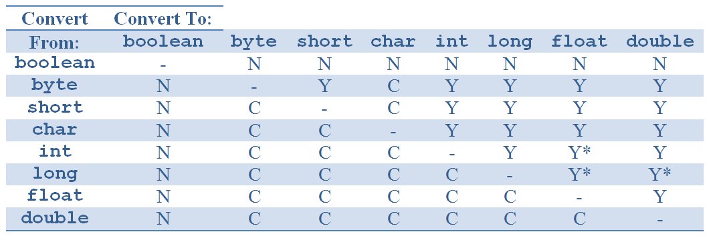
Type Conversion Grid

Slide 9
Type Conversion
N : the conversion cannot be performed
Y : the conversion is performed automatically and implicitly by Java
C : the conversion is a narrowing conversion and requires an explicit cast
Y* : the conversion is an automatic widening conversion, but that some of the least significant digits of the value may be lost by the conversion

Slide 10
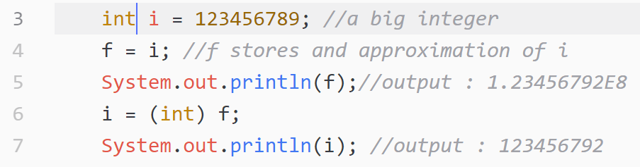
Example
floating-point types are approximations of numbers
They cannot always hold as many significant digits as the integer types

Slide 11
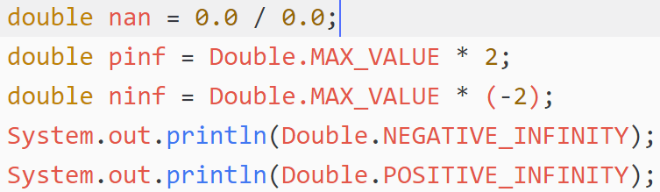
Floating Point, Some Notes
Double.NaN
Infinity
Negative infinity
Formatting a double

Slide 12
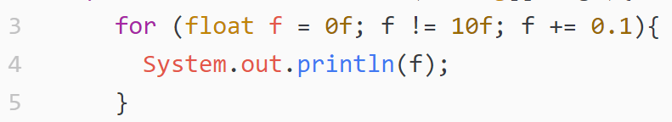
Comparison
Compare doubles
Using == with float or double is an anti-pattern
An infinite loop:

Slide 13
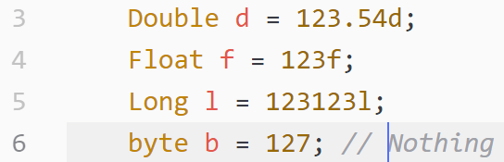
Numeric Assignments
Numeric Suffix
Assignment Overflow
Large long to int
Lower bits are used
No runtime error
Large double to integer
Brings a max int

Slide 14
Switch statement
An alternative to if-else
Better structure
Before Java 1.7
When the condition is a numeric or an ordinal variable
With Java 1.7
Strings are also allowed

Slide 15
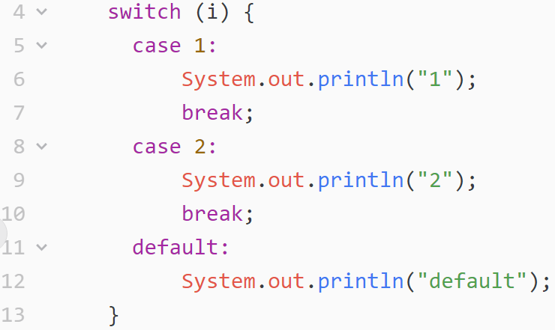
switch example

Slide 16
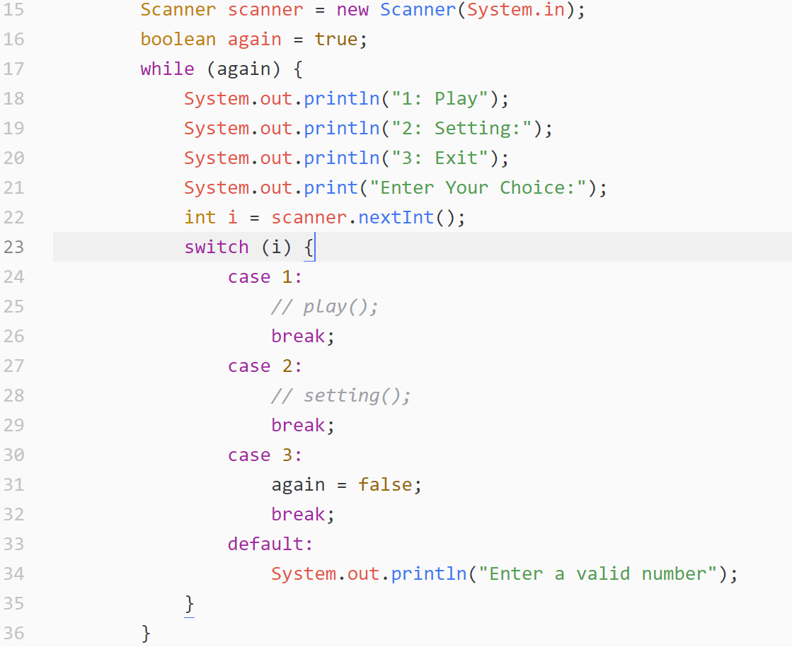

Slide 17
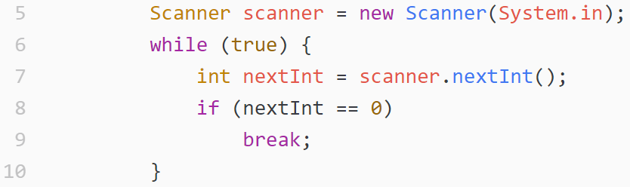
Break
Breaks the execution of a loop

Slide 18
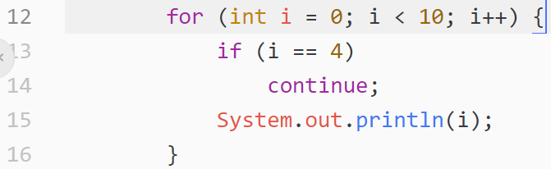
Continue
Stops the execution of the body of the loop and continues from the beginning of the loop
Difference between continue in for and while

Slide 19
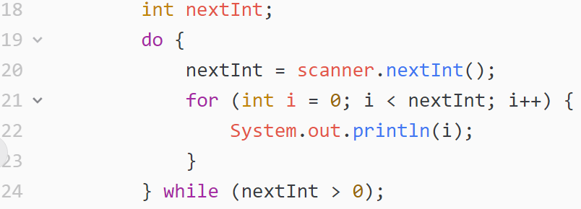
Nested Loops
How to break or continue from outer loop?

Slide 20
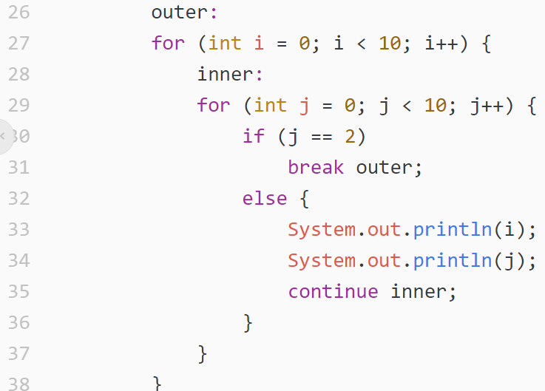
Label

Slide 21
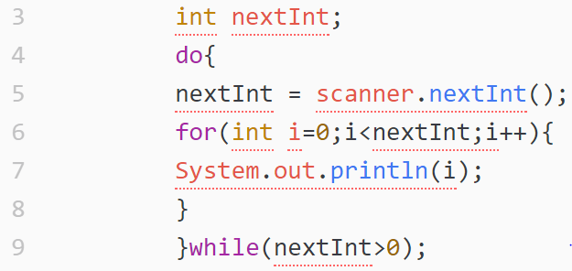
Tip of the Day: Indentation

Slide 22
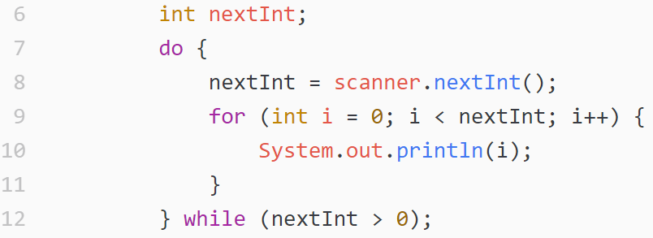
Tip of the Day: Indentation

Slide 23
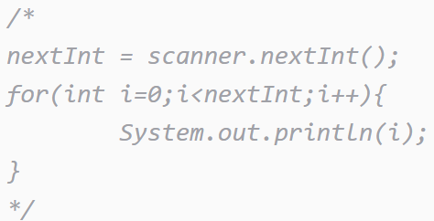
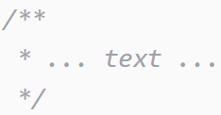
Comments
Comments are ignored by compiler
One-line comment
Multiple-line comment
Javadoc comments

Slide 24
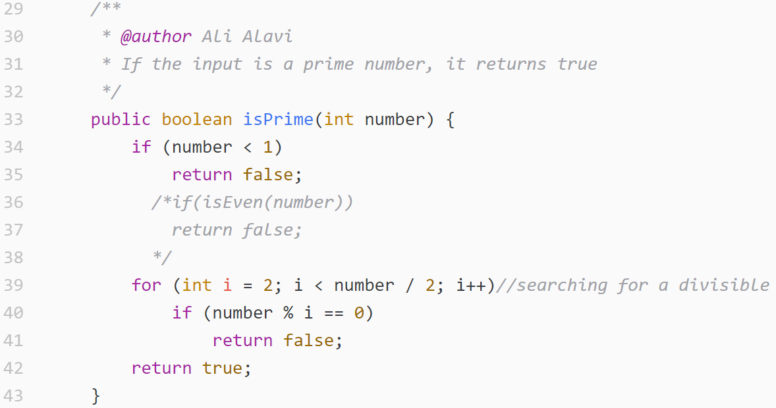
Comment Example

Slide 25
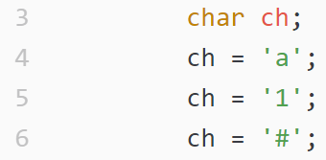
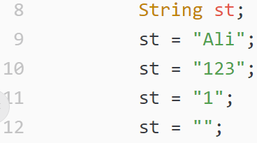
String
A sequence of characters
Character
Strings
String is not a primitive type

Slide 26
String
String in C and C++
char* and char[]
\0 at the end of String
Some functions
strlen, strcpy, …
String in java is String in java is a class
not equal to char[]
Constant strings
“salam!”
“Hellow World!”

Slide 27
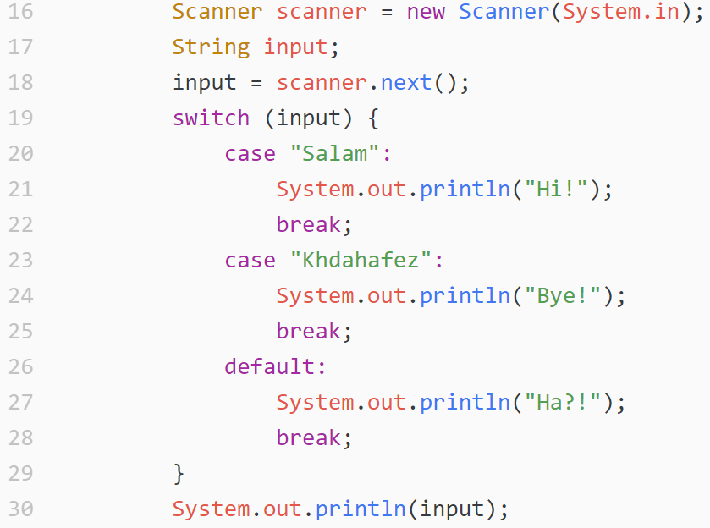
Example

Slide 28
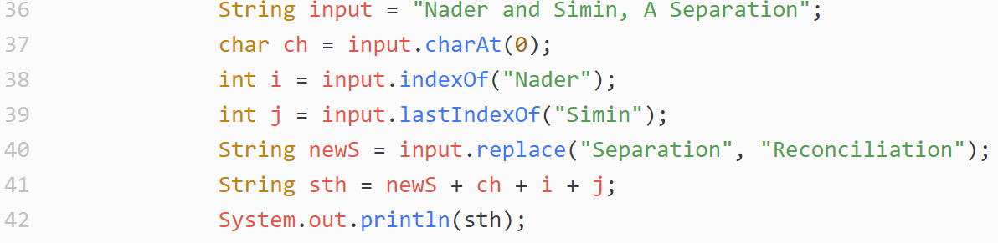
Example(2)

Slide 29
String methods
charAt
concat ➔ plus (+) operator
contains
startsWith
endsWith
indesxOf ➔ first index of sth
lastIndexOf
replace
substring
length
split

Slide 30
Regular Expression
Regular Expression or Regex
Regex is a way to describe a set of strings
Based on their common characteristics
Regex can be used to search, edit, or manipulate text
You must learn a specific syntax to create regex
http://docs.oracle.com/javase/8/docs/api/java/util/regex/Pattern.html

Slide 31
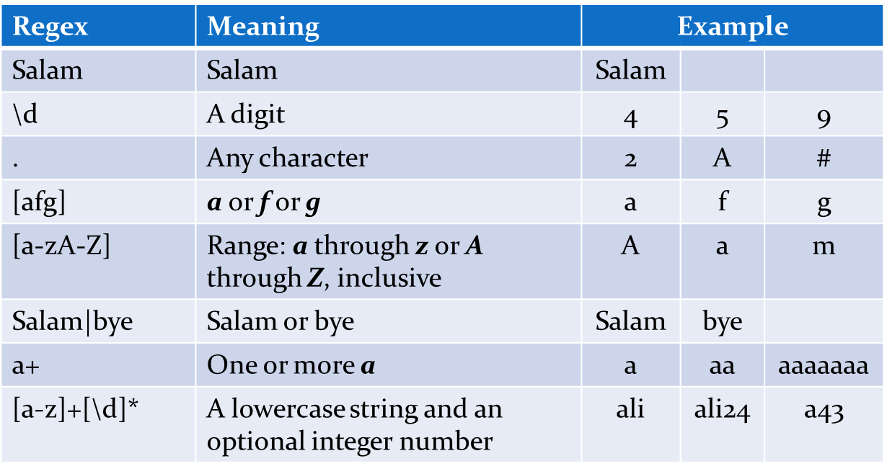
Regex Examples

Slide 32
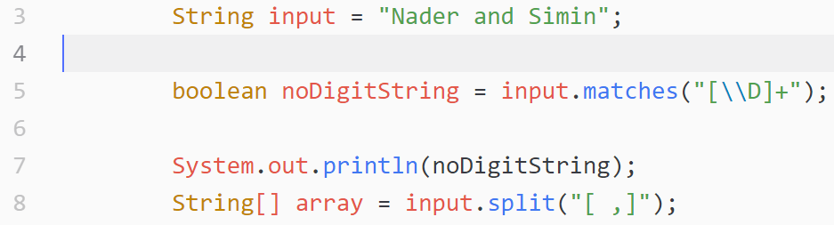
String and Regex

Slide 33
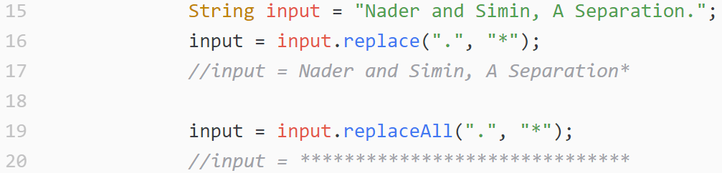
Regex Usage

Slide 34
Immutable String
String in java is an immutable class
After creating a string, you can not change it
If you want to change it, you should create a new string
There is no such methods for strings:
setCharAt(int)
setValue(String)
Methods like replace and replaceAll, do not change the value
They return a new String

Slide 35
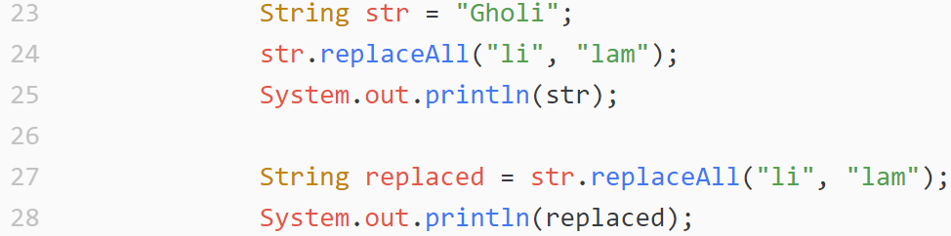
Example
What is the output of this code?

Slide 36
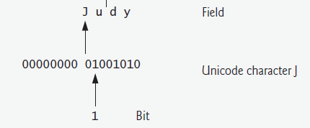
Data Hierarchy
Bit
Byte
Character
Word

Slide 37
Java Characters
A Java character has two bytes
Java supports Unicode character set standard
ASCII
Java uses UTF-16 encoding
Other unicode encodings:
UTF-8
UTF-16
Other non-unicode encodings
Windows-1256

Slide 38
Java Special Characters
Some characters are special characters
Special characters are shown using backslash
Examples:
New line: \n
Tab : \t
Double-quote : \”
Single-quote : \’
Backslash : \\

Slide 39
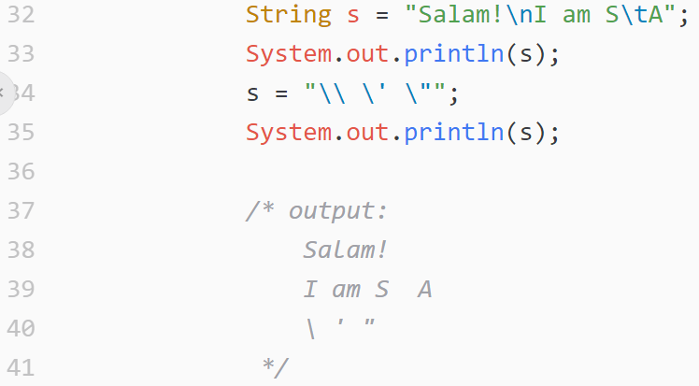
Java Special Characters

Slide 40
Array
Collections of related data items
related data items of the same type
Arrays are fixed-length entities
they remain the same length once they are created
An array is a group of variables
called elements
containing values that all have the same type
The position number of the element is it’s index
Array elements are sequentially located in memory

Slide 41
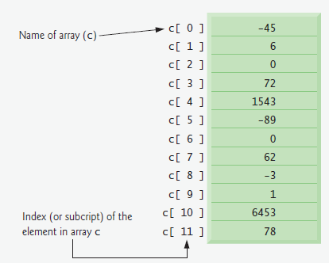
Array

Slide 42
Samples
Create an array of 10 integer elements
int[] array = new int[10];
int array[] = new int[10];//equal
Create an array of n characters
char[] characters = new char[n];
Change value of 5’th element
array[5] = 12;
Retrieving value of n’th element
char ch = array[n];

Slide 43
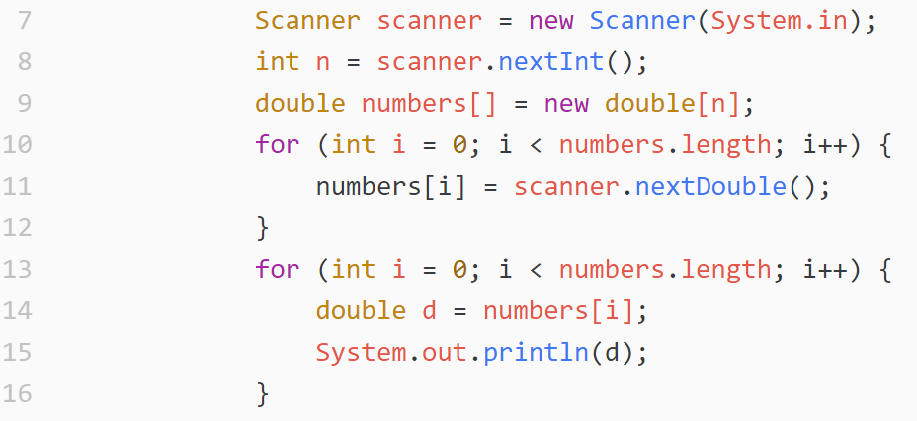
Example

Slide 44
Array Creation Shortcut
char[] array = new char[3];
array[0] = 'a';
array[1] = 's';
array[2] = 't';
The above code can be rewritten as:
char[] array = {'a','s','t'};
Other examples:
int[] numbers = {1,2,3,5,9,123};
boolean[] b = {true, true, false, true};

Slide 45
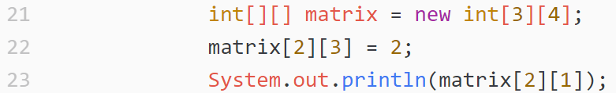
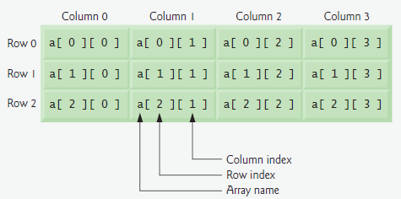
Multidimensional Arrays

Slide 46
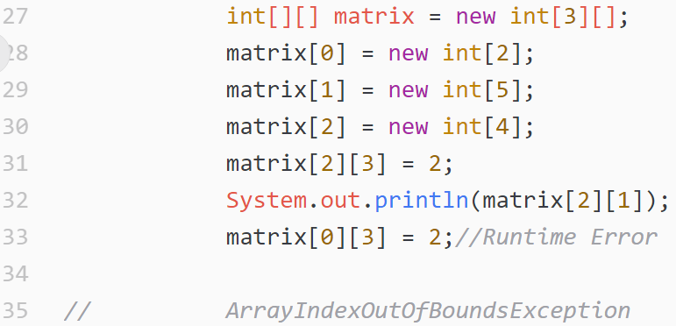
Unbalanced Multidimensional Array

Slide 47
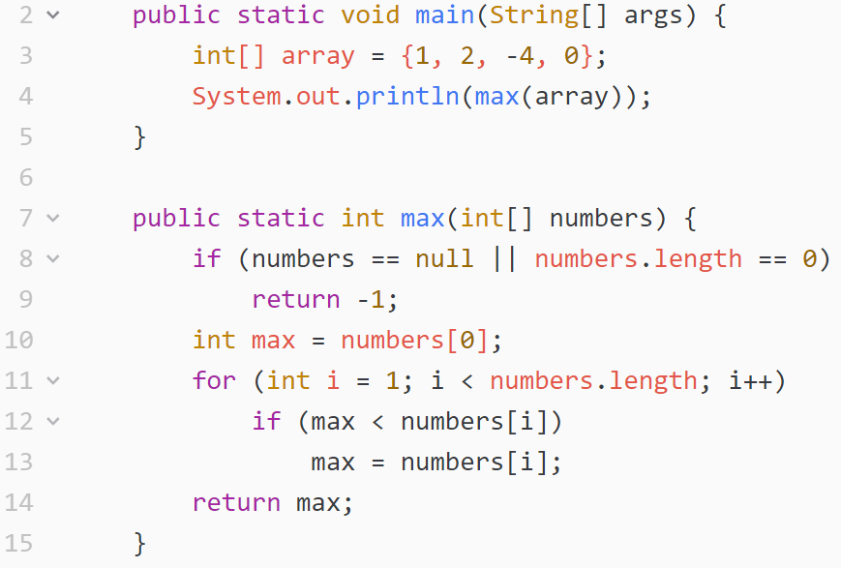
Passing Arrays to Methods

Slide 48
Multi-Dimensional Array Parameters
int determinant(int[][] matrix){…}
int [][] matrix = { {1,2}, {3,4}} ;
int de = determinant(matrix);
void check(int[][] array){…}
int [][] unbalanced = { {1,2}, {3,4,5,6,7,8}};
check(unbalanced);
boolean f(double[][][] cube){…}

Slide 49
Call by Element Values?
No
If the method has an array parameter
Array elements are not copied on method invocations
A reference to the array is passed to the method
More about this topic ➔ later

Slide 50
Exercises
Write a method for sorting an array of integers
Write a method that compares two arrays
returns true if elements of the arrays are equal
returns false , otherwise
Write a method that returns determinant of a matrix
Matrix is a two-dimensional array as the method parameter

Slide 51
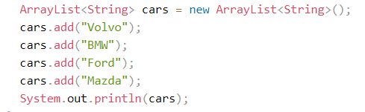
ArrayList

Slide 52
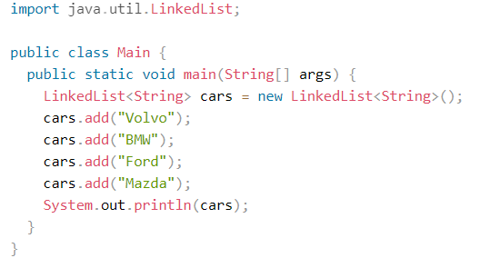
LinkedList

Slide 53
ArrrayList vs LinkedList
It is best to use an ArrayList when:
You want to access random items frequently
You only need to add or remove elements at the end of the list
It is best to use a LinkedList when:
You only use the list by looping through it instead of accessing random items
You frequently need to add and remove items from the beginning, middle or end of thelist

Slide 54
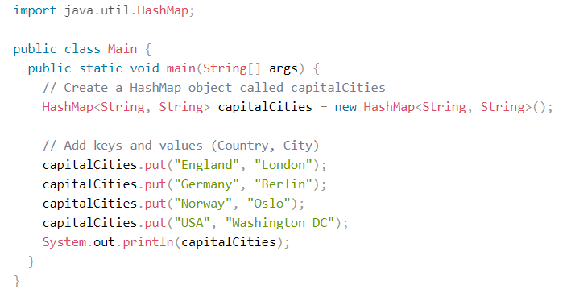
HashMap

Slide 55
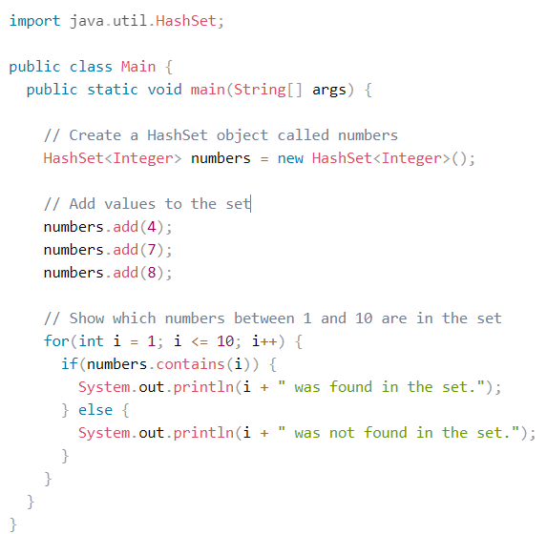
HashSet

Slide 56
References
Java How to Program (9th Edition)
Deitel & Deitel
Thinking in Java (Fourth Edition)
Bruce Eckel
Java cup

Slide 57

Any Question

