Slide 1
Advanced Programming
Fall 2020

Slide 2
Agenda
Package
Package access
Static
this
Method overloading
toString
equals

Slide 3
Access Specifiers

Slide 4
Access Specifiers
public
Interface access
private
Don’t touch!

Slide 5
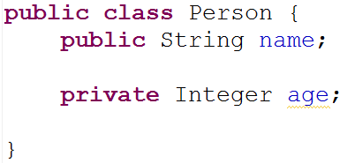
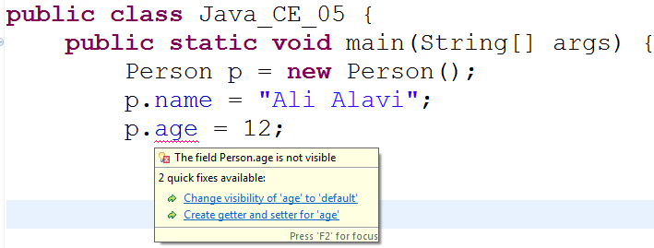
Example

Slide 6
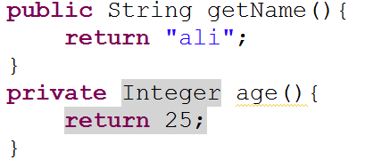
Example

Slide 7
Public classes
You can declare a class which is not public
The class is visible within the file
There can be only one public class per file
The name of the public class must exactly match the name of the file
including capitalization
It is possible to have a java file with no public class
Is not typical

Slide 8
Object Access or Class Access
Access specifiers are declared for classes
Not for objects
When a member is declared as private
It is not visible in methods outside this class
It is visible by other objects of the same class

Slide 9
public class Access {
private String name;
public Access(String name) {
this.name = name;
}
public void check(Access access){
access.name = name;
}
public static void main(String[] args) {
Access a = new Access("Ali");
Access b = new Access("Taghi");
a.check(b);
System.out.println(a.name);
System.out.println(b.name);
}
}
a can touch private property (name) of b
Because a and b has the same class
name is not private for b
name is private for Access

Slide 10
Package
A package contains a group of classes
Organized together under a single namespace
Packages organize classes belonging to the same category or providing similar functionality

Slide 11
Package
A package provides a unique namespace for the types it contains
Classes in one package has the same folder
Packages may contain other packages
Hierarchy of packages

Slide 12
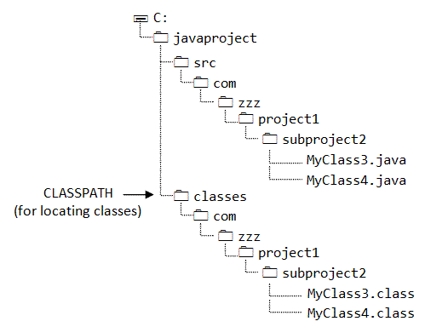
Packages and Folders

Slide 13
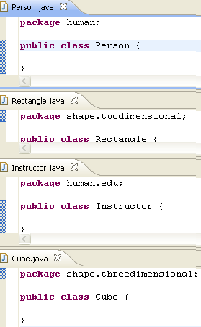
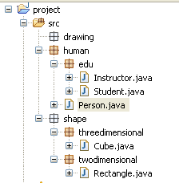
Packages and Folders

Slide 14
Some famous java packages
java.util
java.lang
java.io

Slide 15
Package Access
Remember public and private access specifiers
The default access has no keyword
It is commonly referred to as package access
friendly
Other classes in the current package have access to that member
To classes outside of this package, the member appears to be private

Slide 16
Java Packages
import keyword
Class Qualified Name = package-name + class-name
For example
java .lang.String
java.lang.Math
double sqrt = Math.sqrt(123);
java.util.Scanner
java.awt.Event
org.w3c.dom.events.Event

Slide 17
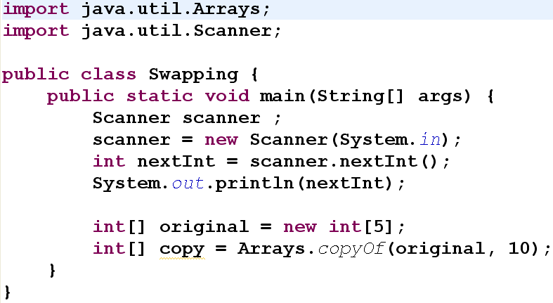
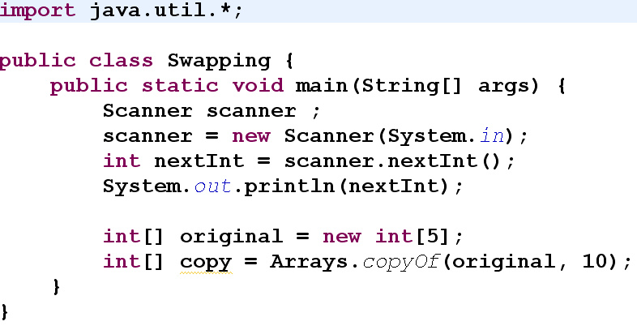
Using packages

Slide 18
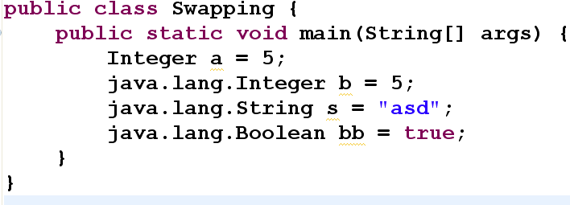
java.lang
java.lang is implicitly imported

Slide 19
No import in Byte Code
Unused imports have a trivial impact on the compiler
But there are no imports in the byte code or at runtime
Unused import have no impact in runtime
But it is better to remove them
Organize Imports

Slide 20
Static Members and this

Slide 21
Writing eBay for Cars
class Peykan{...}
public class Pride {
int color;
int price;
boolean isHatchBack;
int designYear;
int length, width;
}
Properties of objects
Properties of class

Slide 22
Static
When you create a class
You describe how objects of that class look
And how they will behave
You don’t actually get an object until you create one
using new
At that point storage is allocated and methods become available.

Slide 23
Static (2)
There are two situations in which this approach is not sufficient.
Class data or static property
Class method or static method

Slide 24
Class Data
You want to have only a single piece of storage for a particular field
regardless of how many objects of that class are created
or even if no objects are created
Example:
Pride.designYear
Person.?
Class data = static properties

Slide 25
Class Methods
if you need a method that isn’t associated with any particular object of this class.
You need a method that you can call even if no objects are created
Class methods = static methods

Slide 26
Static properties
static properties are shared among all the objects
static properties are properties of classes
Not objects
Example:
Integer.MAX_VALUE
Player.NumberOfObjects

Slide 27
Static methods
Static methods can access only static properties
Static methods are actually class operations
If a method uses only static fields, make it static!
Static methods are accessible via classes
double d = Double.parseDouble("12");
String s = String.valueOf(12);
public static void main(String[] args)
Static properties and methods are invoked on class name
Are not invoked on objects

Slide 28
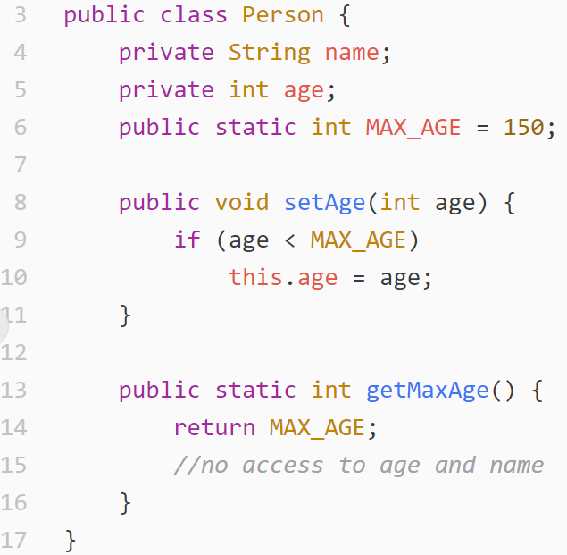
Sample

Slide 29
Static Initialization
Static properties are class data, not object data
Constructors are created for initializing object data
How to initialize class data?
Two ways:
Inline values
Static block
Static initialization is done when Class Loader loads the class

Slide 30
Inline initialization
public static int MAX_AGE = 150;
private static double PI = 3.14;
static String defaultName= theDefaultName();
private static String theDefaultName() {
return "Ali Alavi";
}

Slide 31
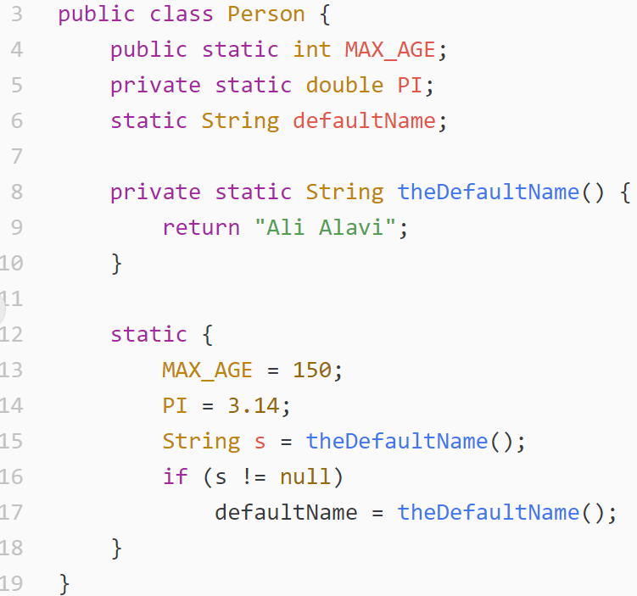
Static Block

Slide 32
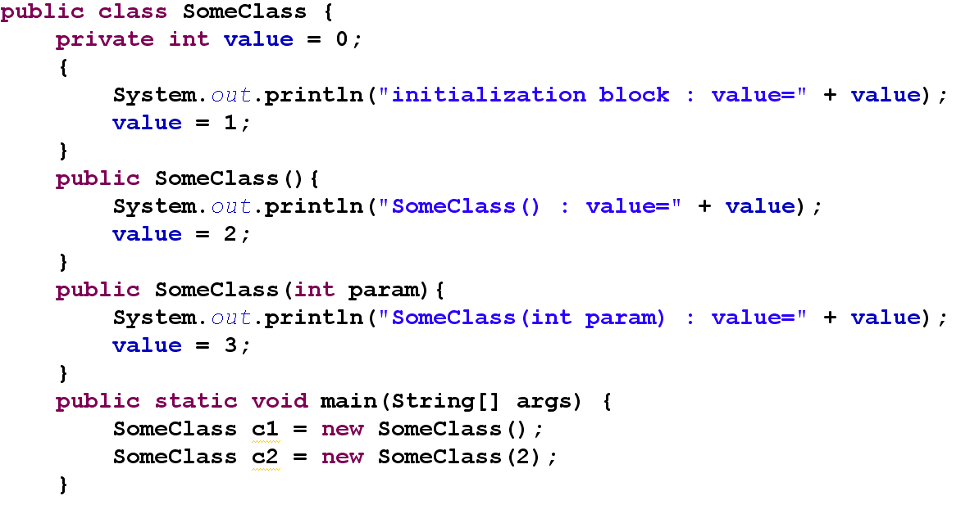
Initialization Block

Slide 33
Order of initialization
Once per class
Static variable declaration
Static block
Once per object
variable declaration
Initialization block
Constructor

Slide 34
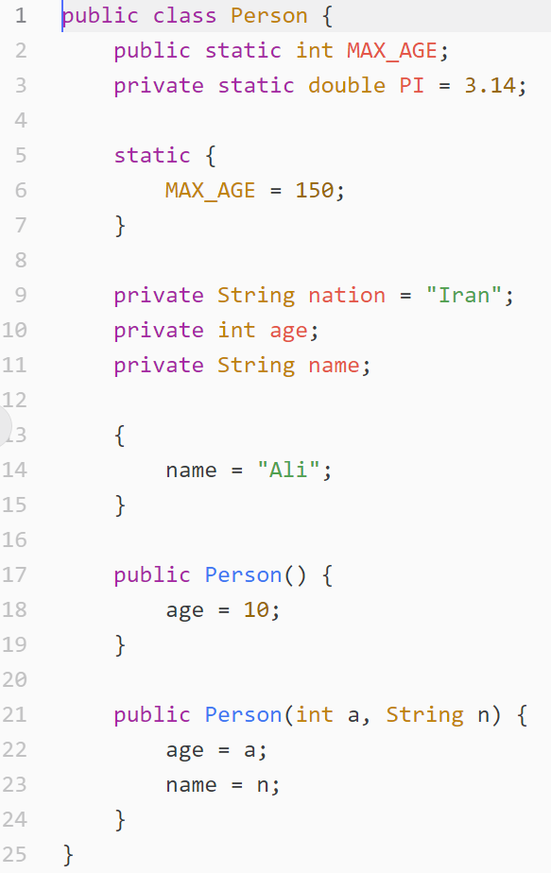
1
Static variables
2
3
6
Object variables
public static void main(String[] args) {
Person p1 =new Person();
Person p2 =new Person(20, "Taghi");
}
7
4
5
8

Slide 35
this

Slide 36
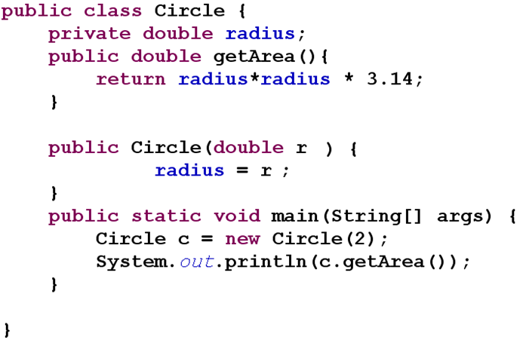
Method-property access
How does getArea() know where radius is?

Slide 37
Compiler solution
A reference to the object is implicitly passed to methods
circle.getArea()
is converted (by compiler) to something like:
Circle.getArea(circle)
What if you want to access this circle object?
Use this keyword
this is available within non-static methods

Slide 38
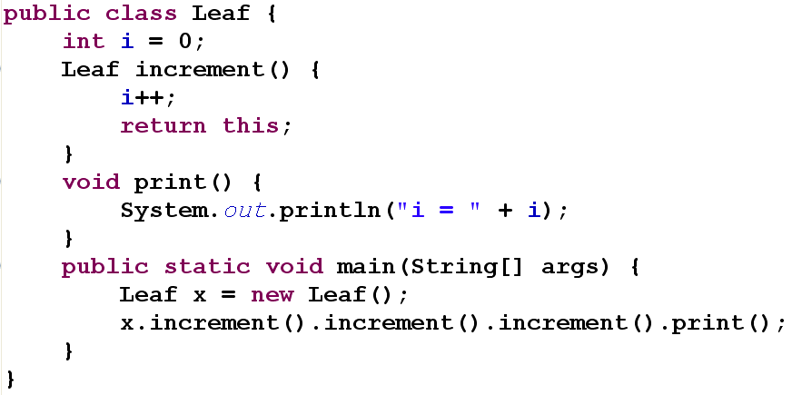
Sample Application of this

Slide 39
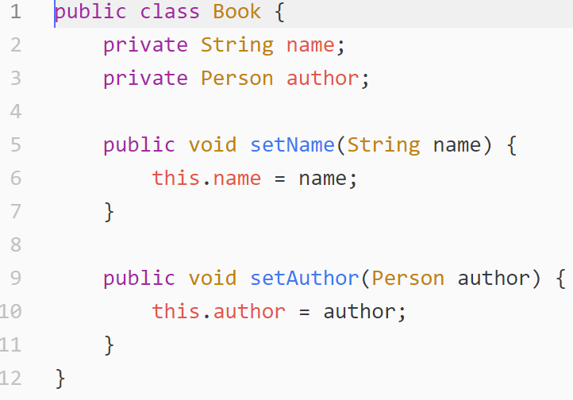
Sample Application of this (2)

Slide 40
Static and this
What are static methods?
Methods without implicit this
Static methods are bound to classes, not objects

Slide 41
Overloading

Slide 42
Method Overloading
Methods with the same name in the same class
With different parameters
Different Signatures

Slide 43
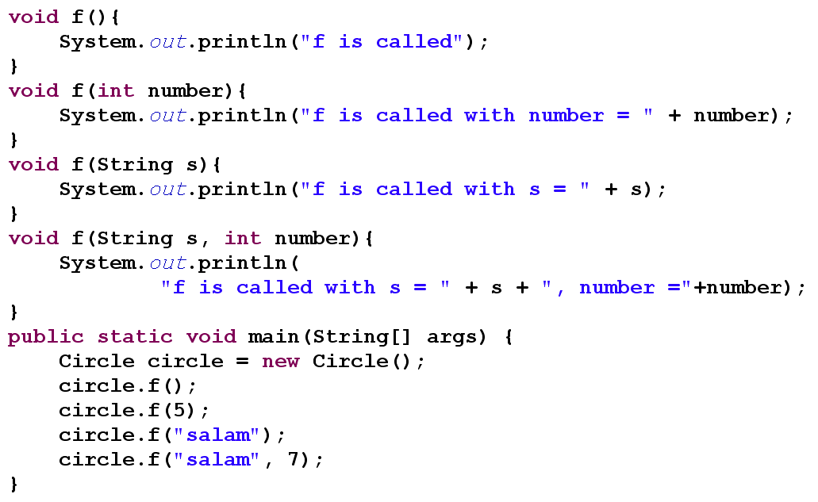

Slide 44
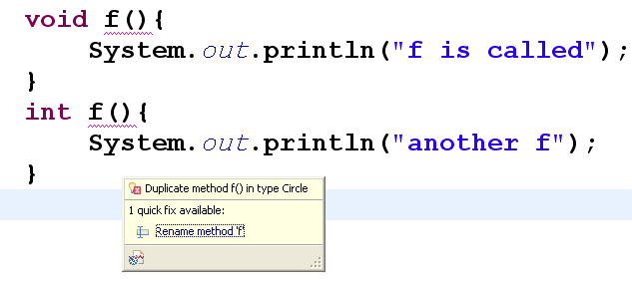
No Return type method overloading
Why this is not permitted?

Slide 45
But this one is OK
int f(){
…
return 0;
}
void f(int a){
…
}

Slide 46
Type Operations

Slide 47
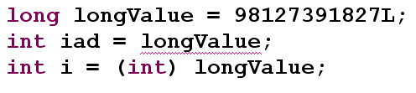
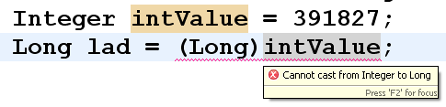
Type Casting
You can change the type by type casting
Casting in reference types and other objects is not so simple
See it later

Slide 48
Type Conversion
Sometimes we want to convert an object to another type
Type casting is not the solution here
We should write some methods to convert the types

Slide 49
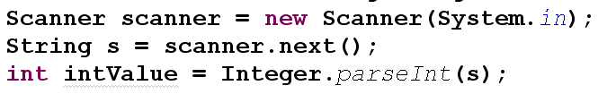

Type Conversion (2)

Slide 50
toString
toString() is a special method
You can write it for every class

Slide 51
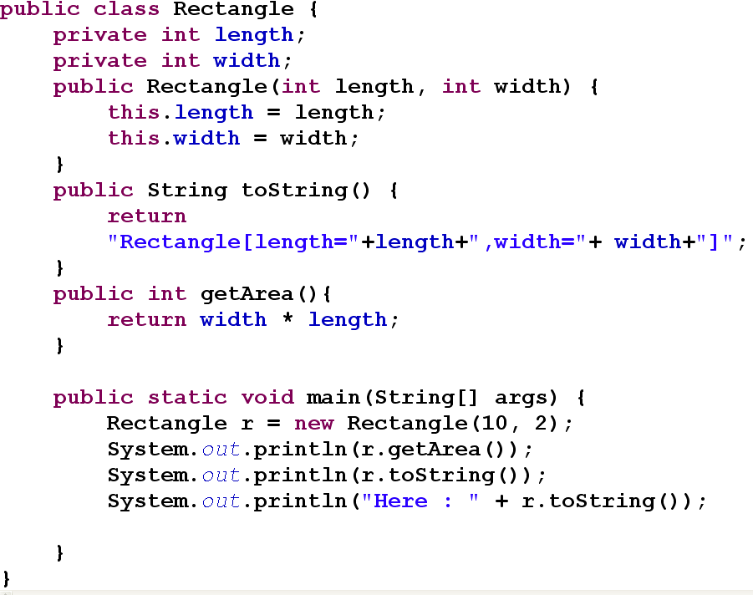

Slide 52
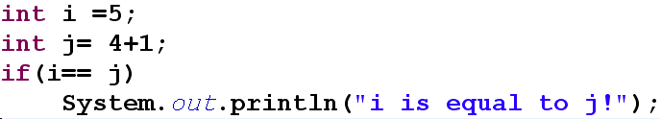
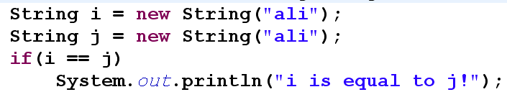
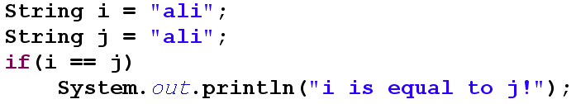
Checking equality in java

Slide 53
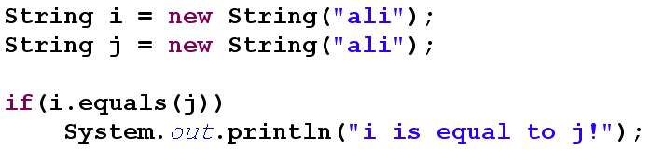
equals method

Slide 54
Creating Your Own Equals()
Person p1 = new Person("1290786547", "Ali Alavi");
Person p2 = new Person("1290786547", "Taghi Taghavi");
Person p3 = new Person("0578905672", "Taghi Taghavi");
System.out.println(p1.equals(p2));
System.out.println(p2.equals(p3));
public class Person {
private String nationalID;
private String name;
private String email;
private int age;
public boolean equals(Person other) {
return nationalID.equals(other.nationalID);
}
}

Slide 55
Creating Your Own Equals()
In fact, equals() is more complicated
The parameter should be an Object
Person as the parameter was incorrect
More checks are required
IDE Support for writing equals
Use your IDE for
getters, setters, constructors, …

Slide 56
public boolean equals(Object obj) {
if (this == obj)
return true;
if (obj == null)
return false;
if (getClass() != obj.getClass())
return false;
Person other = (Person) obj;
if (nationalID == null) {
if (other.nationalID != null)
return false;
} else if (!nationalID.equals(other.nationalID))
return false;
return true;
}

Slide 57
References
Java How to Program (9th Edition)
Deitel & Deitel
Thinking in Java (Fourth Edition)
Bruce Eckel
Java cup

Slide 58

Any Question

