Slide 1
Advanced Programming
Fall 2017

Slide 2
Agenda
Inheritance
Class Hierarchies
is-a relationship
UML Class Diagram
protected members
Abstract Methods
super keyword
Initialization in inheritance

Slide 3
Introduction to Inheritance

Slide 4
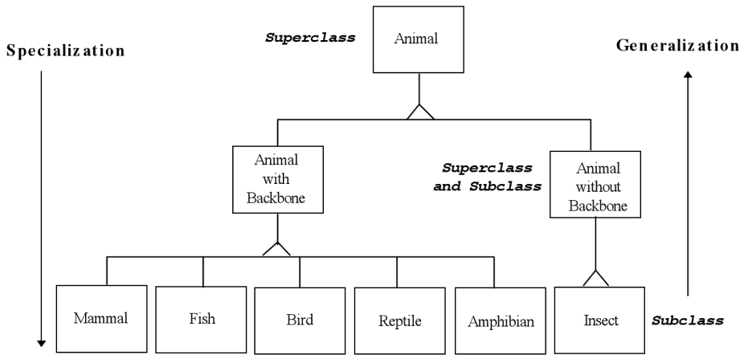
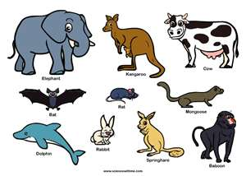


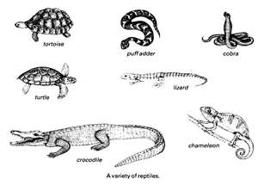
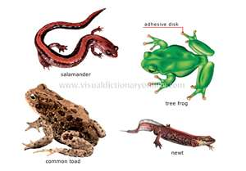
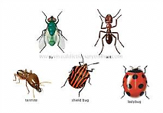
Class Hierarchies

Slide 5
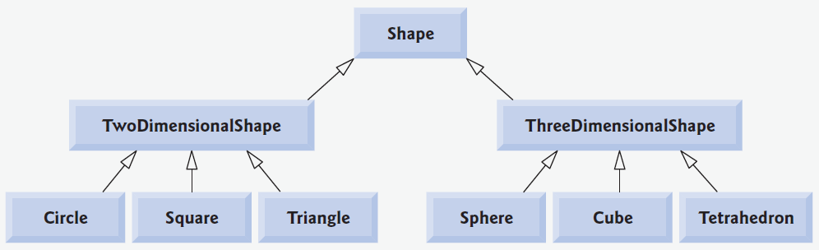
Class Hierarchies (2)

Slide 6
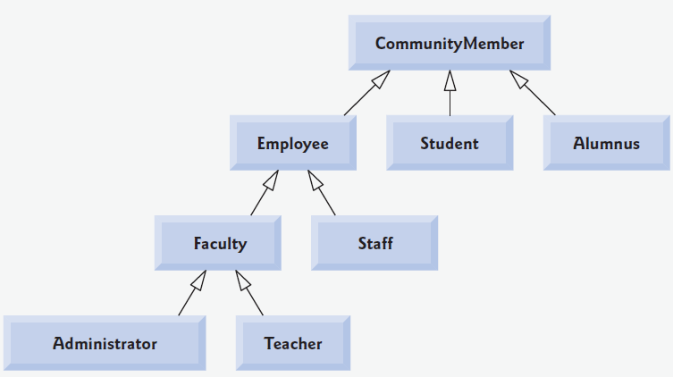
Class Hierarchies (3)

Slide 7
General and Specific Types
Faculty and Employee are both classes
Faculty is a more specific type of Employee
Employee is a more general type of Faculty
A Faculty instance is also a Employee instance
Dr. Felani is a faculty member
He is also an employee of university

Slide 8
is-a Relationship
More general class : Superclass
More specific class : Subclass
Subclass is inherited from superclass
Faculty is inherited from Employee
Rectangle is inherited from Shape
A rectangle is also a shape
Cat is inherited from Animal
Maloos is a cat, she is also an animal

Slide 9
Inheritance (2)
Name some other hierarchies…
Note: More specific type is also a class
Not an object
Ali Karimi is not a more specific type of FootballPlayer
He is an object
Not a class

Slide 10
Class Implementation
How do you implement Employee class?
How do you implement Faculty class?

Slide 11
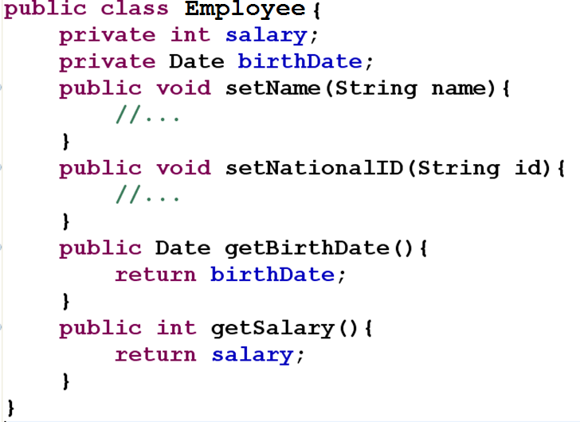

Slide 12
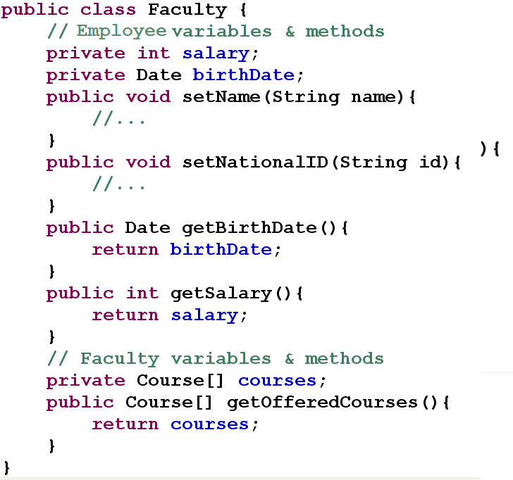

Slide 13
Inheritance in OOP
Java offers inheritance
like any object oriented programming language
Inheritance is used for implementing more specific classes
Duplicate code is eliminated
Inheritance provides code reuse
is-a relationship

Slide 14
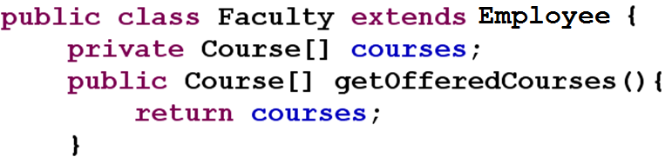
Faculty & Employee
Faculty is inherited from Employee
Faculty extends Employee
Attributes and behaviors of Employee is inherited to Faculty
Inheritance provides code reuse

Slide 15
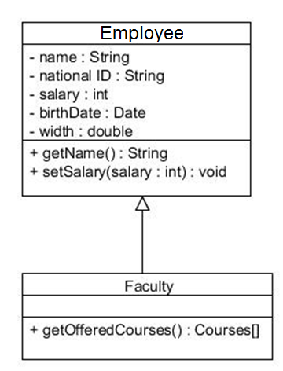
UML Class Diagram

Slide 16
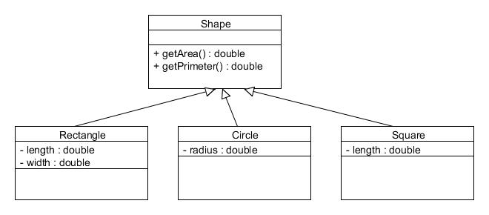
UML Class Diagram

Slide 17
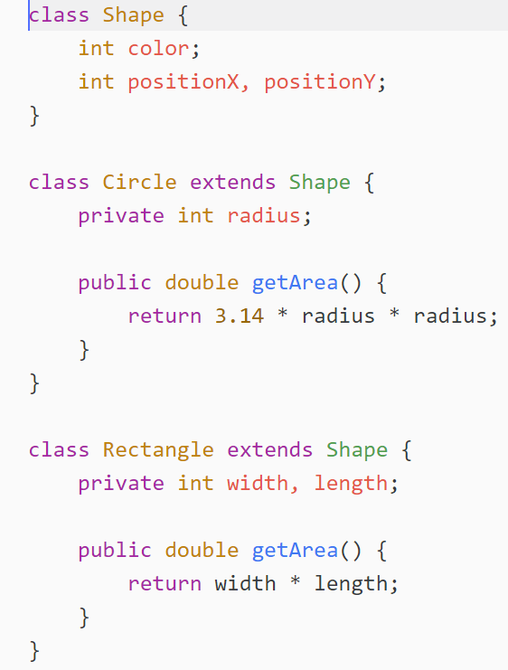

Slide 18
Terminology
Class Rectangle is inherited from class Shape
Rectangle is a subclass of Shape
Rectangle is a child of Shape
Rectangle is a derived class of Shape
Shape is the super-class of Rectangle
Shape is the parent of Rectangle
Shape is the base-class of Rectangle
Rectangle is-a Shape

Slide 19
Inheritance in java
Every class is inherited from class Object
Primitive-types are not objects
Object class has some operations
equals()
toString()
…
Every class adds some operations
And may changes some operations
toString()

Slide 20
Inheritance
Software reusability
Create new class from existing class
Absorb existing class’s data and behaviors
Enhance with new capabilities
Subclass extends superclass.
Subclass:
More specialized group of objects
Behaviors inherited from superclass
Or changed and customized
Additional behaviors

Slide 21
Class Hierarchy
Direct superclass
Inherited explicitly (one level up hierarchy)
Indirect superclass
Inherited two or more levels up hierarchy
Single inheritance
Inherits from one superclass
Multiple inheritance
Inherits from multiple superclasses
Java does not support multiple inheritance

Slide 22
is-a relationship
Object of subclass “is a” object of super-class
Example: Rectangle is quadrilateral.
Class Rectangle inherits from class Quadrilateral
Quadrilateral: superclass
Rectangle: subclass
Superclass typically represents larger set of objects than subclasses
superclass: Vehicle
subclass: Car
Smaller, more-specific subset of vehicles

Slide 23
More Examples

Slide 24
Subclasses may…
Add new functionality
New members
Use inherited functionality
Software reuse
Override inherited functionality
Change parent methods

Slide 25
Software reuse
Software reuse is at the heart of inheritance
Using existing software components to create new ones
Capitalize on all the effort that went into the
design,
implementation,
and testing of the existing software

Slide 26
Bad smell
Avoid Copy & Paste!
Avoid Copy & Paste!
Avoid Copy & Paste!
Avoid Copy & Paste!
Avoid Copy & Paste!
Avoid Copy & Paste!
Avoid Copy & Paste!
Please, Avoid Copy & Paste!

Slide 27
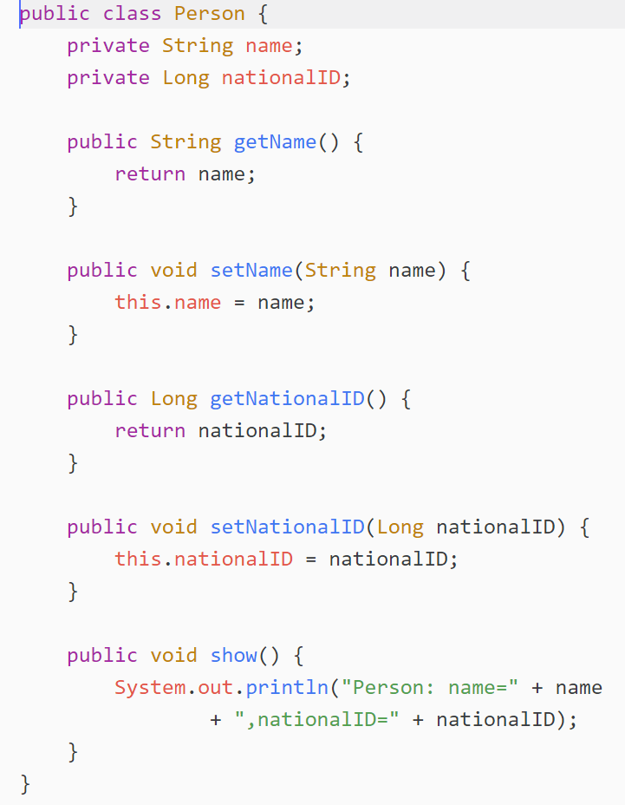

Slide 28
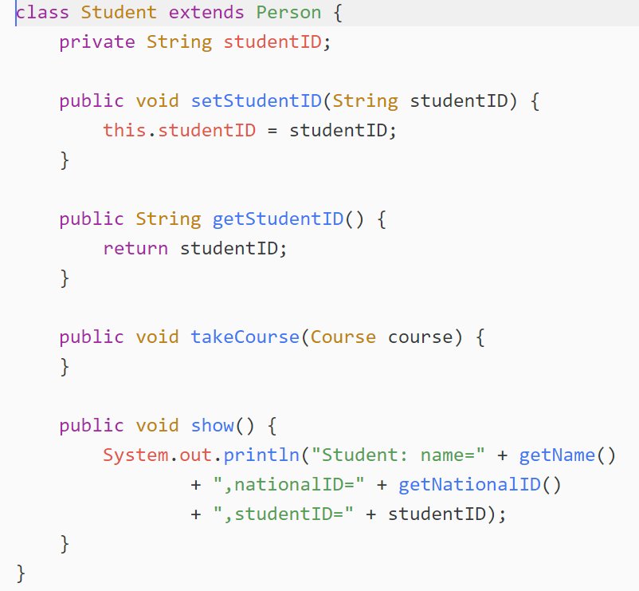
New properties
New methods (more behavior)
Use parent methods (Software Reuse)
Change parent methods (Override)

Slide 29
Person p1 = new Person();
p1.setName("Ali Alavi");
p1.setNationalID(1498670972L);
p1.show();
Student st = new Student();
st.setName("Ali Alavi");
st.setNationalID(1498670972L);
st.setStudentID("89072456");
st.show();
Defined in Parent
Added in Child
Changed in Child

Slide 30
More About Inheritance

Slide 31
Abstract Behaviors
Does any animal swim?
No. So “to swim” is not a behavior of animals.
Any animal has a voice
“to talk” is a behavior of animals
But what is the voice of an animal?
How does an animal “talk”?
It depends to the specific type of animal
Dog: Hop! Hop!
Cat: Mewww!

Slide 32
Abstract Behaviors (2)
“talk” is an abstract behavior of Animal
All animals can “talk”
But we can not specify how an animal talks
It depends to the specific class of animal
“talk” is a concrete behavior of Dog
Hop! Hop!
“swim” is not a behavior of Animal
All animals can not swim
“swim” is a concrete behavior of Fish

Slide 33
Remember Shape Classes

Slide 34
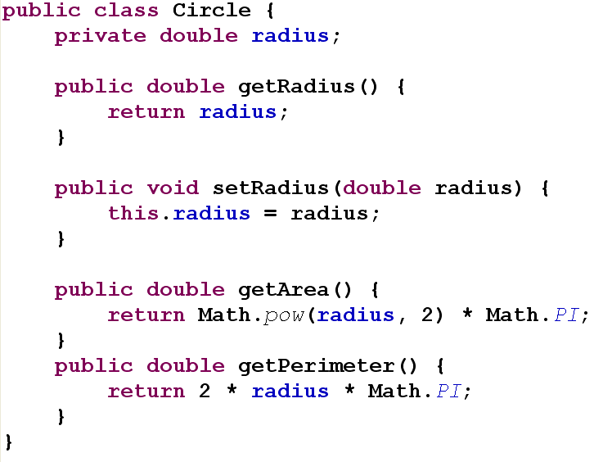

Slide 35
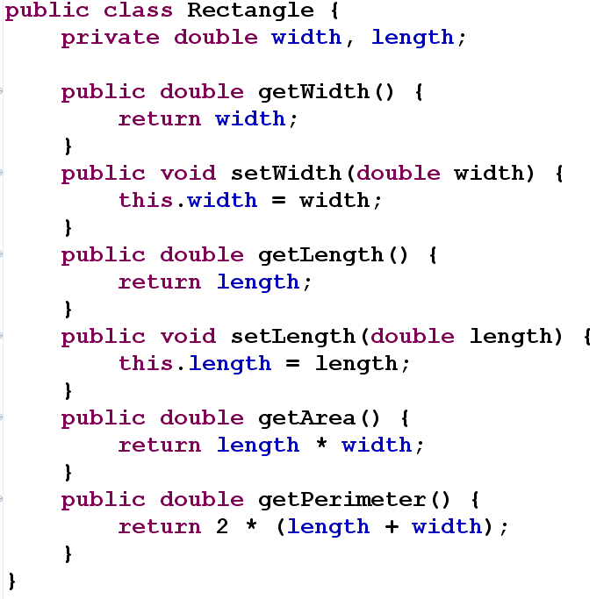

Slide 36
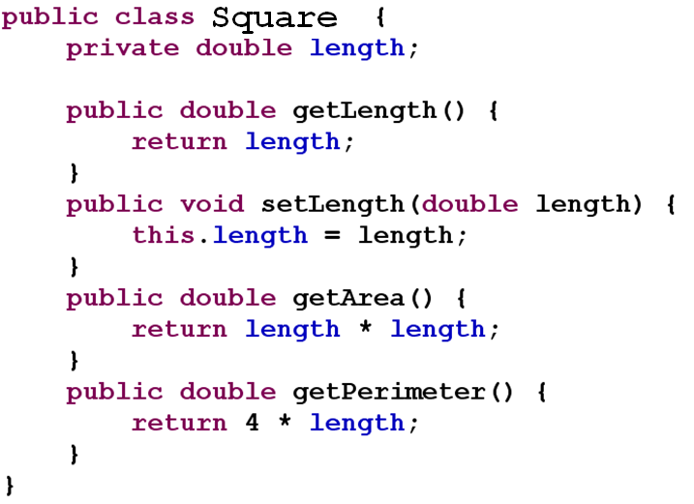

Slide 37
Shapes Example
Shape is an abstract class
Some methods are undefined in Shape
Some methods should be defined in sub-classes
getArea()
getPerimeter()
These methods are abstract methods
Remember abstract behaviors

Slide 38
Abstract Methods
Shape classes
getArea()
draw()
Animals
Talk()
getName()
is not abstract!
How do you implement an abstract method?
We can implement these methods by simple dummy operations
Better way : abstract methods

Slide 39
Abstract Methods (2)
abstract method : no implementation
A class containing abstract methods: an abstract class
You can not instantiate abstract classes
Why?
If a sub-class do not implement the abstract method
It will be abstract too

Slide 40
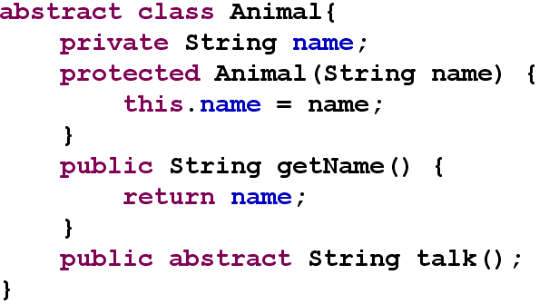
Animal Example

Slide 41
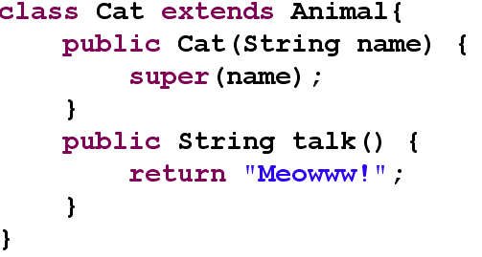
Animal Example (2)

Slide 42
Access modifier in inheritance
You can not override a public method as a private method
Why?
It violates the “is-a” rule
You can not reduce accessibility of methods in subclasses

Slide 43
Accessibility of Members
Subclass has access to public members of parent class
Public methods and properties are accessible in subclass
Student used getName() and getStudentID()
Private members are not accessible in subclass
Student has no access to name and studentID properties
What if you want to let subclasses access a member, but not other classes?

Slide 44
Protected Members
Intermediate level of protection between public and private
protected members accessible by
subclass members
Class members in the same package
protected members are also package accessible
friendly
Protected variables and methods are shown with a # symbol in UML diagrams

Slide 45
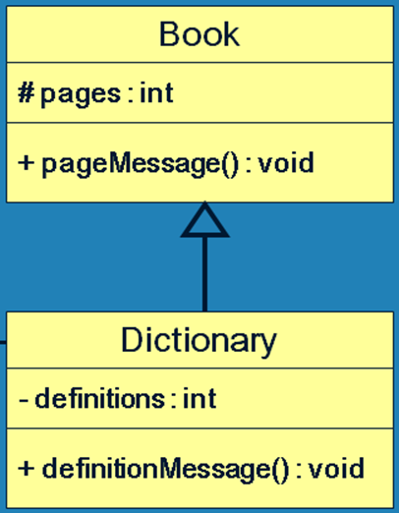
UML Class Diagram

Slide 46
Access Levels
Public
Accessible by all classes
Protected
Accessible by subclasses Accessible by classes of the same package
Package access (friendly)
Accessible by classes of the same package
Private
No access

Slide 47
super Keyword
Access to parent members
The super reference can be used to refer to the parent class
super.f() invokes f() from parent class
Why we need it?
When the method is overridden in subclass
super is also used to invoke the parent's constructor

Slide 48
Application of super Keyword
class Student extends Person{
public void show(){
super.show();
System.out.println(
",studentID=" + studentID);
}
}

Slide 49
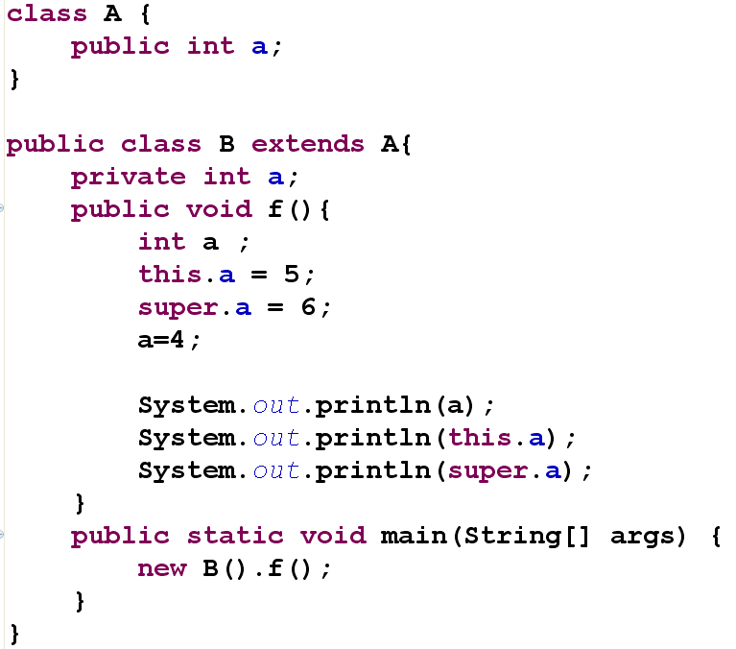

Slide 50
Object class methods
equals()
toString()
finalize()
…
We can override these methods in our classes

Slide 51
Multiple Inheritance
Java supports single inheritance
Derived class can have only one parent class
Multiple inheritance allows a class to be derived from two or more classes
inheriting the members of all parents
Collisions, such as the same variable name in two parents, have to be resolved
Java does not support multiple inheritance
The use of interfaces usually gives us aspects of multiple inheritance without the overhead

Slide 52

Initialization
Constructors are not inherited
even though they have public visibility
We often want to use the parent's constructor to set up the "parent's part" of the object

Slide 53
Constructors
A child’s constructor is responsible for calling the parent’s constructor
It is done using super keyword
The first statement of a child’s constructor should be the super reference to call the parent constructor
Otherwise, default constructor is implicitly invoked
If default constructor does not exist? (how?!)
A syntax error
You should explicitly call an appropriate parent constructor

Slide 54
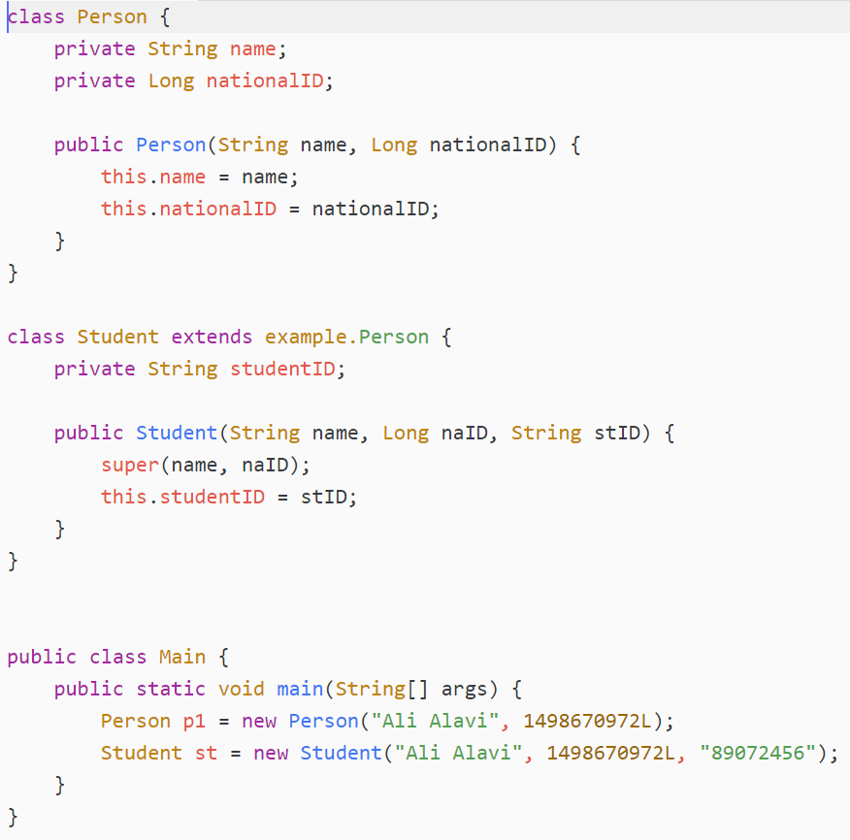

Slide 55
Order of initialization
Once per class
Static variable declaration of parent
Static block of parent
Static variable declaration
Static block
Once per object
variable declaration of parent
Initialization block of parent
Constructor of parent
variable declaration
Initialization block
Constructor

Slide 56
public class Parent {
static int a = A();
static{
a=B();
}
int b = E();
{
b = F();
}
public Parent(){
b = G();
}
}
class Child extends Parent{
static int c = C();
static{
c=D();
}
int b = H();
{
b = I();
}
public Child(){
b = J();
}
}
What happens if we invoke: new Child();

Slide 57
Some Notes
As the first statement of a constructor, we can invoke parent constructor
Using super keyword
Only once
First line? No. first statement.
We can not use properties in this super invocation
super(this.name)
Why?

Slide 58
References
Java How to Program (9th Edition)
Deitel & Deitel
Thinking in Java (Fourth Edition)
Bruce Eckel
Java cup

Slide 59

Any Question

