Slide 1
Advanced Programming
Fall 2020

Slide 2
Agenda
Polymorphism
Final Methods

Slide 3
Polymorphism

Slide 4
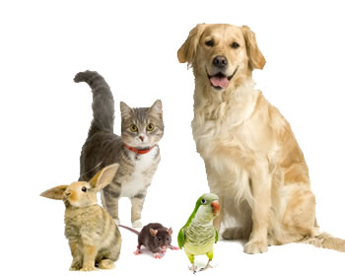
Animals can talk!

Slide 5
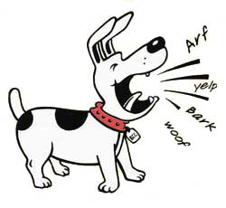
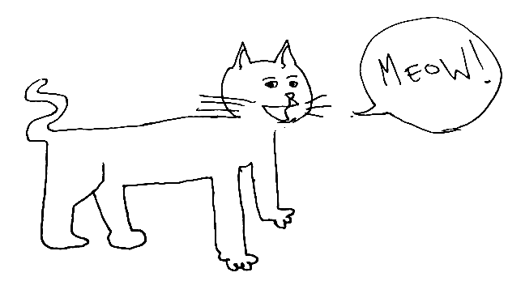
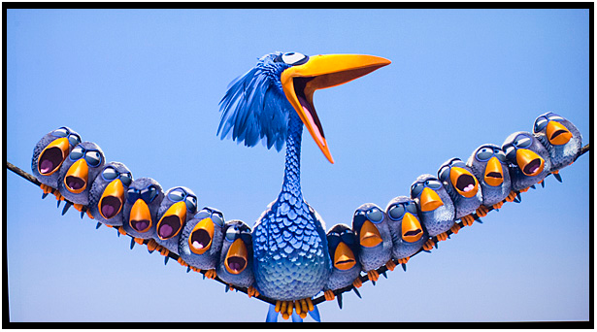
Talk request
You can send a talk request to an animal
What does it do?
It depends on type of the animal

Slide 6

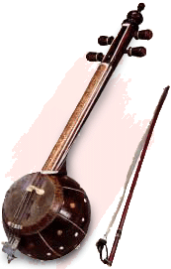
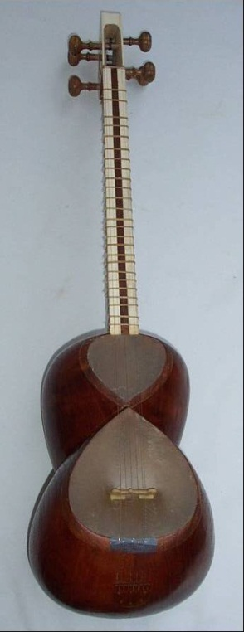
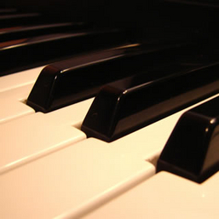
Musical Instruments
The same note
Different sounds on different instruments

Slide 7
Polymorphic Behavior
Common interface
The same request
Different behaviors
Depending on the type of object

Slide 8
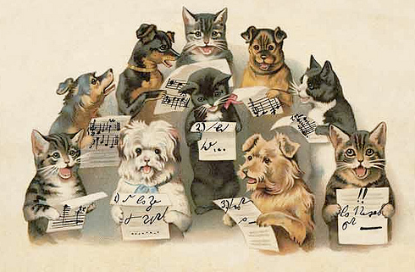
Polymorphism
The same interface
animal.talk()
instrument.play(int note)
But different implementation
in different classes

Slide 9
Polymorphism
Suppose Child is a subclass of Parent class.
Remember : A Child’s object is also a Parent’s object
is-a relationship
So these lines are valid:
Child c = new Child();
Parent p = new Parent();
p = c;
But this line is invalid:
c = p;

Slide 10
UpCasting
Upcasting
Shape s = new Rectangle();
Circle c = new Circle();
Shape s = c;
Upcasting is always valid

Slide 11
DownCasting
Downcasting
Shape s = …
Circle c = s;
Circle c = (Circle) s;
Needs type cast
May cause errors

Slide 12
What About Method Calls?
Shape s = new Rectangle();
s.draw();
double d = s.getArea();
Circle c = new Circle();
Shape s = c;
s.draw();
double d = s.getArea();

Slide 13
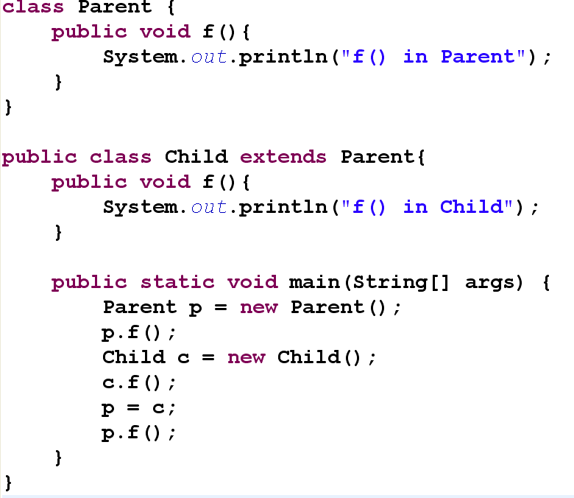

Slide 14
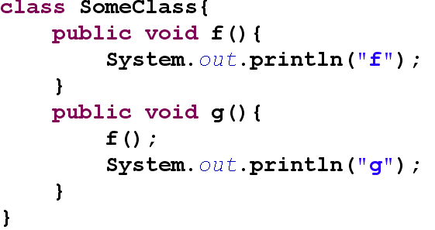
Compile-time Method Binding
Also known as Static Binding
When a method is called, compiler knows which method is called
The translation is done in compile-time

Slide 15
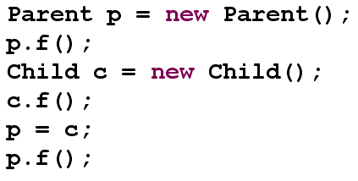
Run-time Method Binding
Also known as Dynamic Binding
When you call a method on a superclass reference
Actual method is bound in runtime
(If it is overridden)
Performance overload

Slide 16
Virtual Methods
In some languages (like C++) you can specify the binding mechanism for methods
If a method is declared as virtual, dynamic binding is used for that method

Slide 17
Applications of Polymorphism
Polymorphic behavior
Suppose you have so many objects in a GUI application
All of them have draw() operation
You simply call draw() on every object
It knows how to draw itself
Classes : Drawable(superclass), Player, Referee, Ball, …

Slide 18
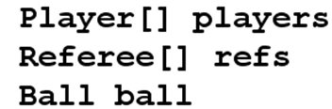
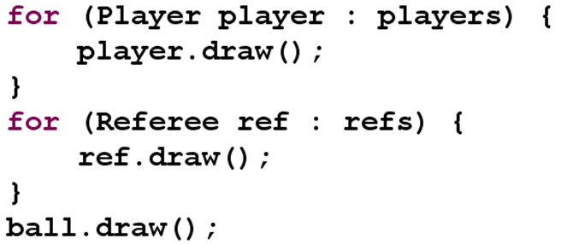
No Polymorphism

Slide 19
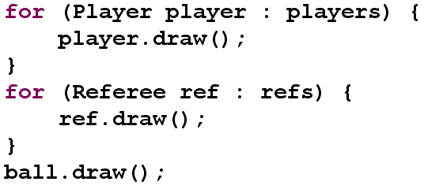


With Polymorphism

Slide 20
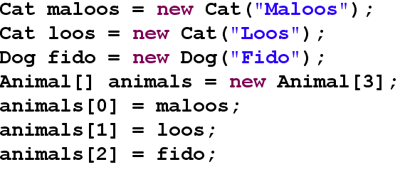
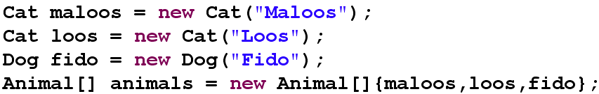
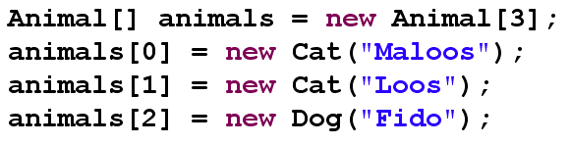
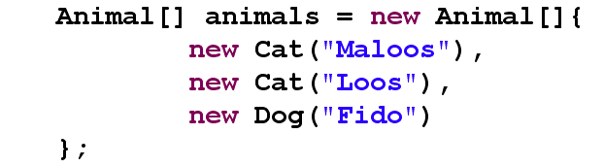
Hint on Array Initialization

Slide 21
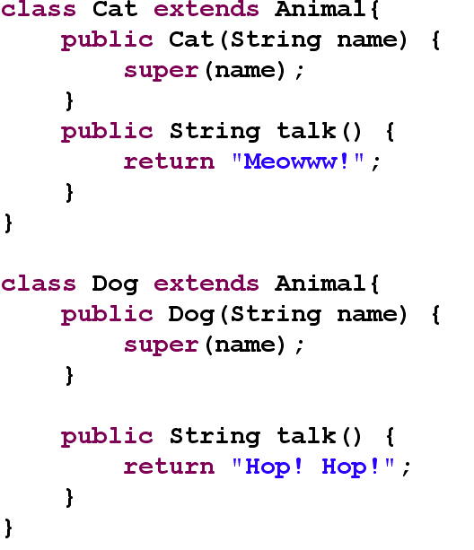

Slide 22
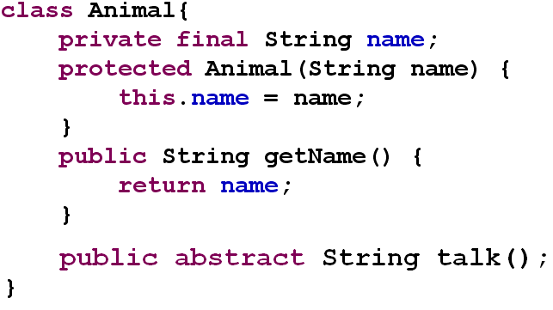
Animal Example

Slide 23
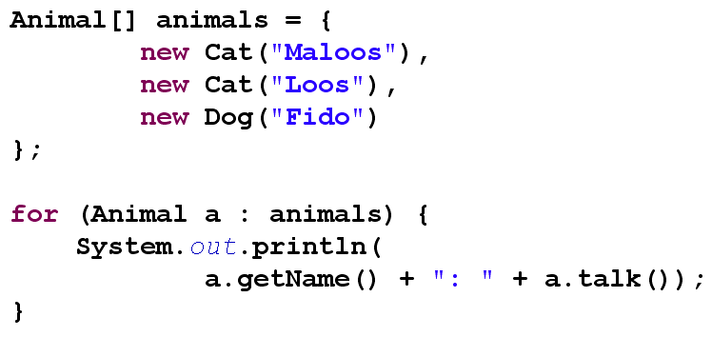
Polymorphic Animals!

Slide 24
More on Polymorphism
Later!

Slide 25
Final

Slide 26
Final Methods
You can not override final methods
final keyword
Static method binding for final methods
Private methods are implicitly final
Static methods are implicitly final
Static methods are statically bound
Invoked reference is not important
No polymorphism for static variables

Slide 27
Final Variables
You can define variables as final
The value of final variable will remain constant
You can not change the value of final variables
You should immediately assign a value to final variables
Final parameter
Final local variable
Final property
Final static variable

Slide 28
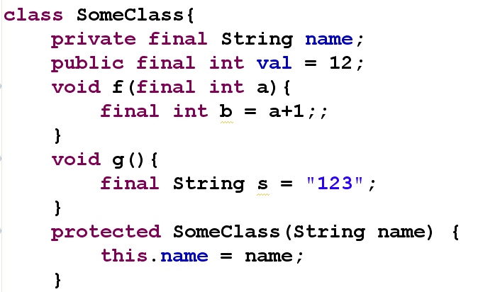
Final Variables

Slide 29
Final Classes
You can not inherit from final classes
No class can extend final classes

Slide 30
Review of final Keyword
Final data
Const
Local variables
Method parameters
Member variables
Primitives ➔ constant values
Objects ➔ constant references
A compile-time constant that won’t ever change
A value initialized at run time that you don’t want changed

Slide 31
Review of final Keyword (2)
Final Methods
No override
Final Class
No sub-class
final keyword on data
Different from final classes & methods

Slide 32
Finalism and Performance
Final methods can be invoked inline
Compiler can bind final methods statically
Static binding
So it may bring a better performance…
It is now discouraged to use final to try to help the optimizer
Especially with Java 6+
Don’t worry about performance
Java optimizer

Slide 33
More on Polymorphism

Slide 34
class Parent{
public void f(){
System.out.println("f() in Parent");
}
}
class Child extends Parent{
public void f(){
System.out.println("f() in Child");
}
}
public class SomeClass {
public void method(Parent p){
System.out.println("method(Parent)");
}
public void method(Child p){
System.out.println("method(Child)");
}
}

Slide 35
What is the output of:
Child child = new Child();
Parent parent = new Parent();
Parent parentRefToChild = new Child();
parent.f();
child.f();
parentRefToChild.f();
Output:
f() in Parent
f() in Child
f() in Child

Slide 36
What is the output of:
SomeClass square = new SomeClass();
square.method(parent);
square.method(child);
square.method(parentRefToChild);
Important Note:
Polymorphic behavior for reference
the reference before dot
Not for the parameters
Output:
method(Parent)
method(Child)
method(Parent)

Slide 37
Note: Overloading
public class SomeClass {
public void method(Parent p){
System.out.println("method(Parent)");
}
public void method(Child p){
System.out.println("method(Child)");
}
}
method() is overloaded in SomeClass
Two independent methods

Slide 38
To Overload or to Override
class SomeClass {
public void method(Parent p){
System.out.println("method(Parent)");
}
}
class SomeSubClass extends SomeClass{
public void method(Child p){
System.out.println("method(Child)");
}
}
method() is overloaded in SomeSubClass
It is not overridden
Two independent methods

Slide 39
What is the output of:
SomeSubClass ref = new SomeSubClass();
ref.method(parent);
ref.method(child);
ref.method(parentRefToChild);
Output:
method(Parent)
method(Child)
method(Parent)

Slide 40
A Question
When we override equals() method
Why do we pass Object as the parameter?
For example class Person has an equals method like this:
public boolean equals(Object obj) {…}
But not like this:
public boolean equals(Person obj) {…}
Why?!

Slide 41
Quiz
Draw UML Driagram:
Person (Age, name, nationalID)
Student (STDNo, Courses)
Instructor (ID, Courses)
Course (ID, Prerequisite Courses)
LabratoryCourse (LabratoryTitle)
Thesis (ThesisTitle)

Slide 42
References
Java How to Program (9th Edition)
Deitel & Deitel
Thinking in Java (Fourth Edition)
Bruce Eckel
Java cup

Slide 43

Any Question

