Slide 1
Advanced Programming
Fall 2020

Slide 2
Agenda
interface
Multiple Inheritance

Slide 3
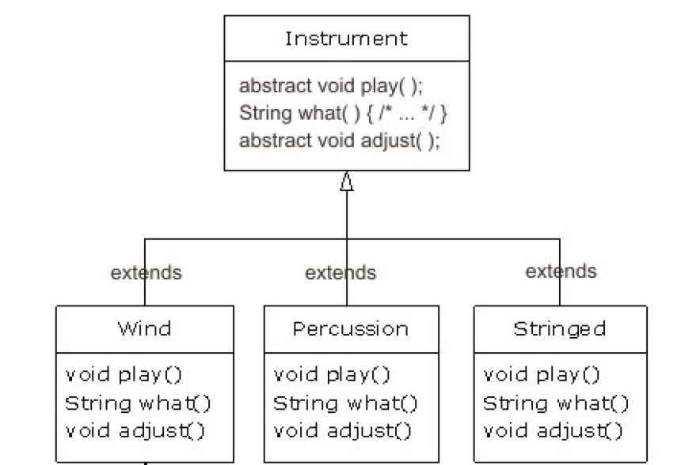
Abstract Example

Slide 4
Abstract Method
All subclasses have the method
But we can not implement the method in super-class
So why we define it in super-class?
Polymorphism

Slide 5
Interface
Sometimes we have an abstract class, with no concrete method
interface : pure abstract class
no implemented method

Slide 6
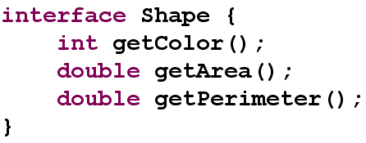
Interface

Slide 7
Interface
All the methods are implicitly abstract
No need to abstract specifier
All the methods are implicitly public
No need to public specifier

Slide 8
Interface Implementation
Some classes may inherit abstract classes
Some classes may implement interfaces
Is-a relation exists
If a class implements an interface
But does not implement all the methods
What will happen?
The class becomes an abstract class

Slide 9
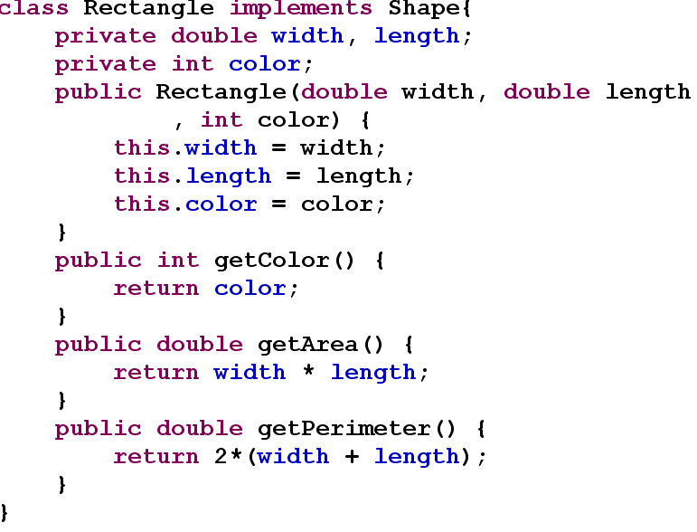

Slide 10
Multiple Inheritance in Java
A class can inherit one and only one class
A class may implement zero or more interfaces

Slide 11
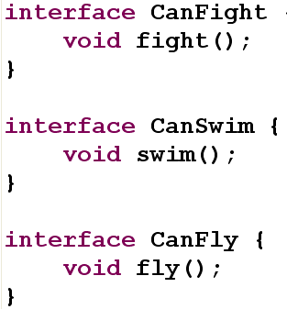
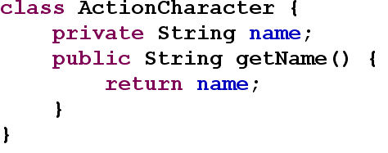
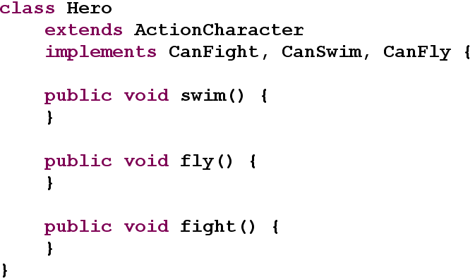

Slide 12
A Question
Why multiple inheritance is not supported for classes?
Why multiple inheritance is supported for interfaces?

Slide 13
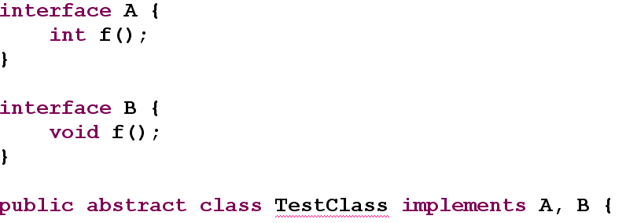
What About Name Collision?
The return types are incompatible for the inherited methods B.f(), A.f()

Slide 14
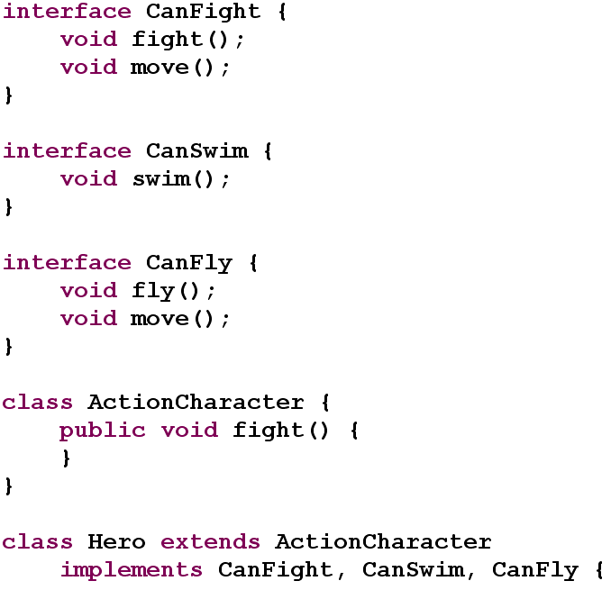

Slide 15
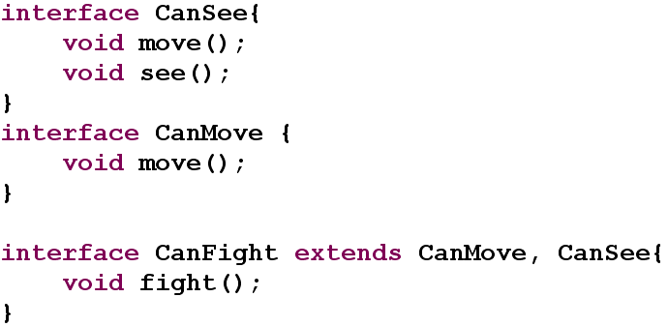
Interface Extension
Interfaces may inherit other interfaces
Code reuse
Is-a relation

Slide 16
Interface properties
No member variable
Variables: implicitly final and static
Usually interfaces declare no variable
Only operations are declared
No constructor
Why?

Slide 17
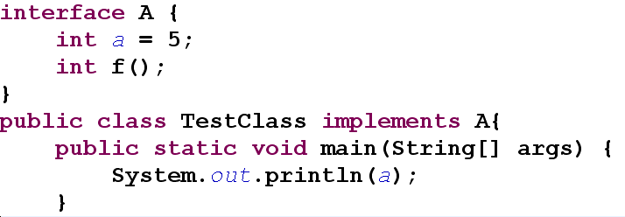
Example

Slide 18
Interfaces Applications
Pure Abstract classes
Describe the design
The architect designs interfaces, the programmer implements them
Only interfaces are delivered to code consumers
More powerful inheritance and polymorphism

Slide 19
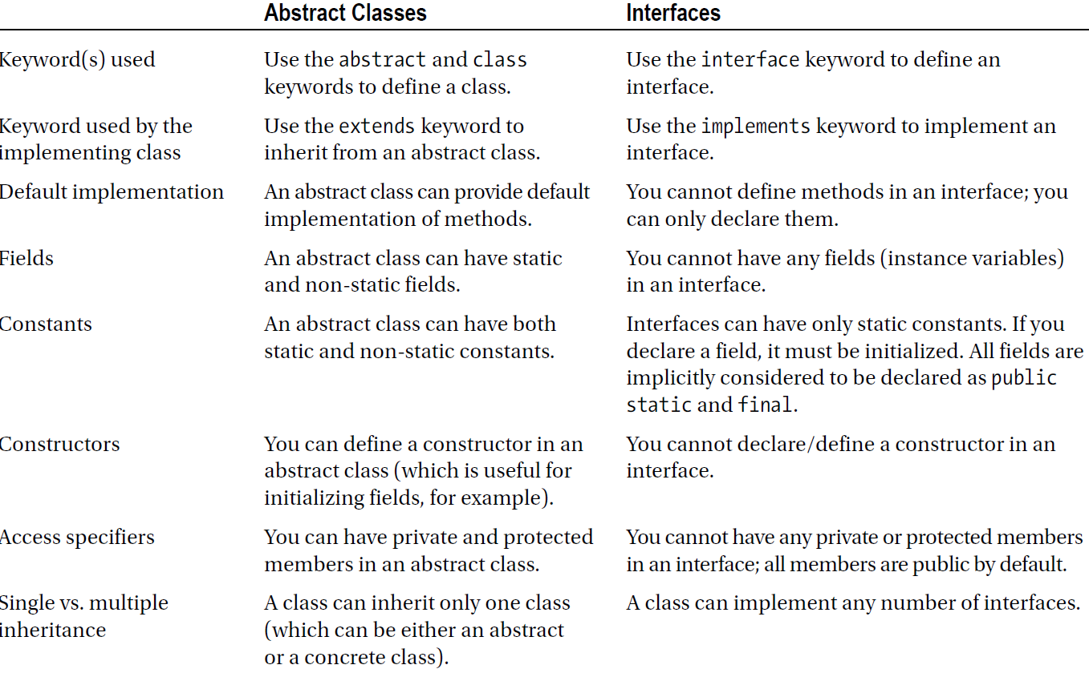

Slide 20
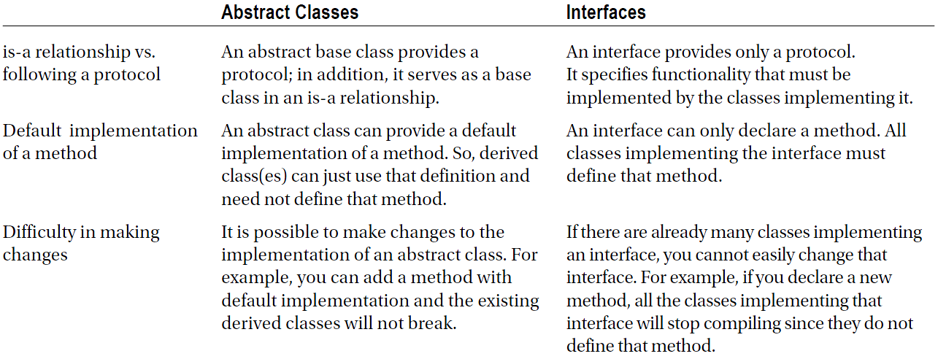

Slide 21
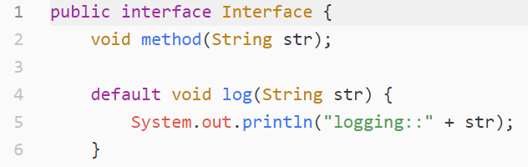
Default Method (Java 8)

Slide 22
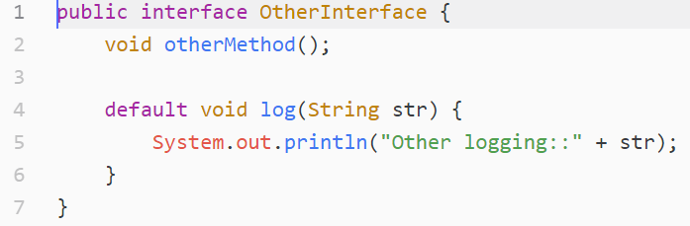
Default Method (Java 8)

Slide 23
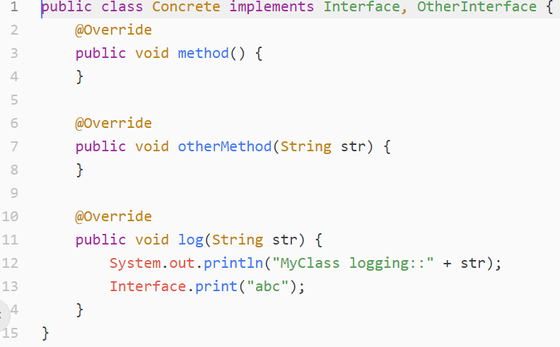
Default Method (Java 8)

Slide 24
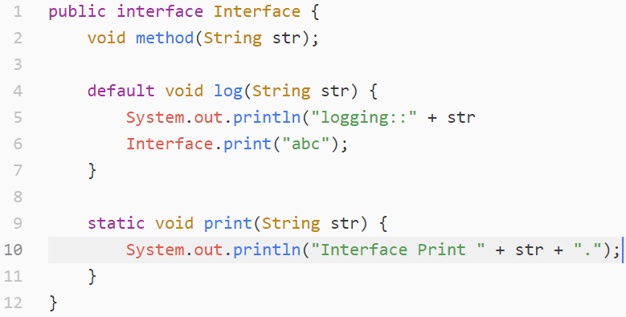
Static method

Slide 25
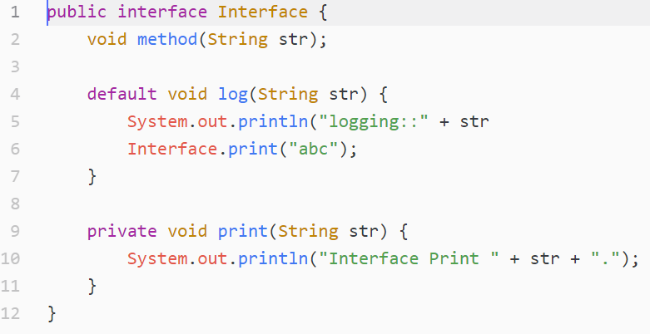
Private Static method

Slide 26
References
Java How to Program (9th Edition)
Deitel & Deitel
Thinking in Java (Fourth Edition)
Bruce Eckel
Java cup

Slide 27

Any Question

