Slide 1
Advanced Programming
Fall 2020

Slide 2
Review
Java Programming Language
Principles of Object Oriented Programming
Characteristics of objects
Encapsulation
Objects in memory
References
Heap
Stack
Parameter Passing

Slide 3
Review (2)
Initialization and Cleanup
Constructor
finalize()
Order of initialization
Initialization blocks
Access specifiers
Public
Private
Package access

Slide 4
Review (3)
Package
Static
The this reference
Method overloading
toString()
equals()
Refactoring
Bad smells
Refactoring techniques

Slide 5
Agenda
Software Quality
Characteristic of a good software
Test
Unit Testing
Refactoring

Slide 6
Quality of Product
The producer should ensure about the quality of the products
Quality Control
Any business, any product

Slide 7

A Cook

Slide 8

In surgery

Slide 9


A Car Maker

Slide 10

Quality Control
Quality should be tested
A product is not finalized, before the test
Different kinds of test, check different kinds of quality

Slide 11
Software Quality
We are programmers
Programmers produce software
What are characteristics of a good software?
Many parameters. E.g.
Conformance to requirements
Performance
Time
Memory
Maintainability
Changeability
Different kinds of test, check different kinds of quality

Slide 12
Test in Other Industries
Test side effects
A damage to the product
Test of a building
Test of a car
Test of a part of a product

Slide 13

Test Side Effects

Slide 14
What to do with Test Side Effects?
Testing a sample of the product
Simulation
Mathematical analysis
In software testing
Along with all of these techniques
And we can also test the software itself!
(Usually) no damage to the software

Slide 15
Test Target
System Test
Test the system as a whole
For performance, correctness and conformance.
Unit Test
Test the units and modules
Test of a component
Test of a class
Test of a method

Slide 16
How to Test Software
Manual Test
Try it!
Test Tools
Performance Test
Profiling
JProfiler, TPTP
Load Test
Jmeter
Test Code
Unit Tests
Test Teams

Slide 17
Test Code
Business Code
The code, written for implementation of a requirement
Test Code
The code, written for test of an implementation

Slide 18
Unit Testing
A process for the programmer
Not a test team procedure
For improving the code quality
Reduces bugs
Test of units of software
before the software is completed
Unit: method, class

Slide 19
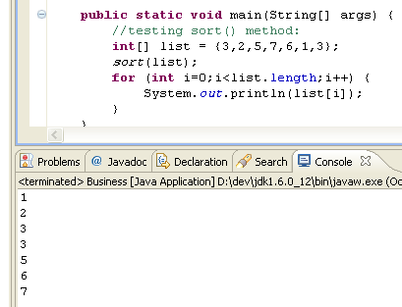
Classical Unit Testing
Writing main() method
Some printlns
Drawbacks?

Slide 20
Drawbacks
Test code coupled with business code
In the same class
Written tests are discarded
One test at a time
The programmer executes the tests himself
Test execution is not automatic
The programmer should check the result of each test himself
The test is passed or failed?
The test result interpretation is not automatic

Slide 21
A Good Unit Test Code
Repeatable
Automatic
Invocation
Acceptance (Pass/Failure)
JUnit helps you write such tests

Slide 22
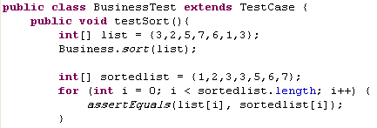
JUnit, First Example

Slide 23
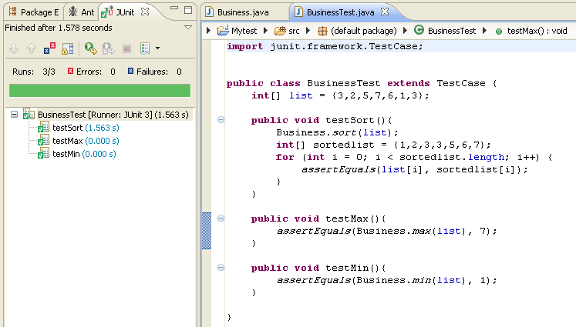
JUnit, The Green Bar

Slide 24
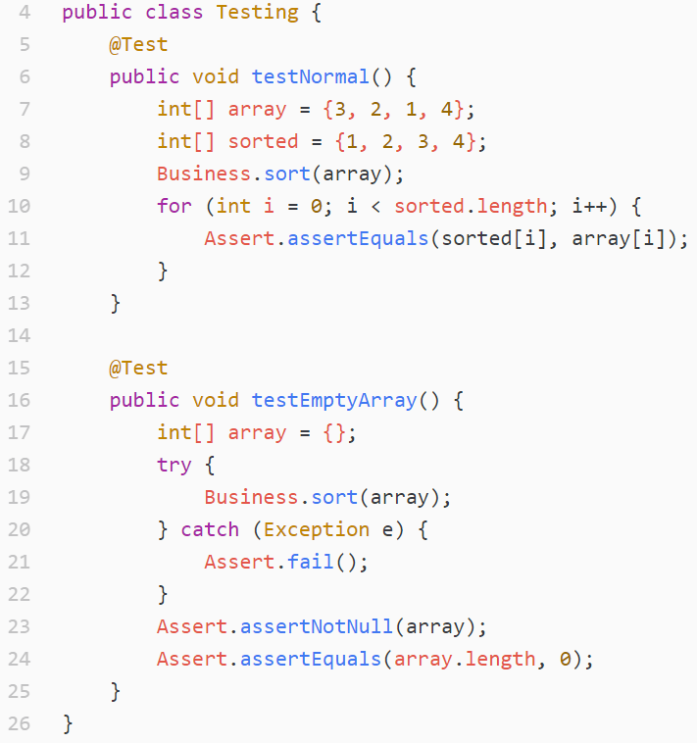

Slide 25
Assertions
assertNull(x)
assertNotNull(x)
assertTrue(boolean x)
assertFalse(boolean x)
assertEquals(x, y)
Uses x.equals(y)
assertSame(x, y)
Uses x ==y
assertNotSame
fail()

Slide 26
Annotations
@Test
@Before
@After
@BeforeClass
@AfterClass

Slide 27
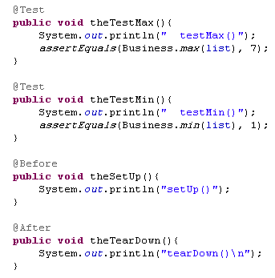

Slide 28
A Good Unit Test is
Automated
Through
Repeatable
Independence
Professional

Slide 29
Test Driven Development
Test First Development
Before writing a code, write the tests!

Slide 30
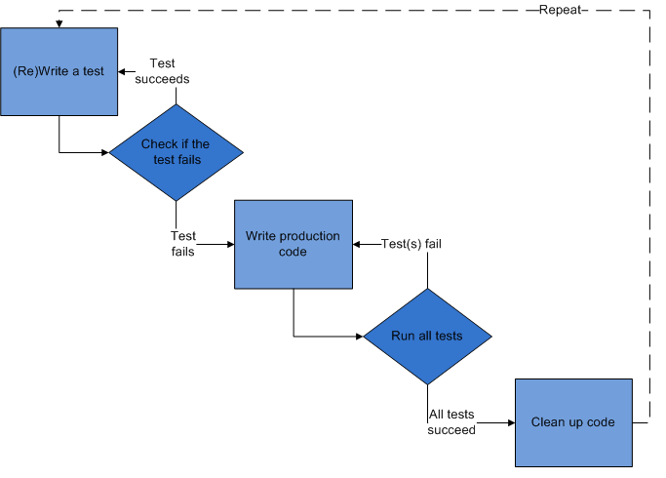
TDD

Slide 31
References
Java How to Program (9th Edition)
Deitel & Deitel
Thinking in Java (Fourth Edition)
Bruce Eckel
Java cup

Slide 32

Any Question

