Slide 1
Advanced Programming
Fall 2020

Slide 2
Refactoring
A disciplined way to restructure code
In order to improve code quality
Without changing its behavior
a change made to the internal structure of software to make it easier to understand and cheaper to modify without changing its observable behavior.

Slide 3
Refactoring
Refactoring is the process of changing a software system
In such a way that it does not alter the external behavior of the code
But improves its internal structure
It is a disciplined way to clean up code
It minimizes the chances of introducing bugs
When you refactor, you are improving the design of the code after it has been written.

Slide 4
Refactoring
By continuously improving the design of code, we make it easier and easier to work with
Joshua Kerievsky, Refactoring to Patterns

Slide 5
Example
Duplicate Code
What are the drawbacks?
What is the solution?
Refactoring:
Finding a “Bad Smell”
Changing the code to remove the bad smell
Some well-known bad smells are reported

Slide 6
Bad Smell
A bad smell in code
Any symptom in the source code that possibly indicates a deeper problem.
The term is coined by Kent Beck.

Slide 7
Bad Smells
If it stinks, change it!
Kent Beck and Martin Fowler.
Bad smells in code
Bad smells are source of problems
Remove bad smells
How?
By Refactoring

Slide 8
Bad Smells
Duplicated Code
Long Method
Large Class
Long Parameter List
…

Slide 9
Refactoring Techniques
Extract Method
Move
Method
Variable
Class
Extract Class
Rename
Method
Variable
Class
Pull Up
Push Down

Slide 10
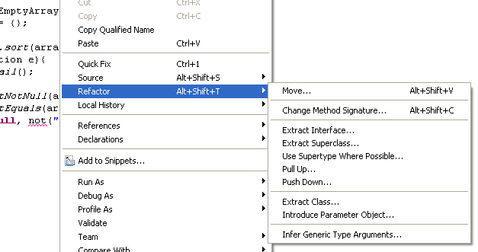
IDE Support
Refactoring techniques are widely supported by IDEs
Practice it in Intelij

Slide 11
The Two Hats
Kent Beck's metaphor of two hats
Divide your time between two distinct activities
adding function
refactoring

Slide 12
Why Should I Refactor?
Refactoring Improves the Design of Software
Refactoring Makes Software Easier to Understand
Refactoring Helps You Find Bugs
Refactoring Helps You Program Faster
Refactoring makes your code more maintainable

Slide 13
When Should You Refactor?
The Rule of Three:
Refactor When You Add Function
Refactor When You Need to Fix a Bug
Refactor As You Do a Code Review

Slide 14
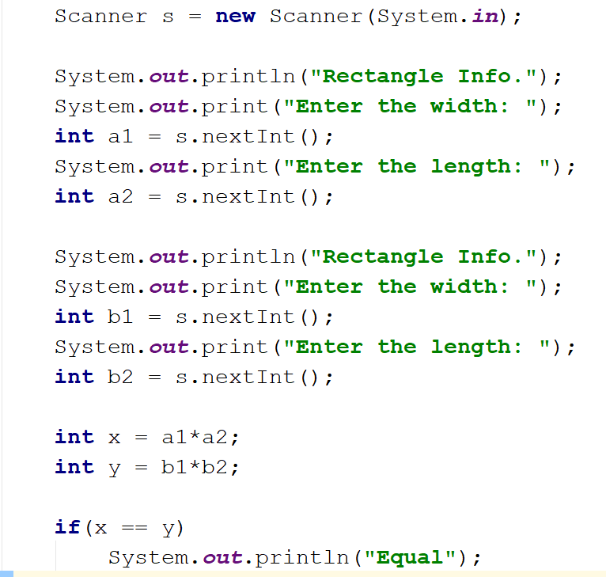
Find bad smells!
Refactor the Code!

Slide 15
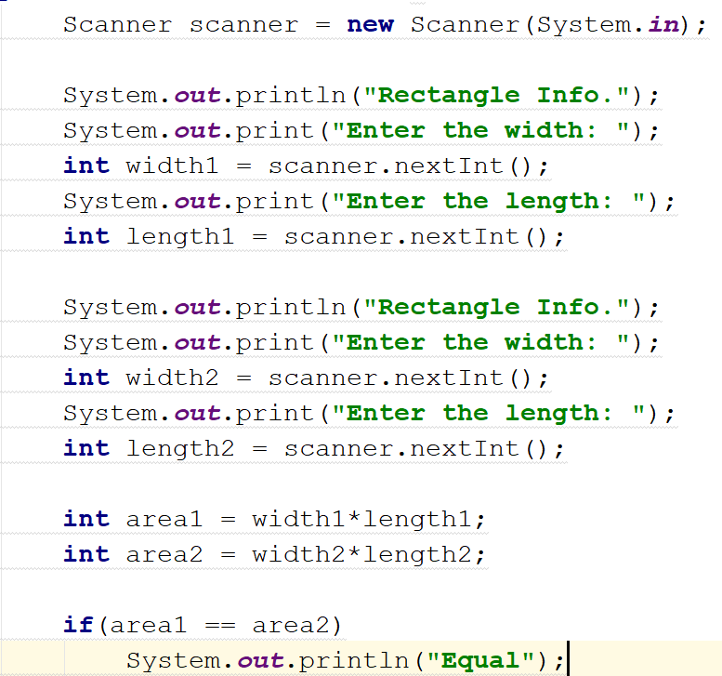
Rename…

Slide 16
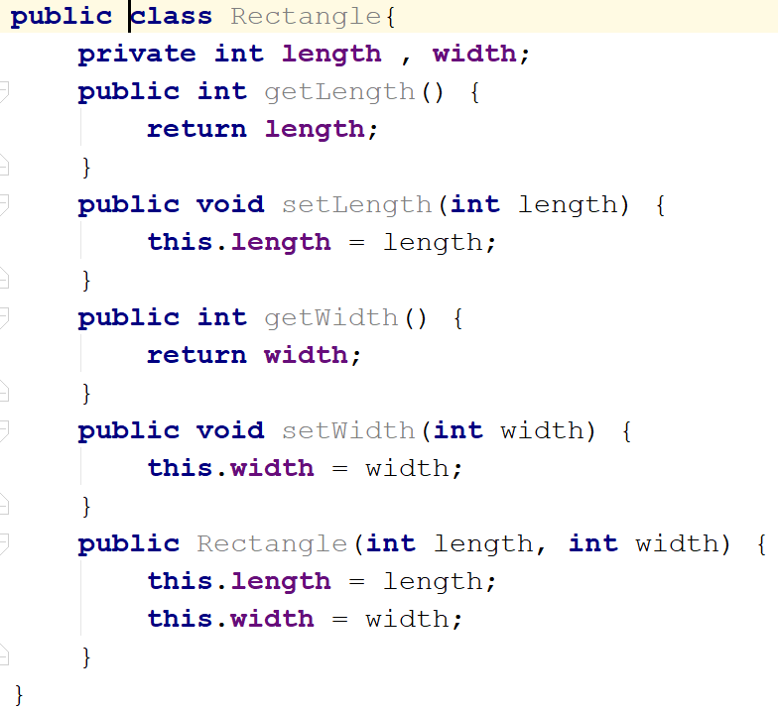
Extract Class…

Slide 17
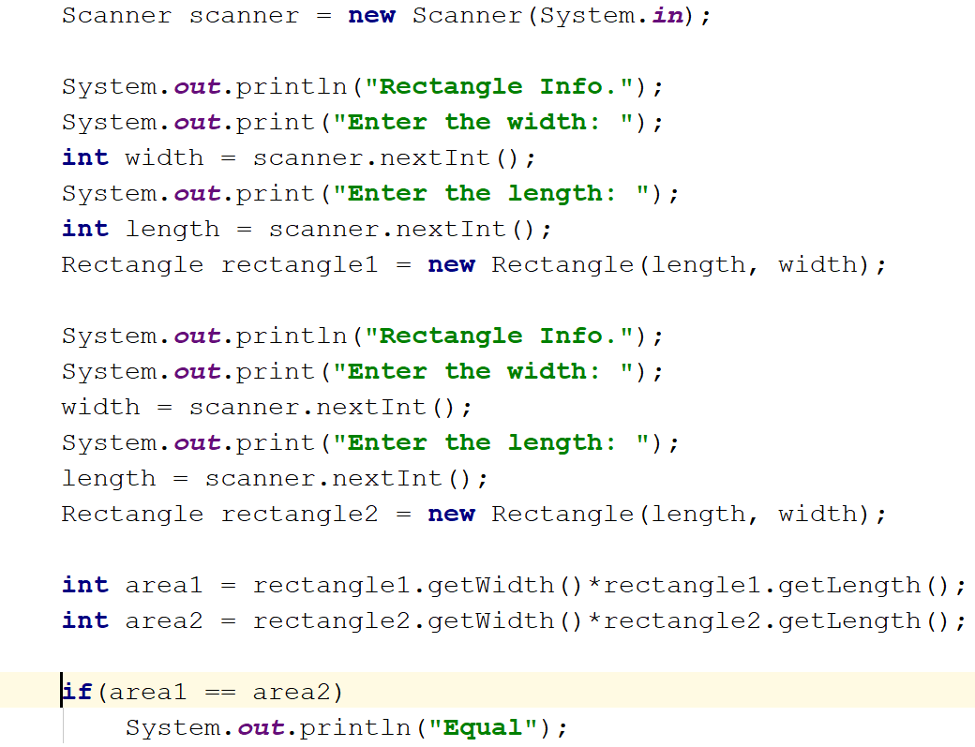

Slide 18
class Rectangle{
...
public int area(){
return length * width;
}
}
…
int area1 = rectangle1.area();
int area2 = rectangle2.area();
Extract Method…

Slide 19
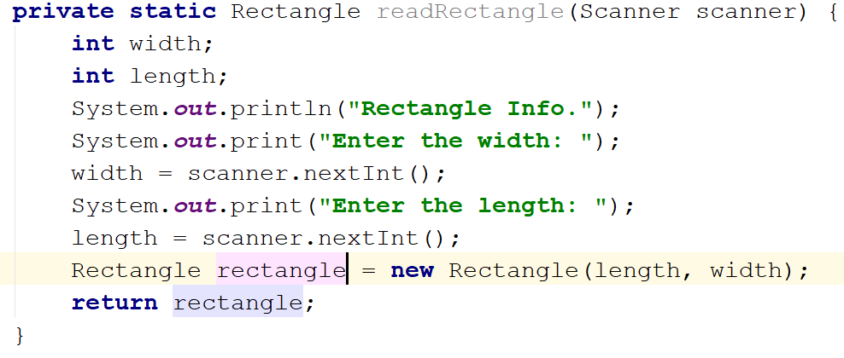
Extract Method…

Slide 20
Refactored Code
Scanner scanner = new Scanner(System.in);
Rectangle rectangle1 = readRectangle(scanner);
Rectangle rectangle2 = readRectangle(scanner);
int area1 = rectangle1.area();
int area2 = rectangle2.area();
if(area1 == area2)
System.out.println("Equal");

Slide 21
References
Refactoring: improving the design of existing code, Martin Fowler, Kent Beck, John Brant, William Opdyke, Don Roberts (1999)
Java cup

Slide 22

Any Question

