Slide 1
Advanced Programming
Fall 2020

Slide 2
Agenda
Design Patterns
Creational Patterns
Structural Patterns
Behavioral Patterns

Slide 3
Types of Design Patterns
Creational patterns
About object instantiation
examples: singleton, Factory, Abstract Factory, and prototype
Structural patterns
how related classes and objects are composed together to form a larger structure.
examples: Decorator, proxy, and Façade.
Behavioral patterns
objects communication and flow control
e.g. Observer, Iterator, state

Slide 4
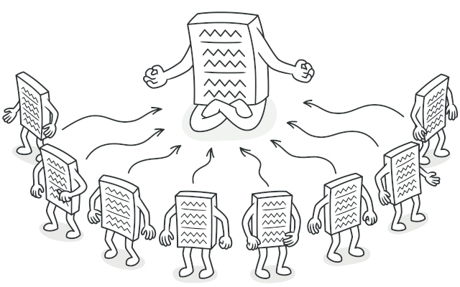
CR: Singleton
Problem
Ensure that a class has just a single instance
Provide a global access point to that instance

Slide 5
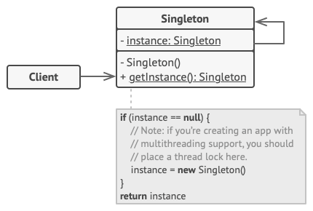
CR: Singleton
Solution:

Slide 6
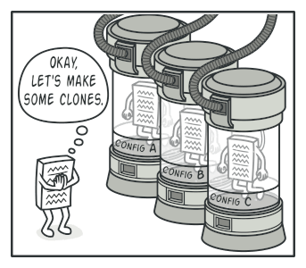
CR: Prototype
Problem:
Say you have an object, and you want to create an exact copy of it. How would you do it? First, you have to create a new object of the same class. Then you have to go through all the fields of the original object and copy their values over to the new object.
Nice! But there’s a catch. Not all objects can be copied that way because some of the object’s fields may be private and not visible from outside of the object itself.

Slide 7
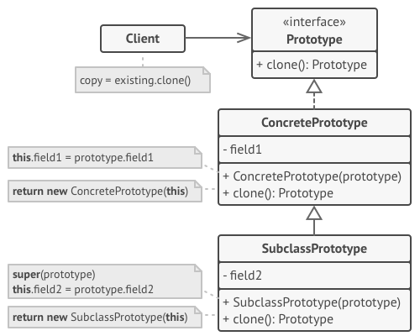
CR: Prototype
Solution:

Slide 8
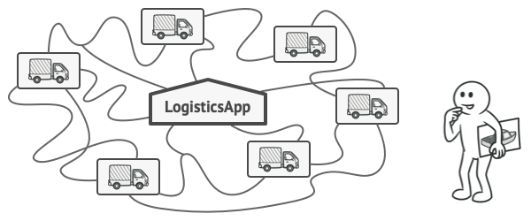
CR: Factory Method
Problem:
Imagine that you’re creating a logistics management application. The first version of your app can only handle transportation by trucks, so the bulk of your code lives inside the Truck class.
At present, most of your code is coupled to the Truck class. Adding Ships into the app would require making changes to the entire codebase. Moreover, if later you decide to add another type of transportation to the app, you will probably need to make all of these changes again.

Slide 9
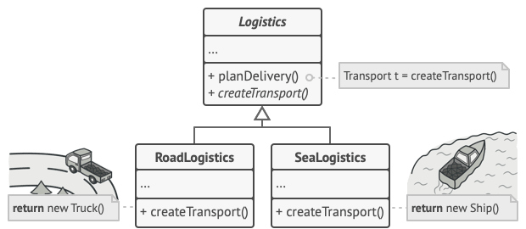
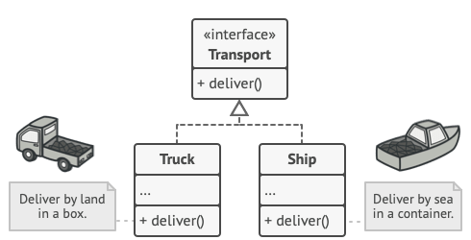
CR: Factory Method
Solution:

Slide 10
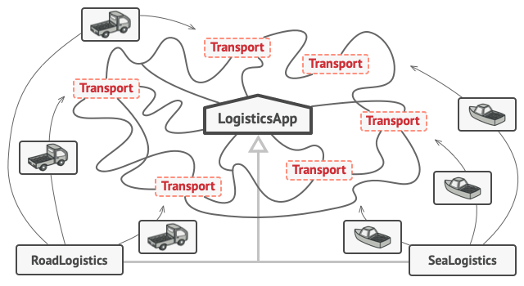
CR: Factory Method
Solution:

Slide 11
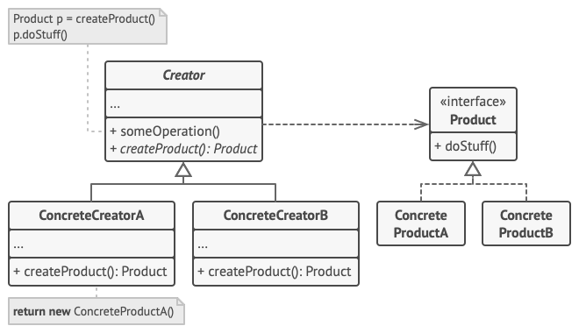
CR: Factory Method
Solution:

Slide 12
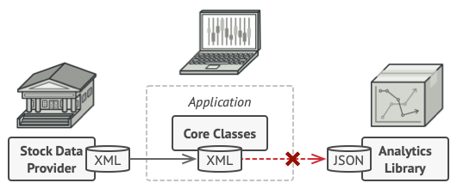
ST: Adapter
Problem:

Slide 13
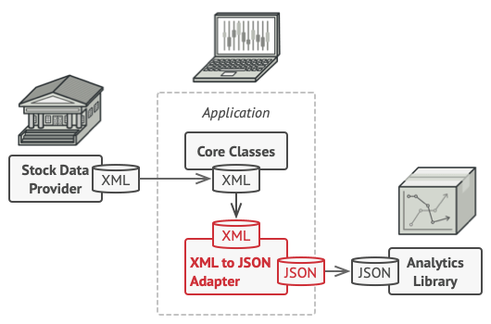
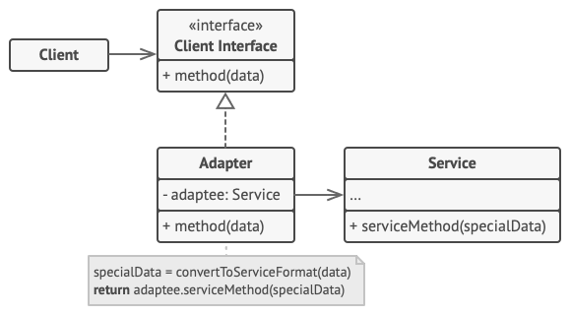
ST: Adapter
Solution:

Slide 14
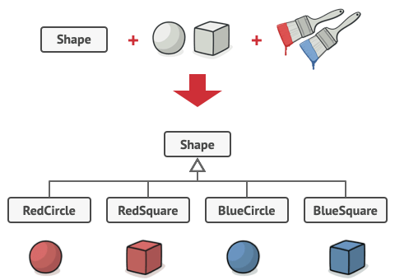
ST: Bridge
Problem:
Say you have a geometric Shape class with a pair of subclasses: Circle and Square.
You want to extend this class hierarchy to incorporate colors, so you plan to create Red and Blue shape subclasses.

Slide 15
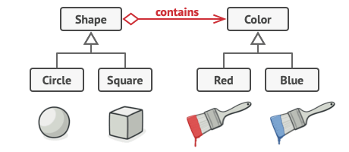
ST: Bridge
Solution:

Slide 16
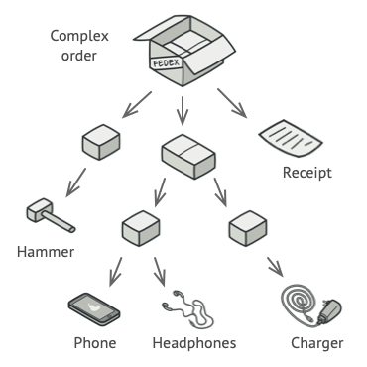
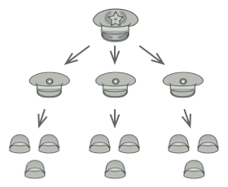
ST: Composite
Problem:
Using the Composite pattern makes sense only when the core model of your app can be represented as a tree.
For example, imagine that you have two types of objects: Products and Boxes. A Box can contain several Products as well as a number of smaller Boxes. These little Boxes can also hold some Products or even smaller Boxes, and so on.

Slide 17
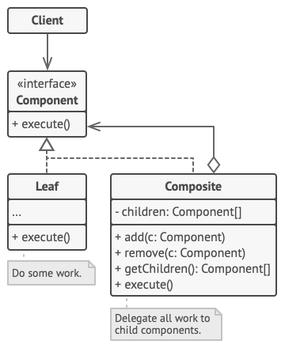
ST: Composite
Solution:

Slide 18
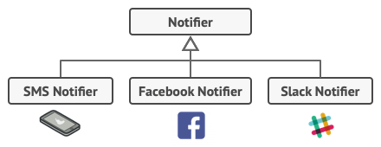
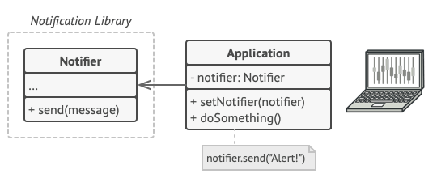
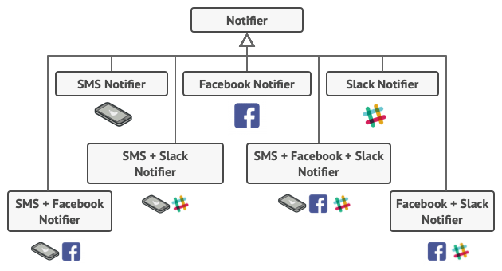
ST: Decorator
Problem:

Slide 19
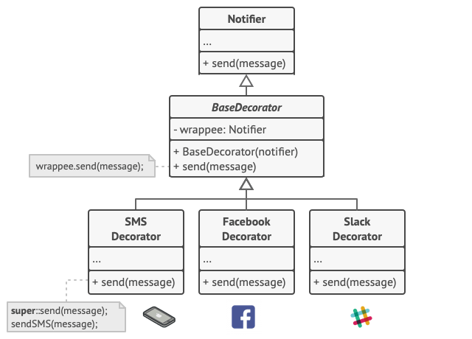
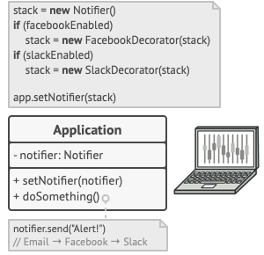
ST: Decorator
Solution:

Slide 20
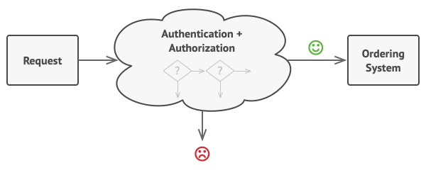
BH: Chain of Responsibility
Problem:
Imagine that you’re working on an online ordering system. You want to restrict access to the system so only authenticated users can create orders. Also, users who have administrative permissions must have full access to all orders.
After a bit of planning, you realized that these checks must be performed sequentially. The application can attempt to authenticate a user to the system whenever it receives a request that contains the user’s credentials. However, if those credentials aren’t correct and authentication fails, there’s no reason to proceed with any other checks.

Slide 21
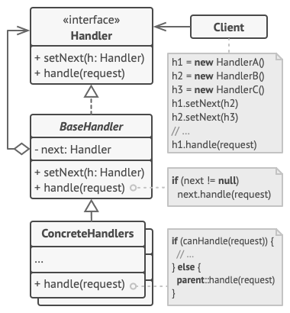
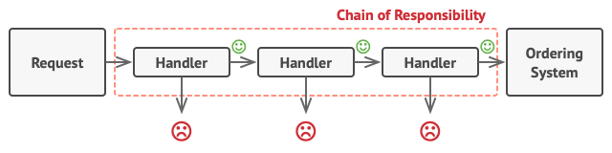
BH: Chain of Responsibility
Solution:

Slide 22
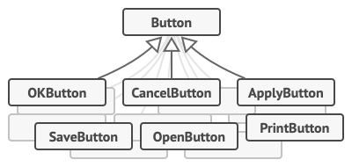
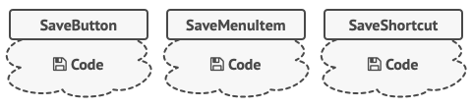
BH: Command
Problem:
Imagine that you’re working on a new text-editor app.
You created a very neat Button class that can be used for buttons on the toolbar, as well as for generic buttons in various dialogs.
While all of these buttons look similar, they’re all supposed to do different things.

Slide 23
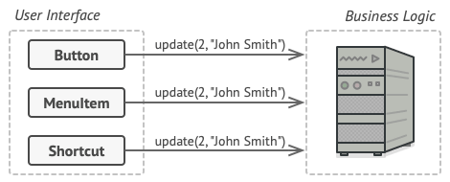
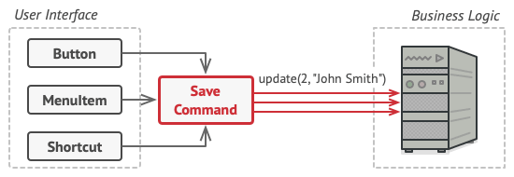
BH: Command
Solution:

Slide 24
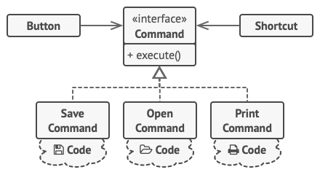
BH: Command
Solution:

Slide 25
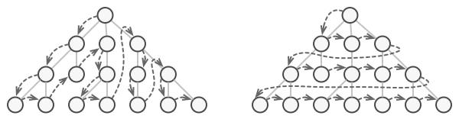
BH: Iterator
Problem:
No matter how a collection is structured, it must provide some way of accessing its elements so that other code can use these elements. There should be a way to go through each element of the collection without accessing the same elements over and over.

Slide 26
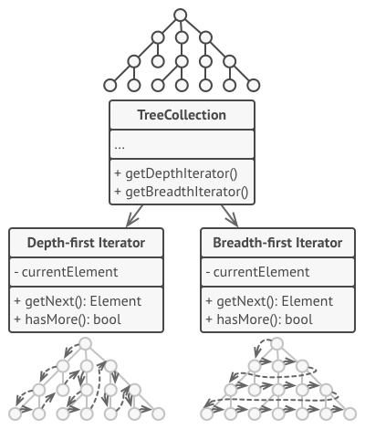
BH: Iterator
Solution:

Slide 27
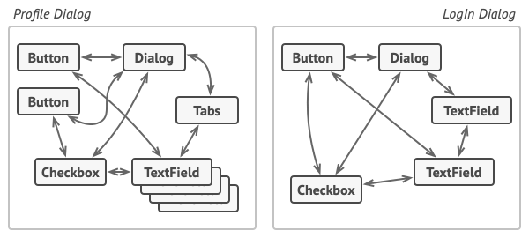
BH: Mediator
Problem:
Managing all direct communications between classes is very hard!

Slide 28
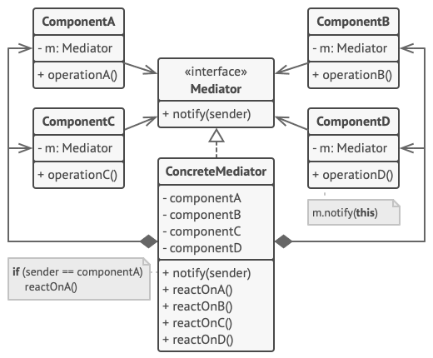
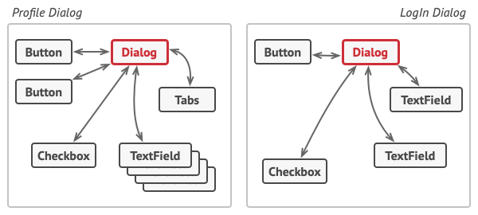
BH: Mediator
Solution:

Slide 29
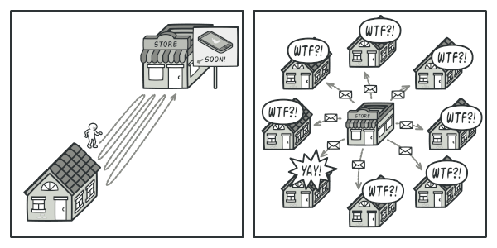
BH: Observer
Problem:
Notifying many objects for a state change is not a good practice!

Slide 30
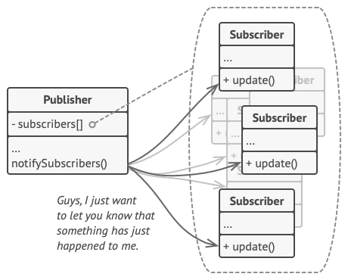
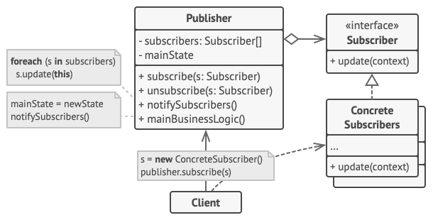
BH: Observer
Solution:

Slide 31
References
Refactoring Guru
Java cup

Slide 32

Any Question

