Slide 1
Advanced Programming
Fall 2020

Slide 2
Agenda
Error handling mechanisms
Exception handling framework
Benefits of exception handling framework
Exception handling in Java

Slide 3
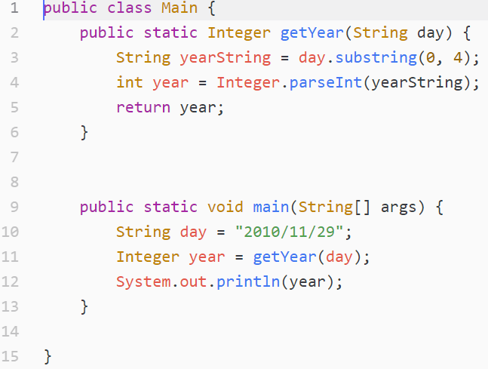
Watch This Method

Slide 4
Exceptions
What is wrong with it?
What if day parameter is not a day representation?
day = “salam!”
What if day parameter is malformed?
Day = “29 Nov 2010”
What if day parameter is empty?
String s = "";
What if day parameter is null?
These occasions are called Exception

Slide 5
Handling Exceptions
What to do with exceptions?
Exit the program
Printing the error on console
Returning a special value
e.g. -1

Slide 6
Important Note
Sometimes the method can’t handle the exception effectively
What should a method do when an exception occurs?
Exit the program?
Suppose you are in a desktop application
Excel, Word, a game, …
Print on console?
edu site
A game

Slide 7
Returning a Special Value
We can return a special value to report an exception
E.g.
return null;
return -1;
return 0;
return “”;
Why not?

Slide 8
Why not?
There is no special value
There are many exceptions
Ambiguity
Need for documentation
Combination of program code and exception code

Slide 9
Exception Handling
Exception Handling is a framework for handling exceptions
;-)
It simplifies code
Separates business code and exception code

Slide 10
What is an Exception?
Exceptional event
Error that occurs during runtime
Cause normal program flow to be disrupted
Examples
?
Divide by zero errors
Accessing the elements of an array beyond its range
Invalid input
Hard disk crash
Opening a non-existent file
Heap memory exhausted

Slide 11
Default Exception Handling
Provided by Java runtime
Prints out exception description
Prints the stack trace
Hierarchy of methods where the exception occurred
Causes the program to terminate

Slide 12
Example
class DivByZero {
public static void main(String a[]) {
System.out.println(3/0);
}
}
Exception in thread "main" java.lang.ArithmeticException: / by zero
at exception.Test2.main(Test2.java:19)
Note: Exception is a runtime concept
This code has no syntax error (No compile-time error)

Slide 13
What Happens When an Exception Occurs?
When an exception occurs within a method
The method creates an exception object
And hands it off to the runtime system
This job is called “throwing an exception”
Exception object contains
information about the error
its type
the state of the program when the error occurred
Exception line of code

Slide 14
What Happens When an Exception Occurs (2)?
The runtime system searches the call stack for a method that contains an exception handler
When an appropriate handler is found
The runtime system passes the exception to the handler
The exception handler catches the exception
What if the runtime system can not find an exception handler?
Uses the default exception handler

Slide 15
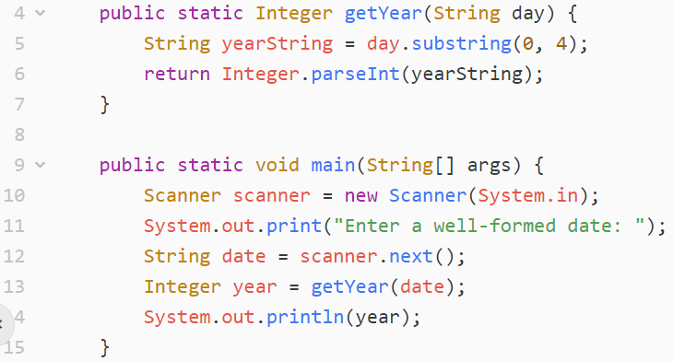
Exception Handling in Java

Slide 16
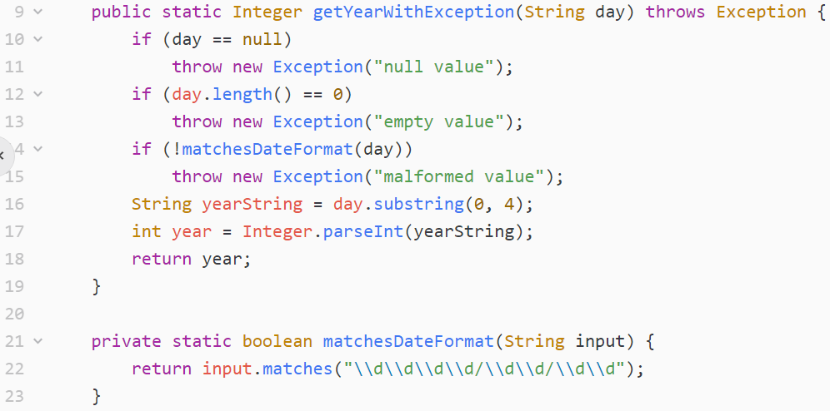
getYear()

Slide 17
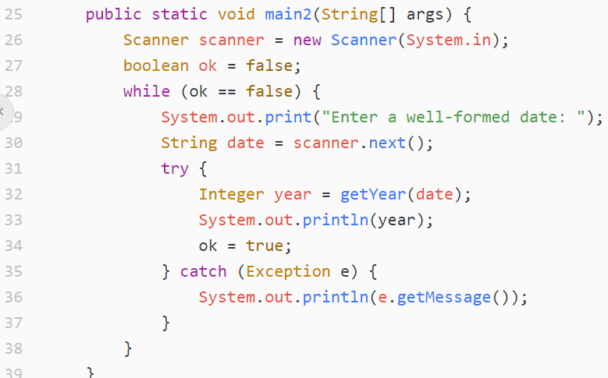
main()

Slide 18
Exception Handling Keywords
throw
throws a new exception
throws
Declares exception throw
If a method may throw an exception, it should declare it
try
Start a block with exception handling
catch
Catch the exception

Slide 19
Benefits of Exception Handling Framework
Separating Error-Handling code from “regular” business logic code
Propagating errors up the call stack
Grouping and differentiating error types

Slide 20
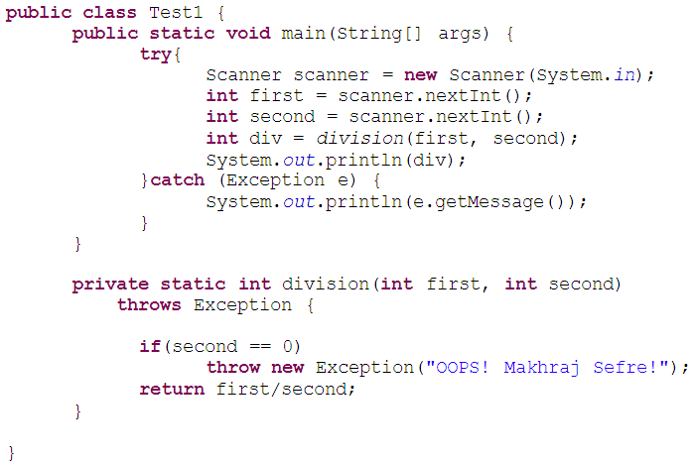
Example

Slide 21
Separating Error-Handling Code
Consider pseudocode method
It reads an entire file into memory
readFile {
open the file;
determine its size;
allocate that much memory;
read the file into memory;
close the file;
}

Slide 22
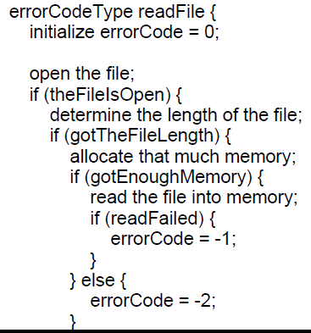
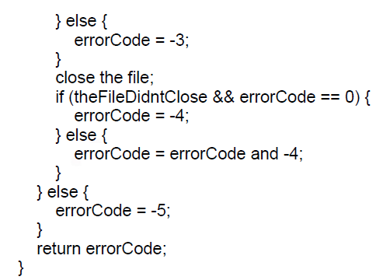
Traditional Programming

Slide 23
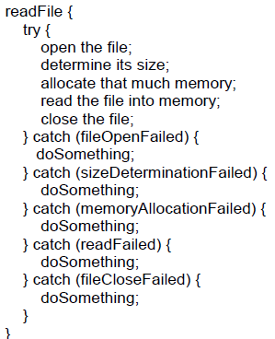
With Exception Handling Framework

Slide 24
Note
You should still write code for detecting, reporting and handling exceptions
Exception handling framework is not responsible for these jobs!
It only helps you organize the work more effectively

Slide 25
Propagating Errors Up the Call Stack
Traditional approach
Each method should explicitly forward the exception
Use a special return code
Using return type for reporting exceptions
Smells bad!
New approach
Automatic
Beautiful!

Slide 26
Grouping and Differentiating Error Types
All exceptions thrown within a program are objects
The grouping or categorizing of exceptions is a natural outcome of the class hierarchy

Slide 27
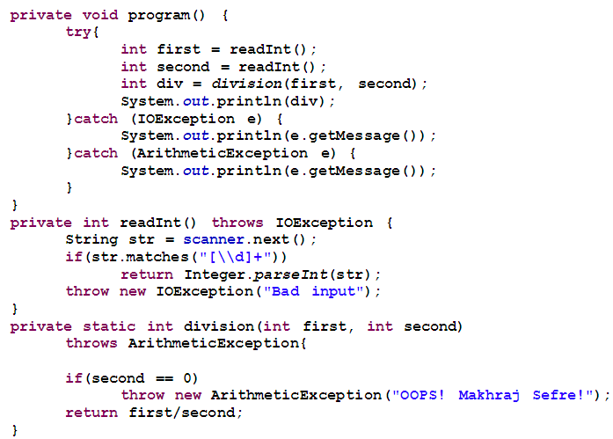

Slide 28
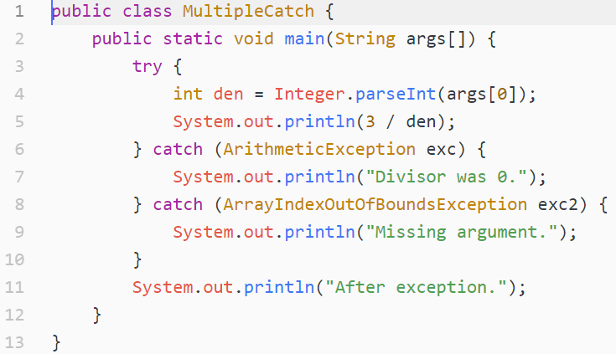
Example

Slide 29
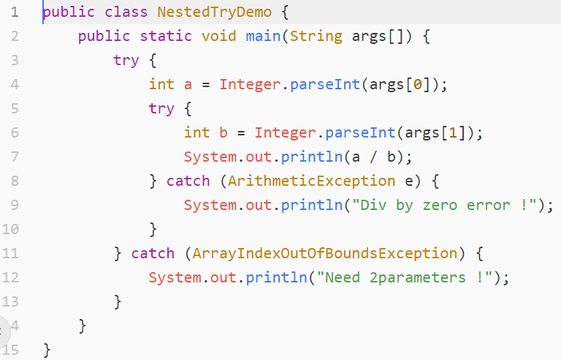
Nested Tries

Slide 30
Bad Use of Exceptions
Don’t Use Exception instead of If-else
Use exceptions for exceptions!

Slide 31
Writing Your Own Exceptions
Your class should extend Exception class
Exception subclasses could be thrown and caught
Steps to follow
Create a class that extends Exception class
Customize the class
Members and constructors may be added to the class
Exception classes are usually simple classes
With no (or few) methods and properties

Slide 32
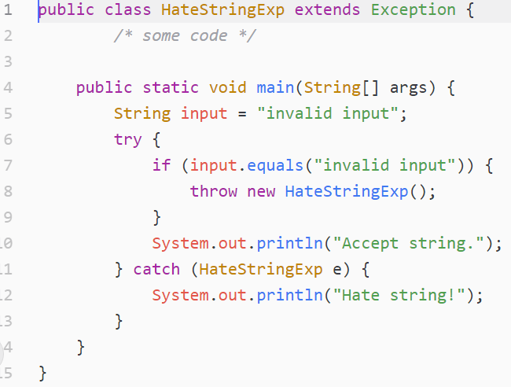
Example

Slide 33
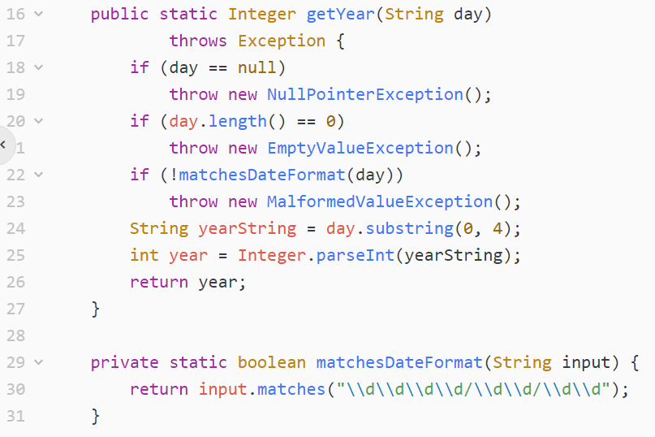
getYear(), revisited

Slide 34
Finally
try {
//..
} catch (ExceptionType e) {
//…
} ...
} finally {
<code to be executed before the try block ends>
}
Contains the code for cleaning up after a try or a catch

Slide 35
Finally (2)
Block of code is always executed
Despite of different scenarios:
Normal completion
Forced exit occurs using a return, a continue or a break statement
Caught exception thrown
Exception was thrown and caught in the method
Uncaught exception thrown
Exception thrown was not specified in any catch block in the method

Slide 36
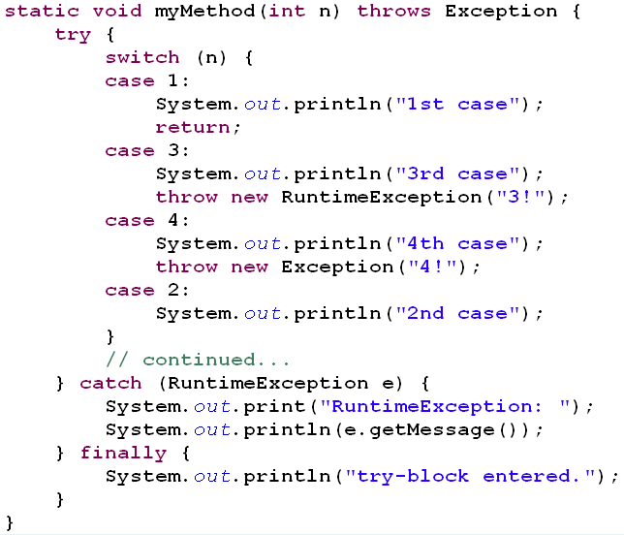

Slide 37
public static int myMethod(int n) {
try {
switch (n) {
case 1:
System.out.println("One");
return 1;
case 2:
System.out.println("Two");
throwMyException();
case 3:
System.out.println("Three");
}
return 4;
} catch (Exception e) {
System.out.println("catch");
return 5;
} finally {
System.out.println("finally");
return 6;
}
class MyException extends Exception {}
Quiz!
private static void throwMyException()
throws MyException {
throw new MyException();
}
int a = myMethod(1);
System.out.println("myMethod(1)=" + a);
a = myMethod(2);
System.out.println("myMethod(2)=" + a);
a = myMethod(3);
System.out.println("myMethod(3)=" + a);

Slide 38
Result:
One
finally
myMethod(1)=6
Two
catch
finally
myMethod(2)=6
Three
finally
myMethod(3)=6

Slide 39
Unchecked Exceptions
private static void function(String[] args) {
int den = Integer.parseInt(args[0]);
System.out.println(3 / den);
}
public static void main(String[] args) {
function(args);
}
The method function() may throw exceptions
But it has not declared it with throws keyword
Why?
Because some exceptions are unchecked
such as ArithmeticException and ArrayIndexOutOfBoundsException

Slide 40
Checked and Unchecked Exceptions
Checked exception
Java compiler checks
the program should catch or list the occurring exception
If not, compiler error will occur
Unchecked exceptions
Not subject to compile-time checking for exception handling
Built-in unchecked exception classes
Error
RuntimeException
Their subclasses
Unchecked exceptions only relax compiler
The runtime behavior is the same

Slide 41
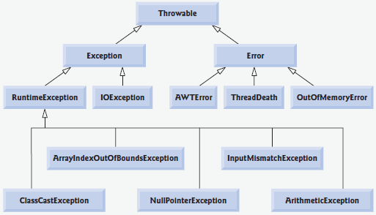
Exception Class Hierarchy

Slide 42
Exception Classes and Hierarchy
Multiple catches should be ordered from subclass to superclass
Or else, Compile error: Unreachable catch block…
class MultipleCatchError {
public static void main(String args[]){
try {
int a = Integer.parseInt(args [0]);
int b = Integer.parseInt(args [1]);
System.out.println(a/b);
} catch (ArrayIndexOutOfBoundsException e) {
//..
} catch (Exception ex) {
//..
}
}
}

Slide 43
Exceptions & Inheritance
Suppose method f() overrides parent’s method
f() in child class can not throw more exceptions than those of f() in Parent class
Less or equal exceptions in throws declaration
These mistakes bring compiler error
Why?
Polymorphic method invocations may cause failure in catching some exceptions

Slide 44
Example (1)
class Parent{
void f(){}
}
class Child extends Parent{
void f()throws Exception{}
}
Result?
Compiler Error

Slide 45
Example (2)
class Parent{
void f()throws ArithmeticException{}
}
class Child extends Parent{
void f()throws ArithmeticException, IOException{}
}
Result?
Compiler Error

Slide 46
Example (3)
class Parent{
void f()throws ArithmeticException{}
}
class Child extends Parent{
void f()throws Exception{}
}
Result?
Compiler Error

Slide 47
Example (4)
class Parent{
void f()throws Exception{}
}
class Child extends Parent{
void f()throws ArithmeticException{}
}
Result?
No Error

Slide 48
Conclusion
f() in child class can not throw more exceptions
Less or equal exceptions in throws declaration
f() in child class can not throw more general exceptions
f() in child class can throw more specific exceptions
Reason:
Prevent uncaught exceptions in polymorphic invocations

Slide 49
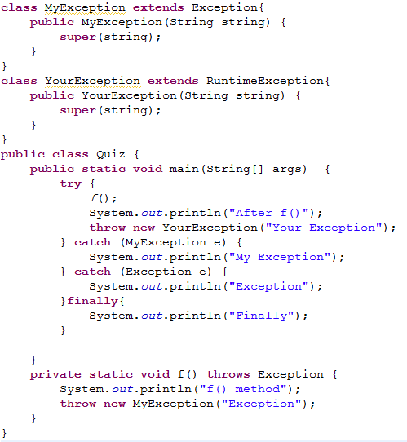

Slide 50
Accessing the Stack Trace
e.printStackTrace();
e.getStackTrace();
for(StackTraceElement methodCall : e.getStackTrace())
System.out.println(methodCall);

Slide 51
Multiple Catch Blocks
When providing multiple catch handlers:
handle specific exceptions before handling general exceptions.
Multi-Catch Blocks (Java7):
catch(IOException | IllegalStateException multie) {…}

Slide 52
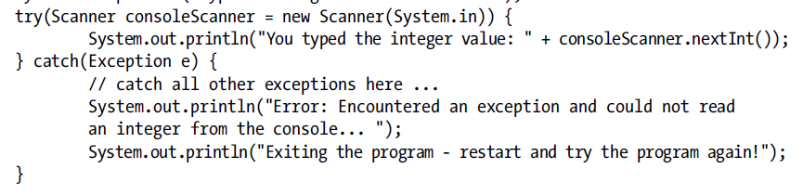

Try-with-Resources (Java7)
java.lang.AutoCloseable interface

Slide 53
References
http://www.javapassion.com/javase/javaexceptions.pdf
Java cup

Slide 54

Any Question

