Slide 1
Advanced Programming
Fall 2020

Slide 2
Agenda
Generic Methods
Generic Classes
Generics and Inheritance
Erasure

Slide 3
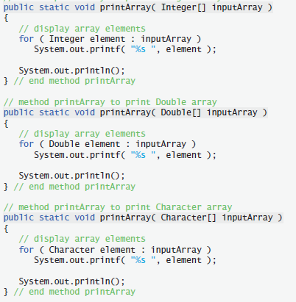

Slide 4
Stack interfaces
interface StringStack{
void push(String s);
String pop();
}
interface IntegerStack{
void push(Integer s);
Integer pop();
}
interface StudentStack{...

Slide 5
Sort Method
static void sort(Integer[] array) {
// ...
}
static void sort(Double[] array) {
// ...
}
static void sort(String[] array) {
// ...
}
static void sort(Student[] array){
// ...
}

Slide 6
The Problem
What is wrong with these examples?
Code redundancy
No effective code reuse
Solution?
Using Object class
Pros and Cons?
Compile-time type safety

Slide 7
The Solution
Generic types and methods
Methods with similar implementation
Applicable for different parameters

Slide 8
Generic Methods
Declaring a method which accepts different parameter types
For each method invocation, the compiler searches the appropriate method
If the compiler does not find a method, it looks for a compatible generic method
Type Parameter
It says: In this method, E is not a regular type, it is a generic one

Slide 9
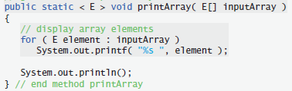
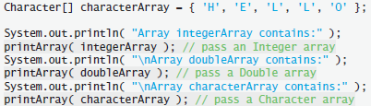
printArray() Generic Method

Slide 10
Benefits of Generics
public static < E extends Number> void printArray( E[] inputArray ){…}
Restricting possible types
Compile-time type checking
printArray(stringArray) brings
Compiler Error
or exception?

Slide 11
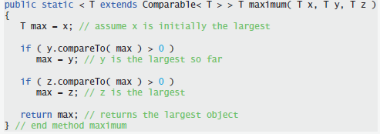

Type parameter as the Return Type

Slide 12
Stack Generic Interface
interface Stack<T>{
void push(T s);
T pop();
}
Stack<String> stringStack = new ...
stringStack.push(“salam”);
String s = stringStack.pop();

Slide 13
public class Stack<E > {
private E[] elements ;
private final int size; // number of elements in the stack
private int top; // location of the top element
public void push(E pushValue) {
if (top == size - 1) // if stack is full
throw new FullStackException();
elements[++top] = pushValue;
}
public E pop() {
if (top == -1) // if stack is empty
throw new EmptyStackException();
return elements[top--];
}
public Stack() {
size = 10;
top = -1;
elements = (E[]) new Object[size];
}
}
A note, later….

Slide 14
Using Stack Class
Stack<String> stack1 = new Stack<String>();
stack1.push("first");
stack1.push("second");
System.out.println(stack1.pop());
System.out.println(stack1.pop());
Stack<Integer> stack2 = new Stack<Integer>();
stack2.push(1);
stack2.push(2);
System.out.println(stack2.pop());
System.out.println(stack2.pop());

Slide 15
Compile-time Type Checking
Stack<String> stack1 = new Stack<String>();
stack1.push(new Integer(2));
Compile-time error

Slide 16
public class Stack<E extends Student> {
private E[] elements ;
private final int size; // number of elements in the stack
private int top; // location of the top element
public void push(E pushValue) {
if (top == size - 1) // if stack is full
throw new FullStackException();
elements[++top] = pushValue;
}
public E pop() {
if (top == -1) // if stack is empty
throw new EmptyStackException();
return elements[top--];
}
public Stack() {
size = 10;
top = -1;
elements = (E[]) new Student[size];
}
}
A note, later….

Slide 17
Raw Types
Generic classes and methods can be used without type parameter
Stack<String> s = new Stack<String>();
String as type parameter
s.push(“salam”);
s.push(new Integer(12)); ➔ Compiler Error
Stack objectStack = new Stack();
no type parameter
s.push(“salam”);
s.push(new Integer(12));
s.push(new Student(“Ali Alavi”));

Slide 18
No Generics in Runtime
Generics is a compile-time aspect
In runtime, there is no generic information
All generic classes and methods are translated with raw types
Byte code has no information about generics
Only raw types in byte code
This mechanism is named erasure

Slide 19
Erasure
When the compiler translates generic method into Java bytecodes
It removes the type parameter section
It replaces the type parameters with actual types.
This process is known as erasure

Slide 20
Erasure Example (1)
class Stack<T>{
void push(T s){...}
T pop() {...}
}
Is translated to
class Stack {
void push(Object s){...}
Object pop() {...}
}

Slide 21
Erasure Example (2)
Translated to

Slide 22
What Happens if…
public static <E extends Number> void f(E i){
}
public static void f(Number i){
}
Compiler Error : Method f(Number) has the same erasure f(Number) as another method in this type

Slide 23
Generics and Inheritance
A non-generic class can be inherited by a non-generic class
As we saw before learning generics
A generic class can be inherited from a non-generic class
Adding generality to classes
A non-generic class can be inherited from a generic class
Removing generality
A generic class can be inherited by a generic class

Slide 24
class GenericList<T> extends Object{
public void add(T t){...}
public T get(int i) {...}
public void remove(int i) {...}
}
class GenericNumericList<T extends Number>
extends GenericList<T>{
}
class NonZeroIntegerList
extends GenericList<Integer>{
public void add(Integer t) {
if(t==null || t==0)
throw new RuntimeException(“Bad value");
super.add(t);
}
}

Slide 25
Some Notes
We can also create generic interfaces
interface Stack<T>{
void push(T s);
T pop();
}
No primitives as type parameters

Slide 26
Multiple Type Parameters
class MultipleType<T,K>{
private T t;
public T getT() {
return t;
}
public void setT(T t) {
this.t = t;
}
public void doSomthing(K k, T t){…}
}
MultipleType<String, Integer> multiple =
new MultipleType<String, Integer>();
multiple.doSomthing(5, "123");

Slide 27
Note
You can not instantiate generic classes
class Stack<T>{
T ref = new T();
}
Syntax Error: Cannot instantiate the type T
Why?

Slide 28
Note (2)
You can not instantiate generic classes
class Stack<T>{
T[] elements = new T[size];
}
Syntax Error: Cannot instantiate the type T
Why?

Slide 29
Note (3)
You cannot create a generic array
class Box<T> {
final T x;
Box(T x) {
this.x = x;
}
}
Then, this line brings a compile error:
Box<String>[] bsa = new Box<String>[3];
Why?
Syntax Error:
Cannot create a generic array of Box<String>

Slide 30
Reason
Operations such as instanceof and new are runtime operations
They use a type at runtime
With erasure type information is removed at runtime
So these operations are Meaningless
Although, they may be possible
T ref = new T(); ➔ impossible
which constructor?
T[] elements = new T[size]; ➔ Meaningless
Box<String>[] bsa = new Box<String>[3]; ➔ Meaningless

Slide 31
Generics and Java 7
Older versions:
ArrayList<String> list = new ArrayList<String>();
With Java 7:
ArrayList<String> list = new ArrayList<>();
Type information after new are ignored.
List<Map<Long, Set<Integer>>> list = new ArrayList<>();

Slide 32
Further Reading
Wildcards as type parameters
Java generics vs. C++ templates
Erasure is different in these languages
Type Argument inference
More on erasure
TIJ is so better than Deitel in generics chapter
More Depth

Slide 33
Wow!!!
public static void wow(ArrayList<String> list) {
Method method = list.getClass().getMethod("add", Object.class);
method.invoke(list, new Integer(2));
}
public static void main(String args[]) {
ArrayList<String> s = new ArrayList<String>();
wow(s);
for (Object string : s) {
System.out.println(string);
}
}

Slide 34
A Note on Inheritance
class A{
public Object f(Object o){
return new Object();
}
}
class B extends A{
public Object f(Object o){
return new String("salam");
}
}
B.f() overrides A.f()

Slide 35
A Note on Inheritance
class A{
public Object f(Object o){
return new Object();
}
}
class B extends A{
public String f(Object o){
return new String("salam");
}
}
B.f() overrides A.f()

Slide 36
A Note on Inheritance
class A{
public Object f(Object o){
return new Object();
}
}
class B extends A{
public Object f(String o){
return new String("salam");
}
}
B.f() is overloading A.f()
B.f() does not override A.f()

Slide 37
Pair class (Quiz)
Pair<T, K>
equals
toString

Slide 38
class Pair<T,K>{
private T first;
private K second;
public Pair(T t, K k) {
this.first = t;
this.second = k;
}
public T getFirst() {
return first;
}
public K getSecond() {
return second;
}
public String toString() {
return "[" + second + ", " + first + "]";
}
}

Slide 39
Pair<Integer, String> pair1 =
new Pair<Integer, String>(4, "Ali");
Integer i = pair1.getFirst();
String s = pair1.getSecond();
Pair<String, Boolean> pair2 =
new Pair<String, Boolean>("salam", true);
String ss = pair2.getFirst();
Boolean bb = pair2.getSecond();

Slide 40
equals() method
public boolean equals(Pair<T,K> pair) {
return pair.first.equals(first) &&
pair.second.equals(second);
}
What is wrong with this implementation?

Slide 41
boolean equals(Pair<T,K> pair)
It should check for nullity of pair
It should check for nullity of pair.first and pair.second
It should check for nullity of this.first and this.second
This method does not override equals()
It is overloading it
Correct signature:
boolean equals(Object pair)
What if parameter is not a Pair?

Slide 42
Type Checking
public boolean equals(Object o) {
Pair<T, K> pair = null;
try{
pair = (Pair<T, K>) o;
}catch(ClassCastException e){
return false;
}
return pair.first.equals(first) && pair.second.equals(second);
}

Slide 43
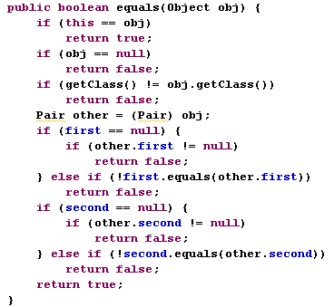

Slide 44
References
Java How to Program (9th Edition)
Deitel & Deitel
Thinking in Java (Fourth Edition)
Bruce Eckel
Java cup

Slide 45

Any Question

