Slide 1

Local-Lingo
Saskatchewan
ICE BREAKER SPEECH
__________
Mohammad Jahanseir
May 15th, 2025

Slide 2

What is Local-Lingo
Specific words, phrases, slang, and expressions use in a particular region

Slide 3
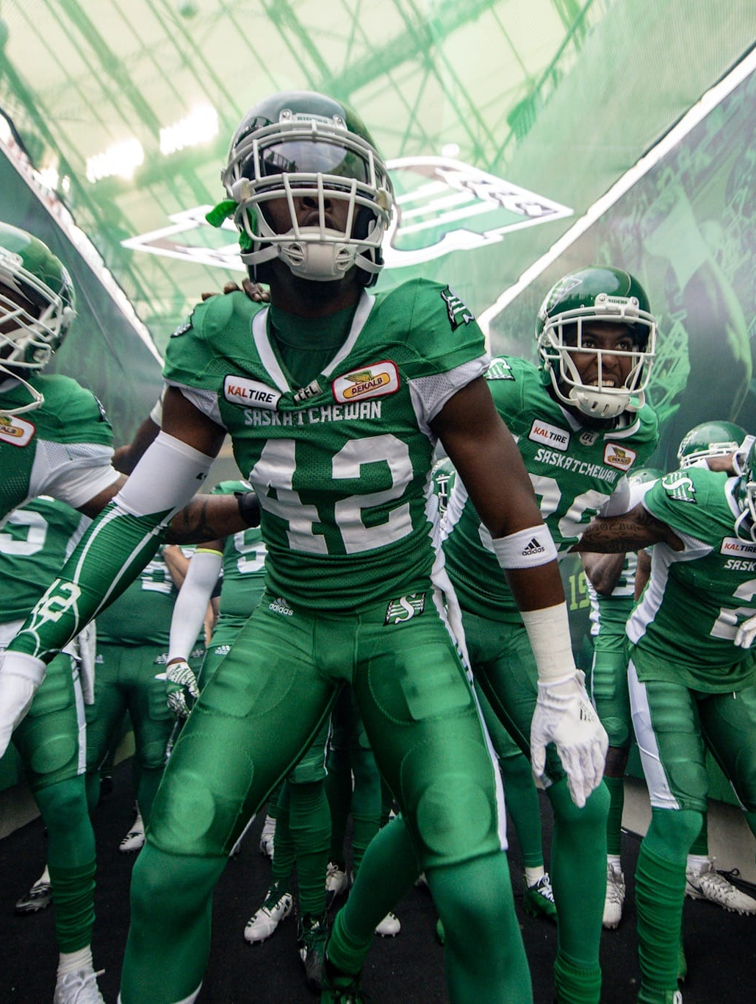
Saskatchewan Roughriders
Roughriders / Riders
Refers to the Saskatchewan Roughriders CFL football team
Bleeding Green
Describe the passionate support for the Saskatchewan Roughriders football team
If you are in Saskatchewan &
Don’t know the Riders...
You’re not from Saskatchewan

Slide 4
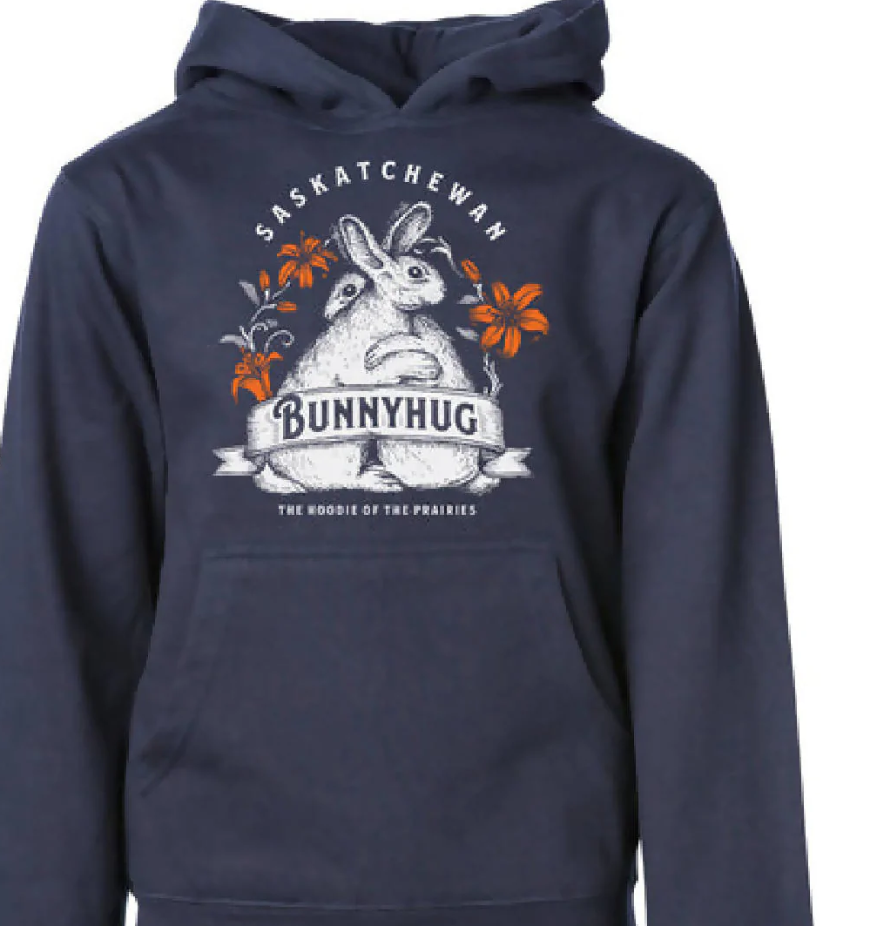
Bunny Hug?!
It's a Hoodie.
Here, it's a 'bunny hug’
and it's serious business!

Slide 5

Hi or Hey
Hey is a common greeting in Saskatchewan
Some older generations and farmers may think it more with calling animals than addressing people
While not offensive, 'Hi' or 'How’s it going?' might be a more natural choice in some situations

Slide 6
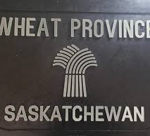

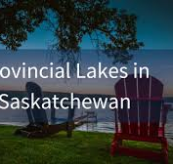
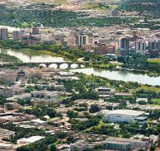
Saskatchewan's slang
Wheat province:
Saskatchewan
The Queen City:
Regina
Stoon:
Saskatoon
The Lake:
any of the many
( locals don’t always specify )
Saskie:
someone from Saskatchewan

Slide 7



Closing
I still say hoodie sometimes. But now I proudly wear my bunny hug
Cheer for the Riders—win or lose
And try to say Hi in my conversation!

Slide 8
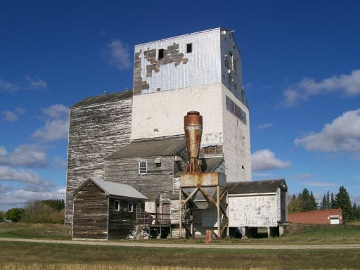
Grain Elevator
The Veregin Christian Community of Universal Brotherhood Grain Elevator, built in 1908 by the Doukhobors, is now a Provincial Heritage Property.
A historic grain-handling facility and a symbol of Saskatchewan’s cooperative movement, it remains one of the province’s few surviving wooden grain elevators.
More info…
Photo: saskatchewan.ca
The Largest Grain Elevator in Saskatchewan:
The Christian Community of Universal Brotherhood Ltd. at Kylemore, SK
website: Doukhobor Heritage

