Slide 1
GIT
Configuration Management

Slide 2
Topics
Basics of Software Configuration Management
Basics of Version Control System
  Centralized version control system
  Distributed/Decentralized version control system
How to install, configure and create repository
Working copy and check out
Review, Commit & Update
How to merge code and avoid conflict

Slide 3
Software Configuration Management
The problem:
  Multiple people have to work on software that is changing
  More than one version of the software has to be supported:
    Released systems
    Custom configured systems (different functionality)
    System(s) under development
    Software on different machines & operating systems
Need for coordination
Software Configuration Management
  manages evolving software systems
  controls the costs involved in making changes to a system.

Slide 4
All Software Has Multiple Versions
Different releases of a product
Variations for different platforms
    Hardware and software
Versions within a development cycle
    Test release with debugging code
    Alpha, beta of final release
Each time you edit a program

Slide 5
Version Control
Version control tracks multiple versions
In particular, allows
  old versions to be recovered
  multiple versions to exist simultaneously
  can recreate project history
Can revert a file or project to a previous version, track modifications and modifying individuals, and compare changes.

Slide 6
Centralized Version Control
This system entails a single server storing all changes and file versions, which can be accessed by various clients.
Allows programmers to have more knowledge of team members activities with certain files, and gave administrators much more control over giving up revision privileges.

Slide 7
GIT
Git is a Distributed Version Control System that stores data in a file system made up of snapshots.
Each time you save a changed version of your project called commit
Git creates a snapshot of the file and stores a reference to it.
If the file has not changed, Git only stores a reference to the already-stored identical version of it.

Slide 8
History of Git
Git traces its roots to the open source software project Linux kernel. Developers
Linus Torvalds, the chief architect of the Linux kernel, began creating Git.
Since its inception in 2005, Git has become one of the most utilized Version Control Systems in the world.

Slide 9
Local Operations
Git mostly relies on local operations because most necessary information can be found in local resources.
Projects history resides on the local disk, eliminating the need to fetch history information from the server
Can continue work on a project even when not online or on a VPN.

Slide 10
GIT-Features
Tracking Changes
  Every single change applied to any file or directory is tracked by Git.
States
  Files in Git can reside in three main states: committed, modified and staged.
  Committed
    Data is securely stored in a local database
  Modified
    File has been changed but not committed to the database
  Staged
    Flagged a file changed version to be committed in the next snapshot

Slide 11
Download GIT
Git can be installed by downloading
Git Website
http://git-scm.com/download/win
GitHub
Install Git as part of the GitHub for Windows install.
http://windows.github.com

Slide 12
Initial Customization
Identity Setting
Can set the user name and email address, to be used for every Git commit.
To SET
  git config --global user.name “Ramesh Kumar"
  git config --global user.email ram@abc.com
To View
  git config --global user.name
  git config --global user.email

Slide 13
Default Text Editor
Git will use the gitPad has the text Editor
  Can configure a different text editor
$ git config --global core.editor wordpad
Check Settings
  git config --list command.
Getting Help
  git help command
  git command –help

Slide 14
Setting up a Git Repository
To import an existing project or directory into Git,
Switch to the target project directory
$ cd test
  Use the git init command
Can start tracking repository files, and initial commit
$ git add *.java
$ git add LICENSE
$ git commit -m any message here
Now, your files are tracked and there an initial commit.

Slide 15
Cloning
To create a copy of an existing Git repository from a particular server
$ git clone https://github.com/test
  Copies all versions of all files for a project.
  creation of a directory called test,
  Has copies of all versions of all files for the specified project.
  automatically checks out or retrieves for editing a copy of the newest version of the project.
$ git clone https://github.com/test mydirectory
  It create a copy of the target repository in a directory named mydirectory

Slide 16
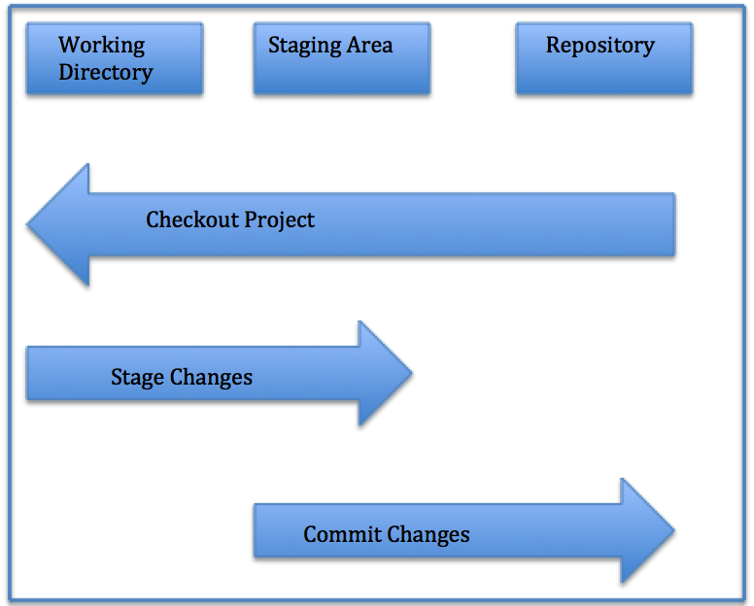
Local Repository Structure
The local Git repository has three components:
Working Directory: The actual files reside here.
Index: The area used for staging
Head: Points to the most recent commit

Slide 17
Saving Changes
All files in a checked out (or working) copy of a project file are either in a tracked or untracked state.
Tracked
  Files can be modified, unmodified, or staged; they were part of the most recent file snapshot.
Untracked
  Untracked files were not in the last snapshot and do not currently reside in the staging area.
  After cloning a repository, files have tracked status and are unmodified because they have been checked out but not edited.

Slide 18
Check File Status
To determine the state of files,
$ git status
Gives information of branch and state of working directory

Slide 19
Tracking and Staging a New File
  files are tracked and staged for committing.
Single File
  git add filename
All Files
  $ git add
$ git status

Slide 20
Committing a File
should commit the changes and record commit message:
  $ git commit –m made change x,y,z
Committing All Changes
  $ git commit -a*

Slide 21
Pushing Changes
To push changes to a remote repository.
$ git push origin master
pushes changes from the local master branch to the remote repository named origin
For cloned repositories,
  Git will automatically give the name origin  to the server from which you cloned and the name master to your local repository.
However, names can be changed by the user.

Slide 22
Repositories
Remote
  Versions of a project residing online or on a network.
  Teams can use remote repositories to push information to and pull data from.
Cloned Repositories
    Versions of a project residing in local machine.
Seeing Your Remotes
  git remote -v,
  you can view all the remote
  git remote -v remote1

Slide 23
Fetching
Fetching entails pulling data you don t have from a remote project.
git fetch [remote-name]
Cloned Repositories
  git fetch origin
  to pull down any new changes that were pushed to the server since you cloned or last fetched from it.
git fetch solely pulls new data to a local repository;
it does not merge changes with or modify your local work.

Slide 24
Pushing
To push your changes upstream for sharing,
  git push [remote-name][branch-name]
$ git push origin master
  pushes committed changes from local master branch upstream to the origin server.

Slide 25
Branching
Branches of a central repository are created
Collaborators are able to work on a project simultaneously via multiple branches, without affecting this main repository.
A collaborator can create a branch, work on it and save commit snapshots within it,
Can switch between various branches, and merge changes.

Slide 26
Branching
A Git branch is basically a movable pointer that always points to the most recent commit, or snapshot.
Git uses the default local branch name master, which can be changed.
Just because the default name is master does not imply that it is higher in importance or has more functionality than other branches.
The head is a special pointer which indicates which branch you are currently working within.

Slide 27
creating a New Branch
$ git branch test
Switching Branches
To switch to another branch,
$ git checkout test
This command moves the HEAD pointer to the test branch
If you make a commit while on the test branch, only this branch will point to the most recent commit.
The master branch will still point at the commit it was pointing to when you checked out to the test branch.

Slide 28
Create a Branch and Checkout
To simultaneously create a new branch and switch to it,
  $ git checkout -b test2*
Creates a new branch test2  and switches you to it.
List Branches
    $ git branch
Deleting Branches
  $ git branch -d test

Slide 29
Merging
To o merge changes from one branch into your current one
Current branch pointer moves forward to the most recent commit for the branch being merged in
$ git checkout master
$ git merge test
  merges in changes from test branch

Slide 30
Merge Conflicts
When the two files being merged both have changes in identical sections of a file,
Git will not be able to complete the merge cleanly.
These conflicts must be dealt with manually.
Portions of files with unresolved merge conflicts will be labeled unmerged
You can easily locate areas of merge conflict via Git conflict resolution markers,

Slide 31
Merge Conflicts
My name is
<<<<<<< HEAD
Jane
======= Mary >>>>>>>
branch-test Here,
HEAD indicates the branch you checked out before running the merge command.
The content above the ======= resides within this branch,
while everything below it is within the test branch.
git add command on fixed files to mark them as resolved.
$ git status will show the merge resolved

Slide 32
GitHUB
GitHub is a is the largest existing host for Git repositories and is used by millions of developers worldwide.
A high percentage of Git repositories reside on GitHub, and this resource is used by many open source projects.
Can set up a free user account.
Done by visiting https://github.com.

Slide 33
GITHUB - General Workflow
GitHub collaboration workflow revolves around Pull Requests.
Create a topic branch from master.
Commit changes for the project.
Push the topic branch to the GitHub project.
Open a Pull Request.
Confer with team and perform additional commits, if applicable.
The project owner closes or merges the Pull Request.

