Slide 1
COMP 110/L Lecture 18
Maryam Jalali Some slides adapted from Dr. Kyle Dewey

Slide 2
Outline
Multidimensional arrays
JUnit fail()

Slide 3
Multidimensional Arrays

Slide 4
Recap - Arrays
Arrays are fixed-length sequences of elements of the same type.

Slide 5
Recap - Arrays
Arrays are fixed-length sequences of elements of the same type.
new char[]{‘a’, ‘b’, ‘c’} new int[]{1, 2, 3}
new String[]{“foo”, “bar”}
new double[]{1.2, 3.4}

Slide 6
Motivations
Thus far, you have used one-dimensional arrays to model linear collections of elements. You can use a two-dimensional array to represent a matrix or a table. For example, the following table that describes the distances between the cities can be represented using a two-dimensional array.

Slide 7
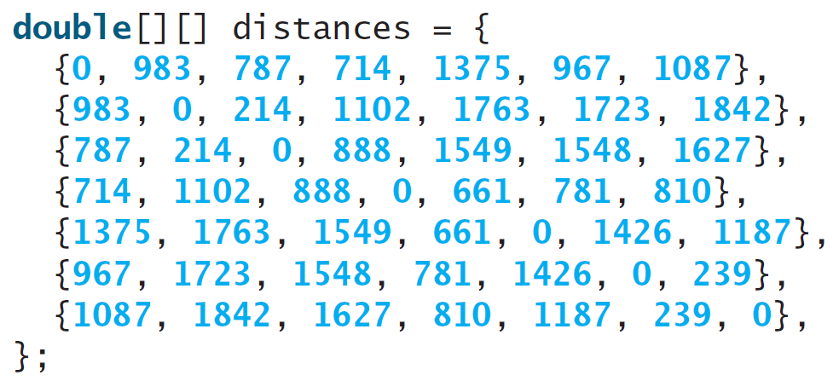
Motivations

Slide 8
Multidimensional Arrays
Java also allows us to make arrays of arrays.
These are often called multidimensional arrays.
Notes:
-”Multidimensional” because we need multiple dimensions to access any single element

Slide 9
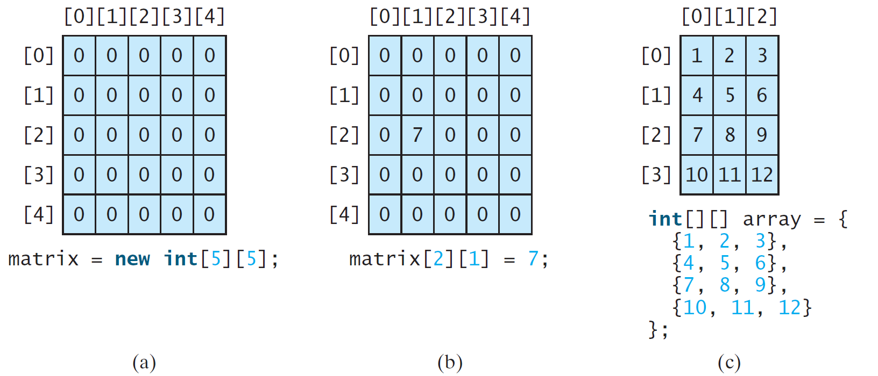
Two-dimensional Array Illustration

Slide 10
Multidimensional Arrays
Java also allows us to make arrays of arrays.
These are often called multidimensional arrays.
new int[][]{ new int[]{1, 2, 3},
new int[]{4, 5},
new int[]{6}, new int[0],
new int[]{7, 8, 9}
}
Notes:
-”Multidimensional” because we need multiple dimensions to access any single element
-This is specifically a two-dimensional array, since we need two dimensions to access a single int (specifically a row and a column)

Slide 11
Multidimensional Arrays
Java also allows us to make arrays of arrays.
These are often called multidimensional arrays.
new int[][]{ new int[]{1, 2, 3},
new int[]{4, 5},
new int[]{6}, new int[0],
new int[]{7, 8, 9}
}
Corresponding type: int[][]
Notes:
-”Multidimensional” because we need multiple dimensions to access any single element
-This is specifically a two-dimensional array, since we need two dimensions to access a single int (specifically a row and a column)

Slide 12
Multidimensional Array Utility
Commonly used for representing tables

Slide 13
Multidimensional Array Utility
Commonly used for representing tables
13 | 12 | 19
64 | 89 | 247
78 | 57 | 21

Slide 14
Multidimensional Array Utility
Commonly used for representing tables
13 | 12 | 19
64 | 89 | 247
78 | 57 | 21
new | int[][]{ | new | int[]{13, | 12, | 19},
 |  | new | int[]{64, | 89, | 247},
 |  | new | int[]{78, | 57, | 21} }

Slide 15
Accessing Rows
One row of a two-dimensional array is an array...

Slide 16
Accessing Rows
One row of a two-dimensional array is an array...
int[][] array = ...; int[] row = array[0];

Slide 17
Accessing Rows
One row of a two-dimensional array is an array...
int[][] array = ...; int[] row = array[0];
Accessing Columns
...and columns are individual elements of rows.

Slide 18
Accessing Rows
One row of a two-dimensional array is an array...
int[][] array = ...; int[] row = array[0];
Accessing Columns
...and columns are individual elements of rows.
int[][] array = ...; int[] row = array[0];
int columnElement = row[5];

Slide 19
Accessing Rows
One row of a two-dimensional array is an array...
int[][] array = ...; int[] row = array[0];
Accessing Columns
...and columns are individual elements of rows.
int[][] array = ...; int[] row = array[0];
int columnElement = row[5];
int[][] array = ...;
int columnElement = array[0][5];
Notes:
-Last box is shorthand for the second box: we can access a row and a column element in a single expression

Slide 20
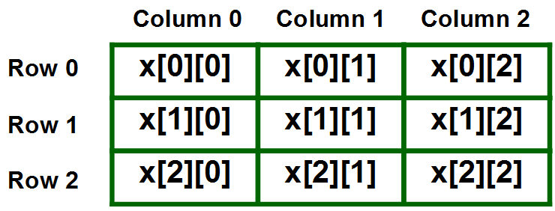

Slide 21
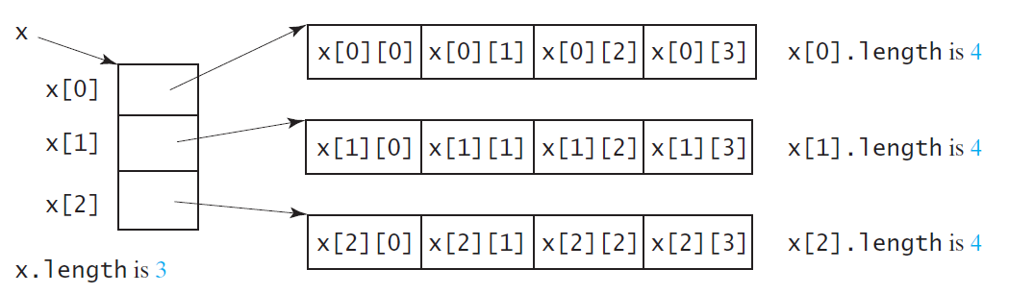
Lengths of Two-dimensional Arrays
int[][] x = new int[3][4];

Slide 22
Lengths of Two-dimensional Arrays, cont.
int[][] array = {
{1, 2, 3},
{4, 5, 6},
{7, 8, 9},
{10, 11, 12}
};
array.length
array[0].length
array[1].length
array[2].length
array[3].length
array[4].length ArrayIndexOutOfBoundsException

Slide 23
Ragged Arrays
Each row in a two-dimensional array is itself an array. So, the rows can have different lengths. Such an array is known as a ragged array.
For example,
int[][] matrix = {
{1, 2, 3, 4, 5},
{2, 3, 4, 5},
{3, 4, 5},
{4, 5},
{5}
};
matrix.length is 5
matrix[0].length is 5
matrix[1].length is 4
matrix[2].length is 3
matrix[3].length is 2
matrix[4].length is 1

Slide 24
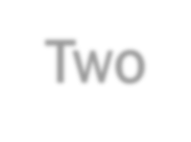


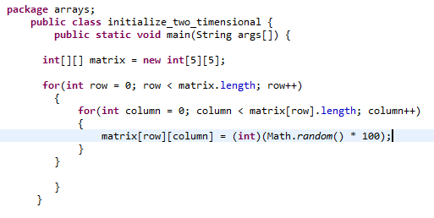
Two-Dimensional Arrays
Processing Two-Dimensional Arrays
» (Initializing arrays with random values) The following loop initializes the array with random values between 0 and 99:

Slide 25
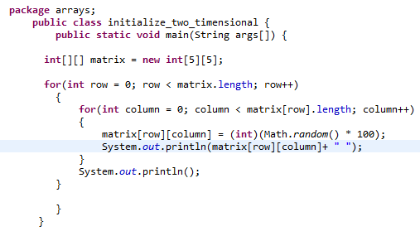
Two-Dimensional Arrays
Processing Two-Dimensional Arrays
» (Printing arrays) To print a two-dimensional array, you have to print each element in the array using a loop like the following:

Slide 26
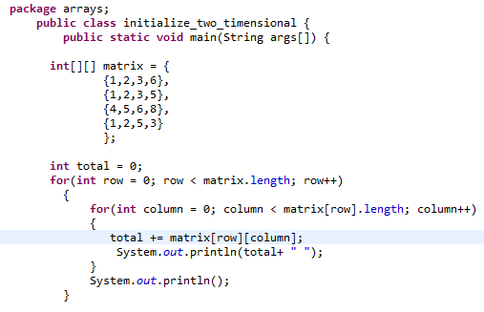
Two-Dimensional Arrays
Processing Two-Dimensional Arrays
» (Summing all elements) Use a variable named total to store the sum. Initially total is 0. Add each element in the array to total using a loop like this:

Slide 27
Example:
AccessTwoDimensionalElement.java

Slide 28
More 2D Array Examples
PrintRow2D.java
PrintCol2D.java

Slide 29
JUnit fail()

Slide 30
fail()
Triggers immediate test failure

Slide 31
fail()
Triggers immediate test failure
import static org.junit.Assert.fail;
Notes:
-Need this import at the beginning of the program

Slide 32
fail()
Triggers immediate test failure
import static org.junit.Assert.fail;
@Test
public void testSomething() { if (someFailureCondition) {
fail();
}
}
Notes:
-We can then use fail() in tests

Slide 33
Example
FailExample.java
FailExampleTest.java

Slide 34
fail() Utility
Some test failures cannot be easily phrased as one value equals another value
Occasionally more convenient
We can define our own assertEquals() and assertArrayEquals() using fail()

Slide 35
There are three states that your test case can end up in
Passed: The function under test executed successfully and returned data as expected
Not Passed: The function under test executed successfully but the returned data was not as expected
Failed: The function did not execute successfully and this was not
intended.
We can use the fail operation for the third scenario.
e.g.:
public Integer add(Integer a, Integer b){
return new Integer(a.intValue() + b.intValue())
}
Passed Case: a = new Interger(1), b= new Integer(2)
and the function returned 3
Not Passed Case: a = new Interger(1), b= new Integer(2)
and the function returned any value other than 3
Failed Case: a = null , b = null
and the function throws a NullPointerException

