Slide 1
COMP 110/L Lecture 4
Maryam Jalali Slides adapted from Dr. Kyle Dewey

Slide 2
Outline
New types: long and double
Reading in with Scanner
Performing operations on them
How they interact with each other and other types
Exponentiation with Math.pow()

Slide 3
New Type: long

Slide 4
Revisit:
AddTwo.java
Try with:
1- 9876543210
2- 1234567890 and 1234567890
Notes:
-If we try this with a really big number (e.g., 9876543210), it will outright crash
-If we try it with two still pretty big numbers (e.g., 1234567890 and 1234567890), it will produce incorrect results, even getting a negative number out of two positive numbers

Slide 5
Fundamental Problem
int stores integers in the following range:
-2³¹ to (2³¹ - 1)
Numbers out of this range won’t work right
Notes:
-This range is around +/- 2 billion.
-2 billion sounds like a lot, and it’s big enough for most things, but there are 7 billion people on the planet

Slide 6
long for Bigger Integers
long works like int, but its range is exponentially larger
-2⁶³ to (2⁶³ - 1)
Notes:
Integer is a signed 32 bit integer type
Denoted as Int
Size = 32 bits (4byte)
Can hold integers of range -2,147,483,648 to 2,147,483,647
Long is a signed 64 bit integer type
Denoted as Long
Size = 64 bits (8byte)
Can hold integers of range -9,223,372,036,854,775,808 to 9,223,372,036,854,775,807

Slide 7
Working with long
Declaring a long variable
long myLong;

Slide 8
Working with long
Declaring a long variable
long myLong;
Reading in a long with Scanner
Scanner in = new Scanner(System.in); long myLong = in.nextLong();
Notes:
-Instead of declaring an int variable, we can declare a long variable
-We can read in a long using nextLong(), as opposed to nextInt()

Slide 9
Example:
LongAddTwo.java

Slide 10
Specifying long
By default, if you write a number, Java assumes it’s an int
If you follow it with an l (the letter ell), Java will treat it as a long

Slide 11
Specifying long
By default, if you write a number, Java assumes it’s an int
If you follow it with an l (the letter ell), Java will treat it as a long
14 // int

Slide 12
Specifying long
By default, if you write a number, Java assumes it’s an int
If you follow it with an l (the letter ell), Java will treat it as a long
14 // int
14l // long (that’s an ell)

Slide 13
Interactions with long
String concatenation works like it does with int

Slide 14
Interactions with long
String concatenation works like it does with int
"my string" + 14l

Slide 15
Interactions with long
String concatenation works like it does with int
"my string" + 14l "my string14"

Slide 16
Interactions with long
String concatenation works like it does with int
"my string" + 14l "my string14"
13l + "other string"

Slide 17
Interactions with long
String concatenation works like it does with int
"my string" + 14l "my string14"
13l + "other string" "13other string"

Slide 18
Interactions with long
Addition works like it does with int

Slide 19
Interactions with long
Addition works like it does with int
5l + 4l

Slide 20
Interactions with long
Addition works like it does with int
5l + 4l 9l

Slide 21
Interactions Between
long and int
Values coerce into long
Notes:
-Intuition: long is bigger, so it wins

Slide 22
Interactions Between
long and int
Values coerce into long
4l + 2
Notes:
-Intuition: long is bigger, so it wins

Slide 23
Interactions Between
long and int
Values coerce into long
4l + 2
6l
Notes:
-Intuition: long is bigger, so it wins

Slide 24
Interactions Between
long and int
Values coerce into long
4l + 2
6l
3 + 6l
Notes:
-Intuition: long is bigger, so it wins

Slide 25
Interactions Between
long and int
Values coerce into long
4l + 2
6l
3 + 6l
9l
Notes:
-Intuition: long is bigger, so it wins

Slide 26
New Type: double

Slide 27
Revisit:
AddTwo.java
Notes:
-If we try to put in a floating-point value, it outright crashes
-We want support for floating-point values (these are really useful!)

Slide 28
double for Floating-Point
double stores floating-point values
float also stores floating-point values, but it’s half the size of double
Narrower range, less precise
Notes:
A float gives you approx. 6-7 decimal digits precision while a double gives you approx. 15-16. Also the range of numbers is larger for double.
A double needs 8 bytes of storage space while a float needs just 4 bytes.

Slide 29
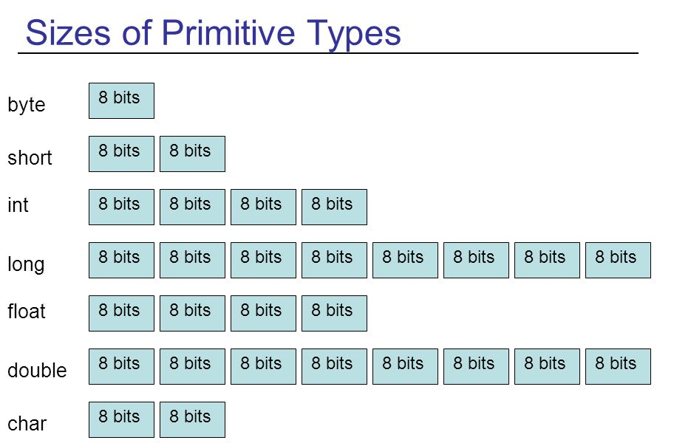

Slide 30
Working with double
Declaring a double variable
double myDouble;

Slide 31
Working with double
Declaring a double variable
double myDouble;
Reading in a double with Scanner
Scanner in = new Scanner(System.in); double myDouble = in.nextDouble();

Slide 32
Example:
DoubleAddTwo.java

Slide 33
Specifying double
If the number contains a decimal point, Java treats it as a double

Slide 34
Specifying double
If the number contains a decimal point, Java treats it as a double
4.5 // double

Slide 35
Specifying double
If the number contains a decimal point, Java treats it as a double
4.5 // double
1.0 // double

Slide 36
Specifying double
If the number contains a decimal point, Java treats it as a double
4.5 // double
1.0 // double
0.2 // double

Slide 37
Interactions with double
String concatenation works like it does with int

Slide 38
Interactions with double
String concatenation works like it does with int
“my string” + 0.5

Slide 39
Interactions with double
String concatenation works like it does with int
“my string” + 0.5 “my string0.5”

Slide 40
Interactions with double
String concatenation works like it does with int
“my string” + 0.5 “my string0.5”
0.2 + “other string”

Slide 41
Interactions with double
String concatenation works like it does with int
"my string" + 0.5 "my string0.5"
0.2 + "other string" "0.2other string"

Slide 42
Interactions with double
Addition works like it does with int

Slide 43
Interactions with double
Addition works like it does with int
5.0 + 4.2

Slide 44
Interactions with double
Addition works like it does with int
5.0 + 4.2
9.2

Slide 45
Interactions Between
double and int
Values coerce into double
Notes:
Type Casting in Java. Type casting is used to convert an object or variable of one type into another.
Syntax. dataType variableName = (dataType) variableToConvert;
Notes. There are two casting directions: narrowing (larger to smaller type) and widening (smaller to larger type). ...
In Java, there are two types of casting:
Widening Casting (automatically) - converting a smaller type to a larger type size byte -> short -> char -> int -> long -> float -> double Narrowing Casting (manually) - converting a larger type to a smaller size type double -> float -> long -> int -> char -> short -> byte

Slide 46
Interactions Between
double and int
Values coerce into double
0.5 + 2

Slide 47
Interactions Between
double and int
Values coerce into double
0.5 + 2
2.5

Slide 48
Interactions Between
double and int
Values coerce into double
0.5 + 2
2.5
3 + 0.75

Slide 49
Interactions Between
double and int
Values coerce into double
0.5 + 2
2.5
3 + 0.75
3.75

Slide 50
Interactions Between
double and long
Values coerce into double

Slide 51
Interactions Between
double and long
Values coerce into double
0.5 + 4l

Slide 52
Interactions Between
double and long
Values coerce into double
0.5 + 4l 4.5

Slide 53
Interactions Between
double and long
Values coerce into double
0.5 + 4l 4.5
3l + 0.75

Slide 54
Interactions Between
double and long
Values coerce into double
0.5 + 4l 4.5
3l + 0.75
3.75

Slide 55
Exponentiation with
Math.pow()

Slide 56
Exponentiation
Use Math.pow() for exponentiation (something to the power of something else)

Slide 57
Exponentiation
Use Math.pow() for exponentiation (something to the power of something else)
Wanted: 2⁷

Slide 58
Exponentiation
Use Math.pow() for exponentiation (something to the power of something else)
Wanted: 2⁷
Math.pow(2, 7)

Slide 59
Exponentiation
Use Math.pow() for exponentiation (something to the power of something else)
Wanted: 2⁷
Math.pow(2,7)
Wanted: 3.4^{5.6}

Slide 60
Exponentiation
Use Math.pow() for exponentiation (something to the power of something else)
Wanted: 2⁷
Math.pow(2,7)
Wanted: 3.4^{5.6}
Math.pow(3.4,5.6)

Slide 61
Example:
Exponentiation.java

