Slide 1
Utilizing an AI Approach to Pathfinding in Super Mario
Nick De Tullio, Thomas Gautier, & Michael Jalkio
CS 4701

Slide 2
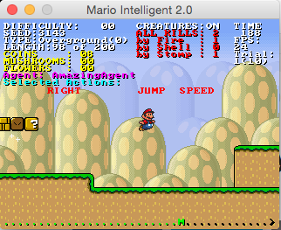
Infinite Mario Bros
Platformer game with open-source Java code based on Nintendo’s Super Mario Bros
Modified by Sergey Karakovskiy and Julian Togelius to include API interface for AI agents to play and be evaluated on
Also included advanced level generator that allowed testers to change level information including enemy density, complexity of features and pathing, and length

Slide 3
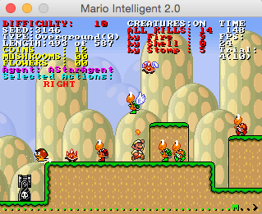
Platformer Games as an AI Benchmark
Platformers have very large statespace (22 x 22 general grid for path objects, pixel resolution for enemies, 20+ object types) and relatively large action space (2⁵ = 32 actions, some of which are nonsensical)
Large number of analysis options (points earned, time of completion, damage taken, enemies killed)
Many different strategies available – optimal strategy for human players is still a source of debate.

Slide 4
Project Goals
Analyze AI approaches to Infinite Mario Bros
Create an optimized AI approach efficiently and effectively and compare to previous competition entries
Observe optimal approaches to AI platformer problem

Slide 5
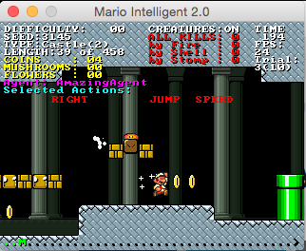
AmazingAgent
Created an AI agent for Infinite Mario Bros based on template of ForwardJumpingAgent (which moves forward and jumps whenever possible)
Used observations of shortcomings of ForwardJumpingAgent to find issues to address
Added rule-based logic to avoid simple shortcomings such as jumping into enemies above Mario, jumping too early and falling into gaps, and running into enemies in front of Mario

Slide 6
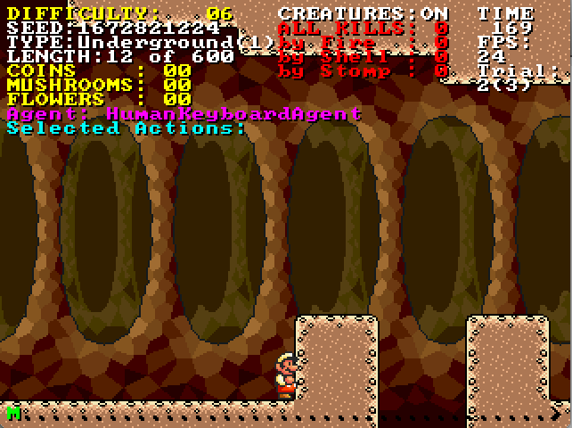
Conclusions
Learning-based algorithms were ineffective because they often never even learned to run forward and jump
A* algorithms dominated, possibly because their authors used workarounds to gain access to all level information (which has been criticized as “not within the spirit of the competition”)
Rule based agents did surprisingly well for how simple their strategies were (ForwardJumpingAgent outperformed the three of us) but were ineffective in traversing more complex levels due to large number of corner cases

