Slide 1

PROJECT PRECIPITATION
TEAM IX
STEVEN - 86164
AMRITHA - 83601
MITAL - 81299
RAJ KIRAN - 84176
SHRAVAN KUMAR - 83356

Slide 2
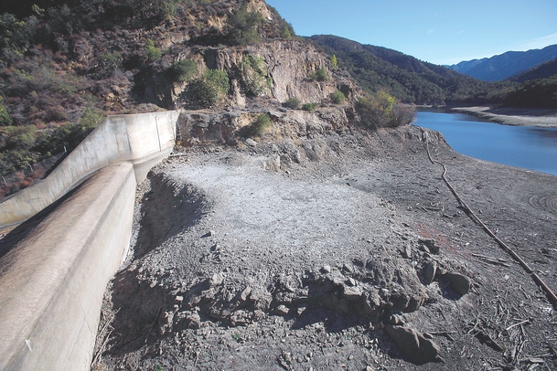
How we came up with this topic?
2013 was the driest year in California since having record. Recently, California Governor Jerry Brown has officially declared a drought emergency.
On Thursday, Federal Scientists said California’s historically dry weather is expected to last for at least another three months.

Slide 3
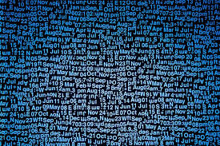


What problem trying to solve?
There are multiple sources of precipitation data. Extracting the right data from different sources is the main task.
Main focus is to do data massaging on raw data.
As Prof. always said that DATA IS GOLD
In this presentation my team mates will show you how we truly convert
We need to find connection between the datasets, combine, clean and normalize the data.
Summarize the statistics of data, with charts and graphs.
Deep Analysis and comparison of datasets.

Slide 4
Timeline of Project

Slide 5
Negative Hypothesis
Flood
Winter rain season
Spring Thaw
Heavy rains
Ice jams
Snow melts

Slide 6
Negative Hypothesis Cont.…
Drought
Hydrological Drought
Meteorological Drought
Agricultural Drought
Global Warming
Acid Rain

Slide 7
Positive Hypothesis
Precipitation is a major component of the water cycle, and is responsible for depositing most of the fresh water on the planet.
Common ways for adequate precipitation are:
Rain
Snow
Hail

Slide 8
Tool Used
R is a language and environment for statistical computing and graphics
R provides a wide variety of statistical like linear and nonlinear modeling, classical statistical tests, time-series analysis, classification, clustering etc. and graphical techniques, and is highly extensible
One of R's strengths is the ease with which well-designed publication-quality plots can be produced, including mathematical symbols and formulae where needed
R is available as Free Software. It compiles and runs on a wide variety of UNIX platforms and similar systems (including FreeBSD and Linux), Windows and MacOS
R is an integrated suite of software facilities for data manipulation, calculation and graphical display

Slide 9
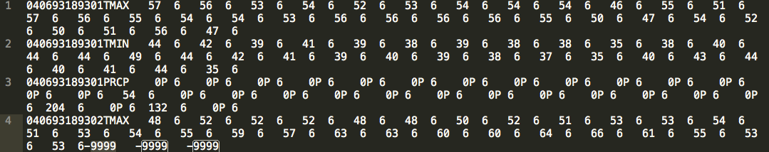
ANALYSIS AND DESIGN
Data Extraction:
The long-term daily precipitation (rain/snow, and also temperature) records for the United States are available from the United States Historical Climatology Network - USHCN
The format of each record is in an ASCII data file, be it a state-level file
The sample of data looks like this:

Slide 10
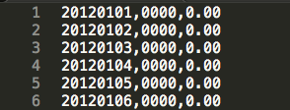
Data Extraction Cont. . . .
We can also obtain the real time and recent precipitation data from Department of Water Resources California Data Exchange Center website
The sample of data is:

Slide 11
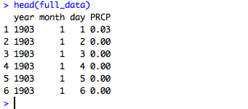
Data Normalization and Cleaning
As we have seen. We load them into R, and treat them separately, then join them together. We only extract the necessary information, i.e., year, month, day, and rainfall
Historical precipitation data is in hundredths of inches, however, the current data is in inches
We normalize them into inches
Sample Output data:

Slide 12
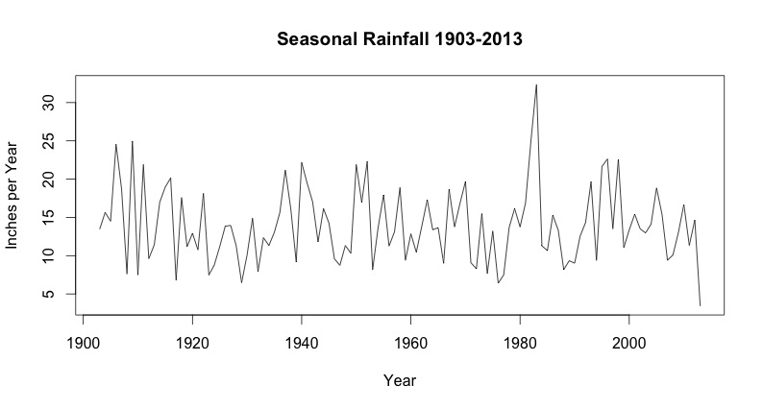
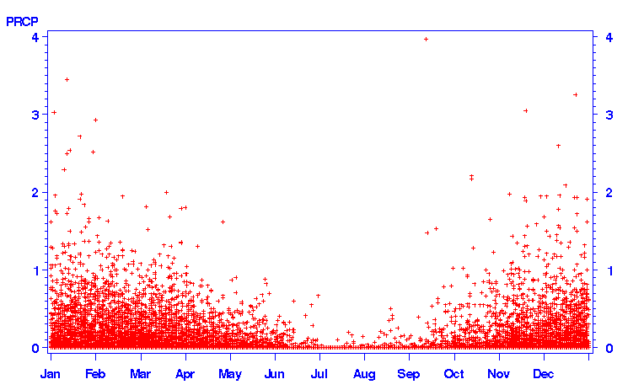
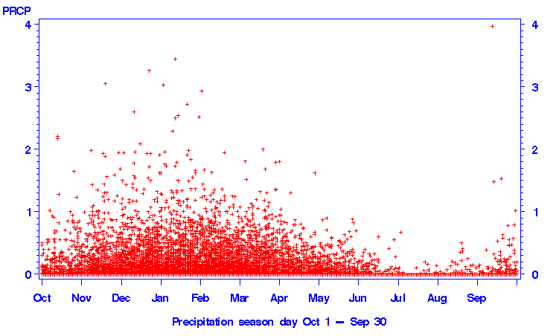
Data Exploration

Slide 13
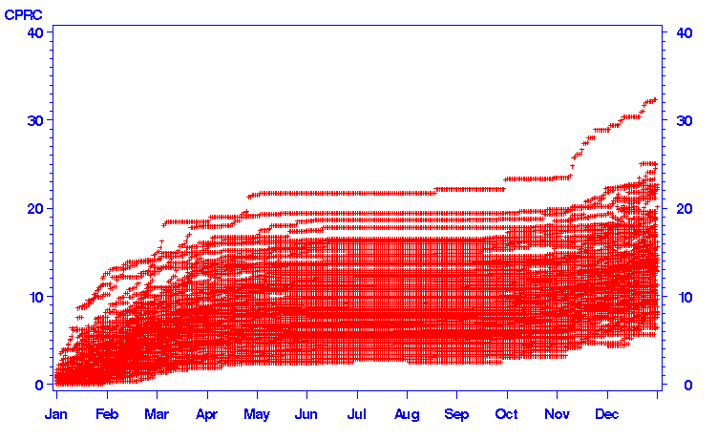
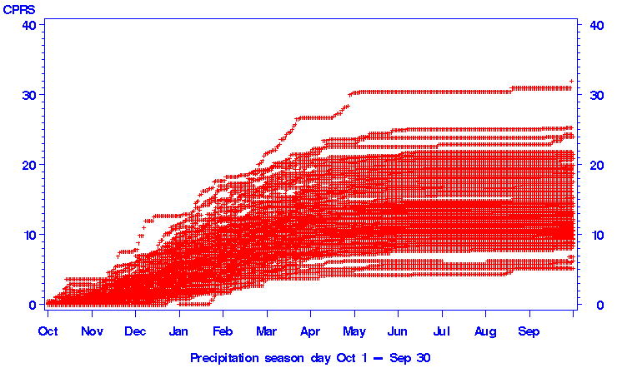
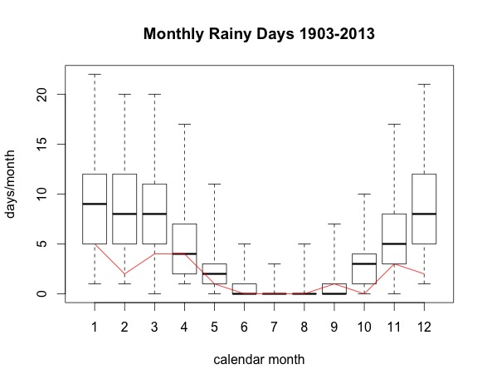
Data Exploration Cont. . . .

Slide 14
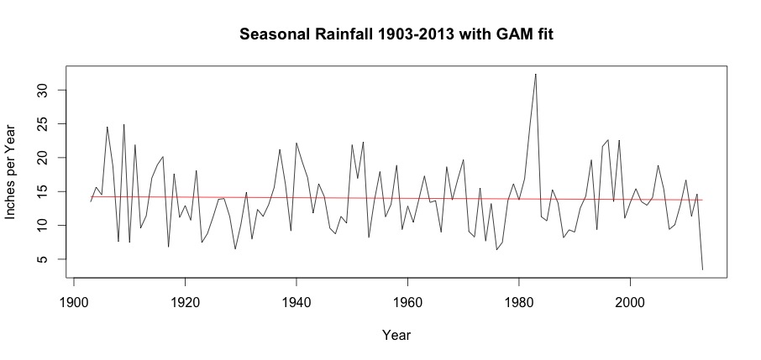
Predictive Modeling
Based on the historical rainfall data from 1903-2012, could we possibly predict the rainfall for 2013?
We try to fit the data with a regression model GAM
Due to the highly variation of data, the output GAM fitting is basically a linear regression, which doesn’t help much

Slide 15
Predictive Modeling Cont. . . .
The moving-average (MA) model is a common approach for modeling univariate time series models. For instance, at time t, a “centered moving average of order 3” with equal weights would be the average of values at times t -1, t, and t+1.
We will use the basic MA model to smooth the yearly rainfall data to discover the possible pattern or trend.

Slide 16
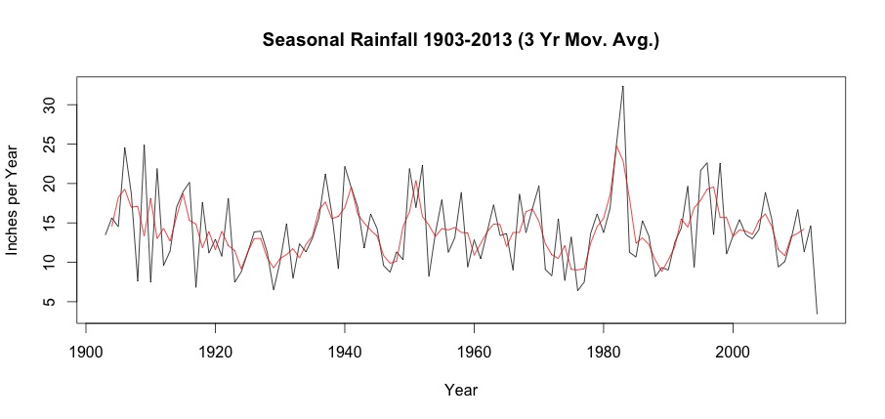
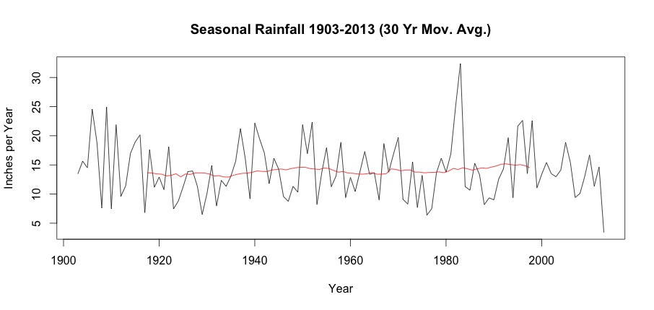
Moving Average Models

Slide 17
Advantages and disadvantages
Precipitation observations with radars operating in the X-band frequency range are essential for meeting present and future requirements for flood forecasting, water management, and other hydro-meteorological applications.
Besides having higher resolution, these systems are cost-effective compared to S- or C-band radars because of smaller antenna size. Disadvantages of single X-band radars are the large influence of attenuation by liquid water and a relatively short range.
.

Slide 18
The project Precipitation and Attenuation Estimates from a High-Resolution Weather Radar Network (PATTERN) is designed to demonstrate that a network of high-resolution weather radars (HRWRs) can overcome the apparent drawbacks of single X-band radars.
Each radar has a maximum range of 20 km with 60 m spatial and 30 s temporal resolution. A large area in the network is covered by at least two radars at the borders and up to four radars in the center.
In addition to identifying advantages and disadvantages of the HRWR network and single X-band radar, Dr. Lengfeld will briefly describe the algorithms used to derive precipitation from reflectivity measurements.

Slide 19
CONCLUSION
The main goal of this experiment is to estimate rainfall for effective use of water resources and optimal planning of water structures.
We computed values for rainfall using 100 years input data by using R language and predicted for future years.
climate variability is a reality that is affecting rural livelihood today and presenting a growing challenge in the region, as in many other parts of the continent and elsewhere.
calculations has been made considering hypothesis ,rain snow ,freezing rain, hail and negative hypothesis with all the data extractions set accordingly with the years looking in to the data .
.

Slide 20
Thank you

