Slide 1
PROTOTYPE
HANGMAN PROJECT
TEAM 4
INSTRUCTOR: JUAN VEGA
SOFTWARE ENGINEERING
2019

Slide 2
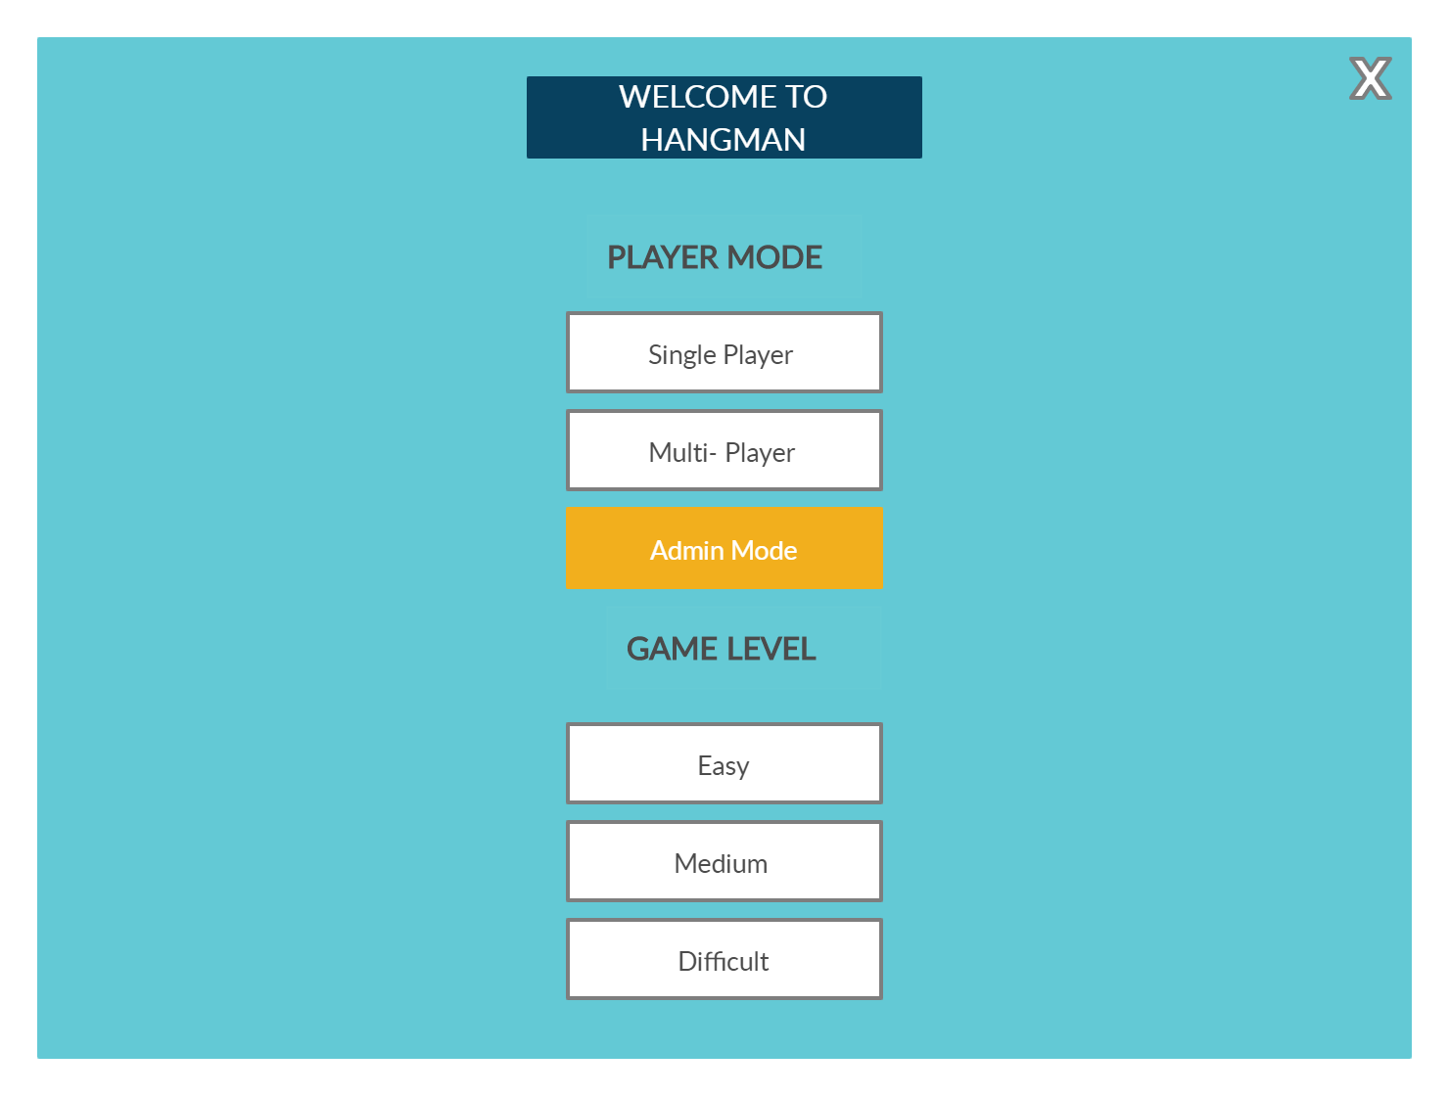
Home Page

Slide 3
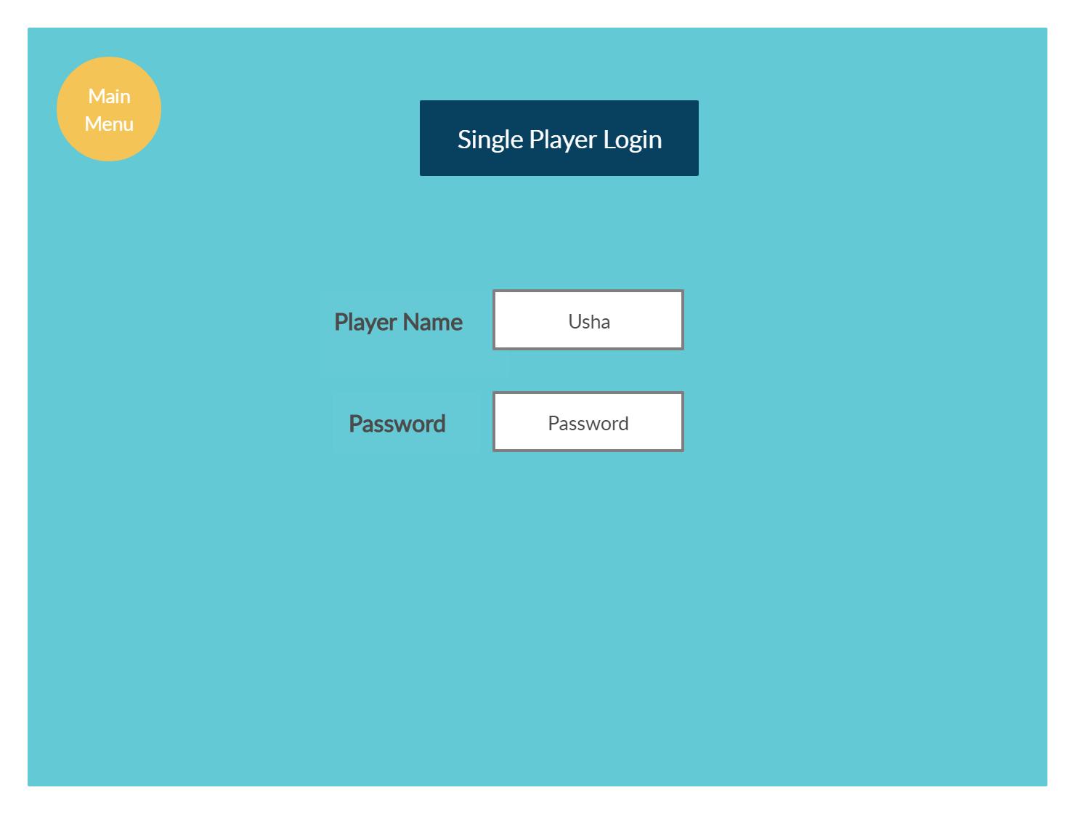
Single User Login

Slide 4
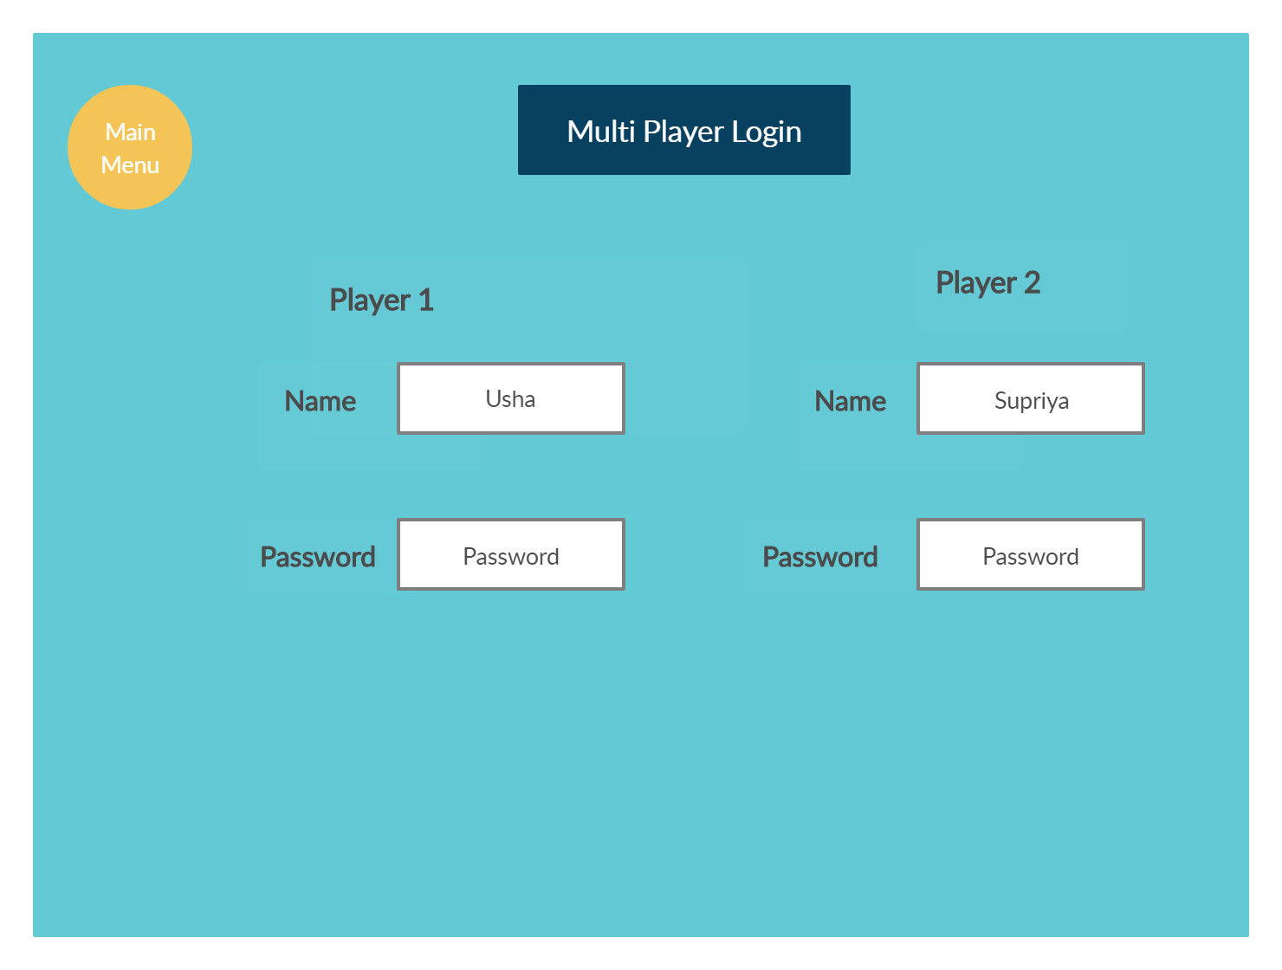
Multi-Player Login

Slide 5
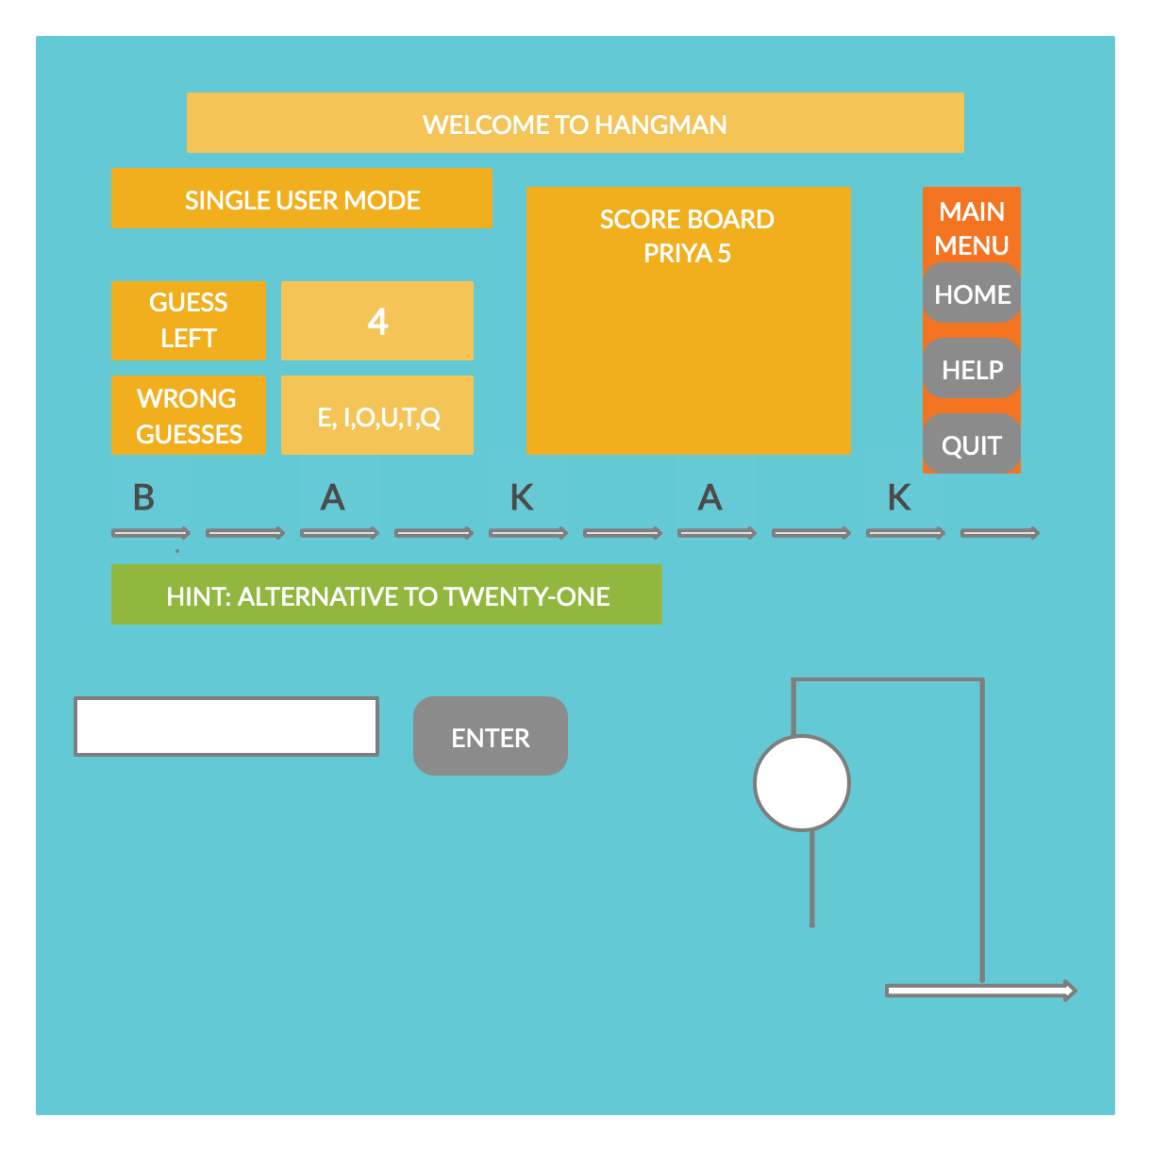
SINGLE MODE

Slide 6
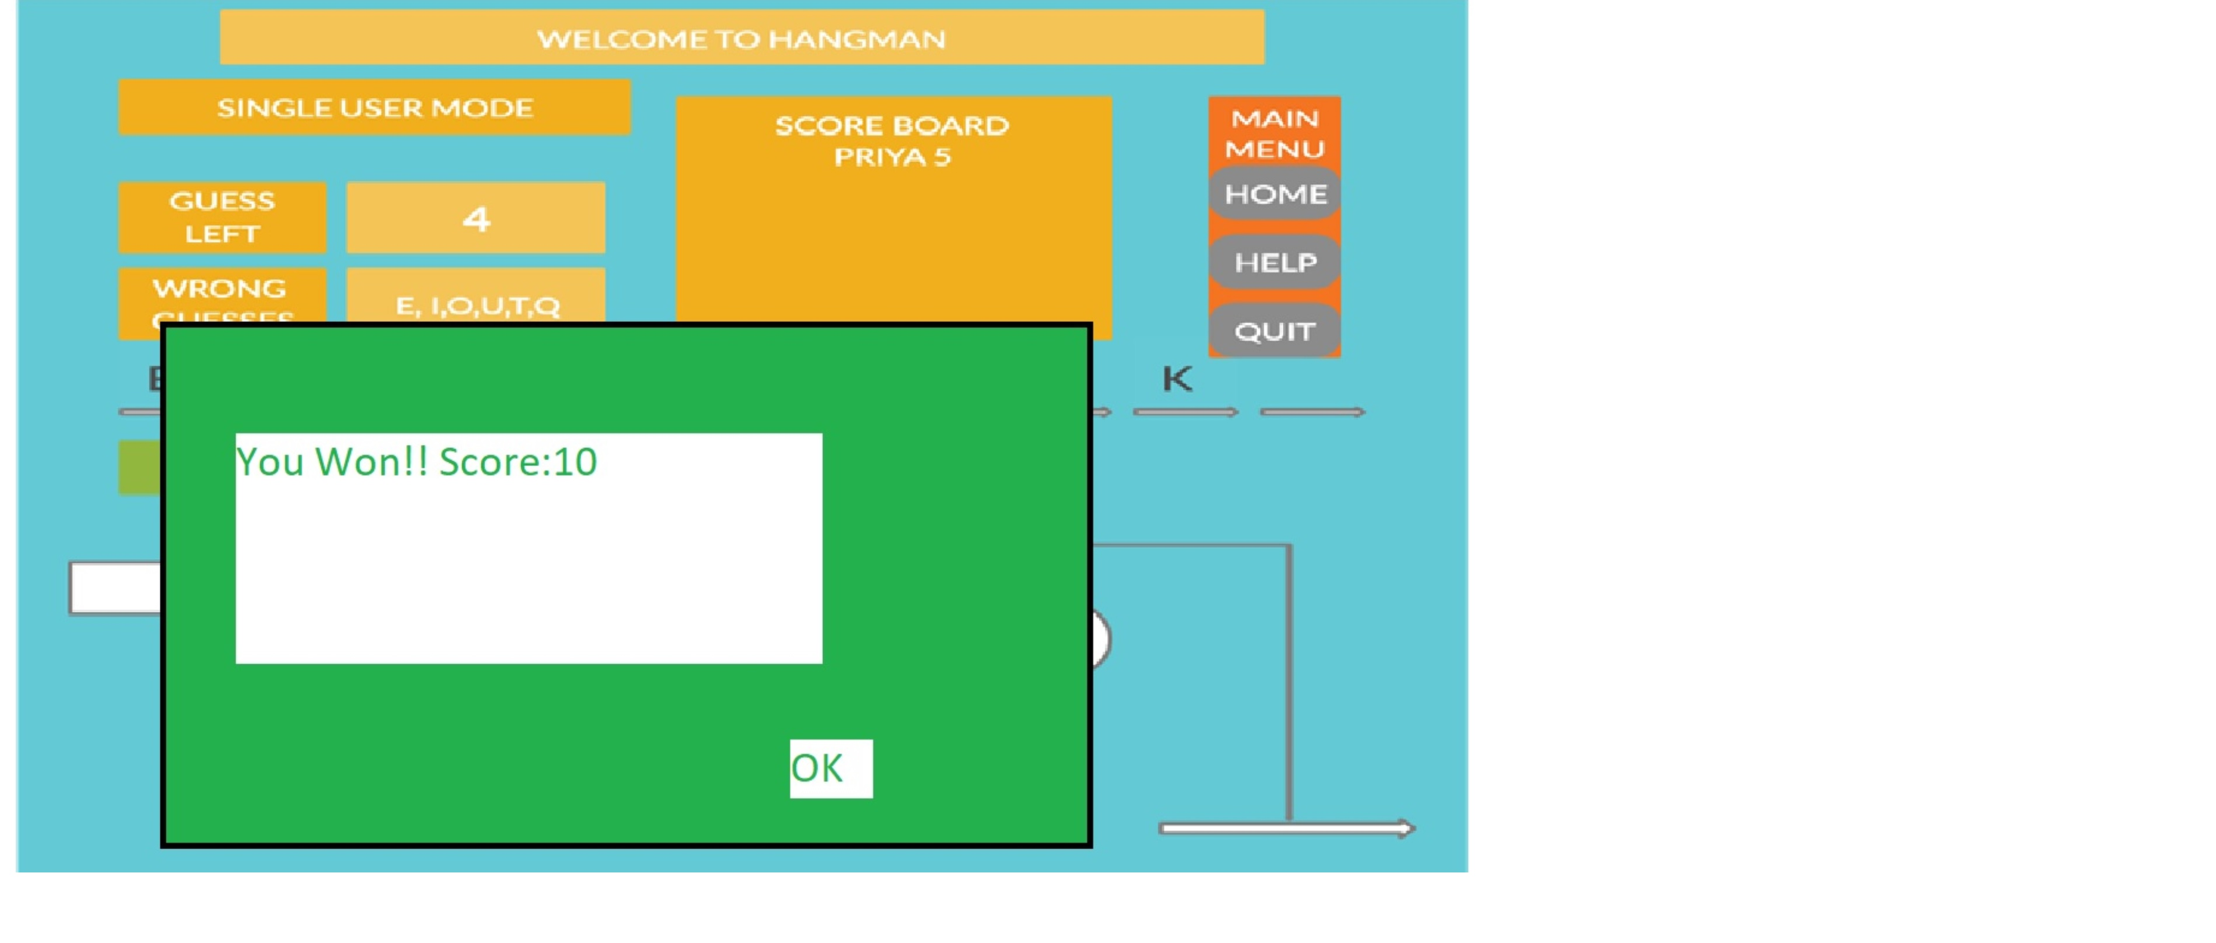
SINGLE MODE- WIN SCENARIO

Slide 7
SINGLE MODE- LOST SCENARIO

Slide 8
MUTLI MODE

Slide 9
ADMIN MODE

