Slide 1

HANGMAN PROJECT TECH-TYCOONS TEAM 4
JOYATEE CHATTOPADHYAY
MATTHEW JANNY
SUPRIYA JAMBOOR NAGESH
USHA RANI THAKUR
INSTRUCTOR: JUAN VEGA
SOFTWARE ENGINEERING
2019

Slide 2
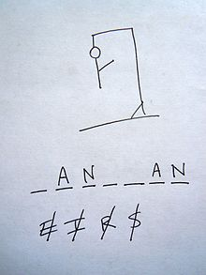
description
Hangman Project is a computer-based version of the classic paper and pencil guessing game for two or more players (Wikipedia). The Players compete against the computer to guess a word the software program has selected at random.

Slide 3

Description
Product Outlook: The advantage of this online program is that it allows someone to play the game in single mode or in groups against the computer.

Slide 4
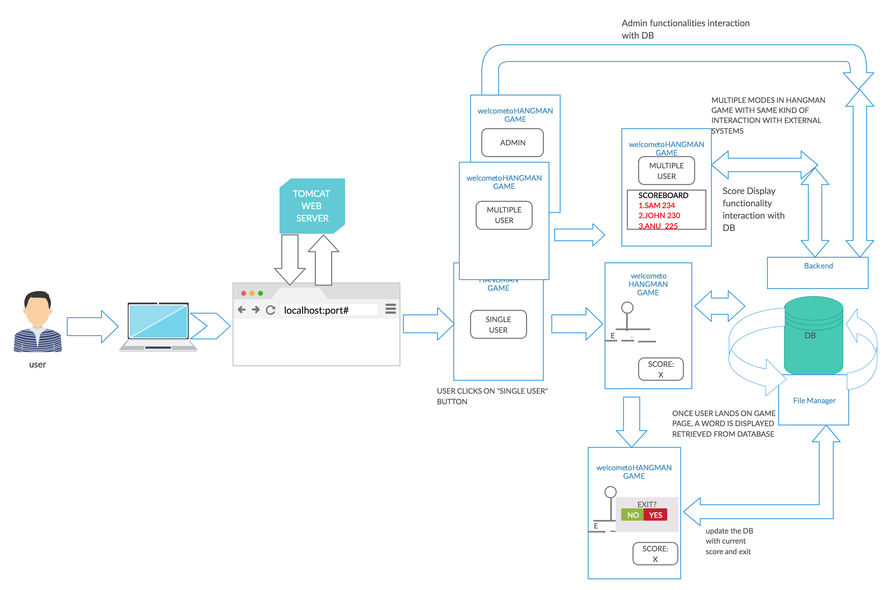
markEtecture

Slide 5
Product Features
Provide a Single User and Multiple User Modes.
Provides with Authentication for users through username and password.
Generate a Random Word to be guessed and provide a hint.
Provide option to guess the letters or a complete word.
Manage the Game Ground – To get players to guess the word, evaluate the alphabets guessed, and finally updating the scoreboard.
Determine if the player wins or lose the game (“Hang the Man”)
Provide options to quit the game but save their progress.
Provide with Administration (Admin) Mode.

Slide 6

User Characteristics
Hangman is designed for personal computer users who enjoy word games. Hangman is a recreational software project. The user is assumed to be competent using computer and Internet. The user is assumed to be familiar with the rules of Hangman. It is also assumed the user knows to type URL address in the browser

Slide 7
Assumptions and Dependencies
Hangman is dependent upon database to generate random words.
Hangman uses words from English Language only.
Hangman will assume that the word generated will be valid.
Hangman will run only on local machine where the necessary set up has been made.

Slide 8
General Constraints
Because of time constraints, multiple mode of this game will be implemented in future.
Because of time constraints, Admin mode of this game will be implemented in future.

Slide 9
architecture
Framework: Spring MVC Framework is used
Decision
Use Spring MVC framework.
Status
Accepted.
Context
Spring MVC helps in building flexible and loosely coupled web applications. The Model-view- controller design pattern helps in separating the business logic, presentation logic, and navigation logic. Models are responsible for encapsulating the application data
Consequences
We will be clear separation between three layers, and hence modification in each layer will not affect the other layer. Spring offers better integration with view technologies other than JSP (HTML/Velocity / XSLT / Free Marker / XL etc.)
Technology: Java Technology is used
Decision
Use Java Technology for coding
Status
Accepted.
Context
Java is object-oriented. This allows to create reusable code. Java is platform-independent. It is easy to write, compile and debug.
Consequences
1. Java has powerful development tools like Eclipse SDK and NetBeans which have debugging capability and offer integrated development environment.
2.It has no control over garbage collection.

Slide 10
Source Control Repository: Git Repository is used
Decision
Use Git Repository
Status
Accepted.
Context
One of the biggest advantages of Git is its branching capabilities. Unlike centralized version control systems, Git branches are cheap and easy to merge. This facilitates the feature branch workflow popular with many Git users. Feature branches provide an isolated environment for every change to your codebase
Consequences
GIT requires technical excellence and it is slower on windows
Methodology: Agile Methodology is used
Decision
Use Agile Methodology
Status
Accepted.
Context
Since our project is a small project and Agile works best for small and medium sized projects, and we don’t need much documentation for this project ,new features are delivered more quickly and frequently.
Consequences
Since there is no documentation ,project easily fall off track, and more commitment is required by each team member.

Slide 11
Security Management: Spring Security is used
Decision
Use Spring Security
Status
Proposed
Context
It supports java and it can be integrated with spring MVC. It supports authentication and authorization.
Consequences
It involves lots of XML configuration.
Front controller and MVC design patterns are used
Decision
Use Spring Security
Status
Proposed
Context
Front controller design pattern-This design pattern enforces a single point of entry for all the incoming requests. All the requests are handled by a single piece of code which can then further delegate the responsibility of processing the request to further application objects.
MVC design pattern- This design pattern helps us develop loosely coupled application by segregating various concerns into different layers. MVC design pattern enforces the application to be divided into three layers, Model, View and Controller.
Consequences
Increased complexity

Slide 12
PROJECT DECISIONS
Why did you choose the technology, process, approach that you did?
We had a choice between java and python – we decided on java since all 4 team member were comfortable with the language.
Everyone in team wanted to work with Agile Scrum methodology, since all of us taught for a small project with 4 members, it would be easy to divide the task and complete on week by week basis.
We decided to use GitHub as repository to maintain the project. All for had the account and we became collaborators. It was new for few team members and we eventually picked up. Few teammates had Windows who had to download Git bash whereas other teammates with mac os was ready with built in Gits commands in their terminals

Slide 13
PROJECT DECISIONS continued
We had Whatsup platform to constantly talk about the on-going task of the project and be in touch for outside hours.
When we started with web framework decision- fewhad worked on JSP, CSS, AJAX, STRUTS2, SPRING MVC- finally choose Spring Version 4.0.2.
We decided to use TOMCAT server – since its web server and is easy to download and add to servers in eclipse
UI- jsp with spring library
Project security – Spring security- for authentication, identity management
We had Google document and spreadsheet used to for building all document based work. We divided the session and uploaded our work to be reviewed by other teammates with a time limit and once reviewed one of the teammate would upload it to blackboard

Slide 14
Project decision continued
What were the pros and cons of your decisions?
Pros –
Project is in executable phase.
Cons-
Project doesn't’ have all the features implemented.

Slide 15
Project TECHNOLOGY AND ENVIRONMENT
LANGUAGE- java
FRAMEWORK –spring MVC
ENIVROMENT- Eclipse IDE
HOSTING- local host (port 8080)
TYPE OF APPLICATION –WEB APPLICATION

Slide 16
CONCLUSIONS!!!
EXPECTATIONS FROM THE COURSE
LIKENESS ABOUT THE COURSE
MEET EXPECTATIONS OR NOT?
ONE SUGGESTION TO MAKE THIS COURSE BETTER

Slide 17
EXPECTATIONS FROM THE COURSE
What Software Engineering can offer to our Career?
How we can implement Software Engineering concepts in our day-to-day industry life?

Slide 18
LIKENESS ABOUT THE COURSE
Software Engineering provided a ride to the overall procedure involved in a project
We tried to implement the same in our project, which helped in recognizing the importance of lesser know task like maintaining communication with team members, understanding team members ideas and eventually overcoming difference in approaching the task.

Slide 19
CHALLENGES FACED
Deciding the push button for the input of words. Few teammates wanted keypad while few wanted text type box. – finally we agreed for text type box considering it would be easy to implement compared to building keypad on all the screen.
We started to implement using MVC framework but realized that it will need extra code to maintain a proper structure of the framework. We started to incline to “Simple Dynamic web project without any MVC framework”- but ended up using Spring MVC framework.
We had issue setting up our local machine – importing tomcat as a server in eclipse – with few trail and error, we figured out the way to import the server and run it on IDE
We had difficult in deciding the flow of the program in terms of what should point to what, where should the buttons be placed- we eventually over came with brain storming each others ideas.

Slide 20
suggestion
If there be a better way of studying the text books [Ian Somerville software engineering 10th] to complete the assignments with emphasis more on hand on project assignments rather than theory assignments.

