Slide 1
Requirement Section
PHASE1

Slide 2
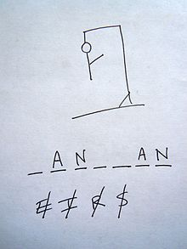
Summary:
Hangman Project is a computer-based version of the classic paper and pencil guessing game for two or more players (Wikipedia). The Players compete against the computer to guess a word the software program has selected at random.

Slide 3
General Description
Product Outlook: The advantage of this online program is that it allows someone to play the game in single mode or in groups against the computer.

Slide 4
Product Features: (Phase1)
The application’s purpose is to build the word game “Hangman”. The features are:
Provide a Single User.
Generate a Random Word to be guessed and provide a hint.
Manage the Game Ground – To get players to guess the word, evaluate the alphabets guessed, and finally updating the scoreboard.
Determine if the player wins or lose the game (“Hang the Man”).
Provide options to quit the game but save their progress.

Slide 5
User Characteristics
Hangman is designed for personal computer users who enjoy word games. Hangman is a recreational software project. The user is assumed to be competent using computer and Internet. The user is assumed to be familiar with the rules of Hangman. It is assumed the user knows to type URL address in the browser

Slide 6
Assumptions and Dependencies
Hangman is dependent upon database to generate random words.
Hangman uses words from English Language only.
Hangman will assume that the word generated will be valid.
Hangman will run only on local machine where the necessary set up has been made.

Slide 7
General Constraints
Because of time constraints, multiple mode of this game will be implemented in future.
Because of time constraints, Admin mode of this game will be implemented in future.

Slide 8
Functional Requirement: (Phase1)
Starting the Application
Allow the user to enter the URL on any browser.
At the start of each game, a main menu should be displayed.
The main menu offers single, multi-players and multi-players group modes.
At phase1 of this project, single mode implementation is provided.
The game should load in 10 seconds after the URL is typed in the browser.

Slide 9
Functional Requirement: (Phase1) CONTINUED
Playing the Game- SINGLE MODE
At each game, the number of letters in the word is displayed using blank character.
At each turn, if the guessed letter is correct, a visual appearance of that letter in correct position is displayed.
At each turn, a messaged is displayed upon entering the alphabet –“You have guessed A”.
If the same letter is guessed again, a message is displayed- “You have already guessed A”.
The already guessed letters are displayed on the screen.
If the guessed letters are not between “A”-“Z”, a message is displayed – “Enter only Letters” and players are allowed to guess again without penalty.

Slide 10
HIGHLEVEL USECASE (PHASE 1)
USE CASE1- STARTING THE APPLICATION
Priya would like to start a hangman game on Chrome browser. Priya has the Tomcat server installed in her computer. Priya first starts her chrome browser and type the URL: local host: 8080. Priya is presented with Hangman Home page with menu option. The menu option consists of single user mode, multi user mode, and exit and help button.
Actions:
Power on the computer.
Type in the URL address in chrome browser.

Slide 11
HIGHLEVEL USECASE (PHASE 1) CONTINUED
USE CASE2- PLAYING THE GAME
Priya wants to start the game on the home page of Hangman project. She clicks on single user mode button. It redirects her into single user page where the game begins. The page displays a hidden word with a hint, scoreboard, and number of guesses left and the guessed letters for Priya to understand where she stands in the game.
Click the Single user button.
Click on the letters on the alphabet pad.
If the guessed letter is correct, the letter is should be displayed in the correct position of the word.
Continue step 2 until the word is displayed or until the count begin zero, whichever is first.

Slide 12
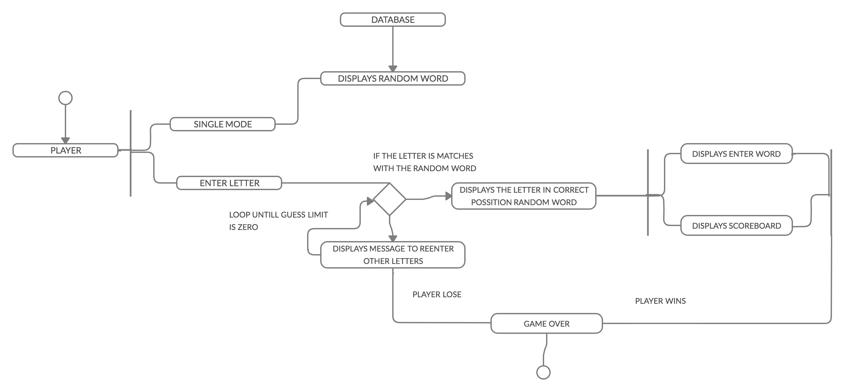
HIGH LEVEL ACTIVITY DIAGRAM (PHASE 1) PLAYING THE GAME

Slide 13
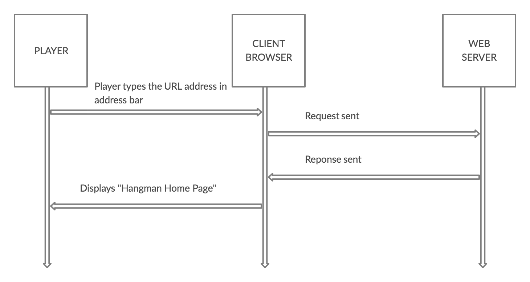
HIGH LEVEL SEQUENCE DIAGRAM (PHASE 1)

Slide 14
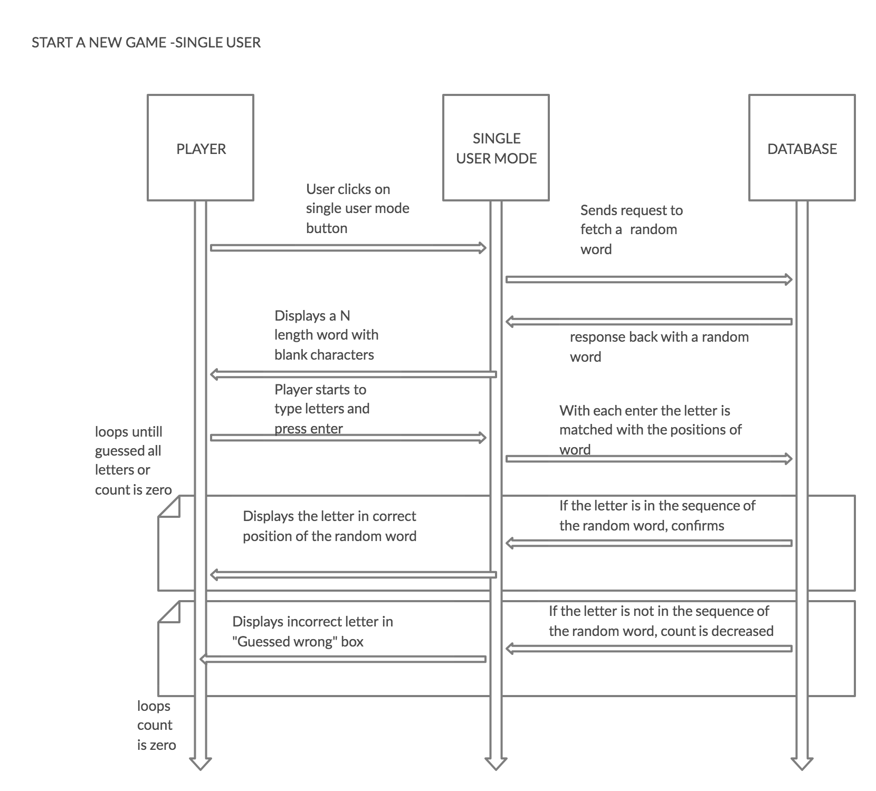
HIGH LEVEL SEQUENCE DIAGRAM (PHASE 1) -CONTINUED

Slide 15
Non-Functional Requirements:
Operating Constraints:
The program requires the JRE 1.4 with Swing.
Documentation
A short (<200 words) message explaining how to use the Hangman project.
Portability
The program will run Windows/Mac Os
Reliability
Since the program is purely for recreation and user data involve only in creating account particularly for this game, reliability is of low importance.
Security
Since user Login is provided for each user, Authentication with username and password will be established based on spring model.
The application will not access any use or alter any system files on which it runs.
Usability
A new user should be able to pick the understanding of the game and play the game under ten minutes.
A user who is familiar with classic Hangman game should be able to play the online game without any written documentation
Deployment
The project will be deployed on web server (tomcat) and the project will be executed on web browser when URL is typed in address bar.
Performance
Desired response time after the game URL as been typed in the browser: less than ten seconds.
Desired response time (not critical): At the game start: less than five seconds
After each turn: less than two seconds.

Slide 16
Non-Functional Requirements: - Database
Performance
After the mode (Single or Multi) is selected and start button is pressed, the hidden word should appear on screen in less than a second.
Maintainability
It is desired that the game administrator be able to modify the words database using simple SQL queries.
Adding a new word to the word database should take less than ten minutes.
Word length will not be less than 5 and more than 20

Slide 17
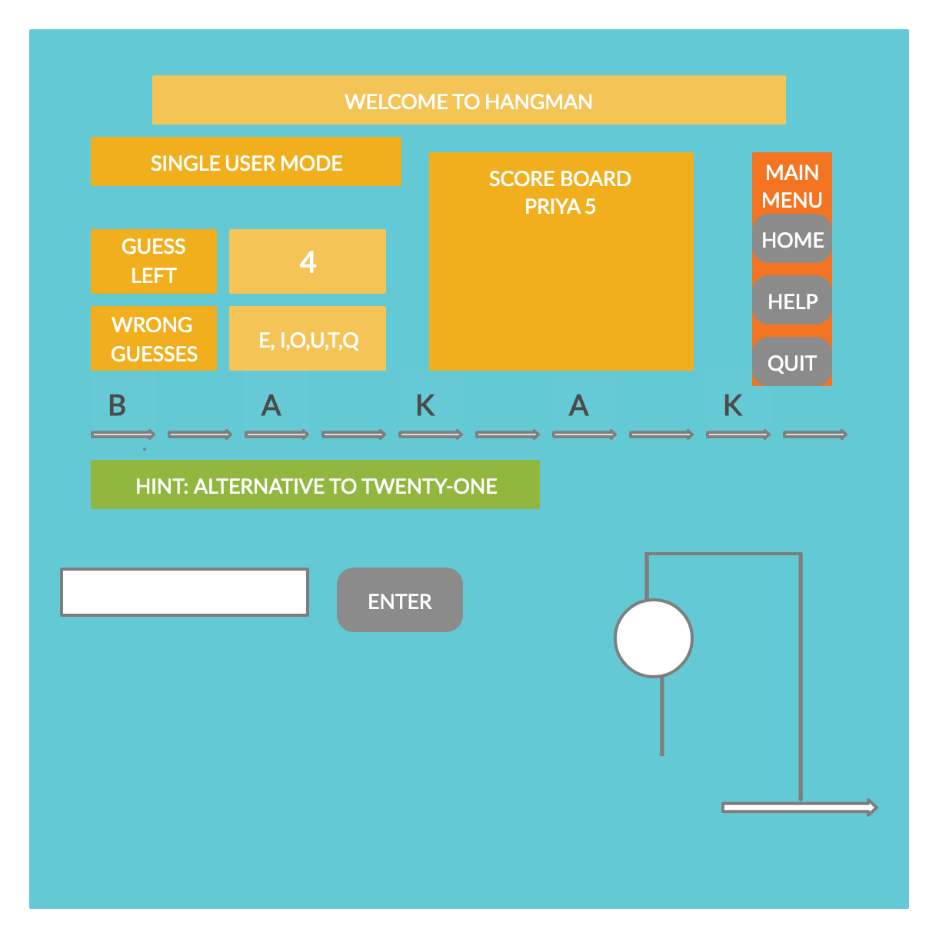
Behavioral Requirements: UI Prototype (PHASE1)

Slide 18
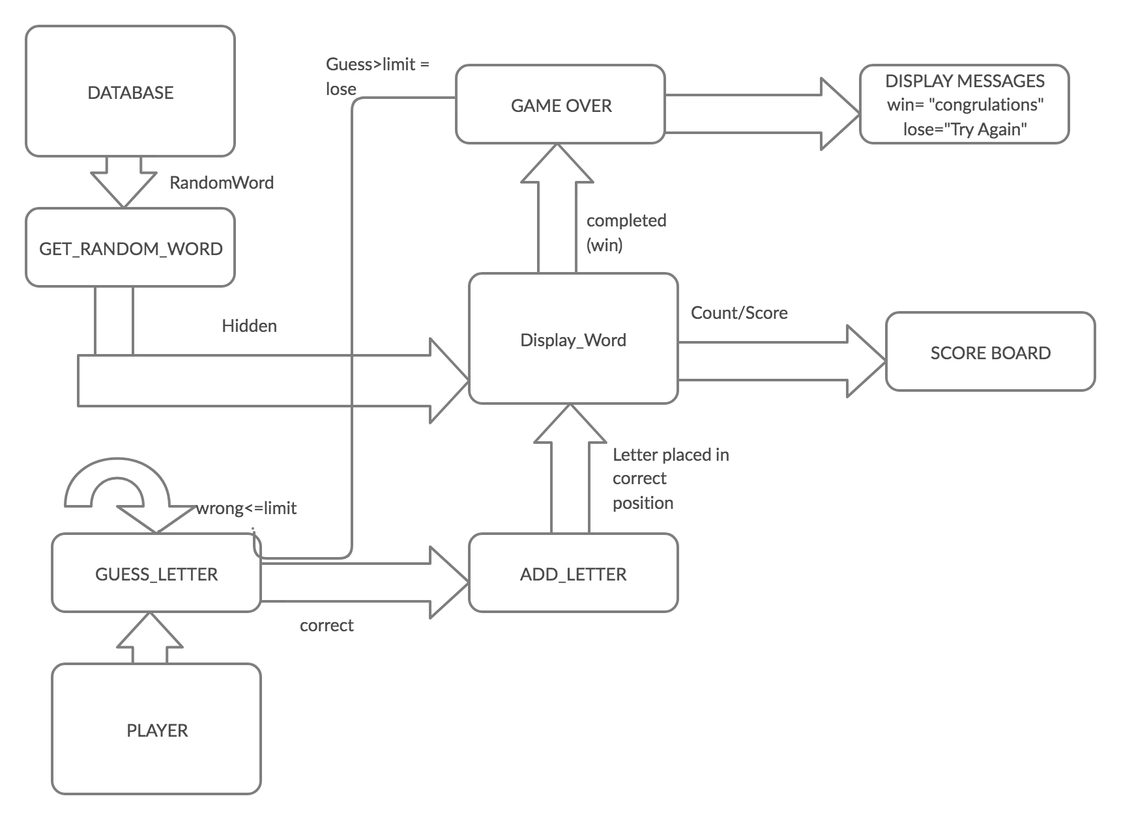
Informational Requirements: Data flow

Slide 19
Data Dictionary
PROJECT | TERM | TERM OWNER | DESCRIPTION | DEFINITION
H A N G M A N | GUESS COUNT | TBD | THE NUMBER OF INCORRECT GUESS | 0<=GUESS COUNT <=10
 | GUESS LIMIT | TBD | THE NUMBER OF GUESSES USERS IS ALLOWED | GUESS LIMIT = 10
 | HIDDEN WORD | TBD | WORD TO BE GUESSED | ALPHABETIC CHARARACTER A-Z
 | GUESSED WORD | TBD | THE LETTERS PLAYER GUESSED CORRECTLY | ALPHABETIC CHARARACTER A-Z
 | CONTINUE CHOICE | TBD | WHETHER TO CONTINUE OR NOT THE GAME | Y/N

Slide 20
Appendices
Glossary
URL: Uniform Resource Locator – web address
RAM: Random Access Memory
JRE: Java Runtime Environment
Error Handling
Included in Functional Requirements.
External Interfaces
The web browser and Tomcat server communicates through standard internet socket communication.
The Hangman Project pulls hidden words from Database running in backend.
Engineering Analysis
Platform (O/S and Language) –WINDOWS/MAC OS and Java 8
IDE- Eclipse
Spring MVC Architecture

