Slide 1

HANGMAN PROJECT TECH-TYCOONS TEAM 4
JOYATEE CHATTOPADHYAY
MATTHEW JANNY
SUPRIYA JAMBOOR NAGESH
USHA RANI THAKUR
INSTRUCTOR: JUAN VEGA
SOFTWARE ENGINEERING
2019

Slide 2
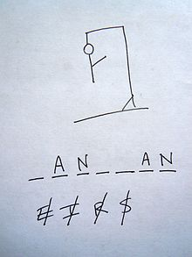
Summary
Hangman Project is a computer-based version of the classic paper and pencil guessing game for two or more players (Wikipedia). The Players compete against the computer to guess a word the software program has selected at random.

Slide 3

General Description
Product Outlook: The advantage of this online program is that it allows someone to play the game in single mode or in groups against the computer.

Slide 4
Product Features
Provide a Single User and Multiple User Modes.
Provides with Authentication for users through username and password.
Generate a Random Word to be guessed and provide a hint.
Provide option to guess the letters or a complete word.
Manage the Game Ground – To get players to guess the word, evaluate the alphabets guessed, and finally updating the scoreboard.
Determine if the player wins or lose the game (“Hang the Man”)
Provide options to quit the game but save their progress.
Provide with Administration (Admin) Mode.

Slide 5

User Characteristics
Hangman is designed for personal computer users who enjoy word games. Hangman is a recreational software project. The user is assumed to be competent using computer and Internet. The user is assumed to be familiar with the rules of Hangman. It is also assumed the user knows to type URL address in the browser

Slide 6
Assumptions and Dependencies
Hangman is dependent upon database to generate random words.
Hangman uses words from English Language only.
Hangman will assume that the word generated will be valid.
Hangman will run only on local machine where the necessary set up has been made.

Slide 7
General Constraints
Because of time constraints, multiple mode of this game will be implemented in future.
Because of time constraints, Admin mode of this game will be implemented in future.

Slide 8
Functional Requirement
Starting the Application
Allow the user to enter the URL on any browser.
At the start of each game, a main menu should be displayed.
The main menu offers single, multi-players and multi-players group modes.
At phase1 of this project, single mode implementation is provided.
The game should load in 10 seconds after the URL is typed in the browser.

Slide 9
Functional Requirement CONTINUED
Playing the Game- SINGLE MODE
At each game, the number of letters in the word is displayed using blank character.
At each turn, if the guessed letter is correct, a visual appearance of that letter in correct position is displayed.
At each turn, a messaged is displayed upon entering the alphabet –“You have guessed A”.
If the same letter is guessed again, a message is displayed- “You have already guessed A”.
The already guessed letters are displayed on the screen.
If the guessed letters are not between “A”-“Z”, a message is displayed – “Enter only Letters” and players are allowed to guess again without penalty.

Slide 10
Functional Requirement CONTINUED
Playing the Game- SINGLE MODE
At each game, the number of letters in the word is displayed using blank character.
At each turn, if the guessed letter is correct, a visual appearance of that letter in correct position is displayed.
At each turn, a messaged is displayed upon entering the alphabet –“You have guessed A”.
If the same letter is guessed again, a message is displayed- “You have already guessed A”.
The already guessed letters are displayed on the screen.
The user can guess the whole word at a time.
If the guessed letters are not between “A”-“Z”, a message is displayed – “Enter only Letters” and players are allowed to guess again without penalty.
At each wrong guess, a stick figure appears

Slide 11
Functional Requirement CONTINUED
Ending the Game – SINGLE MODE
The player is declared as winner if he/she guesses the hidden word.
The player loses the game if he/she makes 10 wrong moves.
If the player wins the game, a message is displayed –“Congratulations”.
If the player loses the game, hidden word is revealed and a message is displayed – “Game over- Try again”
When the game is over either by winning or losing, the Hangman project will ask the player to either continue or quit.
If the player chooses continue, a new game is started.
If the player chooses to quit, the application terminates.
The player is given an option to quit in between the game.

Slide 12
HIGHLEVEL USECASE
USE CASE1- STARTING THE APPLICATION
Priya would like to start a hangman game on Chrome browser. Priya has the Tomcat server installed in her computer. Priya first starts her chrome browser and type the URL: local host: 8080. Priya is presented with Hangman Home page with menu option. The menu option consists of single user mode, multi user mode, and exit and help button.
Actions:
Power on the computer.
Type in the URL address in chrome browser.

Slide 13
HIGHLEVEL USECASE CONTINUED
USE CASE2- PLAYING THE GAME
Priya wants to start the game on the home page of Hangman project. She clicks on single user mode button. It redirects her into single user page where the game begins. The page displays a hidden word with a hint, scoreboard, and number of guesses left and the guessed letters for Priya to understand where she stands in the game.
Actions:
Click the Single user button.
Click on the letters on the alphabet pad.
If the guessed letter is correct, the letter is should be displayed in the correct position of the word.
Continue step 2 until the word is displayed or until the count begin zero, whichever is first.

Slide 14
HIGHLEVEL USECASE CONTINUED
USE CASE 3 – ENDING THE GAME
Priya wants to end the game. She wins the game and the game comes to an end. She has the option to either play another round or end the game. Priya clicks on continue button and restart the game.
Priya wants to end the game. She loses the game and the game comes to an end. She has the option to either play another round or end the game. Priya clicks on continue button and restart the game
Priya wants to end the game. She wins the game and the game comes to an end. She has the option to either play another round or end the game. Priya ends the game.
Priya wants to end the game. She loses the game and the game comes to an end. She has the option to either play another round or end the game. Priya ends the game
Priya wants to quit the game. She clicks on the “Quit” button from the menu option on the single user mode page. She is prompted with “yes” or “no” option. Priya clicks on the “yes” button, and the game ends.

Slide 15
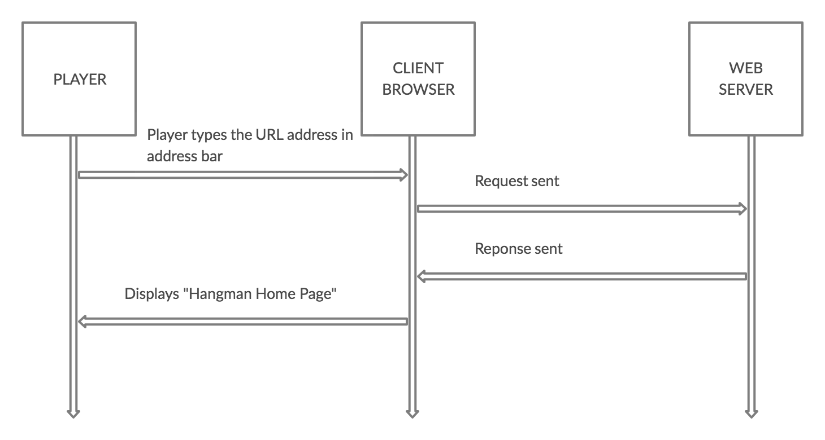
HIGH LEVEL SEQUENCE DIAGRAM

Slide 16
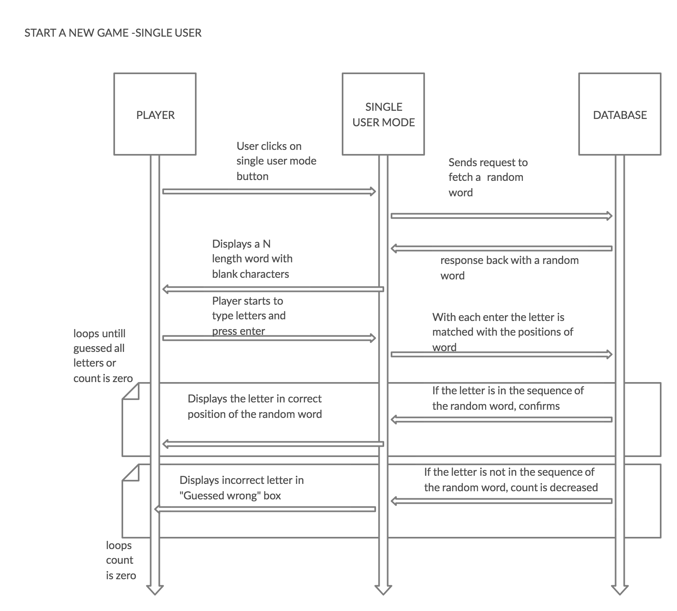
HIGH LEVEL SEQUENCE DIAGRAM CONTINUED

Slide 17
ARCHITECTURAL VIEWS

Slide 18
ARCHITECTURAL VIEWS CONTINUED

Slide 19
ARCHITECTURAL VIEWS CONTINUED

Slide 20
ARCHITECTURAL VIEWS CONTINUED

Slide 21
ARCHITECTURAL VIEWS CONTINUED

Slide 22
ARCHITECTURAL VIEWS CONTINUED

Slide 23
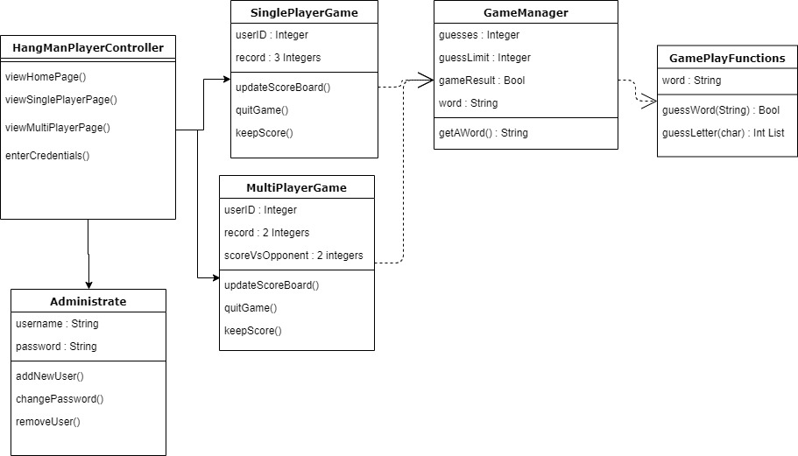
Class Diagram

Slide 24
Architectural Design Decisions Register
Register Decisions

Slide 25
Framework: Spring MVC Framework is used
Decision
Use Spring MVC framework.
Status
Accepted.
Context
Spring MVC helps in building flexible and loosely coupled web applications. The Model-view- controller design pattern helps in separating the business logic, presentation logic, and navigation logic. Models are responsible for encapsulating the application data
Consequences
We will be clear separation between three layers, and hence modification in each layer will not affect the other layer. Spring offers better integration with view technologies other than JSP (HTML/Velocity / XSLT / Free Marker / XL etc.)

Slide 26
Technology: Java Technology is used
Decision
Use Java Technology for coding
Status
Accepted.
Context
Java is object-oriented. This allows to create reusable code. Java is platform-independent. It is easy to write, compile and debug.
Consequences
1. Java has powerful development tools like Eclipse SDK and NetBeans which have debugging capability and offer integrated development environment.
2.It has no control over garbage collection.

Slide 27
Source Control Repository: Git Repository is used
Decision
Use Git Repository
Status
Accepted.
Context
One of the biggest advantages of Git is its branching capabilities. Unlike centralized version control systems, Git branches are cheap and easy to merge. This facilitates the feature branch workflow popular with many Git users. Feature branches provide an isolated environment for every change to your codebase
Consequences
GIT requires technical excellence and it is slower on windows

Slide 28
Methodology: Agile Methodology is used
Decision
Use Agile Methodology
Status
Accepted.
Context
Since our project is a small project and Agile works best for small and medium sized projects, and we don’t need much documentation for this project ,new features are delivered more quickly and frequently.
Consequences
Since there is no documentation ,project easily fall off track, and more commitment is required by each team member.

Slide 29
Security Management: Spring Security is used
Decision
Use Spring Security
Status
Proposed
Context
It supports java and it can be integrated with spring MVC. It supports authentication and authorization.
Consequences
It involves lots of XML configuration.

Slide 30
Front controller and MVC design patterns are used
Decision
Use Spring Security
Status
Proposed
Context
Front controller design pattern-This design pattern enforces a single point of entry for all the incoming requests. All the requests are handled by a single piece of code which can then further delegate the responsibility of processing the request to further application objects.
MVC design pattern- This design pattern helps us develop loosely coupled application by segregating various concerns into different layers. MVC design pattern enforces the application to be divided into three layers, Model, View and Controller.
Consequences
Increased complexity

Slide 31
Non-Functional Requirements:
Operating Constraints:
The program requires the JRE 1.4 with Swing.
Documentation
A short (<200 words) message explaining how to use the Hangman project.
Portability
The program will run Windows/Mac Os
Reliability
Since the program is purely for recreation and user data involve only in creating account particularly for this game, reliability is of low importance.
Security
Since user Login is provided for each user, Authentication with username and password will be established based on spring model.
The application will not access any use or alter any system files on which it runs

Slide 32
Non-Functional Requirements:
Usability
A new user should be able to pick the understanding of the game and play the game under ten minutes.
A user who is familiar with classic Hangman game should be able to play the online game without any written documentation
Deployment
The project will be deployed on web server (tomcat) and the project will be executed on web browser when URL is typed in address bar.
Performance
Desired response time after the game URL as been typed in the browser: less than ten seconds.
Desired response time (not critical): At the game start: less than five seconds
After each turn: less than two seconds.

Slide 33
Non-Functional Requirements - Database
Performance
After the mode (Single or Multi) is selected and start button is pressed, the hidden word should appear on screen in less than a second.
Maintainability
It is desired that the game administrator be able to modify the words database using simple SQL queries.
Adding a new word to the word database should take less than ten minutes.
Word length will not be less than 5 and more than 20

Slide 34
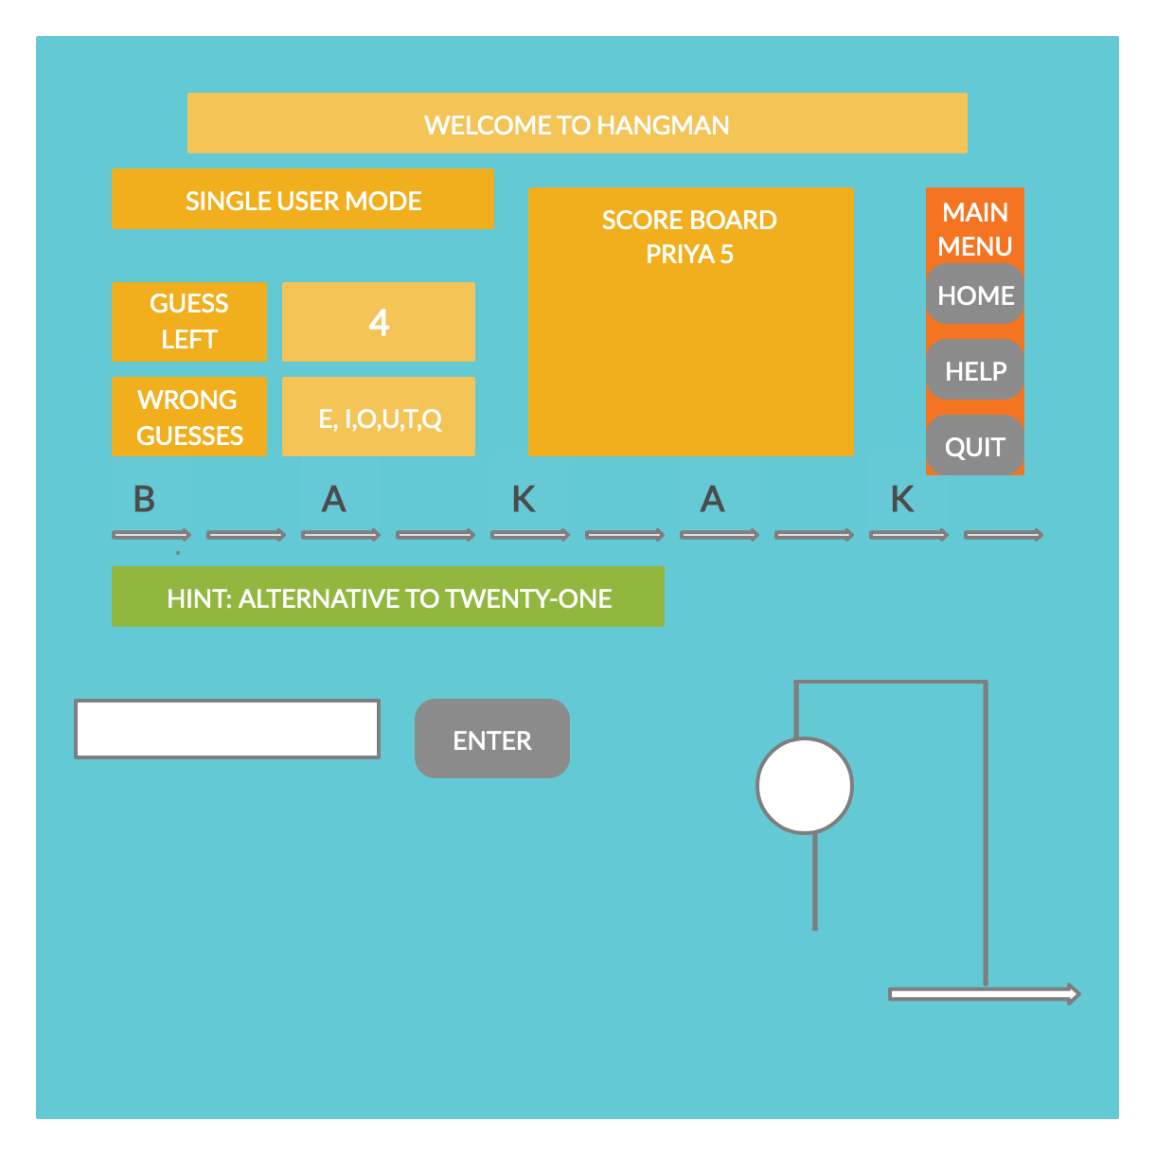
Behavioral Requirements UI Prototype

Slide 35
Appendices
Glossary
URL: Uniform Resource Locator – web address
RAM: Random Access Memory
JRE: Java Runtime Environment
Error Handling
Included in Functional Requirements.
External Interfaces
The web browser and Tomcat server communicates through standard internet socket communication.
The Hangman Project pulls hidden words from Database running in backend.
Engineering Analysis
Platform (O/S and Language) –WINDOWS/MAC OS and Java 8
IDE- Eclipse
Spring MVC Architecture

