Slide 1
PROTOTYPE
HANGMAN PROJECT
TEAM 4
INSTRUCTOR: JUAN VEGA
SOFTWARE ENGINEERING
2019

Slide 2
HOME PAGE

Slide 3
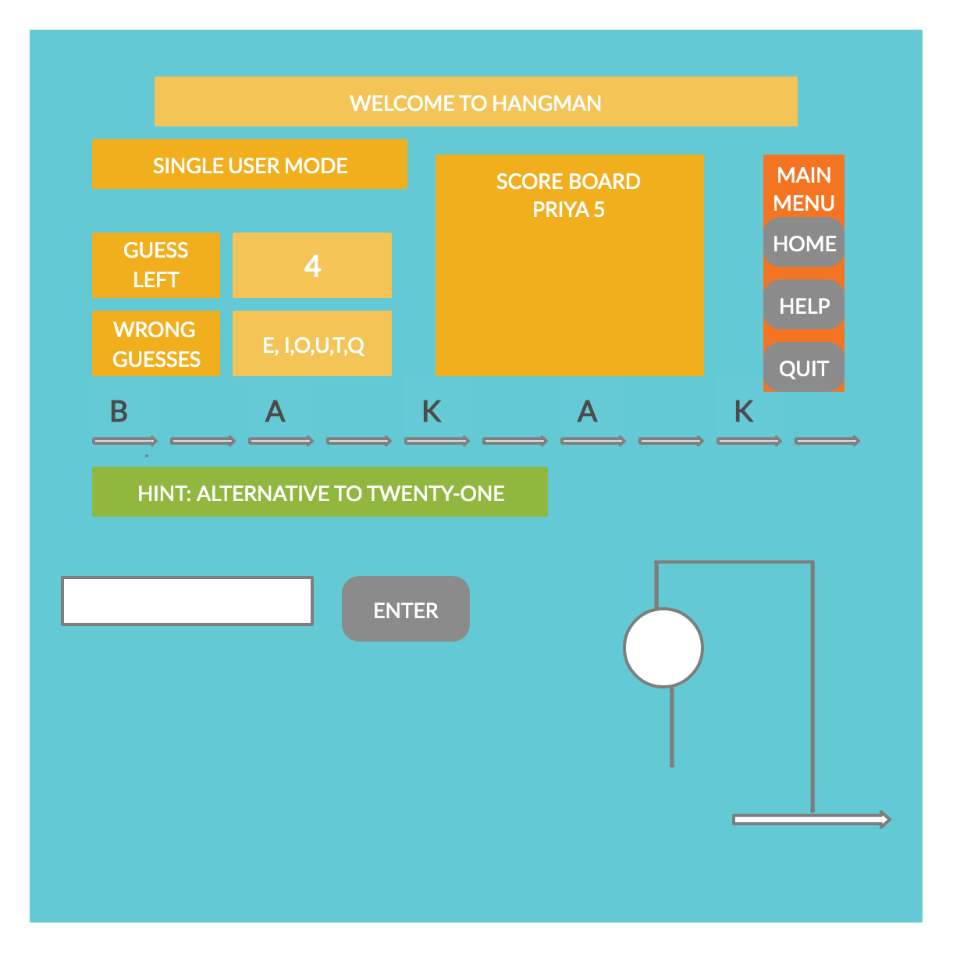
SINGLE MODE

Slide 4
SINGLE MODE- WIN SCENARIO

Slide 5
SINGLE MODE- LOST SCENARIO

Slide 6
MUTLI MODE

Slide 7
ADMIN MODE

