Slide 1
PROTOTYPE
HANGMAN PROJECT
TEAM 4
INSTRUCTOR: JUAN VEGA
SOFTWARE ENGINEERING
2019

Slide 2
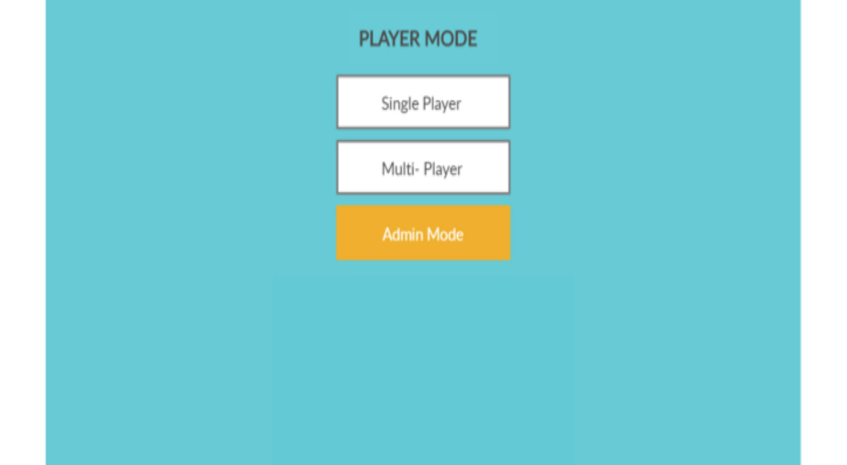
Home Page

Slide 3
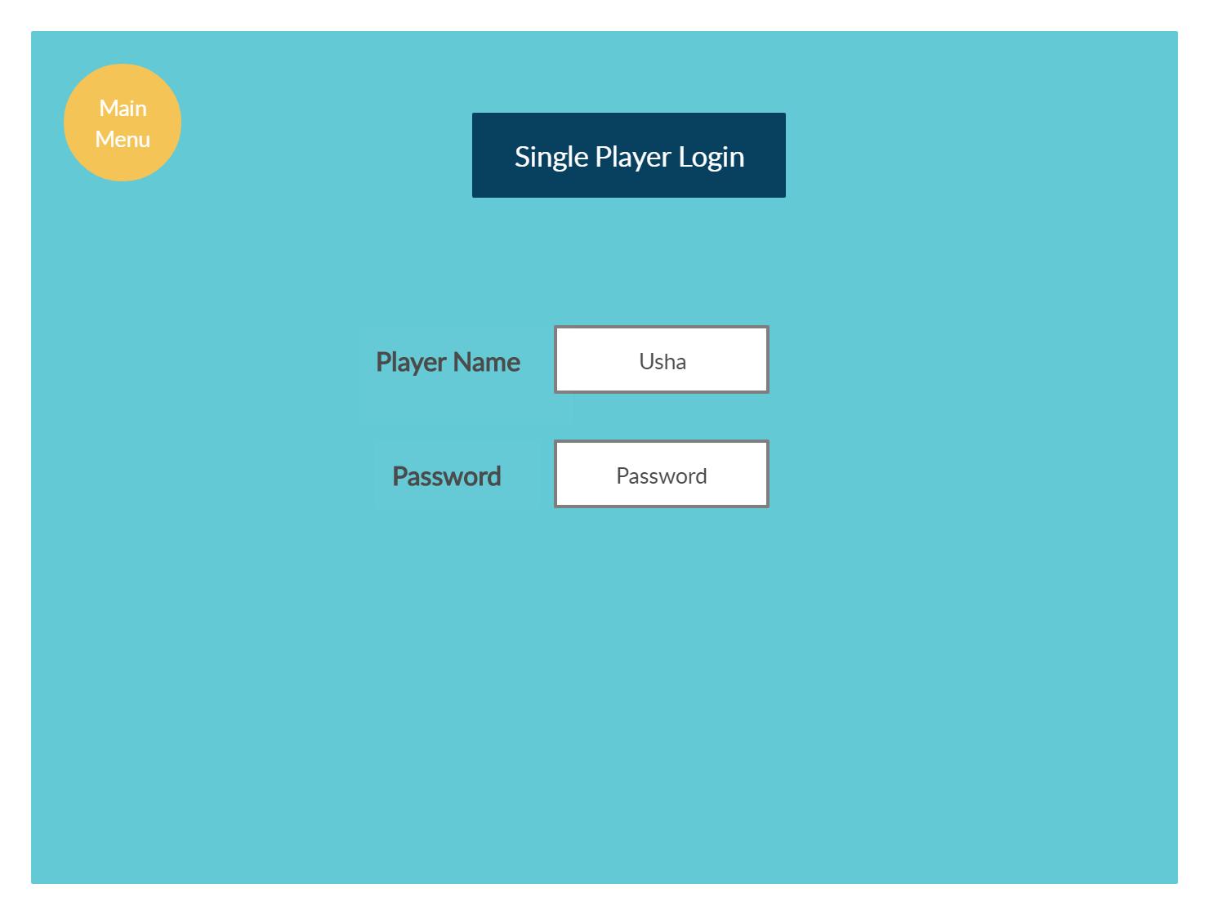
Single User Login

Slide 4
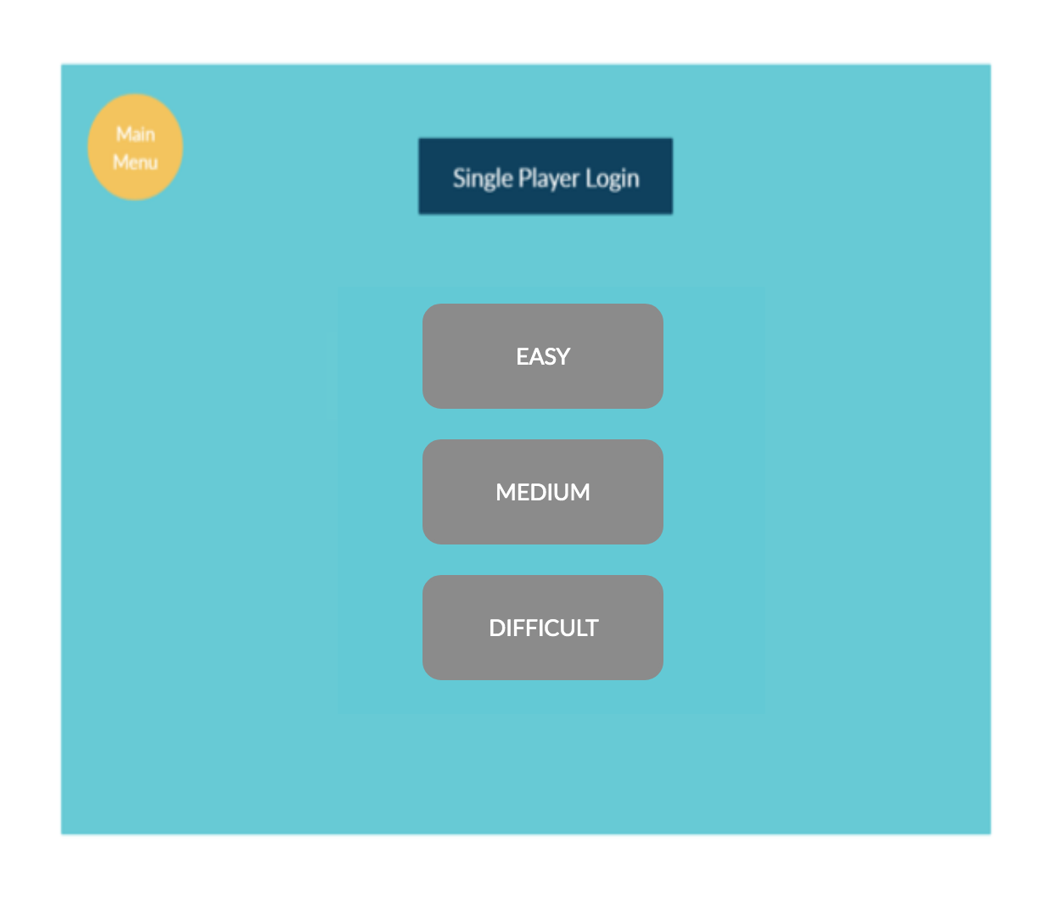
Single User Login

Slide 5
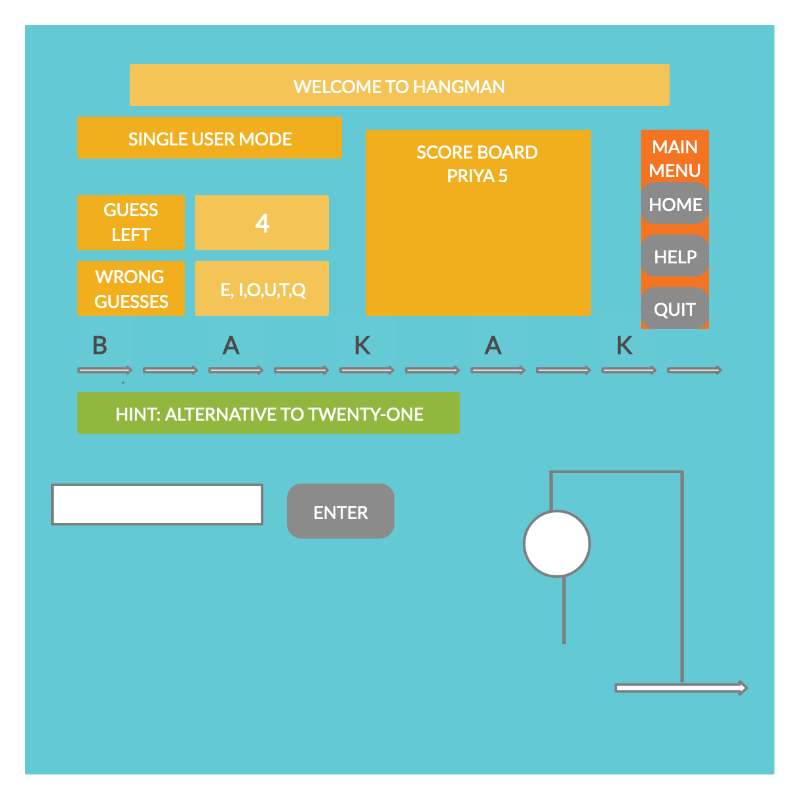
SINGLE MODE

Slide 6
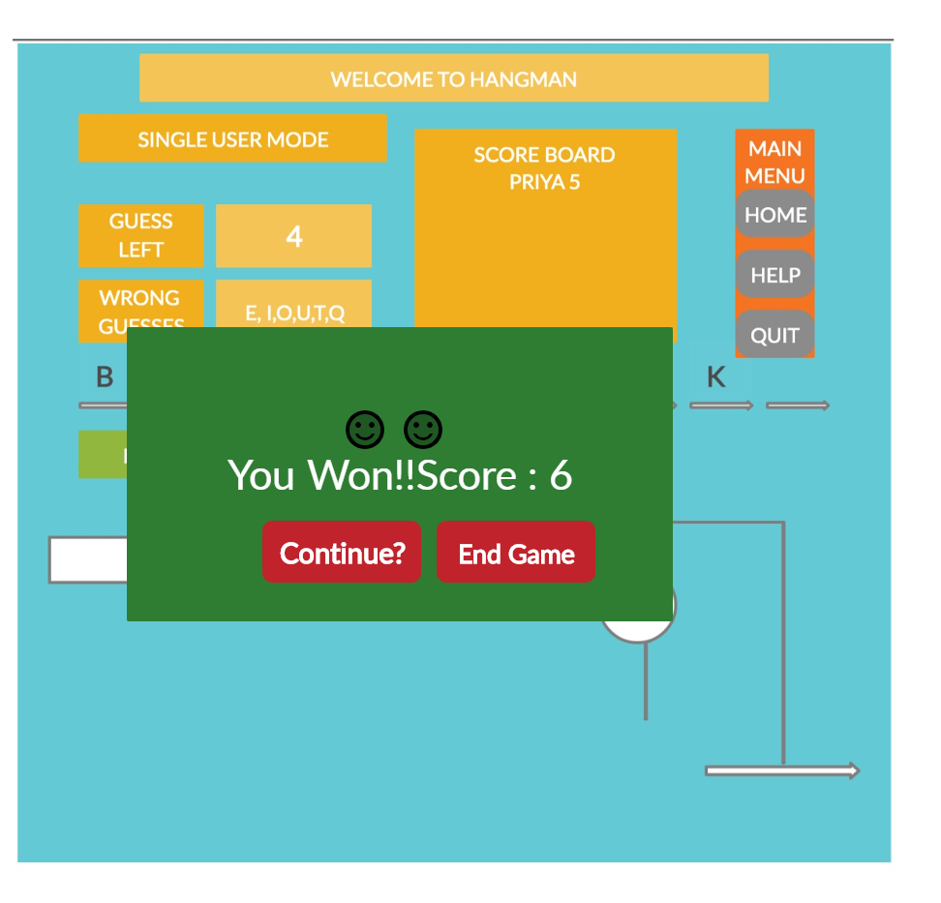
SINGLE MODE- WIN SCENARIO

Slide 7
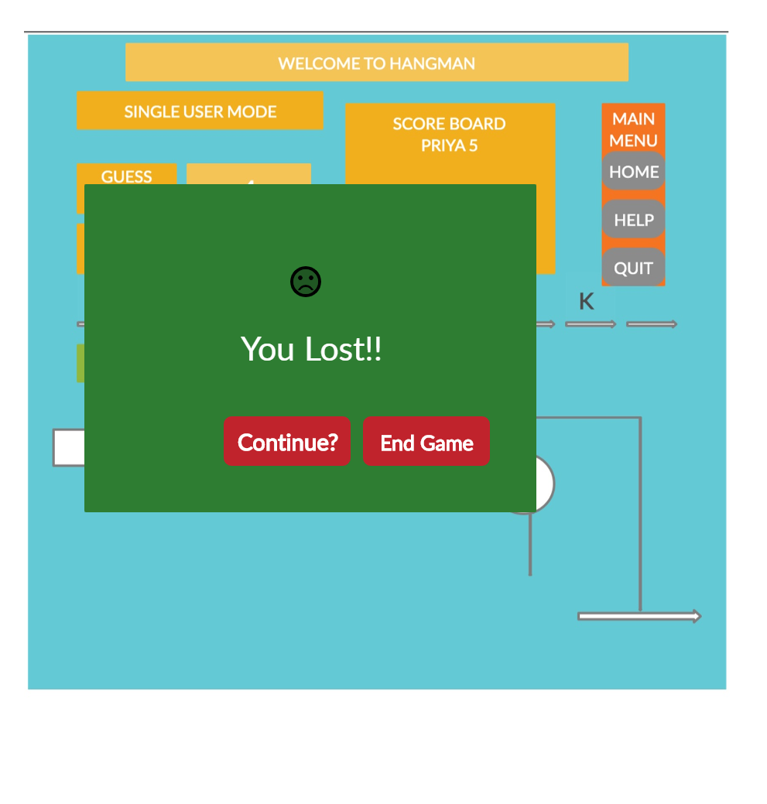
SINGLE MODE- LOST SCENARIO

Slide 8
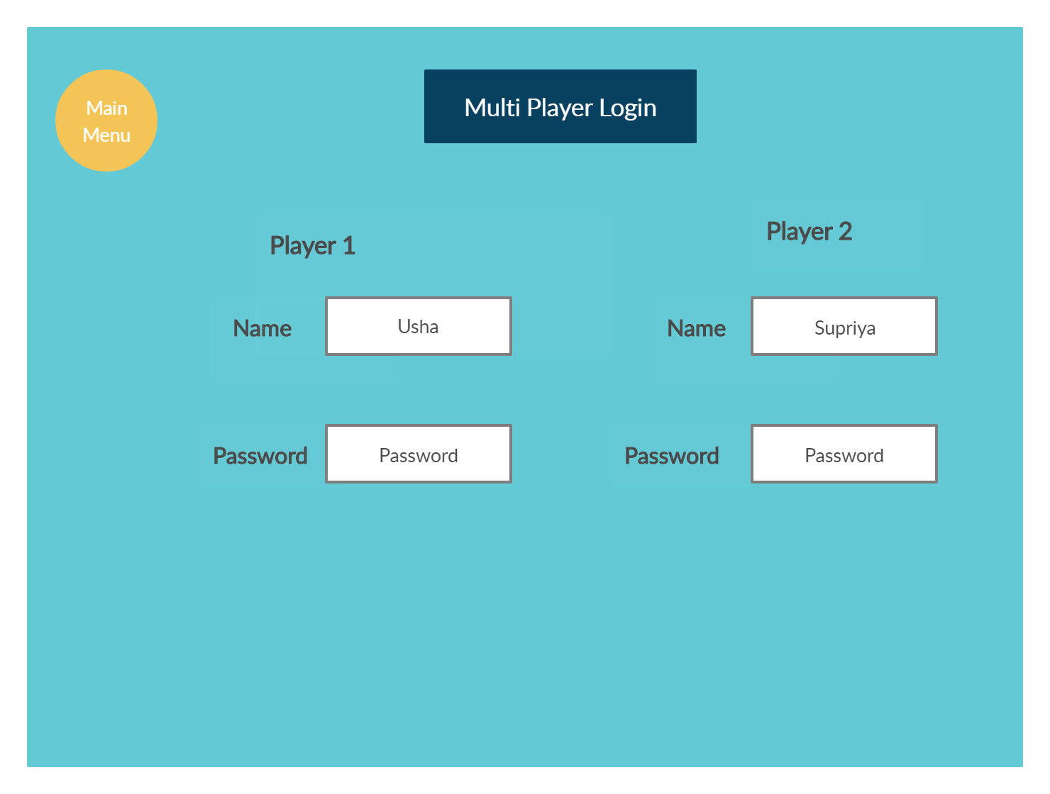
Multi-Player Login

Slide 9
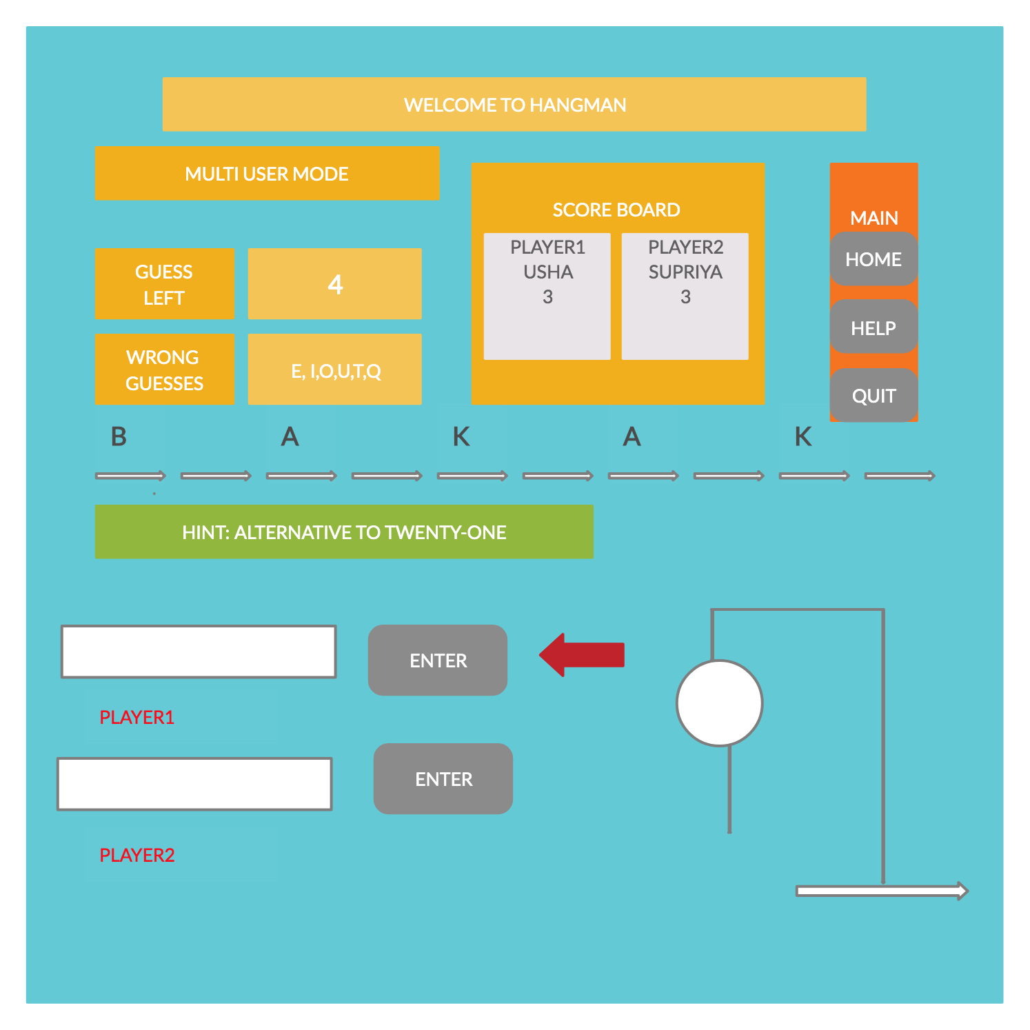
MUTLI MODE

Slide 10
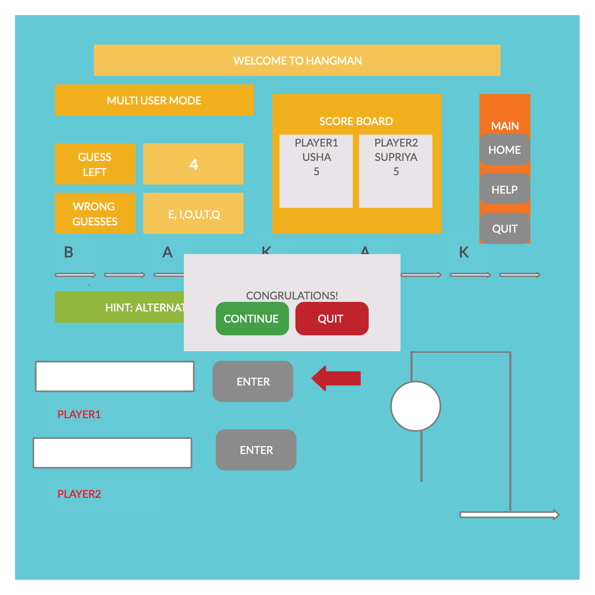
MUTLI MODE USER WIN THE GAME

Slide 11

MUTLI MODE USER LOSE THE GAME

Slide 12
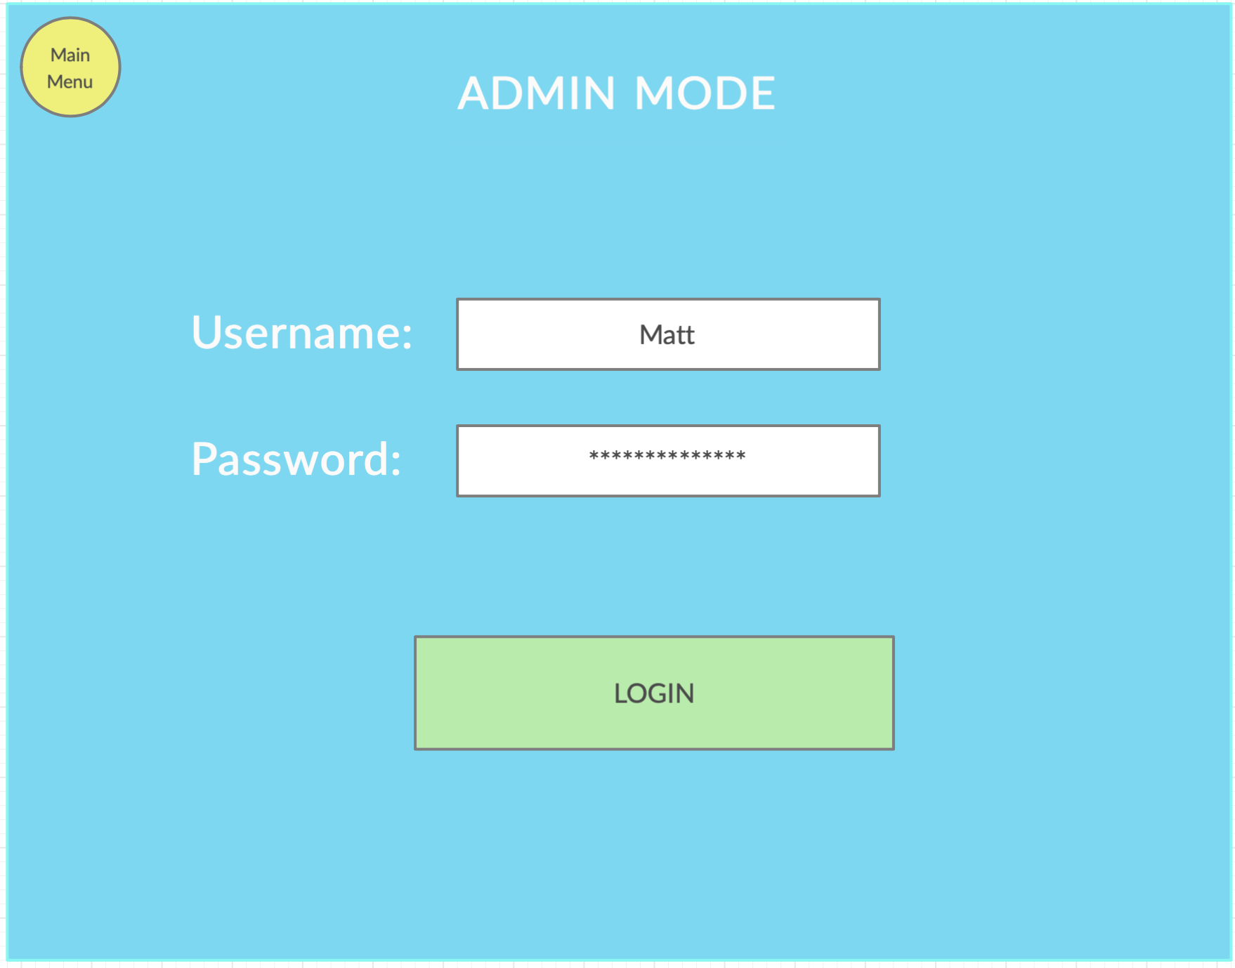

Slide 13
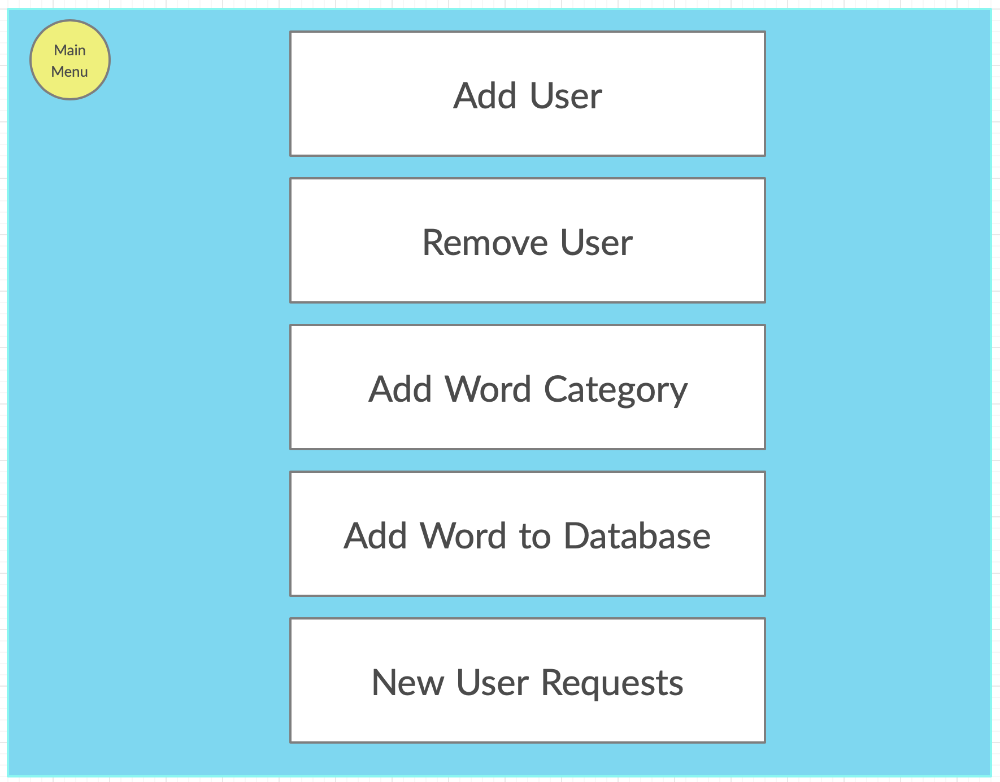

Slide 14
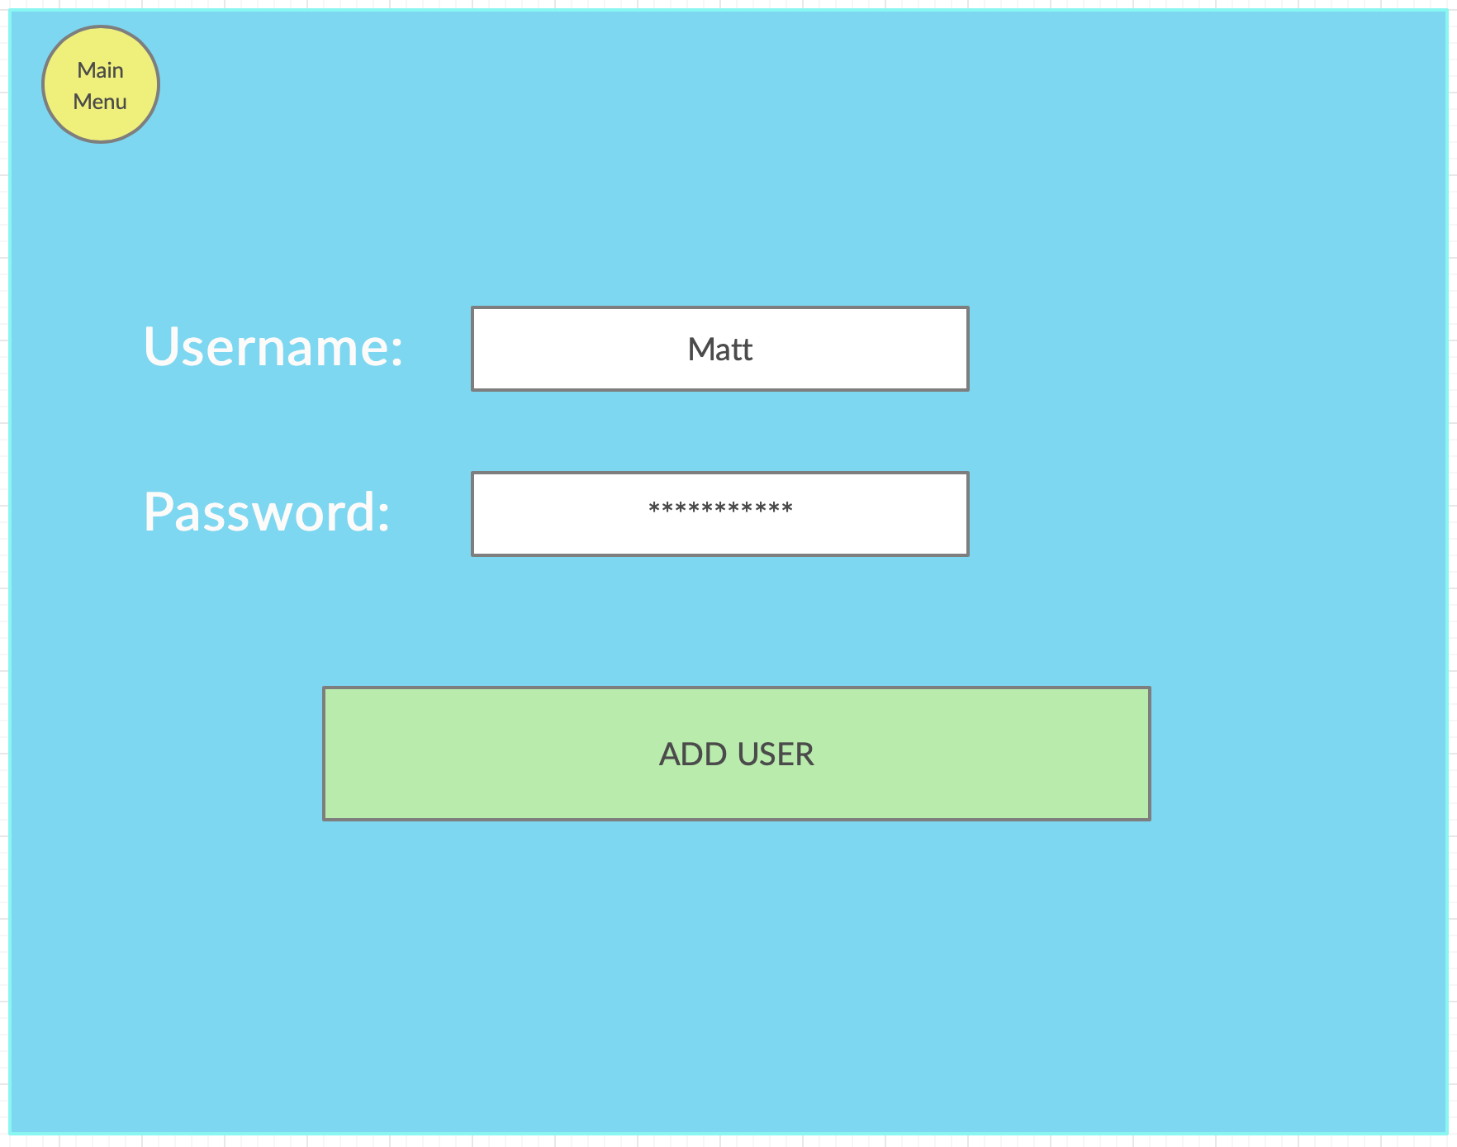

Slide 15
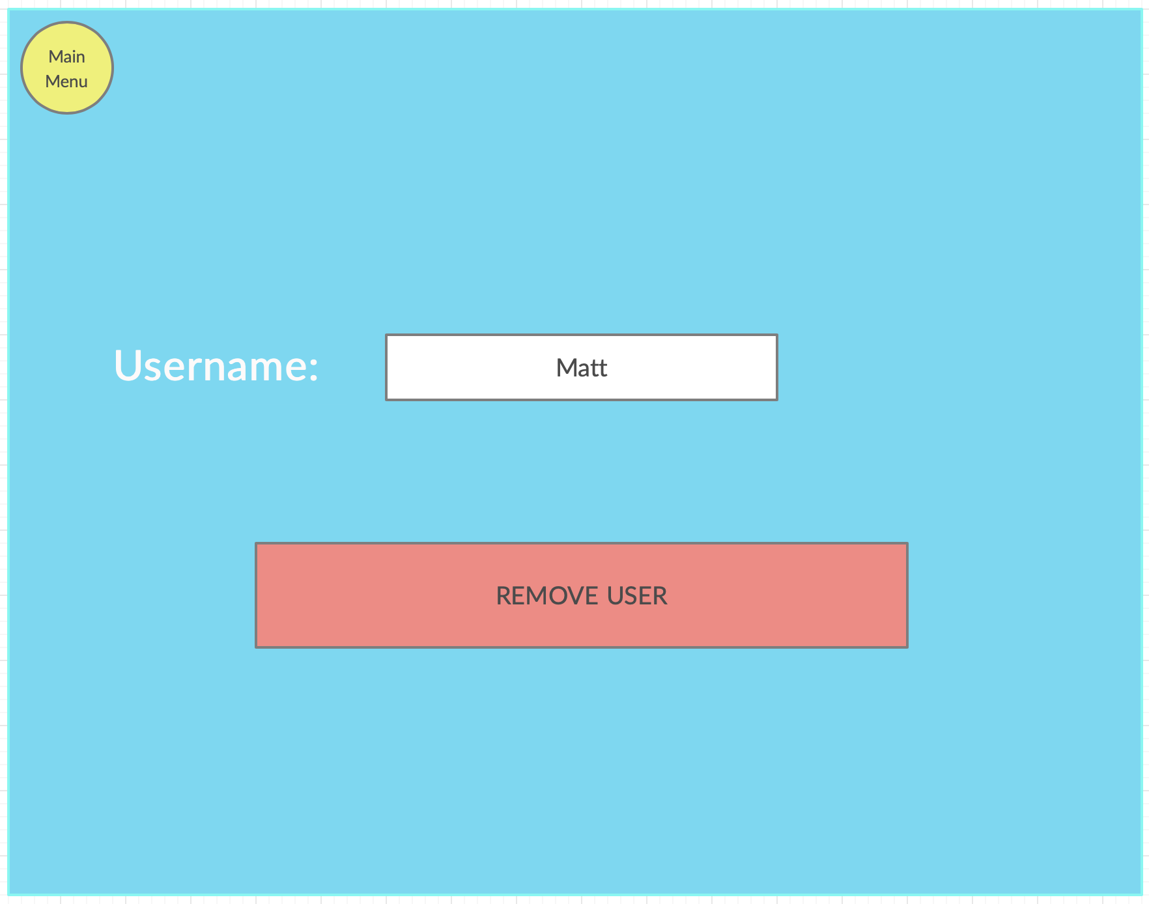

Slide 16
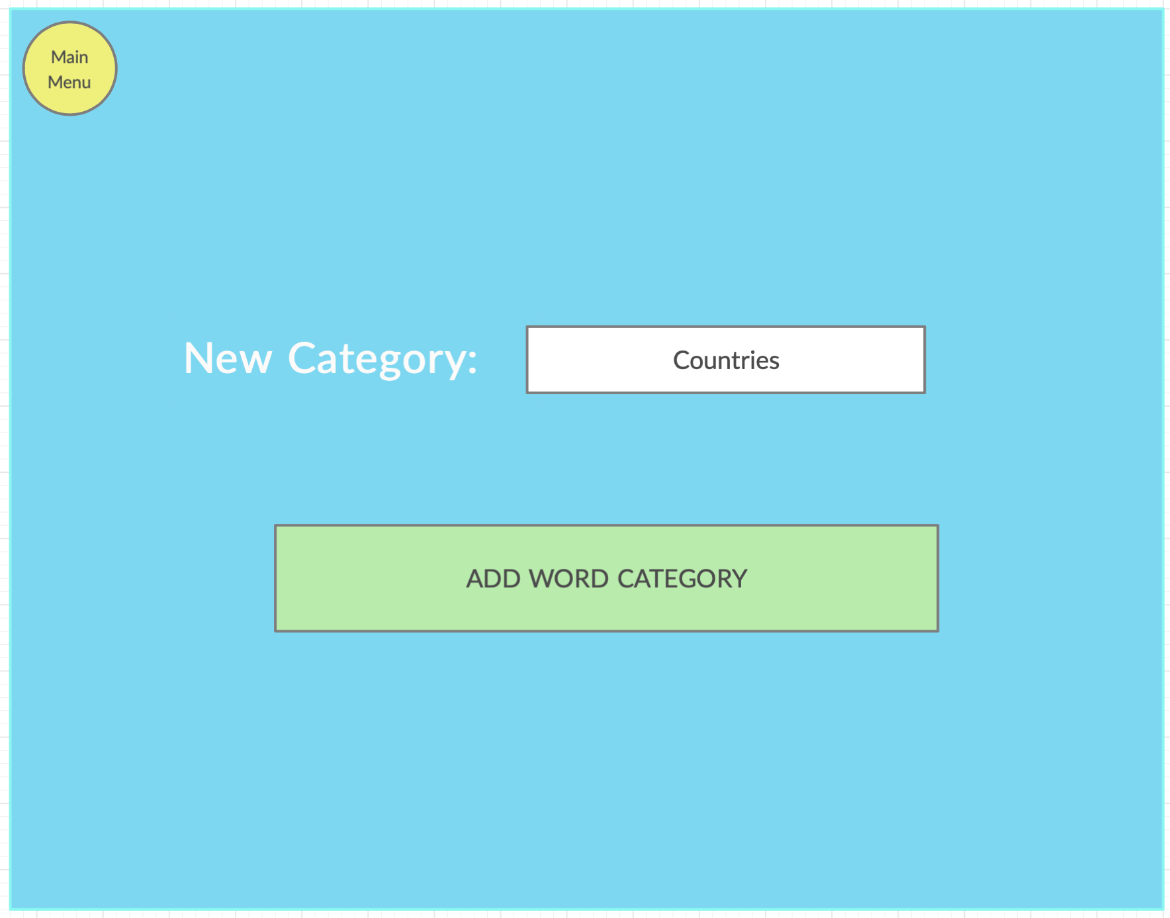

Slide 17
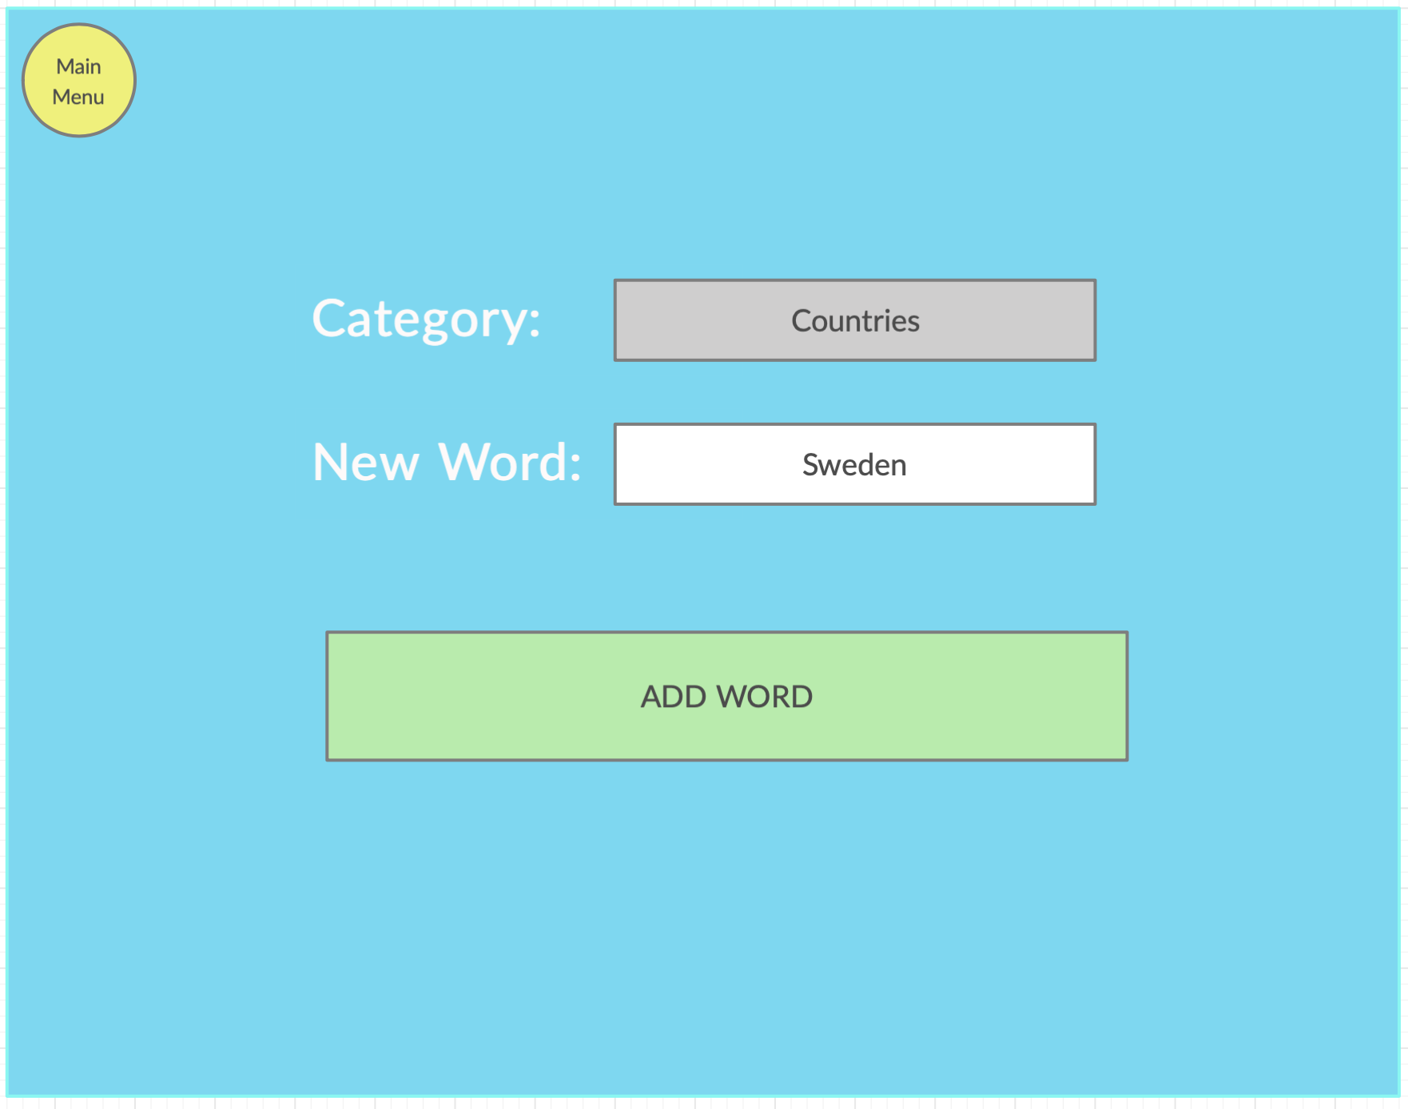

Slide 18
