Slide 1
Pictures handmade

Slide 3
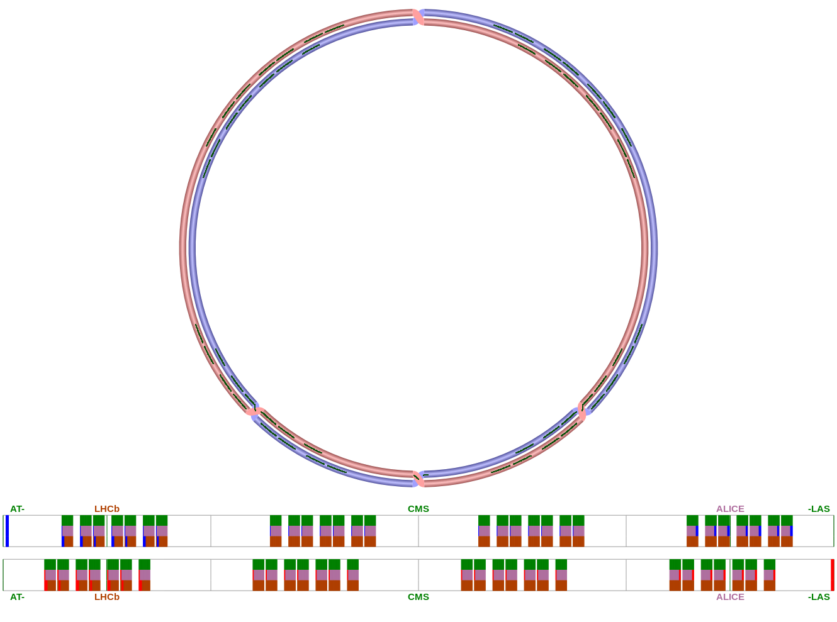
…...
…...

Slide 4
GEANT4 output
Divide energy deposit
Charge drift
Induce charge on strips
Remove dead channels
Add noise
Convert signal to digis
Zero suppression
To reconstruction...

