Slide 1
Emergence of Semi-Supervised Learning
Mondeep Das
40016937
LTTS

Slide 2
Deciding Factors:
Supervised Learning
Unsupervised Learning
Semi-Supervised learning
Well defined solution
Small datasets
Results are highly accurate and trustworthy
Larger dataset
Real time application
Datasets are mixer of labelled and unlabelled data
Confusion about choosing supervised and Unsupervised algorithms
1
2
3

Slide 3
Why Supervised and Unsupervised fails sometimes?
Supervised:
The entire data has to be hand-labelled either by machine learning Engineer or a Data Scientist. This process is very costly and time consuming.
Unsupervised:
The most basic disadvantages of any unsupervised algorithm is that it’s application spectrum is limited.

Slide 4
Semi-Supervised Learning algorithm
We have to work in a sample space where labelled and unlabelled data exist together.
Programmer will cluster similar data using an unsupervised algo and then use the existing labelled data to label the rest of the unlabelled data.
Use small number of labelled data to label large amount of cheap unlabelled data.
Basic Idea: Similar examples should be given the same classification.

Slide 5
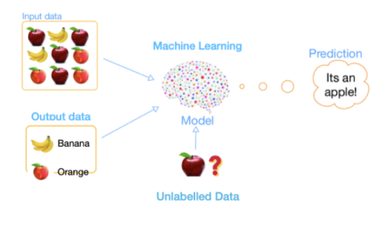
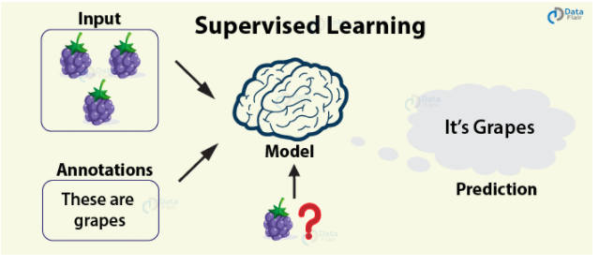
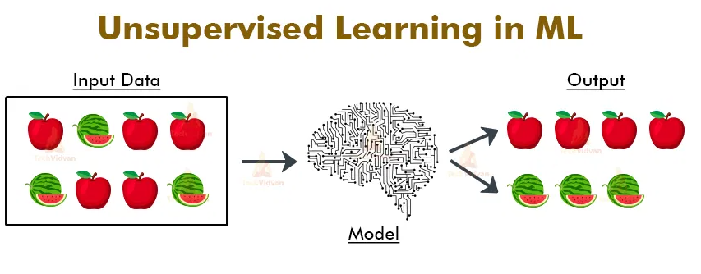
Pictorial view of Semi-Supervised algorithm

Slide 6
Semi-Supervised Assumptions:
Continuity Assumption:
Points which are closer to each other are likely to be in same label.
Manifold Assumption:
The data lie approx on a manifold of much lower dimension.
Cluster Assumption:
The data can be divided into some cluster and points within a cluster share same label.

Slide 7
Sample Dataset:
Here we are going to see how a dataset look like when we are going to use semi-supervised learning algo.
Gender | Weight | Height
M | 165 | 76
F | 158 | 98
 | 176 | 89
 | 160 | 65
Labelled
Unlabelled

Slide 8
Defined Approach:
Train new model based on all data:
Again train the same model using all the data that we had and we predicted.
03
Build and Train on labelled data:
We are going to train any supervised learning algo on our labelled data.
01
02
Label unlabelled Data:
We are going to predict the unlabelled data with the help of model that we have just trained.

Slide 9
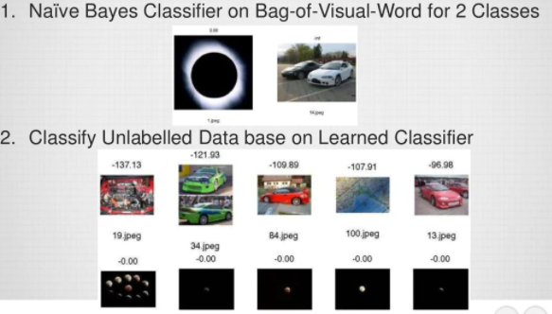
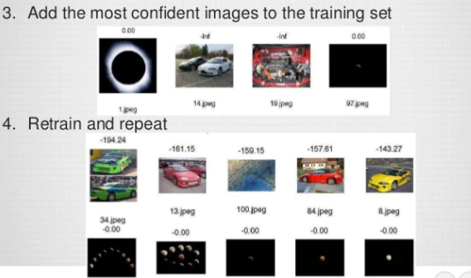
Sample Example
Refinement: Reduce weights of unlabelled data to increase power of more accurate labelled data.

Slide 10
Applications of semi-supervised:
Speech Analysis:
Since labelling of audio files is a very intensive work,semi-supervised learning is a natural approach to solve this problem.
Internet content classification:
Labelling each webpage is an impractical and unfeasible process.
Problem-sequence classification:
Since DNA strands are typically very large in size,the rise of semi-supervised learning are applied to the same.

Slide 11
References
https://www.slideshare.net/lukastencer/semisupervised-learning-42075774
https://www.geeksforgeeks.org/ml-semi-supervised-learning/
https://link.springer.com/article/10.1007/s10994-019-05855-6

