Slide 1

eTechlogix-Academic-Professional-Training-Plan
By Shaqib & Jahid
Version: V2
Date: 06-Nov-2022

Slide 2
Agenda
High Level Planning
High Level Execution Plan
FAQ

Slide 3
High Level Planning
Agenda:
Pictorial View Of Enroll Process
Courses
Tests
Role & Responsibilities

Slide 4

Pictorial View Of Enroll Process
Basic-Test
P2E
Start-Training
1 Month
Prerequisite-Test
(PT)
Dev/Exp Certificate
Live Project
5 months
Interview/Done
B2P
Basic to Professional Training
3-4 Months

Slide 5
Courses
There are two level of courses provided
B2P (Basic to Professional)
P2E (Professional to Expert)

Slide 6
P2E
P2E: Professional to Expert Level
Opportunity to working as Java/.Net Developer in live project with direct US Client by this Organization, it's designed to meet the industry benchmarks and curated by top industry experts.
This is not like others Institution do the online Java/.Net certificate training with some dummy projects and finally DONE!!
We will ensure that you will become java Expert from this P2E Course with 100% placement Assistance! Addition to that, You will directly work with US client on live production project!!
We will give you extensive knowledge of Realtime time experience on Core Java & J2EE and advanced concepts and popular frameworks like Hibernate, Spring & SOA, OOps in Java, JSP, xml, json, SQL, Mongo DB to name a few.
Top of that you will be working on Agile methodology, DevOps, Concurrent Versions System (CVS), COR Tool, Bug tracking tool, JIRA tool and many more tools, which are used day-to-day activities by top industries in Realtime.
Enroll this best online Java/.Net Developer to become a Realtime certified IT professional.

Slide 7
B2P
B2P: Basic to Professional Level
Out of Topic (Future Road Planning)

Slide 8
TESTS
There are Two Tests in this program
Basic Test (Entry Level)
P2E prerequisite Test (Before entering to Live Project)

Slide 9
Role & Responsibilities
One mentor should be assigned to the each P2E candidates.
Mentor should have provided KT on live production project.
Weekly basis status/feedback should provide to each P2E candidates.
After completion of P2E candidates, we should provide 100% placement Assistance & we need to arrange the interview with different clients.
After completion of P2E candidates, make sure review their resume/CV for ready to face interview with other/external IT industry.
Make sure, we should provide proper reliving & Experience letter to P2E candidates. (Incase of P2E candidates willing to join other IT industry)
Make sure, we should provide all supports like Existing US client background verification, etc.. (This will only via email only)
Make sure, one POC should be 24x7 available for P2E candidate for any quires (Via Mail, voice process or etc.)

Slide 10



MOM
We have discussed a professional Training plan and finally all agreed on the P2E plan.
Currently we should focus on P2E rather than B2P.
We should go with the pilot phase for the first 6 months.
Discussed on how to combine existing Tool and technology to create a complete platform.
Discussed on Marketing, brochures or google PPC advertising etc..
Next Meeting will be on Sunday 9th October 10:30 AM Arizona time and we will discuss on execution plan (Action Item on - All of us)
What is the Role and Interest (Action Item on - Jahid & Shaqib)
Who will manage and how will mange in detailed plan (Action Item on - Jahid & Shaqib)
Initially during pilot phase, one person should actively Lead and Guide the Team (Action Item on - Basil Bhai USA)

Slide 11
P2E High Level Execution Plan
Agenda:
Ideas and Few challenges
Prerequisite For P2E Execution
Pictorial View Of Execution Process
Teams Role & Responsibilities
Teams Directory Structure & Resources

Slide 12
IDEAS & Few Challenges
IDEAS & Few of them Challenges:
Why we need to market our Online P2E course ?
How Do we sell/attract an online Course with No Audience ?
How to Market Online Courses on our Website as well ?
Once customer land/registration on website, who & how we will follow up to get into this course/project.
Who will design the Test question pattern in different individual Technologies and Generic question pattern.
Who/How will decide or what are the criteria to qualify the candidate fit for P2E course/project.
What will be the working hours duration (8 hours or 9 hours) and number of days per week (5 Days or 6/7 Days)
How to advertise our business
Physically visit all the institutes for discussion about P2E
Register your business with Google
Use social media
Create Engaging content (Through a blog, video tutorials etc..)
Pay for advertising
Promoted social media posts - choose a target audience, region and length of time you'd like to run the ad
PPC - Pay-Per-click ads
Shall we Get involved in an online community
Join an Industry-specific online community to building connections with the members by actively contributing to conversations

Slide 13
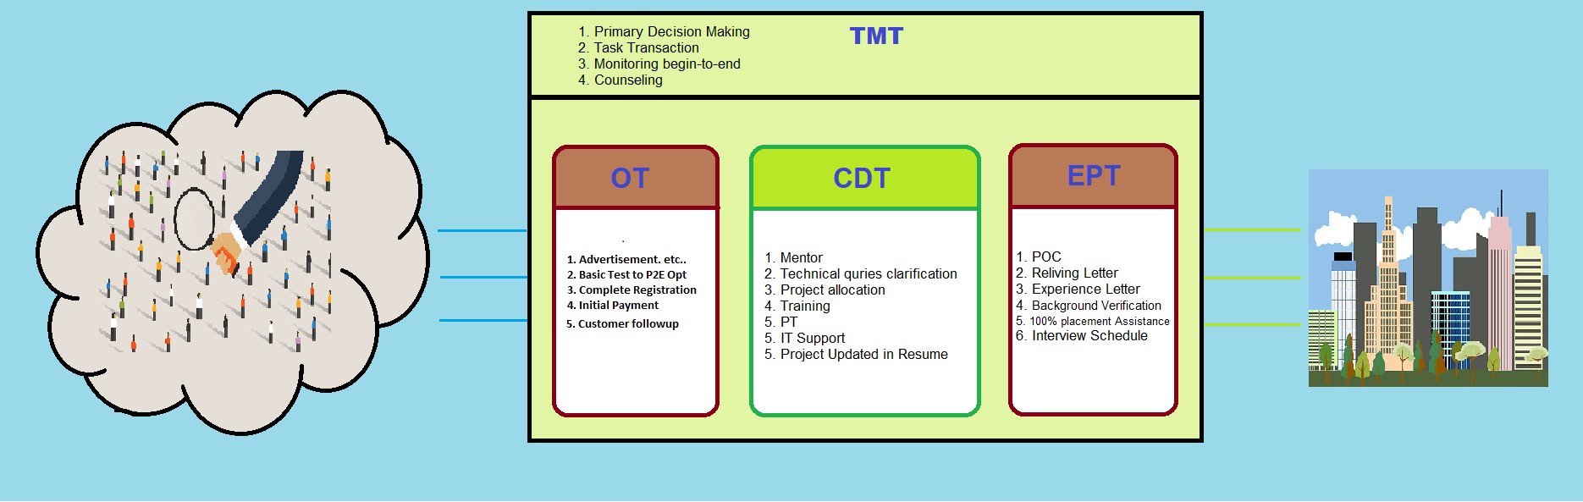
Pictorial View Of Execution Process

Slide 14

TMT Role & Responsibilities
Top Management Team
Primary decision making for whole P2E execution.
All candidate transaction from one team to next team (OT -> CDT -> EPT ).
Each candidate’s monitoring from beginning to end of course.
Should conducting one-on-one meeting with candidate and receiving continuous feedback from respective Teams as well (biweekly or monthly)
Candidate Counseling/Suggestion those are not cleared the Basic-Test.

Slide 15
OT Role & Responsibilities
Operational Team:
P2E Marketing, Advertisement etc..
Daily Candidate follow up till registration successfully.
Once registration success, Basic Test should trigger for the candidate.
Any Term and condition should clarify with candidate and until Initial payment should receive
Daily/weekly basis OT status report share to TMT
Final Selected candidate Hand over to TMT for Start the P2E process

Slide 16
CDT Role & Responsibilities
Core Development Team:
Final Candidate received from TMT, a Mentor should assign to a Candidate or group of Candidates
Mentor should have cleared all doubts or Technical quires for Candidates
As per P2E Process, Trainer should start 1st one month training based on the which project is being Mapped
CDT Team should provide candidate status every weekly basis to TMT
As per P2E Process, CDT should conduct PT after completion of 1st-Training successfully
CDT Team should assign the Real time Project, once PT cleared successfully
CDT should provide the IT Support to candidate (VPN setup, Laptop or software issue, etc..)
CDT Mentor should provide/Reviewed Project Detail Description update on Candidate Resume

Slide 17
EPT Role & Responsibilities
Exit Process Team:
Should provide proper reliving letter & Experience letter.
Should provide all supports like background verification, etc.. (This will only via email only)
EPT provide/mentioned POC 24x7 availability candidate for any quires (Via Mail/voice)
Should provide 100% placement Assistance within the same client or different
Arrange the mock interview and schedule Interview with different clients/organization.
Updated candidate final settlement status to TMT

Slide 18
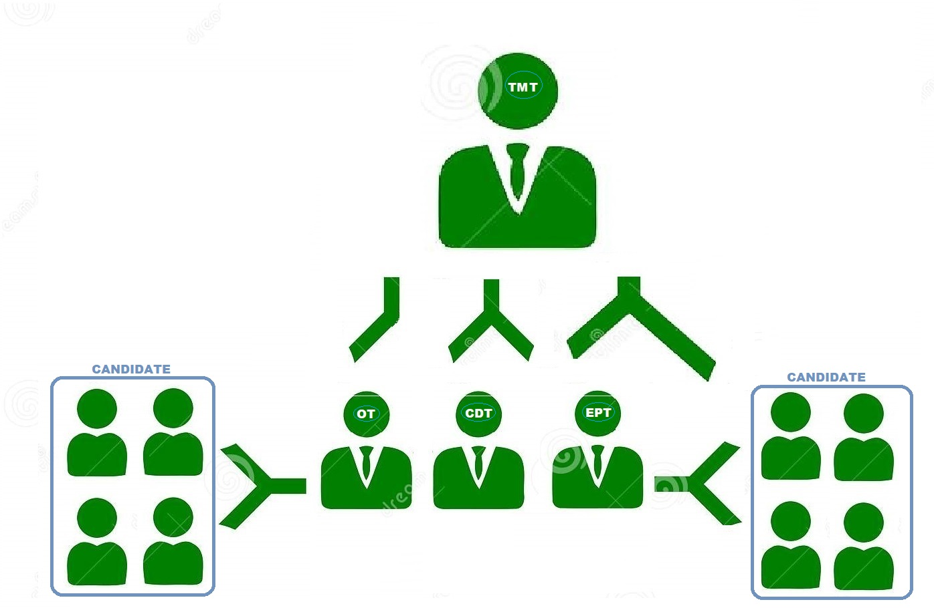
Teams Directory Structure & Resources

Slide 19
FAQ

Slide 20
FAQ
Q. Which course is better for me ? / Q. Which course need to join?
Based on your Basic Test Result, will decide whether the candidate can opt for P2E or B2P.
Q. How to enter this Program ?
You need to qualify the Basic Testing
Q. Who Can Enroll P2E Course ?
Working IT professional, who wants to Change/become a JAVA/.Net Developer in IT industry
If you are successfully completed B2P Courses
Any Graduates holders should have CS subjects and seeking job in IT industry as a JAVA/.Net Developer. ( BSc CS / M.Sc. CS / BCA / MCA / B.Tech /B.E / M.Tech )
Note: Candidate should qualify the P2E prerequisite Test
Q. Who Can Enroll B2P Course ?
Working IT professional, who wants to Change/become a JAVA/.Net Developer in IT industry, but they have very basic programming knowledge.
Any Graduates holders those who have CS background (BSc(CS)/M.Sc.(CS)/BCA/MCA/B.Tech/B.E/M.Tech), but they have very basic programming knowledge.
Any Graduates non-CS background too ?
Q. What will be duration of P2E and B2P Course ?
P2E – 6 months
B2P – 9 months
Q. What will be the Training timing for P2E & B2P Course ?
Monday to Saturday, 9:30 to 18:30 (Including Break Time)

Slide 21
FAQ
Q.?

