Slide 1
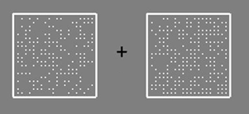
Hello and thank you for participating in this study!
In each trial of this task you will see two boxes containing dots, like this:
It is your task to determine which one contains more dots. In this case the right box contains more dots.
any key: Next

Slide 2
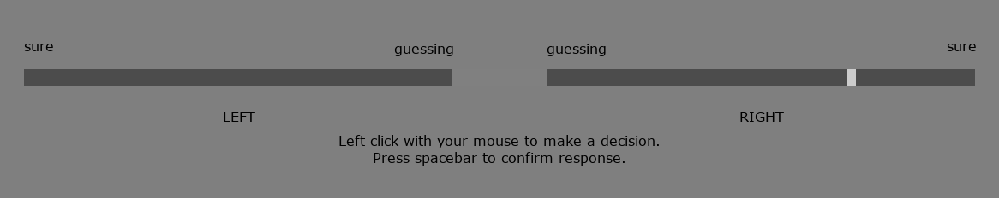
Indicating your Decision
To make your choice you use the scale shown below:
The scale allows you to indicate two things: your decision and your confidence in your decision.
You indicate your decision by choosing to place your marker (shown in white in the right box above) in either the left or the right bar.
Left Arrow: Previous | any other key: Next

Slide 3
Indicating your Decision
For example:
if you think the right box had more dots you would place your marker in the right bar.
You place your marker by clicking the mouse.
Left Arrow: Previous | any other key: Next

Slide 4
Indicating your Confidence
You indicate your confidence in your decision by choosing to whereabouts in the bar you place your marker.
By placing the indicator further away from the centre of the scale you indicate a higher confidence.
By placing the indicator closer to the centre of the scale you indicate a lower confidence.
In the example above the marker suggests high confidence that the right box had more dots.
Left Arrow: Previous | any other key: Next

Slide 5
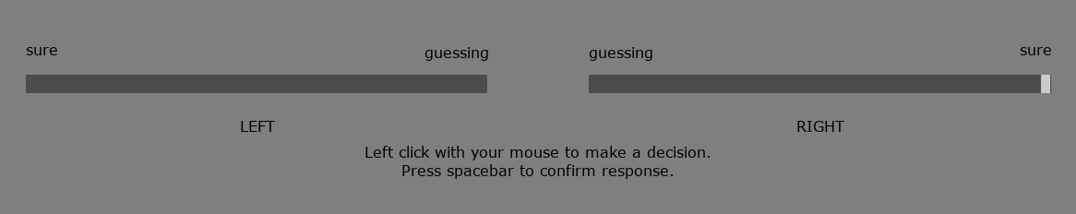
Indicating your Confidence
Placing the marker here indicates you are 100% sure the right box had more dots.
Left Arrow: Previous | any other key: Next

Slide 6
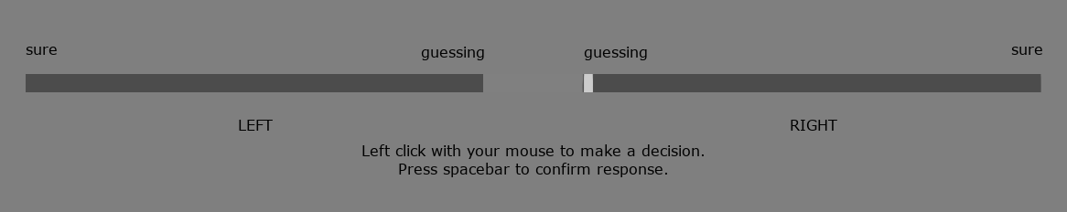
Indicating your Confidence
Placing the marker here indicates you are guessing: the two boxes are almost indistinguishable.
Left Arrow: Previous | any other key: Next

Slide 7
Task Difficulty
You will find the task difficult at first. The boxes appear very briefly and the dots are small.
In the middle of the screen there is a cross.
This cross will flicker just before the boxes appear.
Looking at the cross will allow you to see both boxes at the same time.
Remember: look at the cross and try to be as accurate as you can!
Left Arrow: Previous | any other key: Next

Slide 8
Practice
Now you will get a chance to experience the task.
You will perform the task twice.
If you get the task wrong you will hear a noise.
Press a key when you are ready, and pay attention – the dots only appear very briefly!
Left Arrow: Previous | any other key: Practice

Slide 9
Advice
Good.
Sometimes you will get advisors who give you advice on your decisions.
They’re not always right, but they can be helpful.
After you receive advice, you must provide a second answer
(your first answer is displayed in yellow)
Press any key to see how the advice works.
any key: Practice

Slide 10
General Knowledge
There is also a general knowledge task.
This task uses the same confidence scale, but this time you will see a general knowledge question and two possible answers.
any key: Practice

Slide 11
General Knowledge
Sometimes you will get advice from your advisors on the general knowledge task, too.
Press any key to see how this works.
any key: Practice

Slide 12
Experiment Structure
You will now get some practice on the dot task on its own.
Then you will get some practice on the dot task with advice.
Once the practice is completed, you will begin the task proper.
any key: Next

Slide 13
Confidence Reporting
Please try to use the confidence scale in a meaningful way.
This means you should:
go toward the extremes only when you are truly confident
go toward the middle only when you are truly unsure
Left Arrow: Previous | any other key: Practice

Slide 14
Well done!
From now on you will receive advice on your decisions from virtual agents.
These virtual agents are performing the same task as you do, and they will inform you as to whether they think the box with the most dots was on the left or the right.
any key: Next

Slide 15
Well done!
From now on you will receive advice on your decisions from virtual agents.
These virtual agents are performing the same task as you do, and they will inform you as to whether they think the box with the most dots was on the left or the right.
You will see the boxes and place your marker as before.
any key: Next

Slide 16
Well done!
From now on you will receive advice on your decisions from virtual agents.
These virtual agents are performing the same task as you do, and they will inform you as to whether they think the box with the most dots was on the left or the right.
You will see the boxes and place your marker as before.
Next, an advisor will tell you what they think the answer is.
You will then see the scale again, with your previous marker position highlighted in yellow.
You will then place another marker; this marker can be in a different place if you change either your decision or your confidence in your decision.
any key: Next

Slide 17
Well done!
From now on you will receive advice on your decisions from virtual agents.
These virtual agents are performing the same task as you do, and they will inform you as to whether they think the box with the most dots was on the left or the right.
You will see the boxes and place your marker as before.
Next, an advisor will tell you what they think the answer is.
You will then see the scale again, with your previous marker position highlighted in yellow.
You will then place another marker; this marker can be in a different place if you change either your decision or your confidence in your decision.
The advisors perform the task differently from one another.
The advisors can be wrong.
any key: Next

Slide 18

Silhouettes
Sometimes you will not get advice, in which case your advisor will be replaced with a silhouette:
This means you should always try to make your first answer as accurate as you can:
you will not always have the chance to change your mind!
Press any key to begin the practice with advice.
Left Arrow: Previous | any other key: Start Practice

Slide 19
Well done!
Now you will start the real experiment.
From now on you will not be told if you are incorrect.
Remember:
look at the cross so you can see both boxes
Try to be as accurate as you can
Try to use the whole width of the confidence bar
The advisors are different
The advisors are sometimes wrong
Sometimes you don’t get advice, so make sure your first marker placement is as good as you can make it
any key: Start Experiment

Slide 20
General Knowledge
Next you will do some general knowledge questions.
You will get advice on these questions from the same advisors you just saw.
any key: Next

Slide 21
Dot Task
Finally, you will do a bit more of the dot task.
You will continue to receive advice from your advisors.
any key: Next

Slide 22
The End!
Thank you so much for participating!

