Slide 1
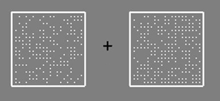
Hello and thank you for participating in this study!
In each trial of this task you will see two boxes containing dots, like this:
It is your task to determine which one contains more dots. In this case the right box contains more dots.
any key: Next

Slide 2
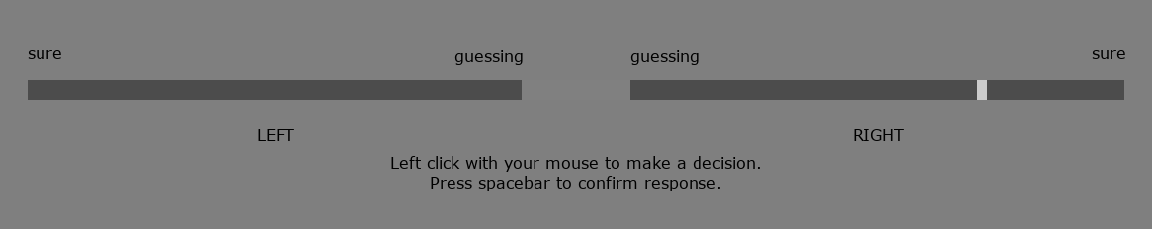
Indicating your Decision
To make your choice you use the scale shown below:
The scale allows you to indicate two things: your decision and your confidence in your decision.
You indicate your decision by choosing to place your marker (shown in white in the right box above) in either the left or the right bar.
Left Arrow: Previous | any other key: Next

Slide 3
Indicating your Decision
For example:
if you think the right box had more dots you would place your marker in the right bar.
You place your marker by clicking the mouse.
Left Arrow: Previous | any other key: Next

Slide 4
Indicating your Confidence
You indicate your confidence in your decision by choosing to whereabouts in the bar you place your marker.
By placing the indicator further away from the centre of the scale you indicate a higher confidence.
By placing the indicator closer to the centre of the scale you indicate a lower confidence.
In the example above the marker suggests high confidence that the right box had more dots.
Left Arrow: Previous | any other key: Next

Slide 5
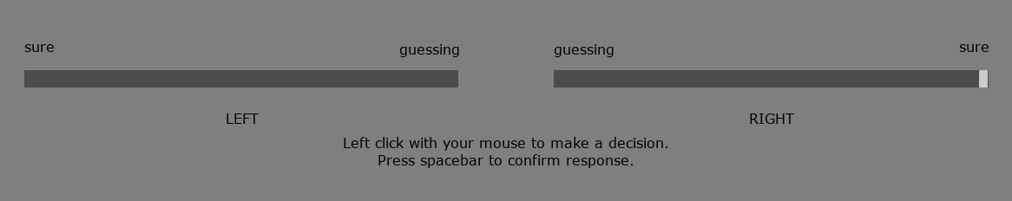
Indicating your Confidence
Placing the marker here indicates you are 100% sure the right box had more dots.
Left Arrow: Previous | any other key: Next

Slide 6
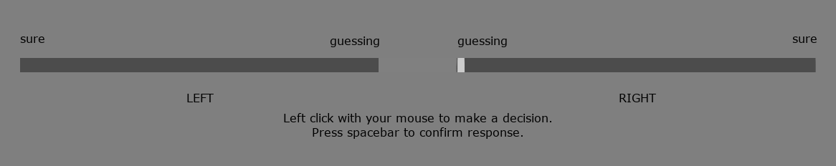
Indicating your Confidence
Placing the marker here indicates you are guessing: the two boxes are almost indistinguishable.
Left Arrow: Previous | any other key: Next

Slide 7
Strategy
Should I always place the cursor in the same position?
No!
Try not to be overconfident OR under-confident. Please try to use the confidence scale in a meaningful way.
What is the best strategy?
The best strategy is:
go toward the extremes of the scale only when you are truly confident or
go toward the middle of the scale only when you are truly unsure.
The best way to do this task is thus to honestly report how sure you are you chose correctly using the confidence scale.
Left Arrow: Previous | any other key: Next

Slide 8
Task Difficulty
You will find the task difficult at first. The boxes appear very briefly and the dots are small.
In the middle of the screen there is a cross.
This cross will flicker just before the boxes appear.
Looking at the cross will allow you to see both boxes at the same time.
Now you can practice the task.
Remember: look at the cross and try to be as accurate and honest as you can!
Left Arrow: Previous | any other key: Start Practice

Slide 9
Well done!
From now on you will receive advice on your decisions from virtual agents.
These virtual agents are performing the same task as you do, and they will inform you as to whether they think the box with the most dots was on the left or the right.
any key: Next

Slide 10
Well done!
From now on you will receive advice on your decisions from virtual agents.
These virtual agents are performing the same task as you do, and they will inform you as to whether they think the box with the most dots was on the left or the right.
You will see the boxes and place your marker as before.
any key: Next

Slide 11
Well done!
From now on you will receive advice on your decisions from virtual agents.
These virtual agents are performing the same task as you do, and they will inform you as to whether they think the box with the most dots was on the left or the right.
You will see the boxes and place your marker as before.
You will then be asked to choose an advisor. You choose an advisor by clicking their portrait with the mouse.
Once you have chosen an advisor, they will tell you what they think the answer is. You will then see the scale again, with your previous marker position highlighted in yellow. You will then place another marker; this marker can be in a different place if you change either your decision or your confidence in your decision.
any key: Next

Slide 12
Well done!
From now on you will receive advice on your decisions from virtual agents.
These virtual agents are performing the same task as you do, and they will inform you as to whether they think the box with the most dots was on the left or the right.
You will see the boxes and place your marker as before.
You will then be asked to choose an advisor. You choose an advisor by clicking their portrait with the mouse.
Once you have chosen an advisor, they will tell you what they think the answer is. You will then see the scale again, with your previous marker position highlighted in yellow. You will then place another marker; this marker can be in a different place if you change either your decision or your confidence in your decision.
The advisors perform the task differently from one another.
The advisors can be wrong.
any key: Next

Slide 13
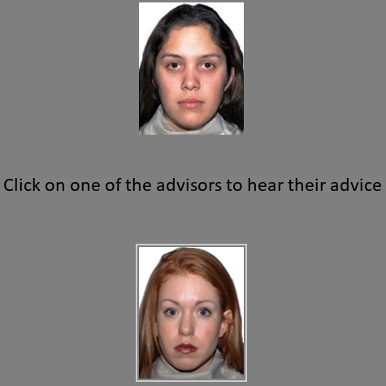
Advisor Choice
The advisor choice screen looks like this:
In this case the bottom advisor is highlighted because her portrait has the grey box around it. Clicking the mouse would select the bottom advisor.
Left Arrow: Previous | any other key: Next

Slide 14
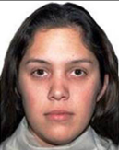


Advisor Portraits
There are three kinds of picture you will see in either the top or bottom of the selection screen:
Advisor portrait:
Selecting an advisor’s portrait will mean you get to hear the advisor’s answer.
Once heard, you will get the opportunity to adjust your marker position.
Silhouette:
Selecting the silhouette will mean you do not get advice; your initial marker placement is taken as your final answer.
Disabled:
You are unable to select this response. Select the other option.
Now you can practice with the ability to select advisors and hear their advice.
Remember: the advisors are different, and aren’t always correct!
Left Arrow: Previous | any other key: Start Practice

Slide 15
Well done!
Now you will start the real experiment.
Remember:
look at the cross so you can see both boxes
Try to be as accurate as you can
Try to use the whole width of the confidence bar
The advisors are different
The advisors are sometimes wrong
Sometimes you don’t get advice, so make sure your first marker placement is as good as you can make it
any key: Start Experiment

Slide 16
The End!
Thank you so much for participating!

