Slide 1
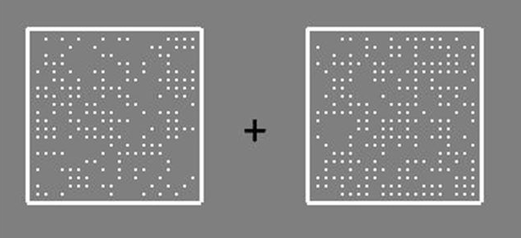
Hello and thank you for participating in this study!
In each trial of this task you will see two boxes containing dots, like this:
It is your task to determine which one contains more dots. In this case the right box contains more dots.
[Press any button to go to the next screen]

Slide 2
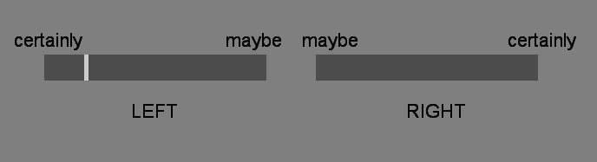
To choose which box contained most dots and how confident you are in your choice you will use a scale like this:
(insert picture)
If you think the left box contained more dots, place the indicator on the left part of the scale using the mouse.
If you think the right box contained more dots, place the indicator on the right part of the scale using the mouse.
By placing the indicator further away from the centre of the scale you indicate a higher confidence.
By placing the indicator closer to the centre of the scale you indicate a lower confidence.
[Press any button to go to the next screen]

Slide 3
As you can see, it can sometimes be difficult to decide which box contains more dots.
To make it easier, there will be a black cross in the middle of the screen which you must fix your gaze on as you do the task.
You will hear an error tone when you make a mistake.
[Press any button to begin practice block 1]

Slide 4
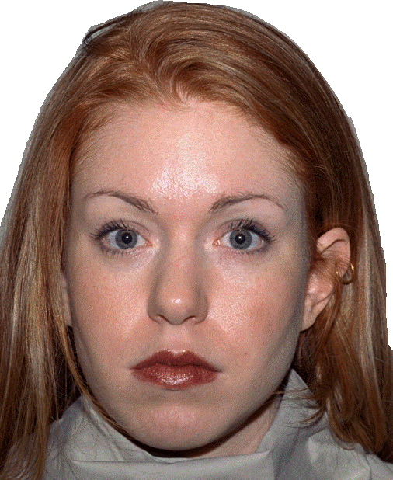
Well done!
To make things more interesting we will match you with a virtual agent who is performing the same task.
In most of the trials (not all of them!), after you have made the first choice and confidence judgment, you will be told which box the virtual agent chose.
Then you will have the opportunity to adjust your initial choice and confidence judgment.
[Press any button to go to the next screen]

Slide 5
Please remember that in this task you must choose the box containing the most dots. You make your response along a confidence scale using your mouse.
After rating your confidence for the first time you will hear your virtual partner’s decision. Then you will get a chance to adjust your judgment.
Please note: the virtual agent can either be right or wrong. Make wise use of their advice!
Please keep in mind that your confidence rating is always about your own perceptual experience, NOT about whether you think the other person is correct!!
If you have any questions, please ask the experimenter.
[Press any button to begin practice block 2]

Slide 6
Well done!
Now you will start the actual task.
Sometimes you will be offered a choice of advisor. To choose an advisor, click on the side of the screen that their portrait is on. Sometimes an advisor will be selected for you and you will not be given a choice.
Like in the previous block, sometimes you won’t get any advice and only your first response will be recorded.
Please be careful to always indicate your true initial confidence in your decision to maximize your performance!
From now on you will not hear the error tone when you get the answer wrong.
If you have any questions, please ask the experimenter.
[Press any button to start the task]

Slide 7
The End!
Thank you so much for participating!

