Slide 1
Predict new offer success
Mateusz Jasieczko
29th of November 2019

Slide 2
Agenda
Problem overview and features transformation
Insights
Solution approach and a little bit of technical details
What mostly impacted results?
Deliverables

Slide 3
Agenda
Problem overview and features transformation
Insights
Solution approach and a little bit of technical details
What mostly impacted results?
Deliverables

Slide 4
Problem overview
You are business representatives of a company, which prepared special new offer for their customers.
My goal is to help you by providing a list of customers who will accept this new offer and also give you arguments to discuss with senior management on: why company should send new offer to this customers.
Clients database with information about clients and how they reacted to previous offers

Slide 5
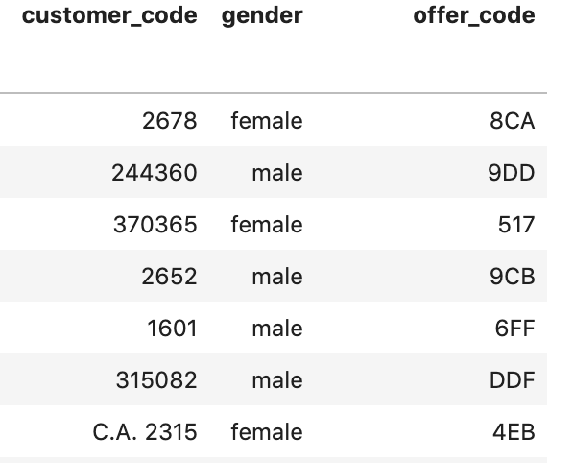
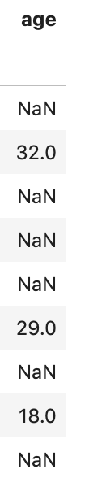
Why data need transformation?
number of unique customer codes: 752
total number of customer codes: 1031

Slide 6
Features transformation
business delivered
gender
offer_class
customer_code
center
customer_type
phone_calls
salary
offer_value
estimated_expenses
age
emails
number
offer_code
name
accepted
feeded into model
encoded_gender
encoded_cc_len
encoded_offer_class
encoded_center
encoded_cc_startswith
encoded_customer_type
encoded_phone_calls
log_salary
log_offer_value_knn
log_estimated_expenses_knn
not_nan_age and nan_age
0_emails to 5_emails
transformation

Slide 7
Agenda
Problem overview and features transformation
Insights
Solution approach and a little bit of technical details
What mostly impacted results?
Deliverables

Slide 8
Women are more likely to accept our offer than men
 | Men | Women
Ratio of consumers accepting our offers (do not sum to 100%) | 19% | 72.2%
Ratio of total consumers (sum to 100%) | 64.5% | 35.5%

Slide 9
Women are more likely to accept our offer than men
 | Men | Women
Ratio of consumers accepting our offers (do not sum to 100%) | 19% | 72.2%
Ratio of total consumers (sum to 100%) | 64.5% | 35.5%

Slide 10
Women are more likely to accept our offer than men
 | Men | Women
Ratio of consumers accepting our offers (do not sum to 100%) | 19% | 72.2%
Ratio of total consumers (sum to 100%) | 64.5% | 35.5%

Slide 11
Customer code – anomaly or something useful?
55%
of our customers had unique
customer code

Slide 12
Customer code – anomaly or something useful?
55%
of our customers had unique
customer code
but the rest didnt

Slide 13
Customer code – anomaly or something useful?
55%
of our customers had unique
customer code
but the rest didnt

Slide 14
Customer code – anomaly or something useful?
55%
of our customers had unique
customer code
but the rest didnt
?
data issue/anomaly

Slide 15
Customer code – anomaly or something useful?
55%
of our customers had unique
customer code
but the rest didnt
?
data issue/anomaly

Slide 16
Customer code – anomaly or something useful?
55%
of our customers had unique
customer code
but the rest didnt
?
data issue/anomaly
60%
customer codes shared by multiple customers
had identical response to our offer inside their community

Slide 17
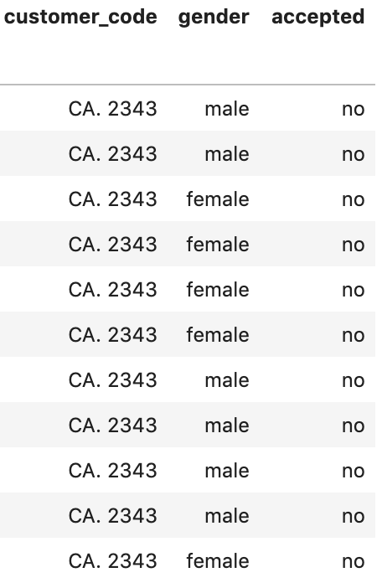
Customer code – anomaly or something useful?
55%
of our customers had unique
customer code
but the rest didnt
?
data issue/anomaly
60%
customer codes shared by multiple customers
had identical response to our offer inside their community

Slide 18
Agenda
Problem overview and features transformation
Insights
Solution approach and a little bit of technical details
What mostly impacted results?
Deliverables

Slide 19
Solution approach (part I)
Binary classification
How our binary classifiers are working?
they use past data to predict which customers will accept new offer and which will reject it
accordingly to prediction they divide (classify) customers to two (binary) groups

Slide 20
Solution approach (part II)
Binary classification
What I do with these results?
for each customer I check how probable it was that he will be classified to success group
return list of this probabilities

Slide 21
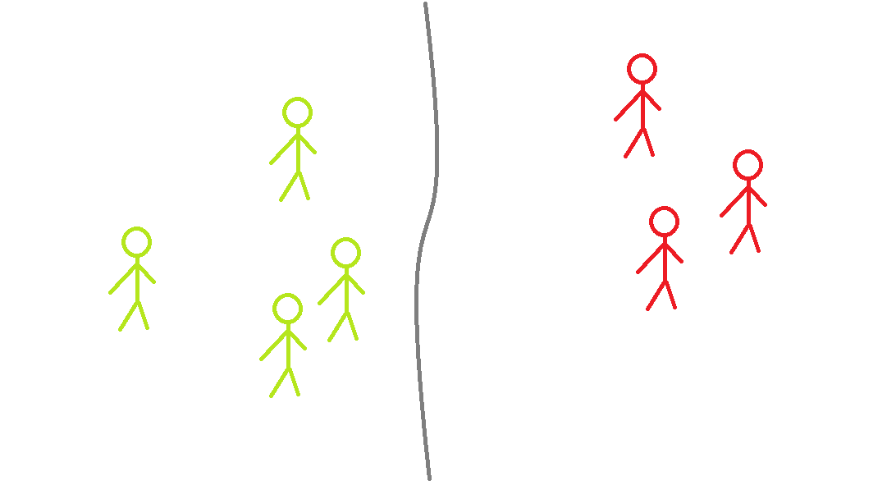
A little bit of technical details
Story about binary classification:
The quality of the model is assessed based on classification results of the sampled group of customers, unseen by the model during learning.
258 customers:
Recall: 0.71aa
Precision: 0.69
Accuracy: 0.77
all these metrics ranges from 0 to 1,
where: the closer to 1 the better model
129 TN | 31 FP
28 FN | 70 TP

Slide 22

A little bit of technical details
Story about binary classification:
The quality of the model is assessed based on classification results of the sampled group of customers, unseen by the model during learning.
258 customers:
Recall: 0.71aa
Precision: 0.69
Accuracy: 0.77
all these metrics ranges from 0 to 1,
where: the closer to 1 the better model
129 TN | 31 FP
28 FN | 70 TP

Slide 23
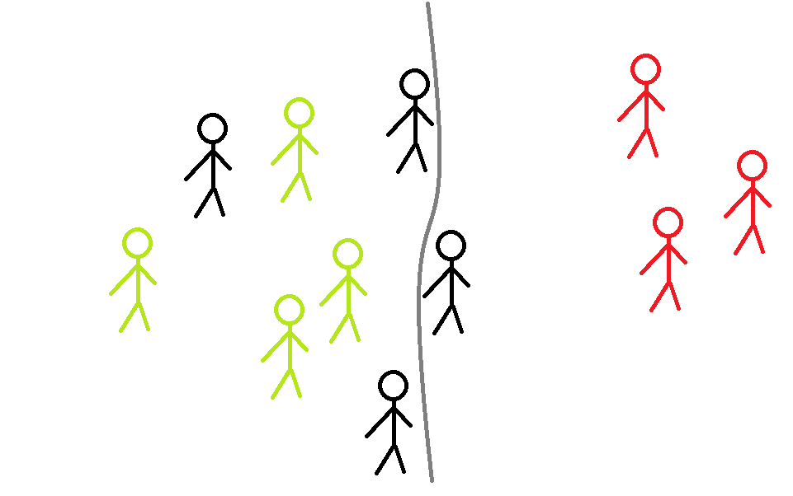
A little bit of technical details
Story about binary classification:
The quality of the model is assessed based on classification results of the sampled group of customers, unseen by the model during learning.
258 customers:
Recall: 0.71aa
Precision: 0.69
Accuracy: 0.77
all these metrics ranges from 0 to 1,
where: the closer to 1 the better model
129 TN | 31 FP
28 FN | 70 TP

Slide 24
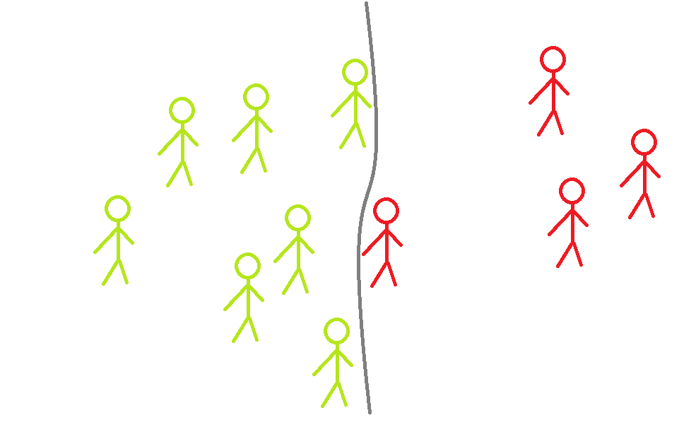
A little bit of technical details
Story about binary classification:
The quality of the model is assessed based on classification results of the sampled group of customers, unseen by the model during learning.
258 customers:
Recall: 0.71aa
Precision: 0.69
Accuracy: 0.77
all these metrics ranges from 0 to 1,
where: the closer to 1 the better model
129 TN | 31 FP
28 FN | 70 TP

Slide 25
A little bit of technical details
Story about binary classification:
The quality of the model is assessed based on classification results of the sampled group of customers, unseen by the model during learning.
258 customers:
Recall: 0.71aa
Precision: 0.69
Accuracy: 0.77
all these metrics ranges from 0 to 1,
where: the closer to 1 the better model
129 TN | 31 FP
28 FN | 70 TP

Slide 26
How to understand numbers in table of 258 customers?
customer predicted as rejected, actual rejected offer TN | customer predicted as accepted, actual rejected offer FP
customer predicted as rejected, actual accepted offer FN | customers predicted as accepted, actual accepted offer TP

Slide 27
A little bit of technical details
Story about binary classification:
The quality of the model is assessed based on classification results of the sampled group of customers, unseen by the model during learning.
258 customers:
Recall: 0.71aa
Precision: 0.69
Accuracy: 0.77
Ratio of customers who will accept new offer
detected by the model
all these metrics ranges from 0 to 1,
where: the closer to 1 the better model
129 TN | 31 FP
28 FN | 70 TP

Slide 28
A little bit of technical details
Story about binary classification:
The quality of the model is assessed based on classification results of the sampled group of customers, unseen by the model during learning.
258 customers:
Recall: 0.71aa
Precision: 0.69
Accuracy: 0.77
How accurate were positive predictions?
all these metrics ranges from 0 to 1,
where: the closer to 1 the better model
129 TN | 31 FP
28 FN | 70 TP

Slide 29
A little bit of technical details
Story about binary classification:
The quality of the model is assessed based on classification results of the sampled group of customers, unseen by the model during learning.
258 customers:
Recall: 0.71aa
Precision: 0.69
Accuracy: 0.77
Ratio of correctly identified customers
all these metrics ranges from 0 to 1,
where: the closer to 1 the better model
129 TN | 31 FP
28 FN | 70 TP

Slide 30
Agenda
Problem overview and features transformation
Insights
Solution approach and a little bit of technical details
What mostly impacted results?
Deliverables

Slide 31
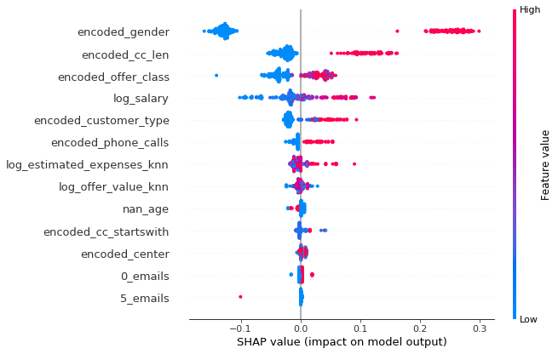
Factors impacting results
there is much higher likelihood that woman will accept our offer than man will do it
there is higher likelihood that people with cc of len 5 or 8 will accept our offer than others
there is higher likelihood that customers will accept high or medium class offers than premium
there is higher likelihood that customers type C will accept our offer than other customers
there is higher likelihood that customers who didnt
called us or called us more than 2 times during last
quarter will reject our offer
the higher likelihood of accepting our offer the higher customer’s estimated expenses
there is higher likelihood that customer who gave us his age will accept our offer
customers who didnt contact with us via email during last 6 months have higher likelihood of accepting our new offer
customers which contacted with us more than 4 times via email during last 6 months have higher likelihood to reject our offer

Slide 32
Agenda
Problem overview and features transformation
Insights
Solution approach and a little bit of technical details
What mostly impacted results?
Deliverables

Slide 33


Deliverables
Program computing success probabilities
for new customers or new campaigns
List of success probabilities for current customers

