Slide 1
Omnipresent Serendipity

Slide 2
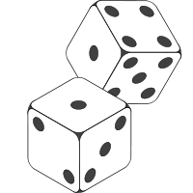
DICE 0.1
User Guide
About
Announcement
Negative Reaction
Disagreement
Appreciation
Discussions
Topics
Questions
Answers
Elaboration
Agreement
Humor
Build a tower
Increased Mobility
Color Realms
Fancy Lights
More People
Public art
Bad Art
Public Art
Roundabout
Roundabouts
Private Vehicle
Columbus Circle
Crossing
Huge fountain
Water
Running Water
More People
Natural
Interactive art
Public Art
Homeless
Local Artists
Pedestrian Traffic
El Parquecito
People
Private Vehicle
Reason
Own Space

Slide 3
DICE 0.1
User Guide
About
Announcement
Negative Reaction
Disagreement
Appreciation
Discussions
Topics
Questions
Answers
Elaboration
Agreement
Humor
Build a tower
Increased Mobility
Color Realms
Fancy Lights
More People
Public art
Bad Art
Public Art
Roundabout
Roundabouts
Private Vehicle
Columbus Circle
Crossing
Huge fountain
Water
Running Water
More People
Natural
Interactive art
Public Art
Homeless
Local Artists
Pedestrian Traffic
El Parquecito
People
Private Vehicle
Reason
Own Space

Slide 4



DICE 0.1
User Guide
About
Announcement
Negative Reaction
Disagreement
Appreciation
Discussions
Topics
Questions
Answers
Elaboration
Agreement
Humor
Build a tower
Increased Mobility
Color Realms
Fancy Lights
More People
Public art
9
Bad Art
Public Art
26
19
7
Roundabout
Roundabout
Roundabouts
Private Vehicle
Columbus Circle
Crossing
Huge fountain
Water
Running Water
More People
Natural
Interactive art
Public Art
Homeless
Local Artists
Pedestrian Traffic
El Parquecito
People
Private Vehicle
Reason
Own Space
As long as we can make it work from a traffic perspective, I love it. It would transform the entire area and it is a very important connection point in downtown.

Slide 5
DICE 0.1
User Guide
About
Announcement
Negative Reaction
Disagreement
Appreciation
Discussions
Topics
Questions
Answers
Elaboration
Agreement
Humor
9
36
19
17
Build a tower
Build a tower
Increased Mobility
Color Realms
Fancy Lights
More People
Public art
Bad Art
Public Art
Roundabout
Roundabouts
Private Vehicle
Columbus Circle
Crossing
Huge fountain
Water
Running Water
More People
Natural
Interactive art
Public Art
Homeless
Local Artists
Pedestrian Traffic
El Parquecito
People
Private Vehicle
Reason
Own Space
This seems like it would be more of a barrier than something that would provide increased mobility and connectivity.

Slide 6
DICE 0.1
User Guide
About
Announcement
Negative Reaction
Disagreement
Appreciation
Discussions
Topics
Questions
Answers
Elaboration
Agreement
Humor
9
36
19
17
Build a tower
Build a tower
Increased Mobility
Color Realms
Fancy Lights
More People
Public art
Bad Art
Public Art
Roundabout
Roundabouts
Private Vehicle
Columbus Circle
Crossing
Huge fountain
Water
Running Water
More People
Natural
Interactive art
Public Art
Homeless
Local Artists
Pedestrian Traffic
El Parquecito
People
Private Vehicle
Reason
Own Space
This seems like it would be more of a barrier than something that would provide increased mobility and connectivity.

Slide 7
DICE 0.1
User Guide
About
Announcement
Negative Reaction
Disagreement
Appreciation
Discussions
Topics
Questions
Answers
Elaboration
Agreement
Humor
9
36
19
17
Build a tower
Build a tower
Increased Mobility
Color Realms
Fancy Lights
More People
Public art
Bad Art
Public Art
Roundabout
Roundabouts
Private Vehicle
Columbus Circle
Crossing
Huge fountain
Water
Running Water
More People
Natural
Interactive art
Public Art
Homeless
Local Artists
Pedestrian Traffic
El Parquecito
People
Private Vehicle
Reason
Own Space
I would like a tree shaded green space where residents can gather to hear music or attend a farmer's market. Also the tower concept…
Notes:
End of Set 1

Slide 8
DICE 0.1
User Guide
About
Announcement
Negative Reaction
Disagreement
Appreciation
Discussions
Topics
Questions
Answers
Elaboration
Agreement
Humor
9
36
19
17
This seems like it would be more of a barrier than something that would provide increased mobility and connectivity.
Build a tower
Build a tower
Increased Mobility
Color Realms
Fancy Lights
More People
Public art
Bad Art
Public Art
Roundabout
Roundabouts
Private Vehicle
Columbus Circle
Crossing
Huge fountain
Water
Running Water
More People
Natural
Interactive art
Public Art
Homeless
Local Artists
Pedestrian Traffic
El Parquecito
People
Private Vehicle
Reason
Own Space
Notes:
End of 2

Slide 9
DICE 0.1
User Guide
About
Announcement
Negative Reaction
Disagreement
Appreciation
Discussions
Topics
Questions
Answers
Elaboration
Agreement
Humor
Build a tower
Increased Mobility
Color Realms
Fancy Lights
More People
Public art
Bad Art
Public Art
Roundabout
Roundabouts
Private Vehicle
Columbus Circle
Crossing
Huge fountain
Water
Running Water
More People
Natural
Interactive art
Public Art
Homeless
Local Artists
Pedestrian Traffic
El Parquecito
People
Private Vehicle
Reason
Own Space

Slide 10
DICE 0.1
User Guide
About
Announcement
Negative Reaction
Disagreement
Appreciation
Discussions
Topics
Questions
Answers
Elaboration
Agreement
Humor
As long as we can make it work from a traffic perspective, I love it. It would transform the entire area and it is a very important connection point in downtown.
Build a tower
Increased Mobility
Color Realms
Fancy Lights
More People
Public art
Bad Art
Public Art
Roundabout
Roundabouts
Private Vehicle
Columbus Circle
Crossing
Huge fountain
Water
Running Water
More People
Natural
Interactive art
Public Art
Homeless
Local Artists
Pedestrian Traffic
El Parquecito
People
Private Vehicle
Reason
Own Space

Slide 11
DICE 0.1
User Guide
About
This seems like it would be more of a barrier than something that would provide increased mobility and connectivity.
Announcement
Negative Reaction
Disagreement
Appreciation
Discussions
Topics
Questions
Answers
Elaboration
Agreement
Humor
Build a tower
Increased Mobility
Color Realms
Fancy Lights
More People
Public art
Bad Art
Public Art
Roundabout
Roundabouts
Private Vehicle
Columbus Circle
Crossing
Huge fountain
Water
Running Water
More People
Natural
Interactive art
Public Art
Homeless
Local Artists
Pedestrian Traffic
El Parquecito
People
Private Vehicle
Reason
Own Space

Slide 12
DICE 0.1
User Guide
About
Announcement
Negative Reaction
Disagreement
Appreciation
Discussions
Topics
Questions
Answers
Elaboration
Agreement
Humor
Build a tower
Increased Mobility
Color Realms
Fancy Lights
More People
Public art
Bad Art
Public Art
Roundabout
Roundabouts
Private Vehicle
Columbus Circle
Crossing
Huge fountain
Water
Running Water
More People
Natural
Interactive art
Public Art
Homeless
Local Artists
Pedestrian Traffic
El Parquecito
People
Private Vehicle
Reason
Own Space
Notes:
End of 3

Slide 13
Exploration Metrics

Slide 14
DICE 0.1
User Guide
About
30%
60%
15%
Negative Reaction
Build a Tower
Announcement
Disagreement
Appreciation
Questions
Answers
Elaboration
Agreement
Humor
35%
Increased Mobility
Mobility
Light
Chime
Village
Dense
Fine
27%
Color Realms
Structure
Transportation
Great
Beauty
23%
Fancy Lights
Impact
Community
Area
Art
15%
More People
People
Work
City
Spot
Money

Slide 15
DICE 0.1
User Guide
About
30%
60%
15%
Negative Reaction
Build a Tower
Announcement
Disagreement
Appreciation
Questions
Answers
Elaboration
Agreement
Humor
35%
Increased Mobility
Mobility
Light
Chime
Village
Dense
Fine
27%
Color Realms
Structure
Transportation
Great
Beauty
23%
Fancy Lights
Impact
Community
Area
Art
15%
More People
People
Work
City
Spot
Money

Slide 16
DICE 0.1
User Guide
About
Announcement
Negative Reaction
Build a Tower
Disagreement
Appreciation
Questions
Answers
Elaboration
Agreement
Humor
35%
Increased Mobility
Mobility
Light
Chime
Village
Dense
Fine
27%
Color Realms
Structure
Transportation
Great
Beauty
23%
Fancy Lights
Impact
Community
Area
Art
15%
More People
People
Work
City
Spot
Money

Slide 17
DICE 0.1
User Guide
About
Announcement
Negative Reaction
Build a Tower
Disagreement
Appreciation
Questions
Answers
Elaboration
Agreement
Humor
35%
Increased Mobility
Mobility
Light
Chime
Village
Dense
Fine
27%
Color Realms
Structure
Transportation
Great
Beauty
23%
Fancy Lights
Impact
Community
Area
Art
15%
More People
People
Work
City
Spot
Money

Slide 18
Dashboard

Slide 19


DICE 0.1
User Guide
About
Questions
Answers
30%
60%
15%
Announcement
Announcement
Negative Reaction
Elaboration
Disagreement
Appreciation
Elaboration
Questions
Answers
Agreement
Humor
Build a Tower
Increased Mobility
Agreement
35%
Mobility
Light
Chime
Village
Dense
Fine
Disagreement
Color Realms
Structure
Negative Reaction
27%
Transportation
Great
Beauty
Appreciation
23%
Fancy Lights
Impact
Community
Area
Art
Humor
More People
People
Work
City
Spot
Money
15%
Help
Mobility
Fine
Work
Car
Money
Impact
Transportation
Dense
Impact
Community
City
Limit
Built
Structure
Light
Chime
Built
Structure
Light
Chime
Village
People
Hangout
Spot
VISIT
COVERAGE
DISTRIBUTION

Slide 20
DICE 0.1
User Guide
About
Sententree – Sequential frequent patterns
https://twitter.github.io/SentenTree/
Mobility
Announcement
Negative Reaction
Elaboration
Disagreement
Appreciation
Questions
Answers
Agreement
Humor
Fine
Help
City
Work
Car
Money
Impact
Dense
Help
Mobility
Fine
Money
Impact
Community
City
Limit
Built
Structure
Chime
Impact
Transportation
Dense
Built
Limit
Built
Structure
Light
Chime
Built
Structure
Light
Chime
Village
Light
Village
People
Hangout
Spot
Transportation
People
Structure
Work
Spot
Street
Hangout
Area
Community
Car
Answer
Tower
More people living and working near a major transit center means less use for a personal car.
Evaluate Impact: Mobility

Slide 21
DICE 0.1
User Guide
About
N most frequent/relevant words and how many times these words were uttered in different categories
Announcement
Negative Reaction
Elaboration
Disagreement
Appreciation
Mobility
Impact
Help
Built
Structure
Chime
Dense
Fine
Money
Village
People
Questions
Answers
Agreement
Humor
Questions
Answers
Announcement
Elaboration
Agreement
Disagreement
Negative Reaction
Appreciation
Humor
Elaboration
The structure could incorporate an observation deck. It could echo the tower elements of the California Tower (which is visible from the Nudillo) and the MTS clock tower.
Comment on the idea

Slide 22
DICE 0.1
User Guide
About
Mobility
Fine
Help
Negative Reaction
City
Announcement
Disagreement
Appreciation
Questions
Answers
Elaboration
Agreement
Humor
Impact
Dense
Money
Built
Structure
Chime
Built
Village
Light
Mobility
Impact
Help
Built
Structure
Chime
Dense
Fine
Money
Village
People
Questions
Answers
Announcement
Elaboration
Agreement
Disagreement
Negative Reaction
Appreciation
Humor

Slide 23
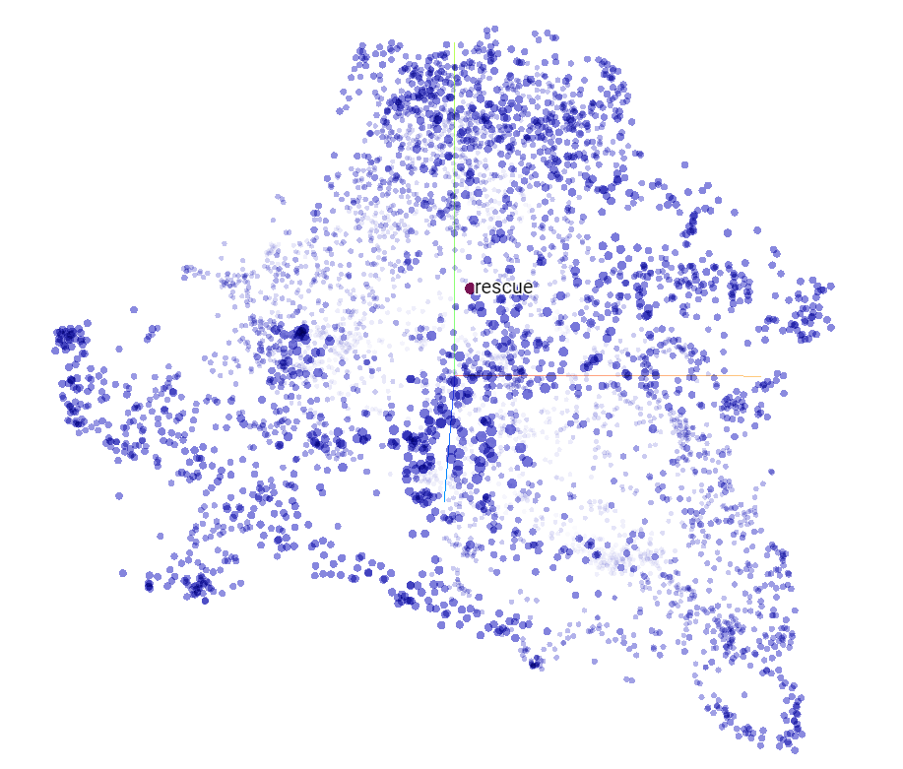
DICE 0.1
User Guide
About
Data after dimension reduction
https://projector.tensorflow.org/
Announcement
Negative Reaction
Elaboration
Disagreement
Appreciation
Agreement
Humor

Slide 24
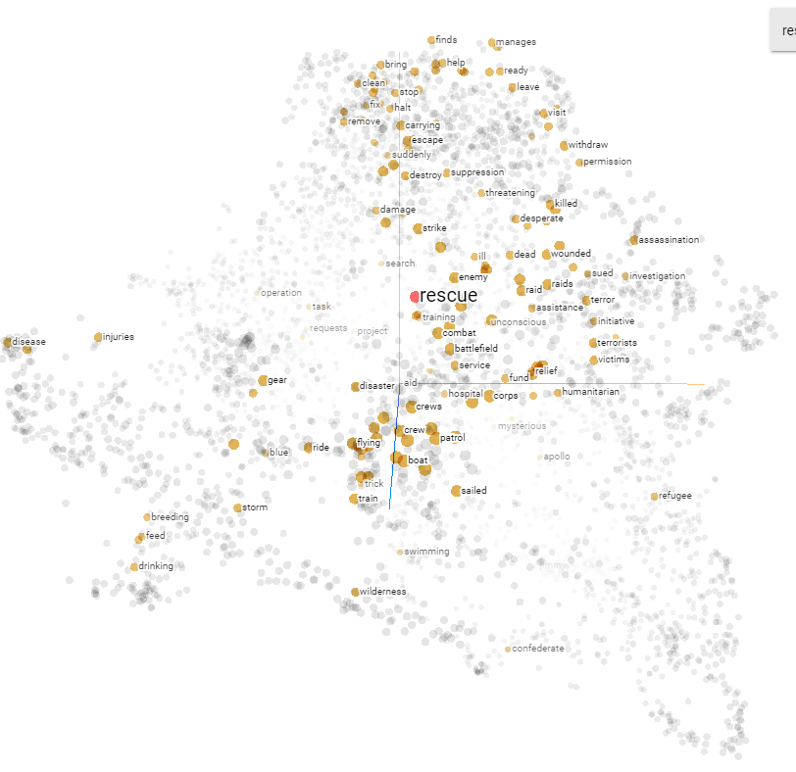
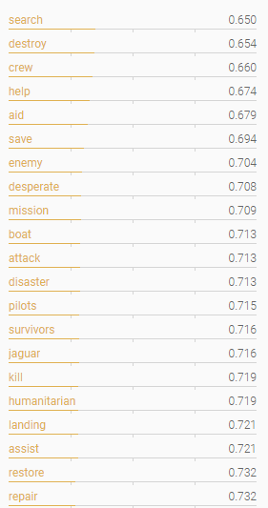
DICE 0.1
User Guide
About
Data after dimension reduction
https://projector.tensorflow.org/
Data after dimension reduction
https://projector.tensorflow.org/
Word proximity
Announcement
Negative Reaction
Elaboration
Disagreement
Appreciation
Agreement
Humor

Slide 25

DICE 0.1
User Guide
About
Data after dimension reduction
https://projector.tensorflow.org/
Data after dimension reduction
https://projector.tensorflow.org/
Word frequency
Announcement
Negative Reaction
Elaboration
Disagreement
Appreciation
Agreement
Humor

Slide 26
DICE 0.1
User Guide
About
Announcement
Negative Reaction
Disagreement
Appreciation
Discussions
Topics
Questions
Answers
Elaboration
Agreement
Humor
Build a tower
Increased Mobility
Color Realms
Fancy Lights
More People
Public art
Bad Art
Public Art
Roundabout
Roundabouts
Private Vehicle
Columbus Circle
Crossing
Huge fountain
Water
Running Water
More People
Natural
Interactive art
Public Art
Homeless
Local Artists
Pedestrian Traffic
El Parquecito
People
Private Vehicle
Reason
Own Space

