Slide 1
Diversity, Serendipity, Novelty, and Coverage: A Survey and Empirical Analysis of Beyond-Accuracy Objectives in Recommender Systems
Marius Kaminskas and Derek Bridge, Insight Centre for Data Analytics,
University College Cork, Ireland
Transaction on Interactive Intelligent Systems (TIIS), 2016

Slide 2
Preface
This study focuses on Recommender Systems (RS) and Information Retrieval (IR) research
Accuracy
How closely the recommender’s ratings are to the users’ true ratings
Beyond Accuracy
Impact on the quality of the recommender system

Slide 3
Why beyond accuracy objectives?
Users are most likely to consider only a small set of top-N recommendations
Ranking items based on their predicted relevance only results increases the risk of producing results too similar to each other
Diversifying results deduces this risk by introducing items that the users will be interested in

Slide 4
Beyond Accuracy Objectives
Diversity
Serendipity
Novelty
Coverage
Diversity is often used in reference to the system’s ability to recommend different items to different users
To the portion of the item catalog recommended across all users (i.e., coverage)
Notes:
The terminology concerning beyond-accuracy objectives in the RS literature is not consistent.

Slide 5

Beyond Accuracy Objectives
Diversity
The value of a retrieved document is influenced not just by the document’s similarity to a query but also by its similarity to other documents retrieved with it [Carbonell and Goldstein 1998]
Costs accuracy
Notes:
Average pairwise distance between the items in the list

Slide 6
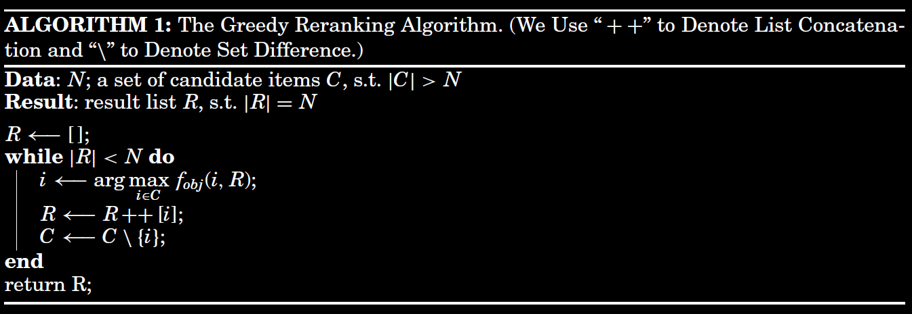
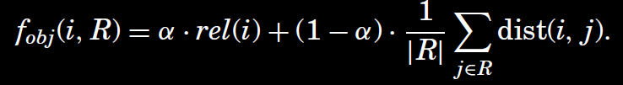
Beyond Accuracy Objectives
Diversity
Notes:
In the equation, rel(i) denotes the item’s relevance and parameter ! controls the tradeoff
between the influence of relevance and diversity in the reranking procedure. Similarly
to the diversity metric (see Section 2.1, Equation (1)), the distance between two
items dist(i, j) can be computed using a variety of approaches.
Distance:
Jaccard similarity
Cosine similarity
Hamming distance
Complement of Pearson correlation
Matrix factorization

Slide 7

Beyond Accuracy Objectives
Serendipity
Serendipitous recommendation is informally defined as one that helps the user find a “surprisingly interesting item he might not have otherwise discovered.” Herlocker et al. [2004]
Surprise and Relevance
Notes:
Difficult to define “surprising” or “unexpected”
Predominantly designed by applying heuristics
The usefulness is measured based on user profile

Slide 8

Beyond Accuracy Objectives
Novelty
An item that is novel to a user is not necessarily serendipitous for that user (it needs only to be unknown to the user)
Novelty = 1 / Popularity
Novelty
Serendipity
Notes:
A novel recommended item is one that is previously unknown to the user
An item with high novelty will not necessarily be serendipitous for a user, and a serendipitous recommendation will not necessarily be novel

Slide 9

Beyond Accuracy
Coverage
Coverage reflects the degree to which the recommendations cover the catalog of available items [Herlocker et al. 2004; Ge et al. 2010; Adomavicius and Kwon 2012].
The fraction of items that appear in the users’ recommendation lists
Notes:
Vastly different from our definition
where Ru is the set of all recommendations generated for user u, U is the set of all
users of the system, and I is the item catalog.
Gini coefficient
Shannon entropy
Max flow

Slide 10
Measuring Users’ Perception of BA Objectives
Challenges involved
Large number of participants
Correctly formulating survey questions
Tone of the questions have been shown to impact user experiences to the measured objectives
Avoiding bias
Data type

Slide 11
Findings from multicriteria user studies
Perceived usefulness of a recommender is influenced by the perceived accuracy and novelty, and to a lesser extent by the perceived diversity [Pu et al. 2011]
Perceived diversity of recommendations have positive relationship with the perceived accuracy, the ease of choice, and consequently the overall satisfaction with the system [Knijnenburg et al. 2012]
The perceived satisfaction with the recommendations was found to positively correlate with the perceived diversity and negatively with perceived novelty [Ekstrand et al. 2014]
Notes:
The last one contradicts with the first one
(Pu et al. conducted the survey using a number of online recommender services including Amazon, while Ekstrand et al. focused on movie recommendations).

Slide 12
Findings from targeted user studies
Light diversification (changing up to four items in a list of 10 recommendations) positively influences user satisfaction with the item-based CF recommender [Ziegler et al. 2005]
The content-based recommendation was the most novel (i.e., the users were least familiar with them), but also the least accurate (i.e., they assigned the lowest ratings to the tracks) [Celma 2009]
After a certain level of diversity is achieved, users may not appreciate further diversification [Willemsen et al. 2011]
Notes:
Content based – text description
Celma hypothesizes that the low ratings of novel recommendations may be improved by providing explanations about why particular unknown songs are recommended.

Slide 13
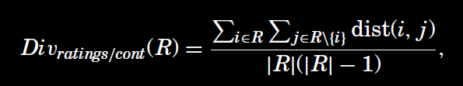
Experimental Procedure
One plus random methodology [Koren, 2008]
The overall performance was measured by recall, which is the ratio of number of hits over the number of test cases. Moreover, there are 5 beyond accuracy metrics

Slide 14
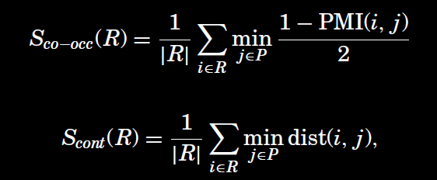


Experimental Procedure
Notes:
Co-occurrence based surprise
Content based surprise

Slide 15
Experimental Procedure
Datasets
MovieLens 1M
Last.fm 1K
Algorithms
Pairwise learning to rank (LTR) [Weston et al., 2010]
PureSVD [Cremonesi et al., 2010]
Matrix factorization (MF)
Two K-NN algorithms
User-based collaborative filtering (UB)
Item-based collaborative filtering (IB)
Notes:
Item-item collaborative filtering, or item-based, or item-to-item, is a form of collaborative filtering for recommender systems based on the similarity between items calculated using people's ratings of those items. Item-item collaborative filtering was invented and used by Amazon.com in 1998.

Slide 16
Findings
Rating-based diversity is positively correlated with novelty
There is a positive correlation between the content-based diversity and the content-based surprise
A negative correlation is observed among the co-occurrence-based surprise and novelty

Slide 17
Major Takeaways
The users were more confident when they clearly understood why a particular item was recommended [Castagnos et al., 2013]
While diversity may be positively perceived by users, additional explanations may be important for improving the acceptance of such recommendations
The users were willing to sacrifice recommendation accuracy for the sake of discovering new interesting [Zhang et al., 2012]
Notes:
However,

Slide 18
Big Questions
These findings offer an approximation of user behavior in real-life settings
What happens if the users are unaware of these conditions that we are trying to measure beyond accuracy objectives?
Do we explain the goal of the study to the users or not?

