Slide 1
Set D

Slide 2


Slide 3
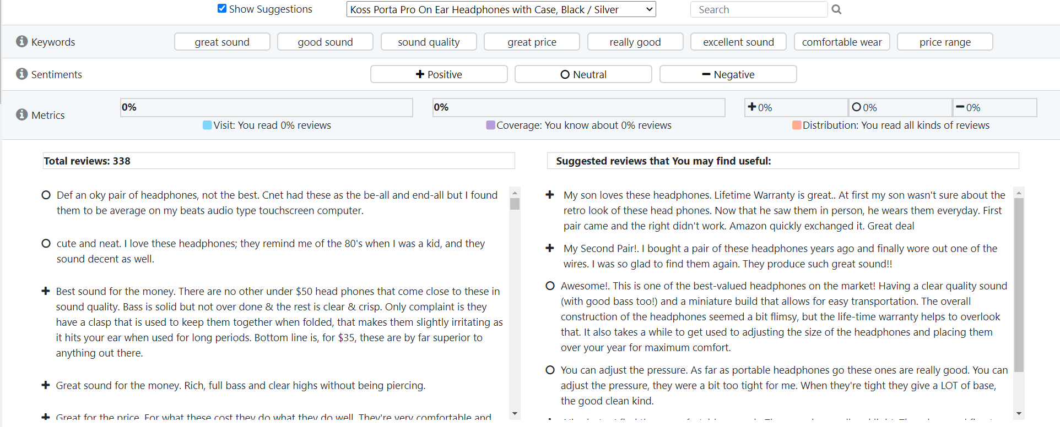
Keywords
Sentiments
Exploration metrics
List of reviews
List of suggested
reviews that you
may find useful

Slide 4
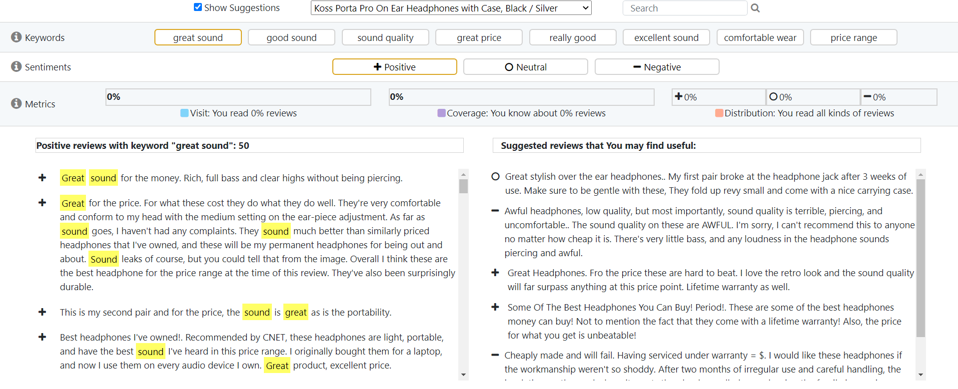

Slide 5
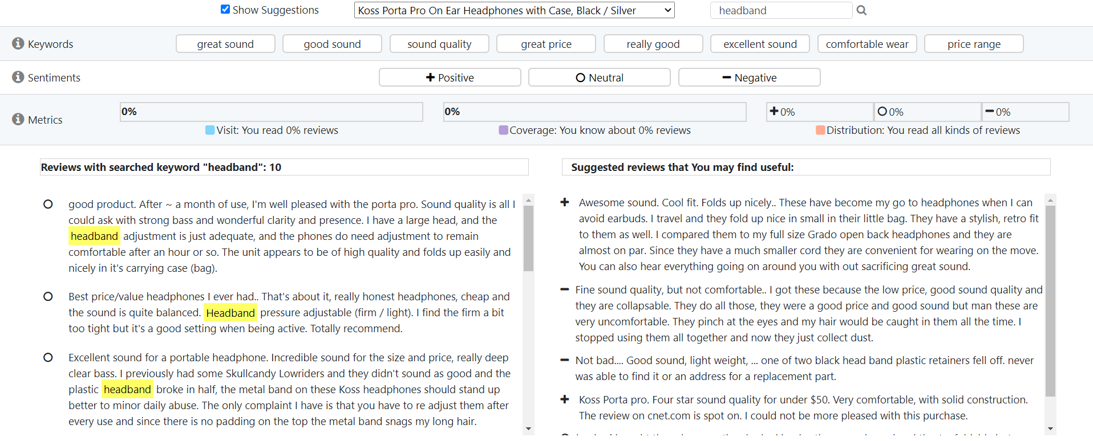

Slide 6


Slide 7






Slide 8

Metric arrows

Slide 9
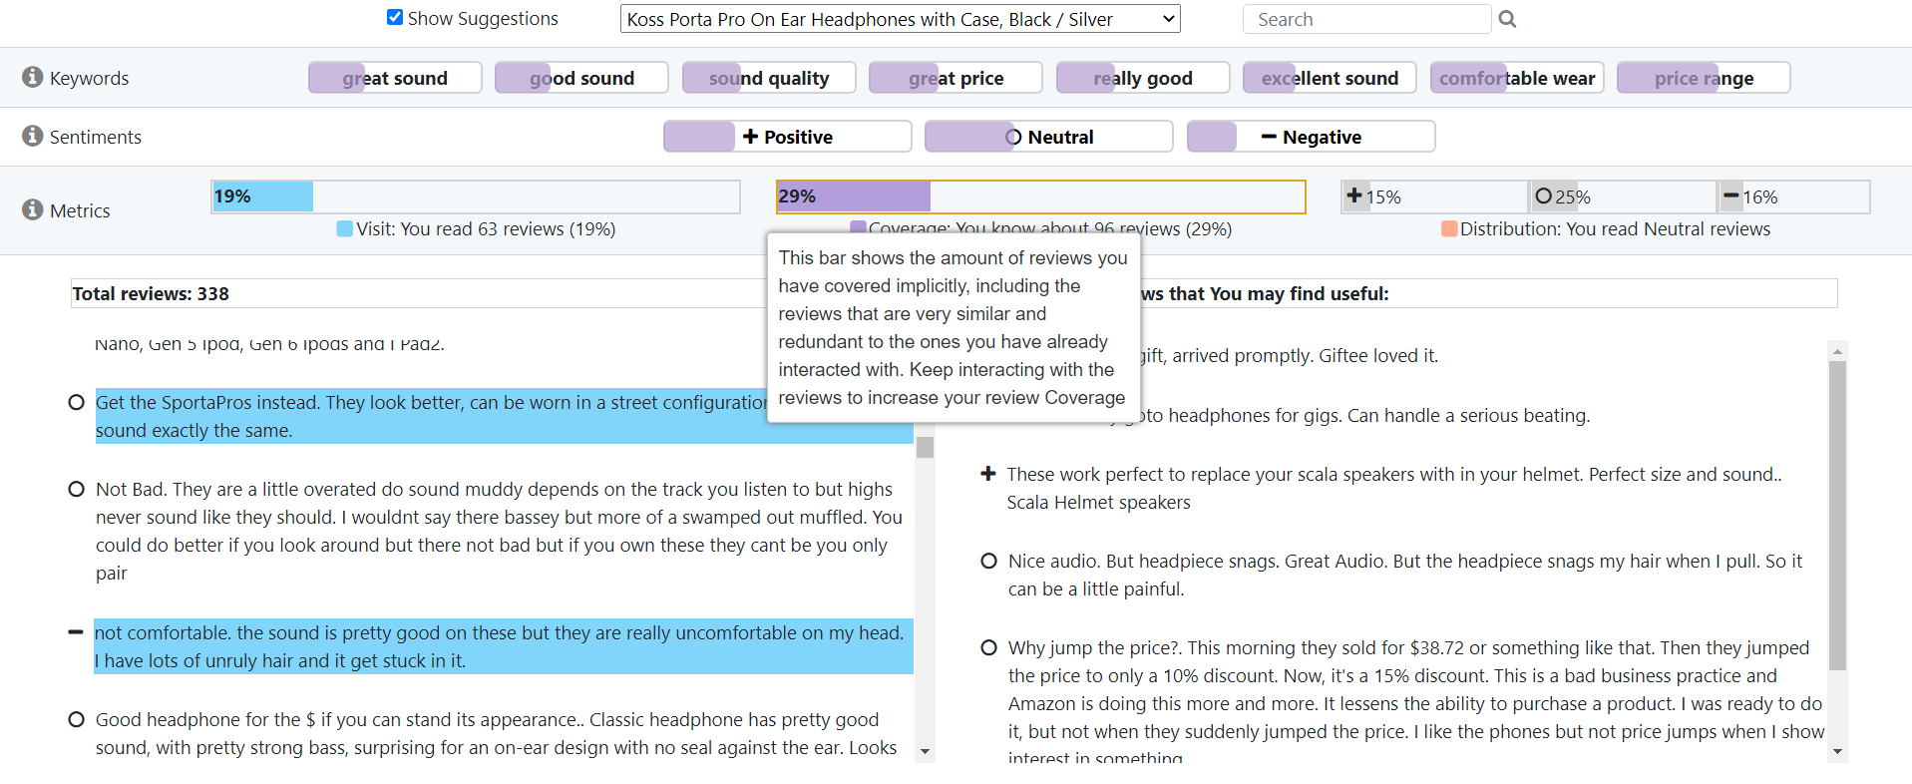

Slide 10
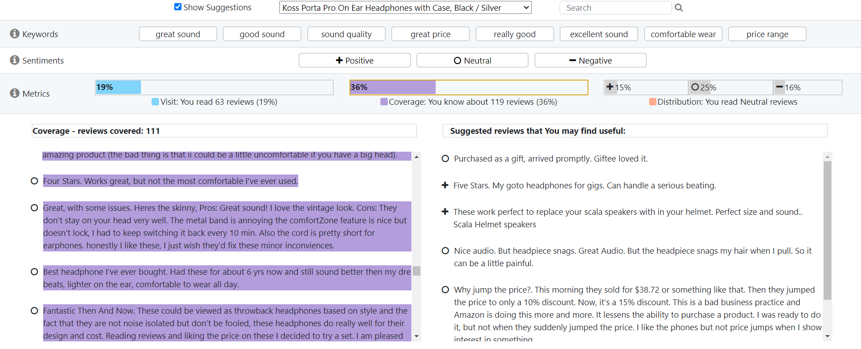

Slide 12
Set A

Slide 13
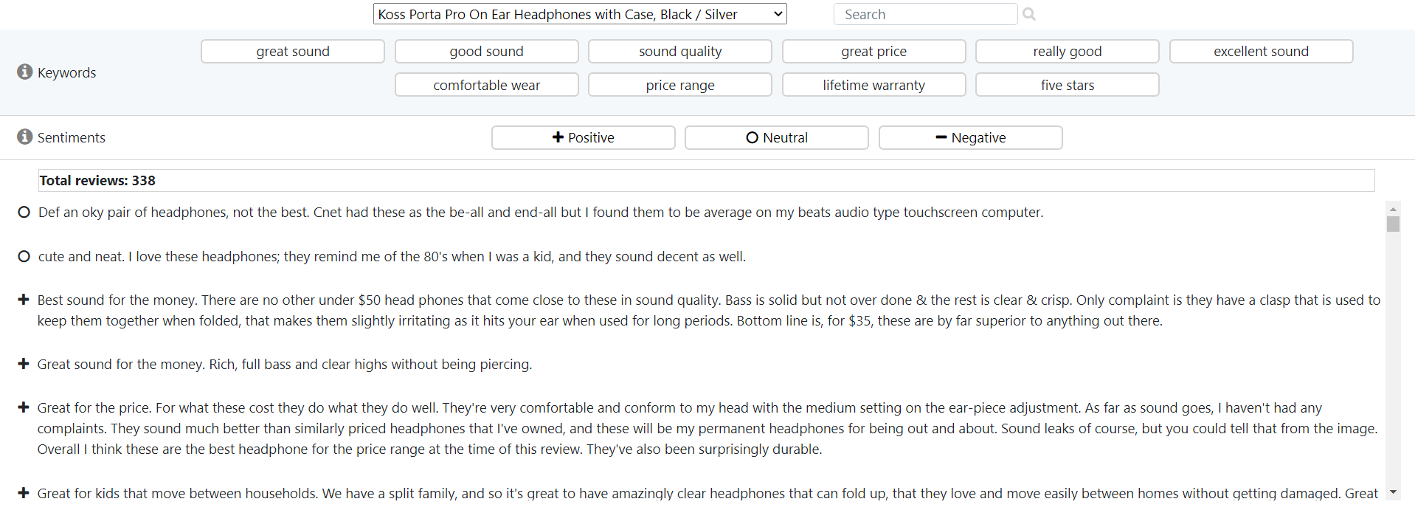
Keywords
Sentiments
List of reviews

Slide 14
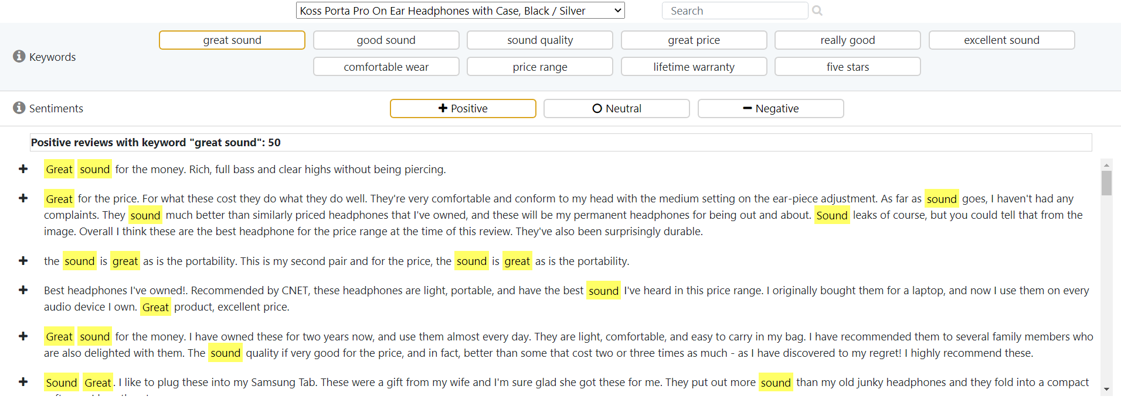

Slide 15
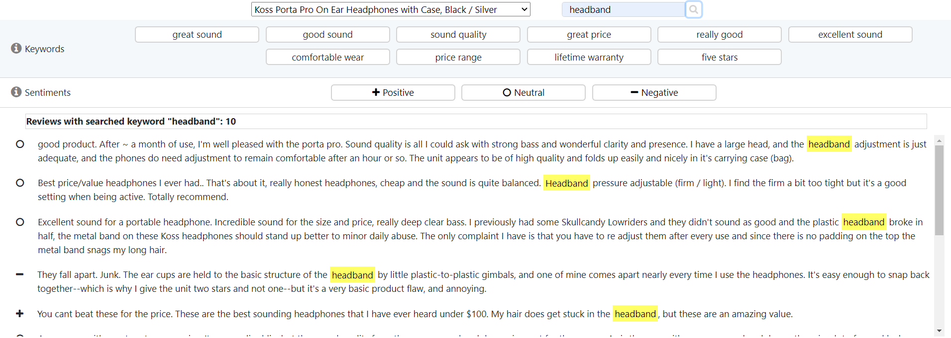

Slide 16


Slide 17
Set B

Slide 18
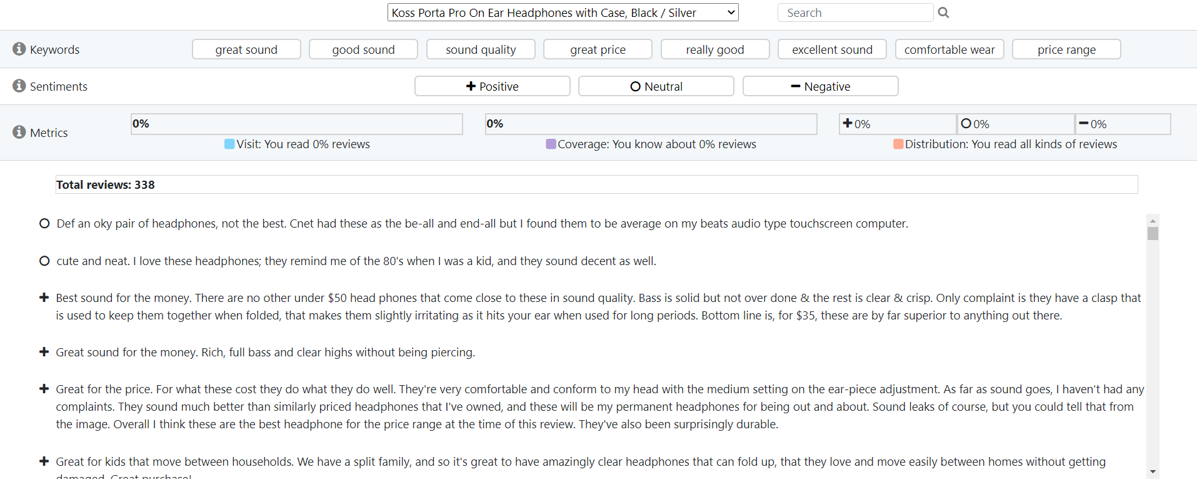
Keywords
Sentiments
Exploration metrics
List of reviews

Slide 19
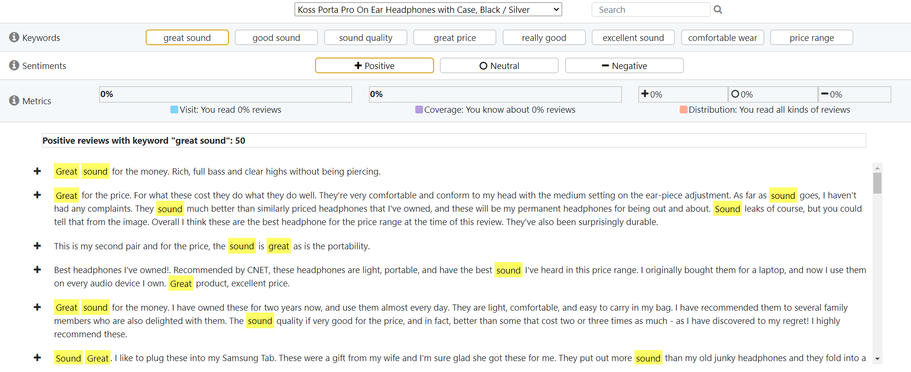

Slide 20
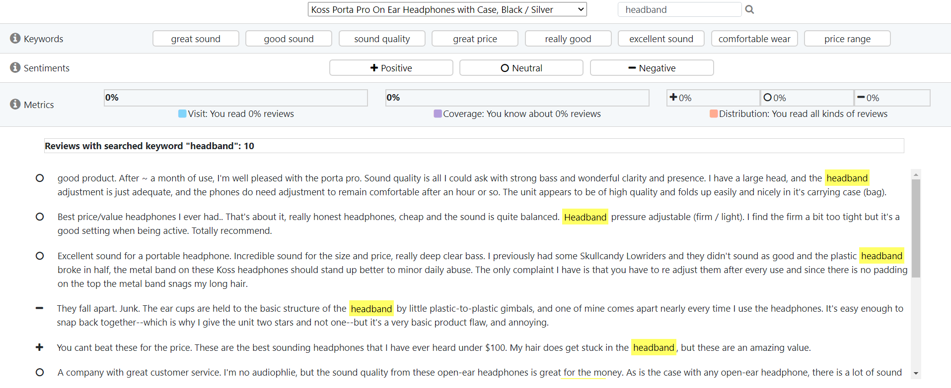

Slide 21
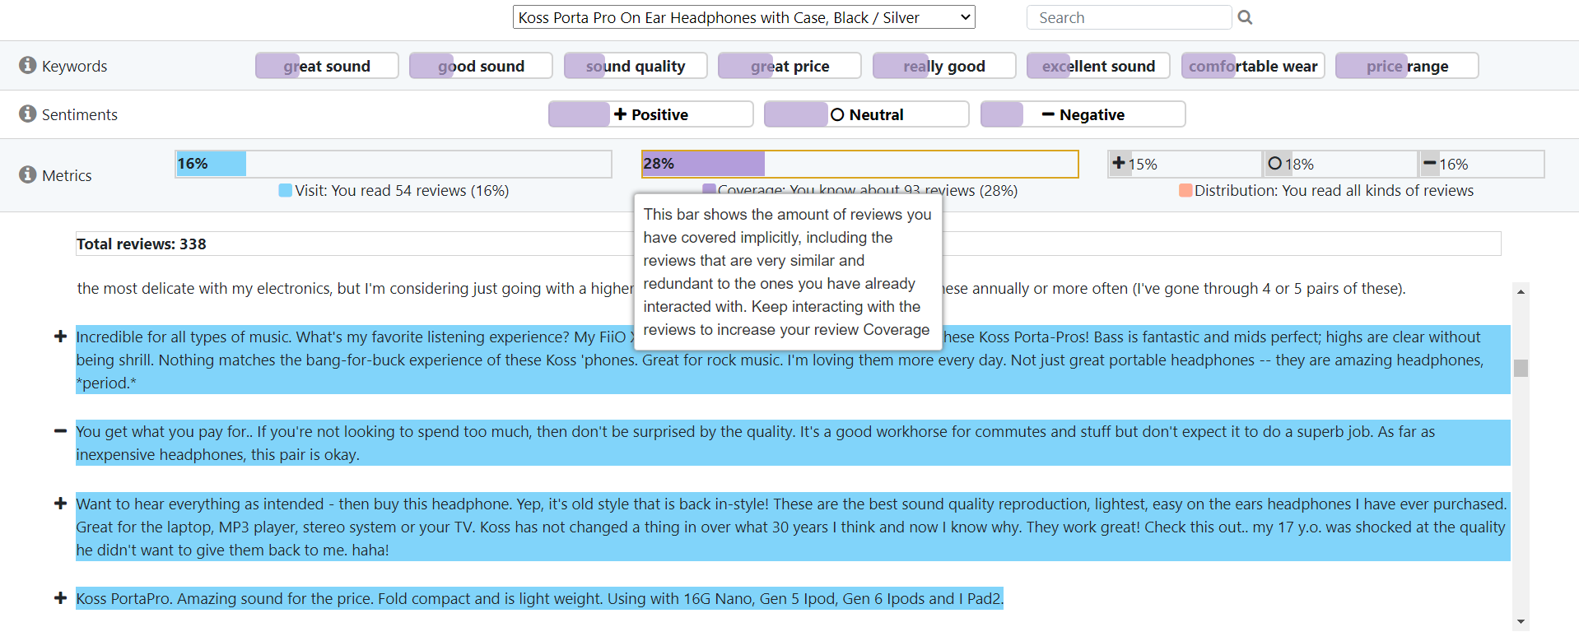

Slide 22
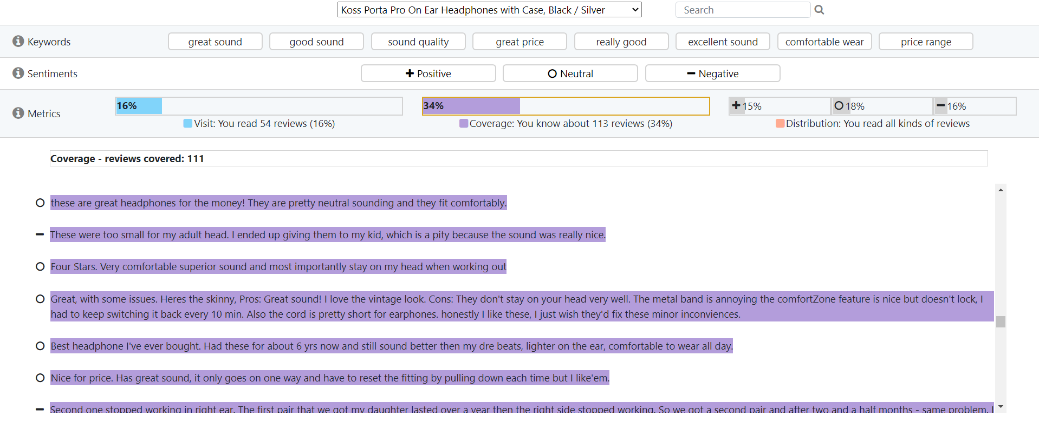

Slide 23
Set C

Slide 24
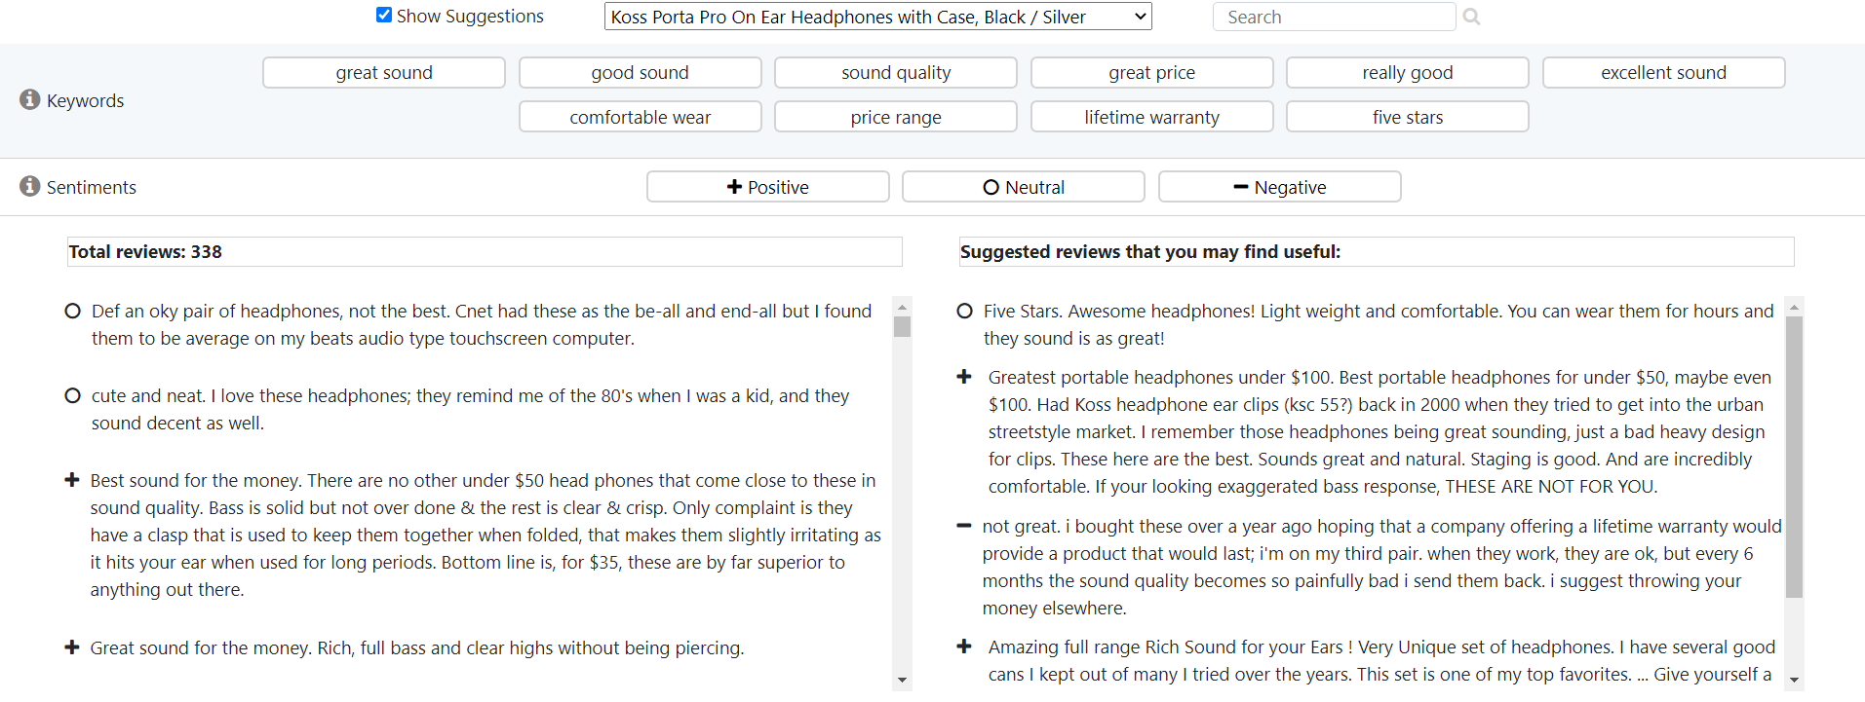
Keywords
Sentiments
List of reviews
List of suggested
Reviews that you
May find useful

Slide 25
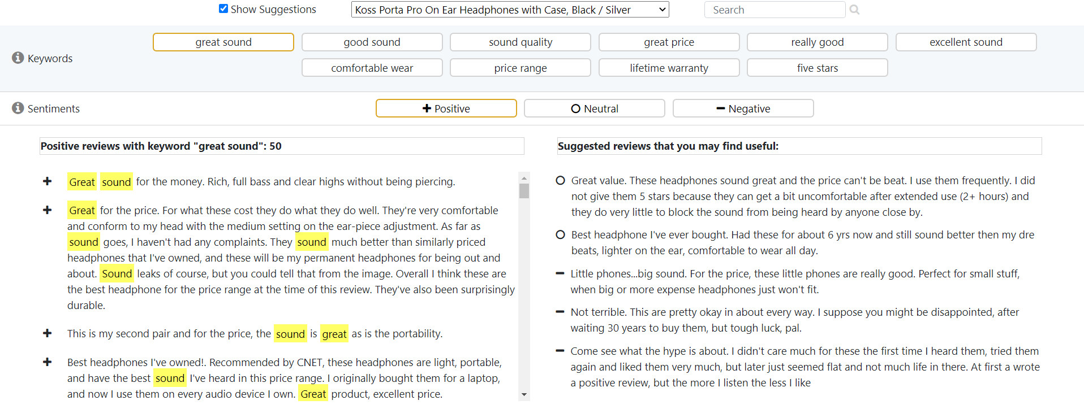

Slide 26
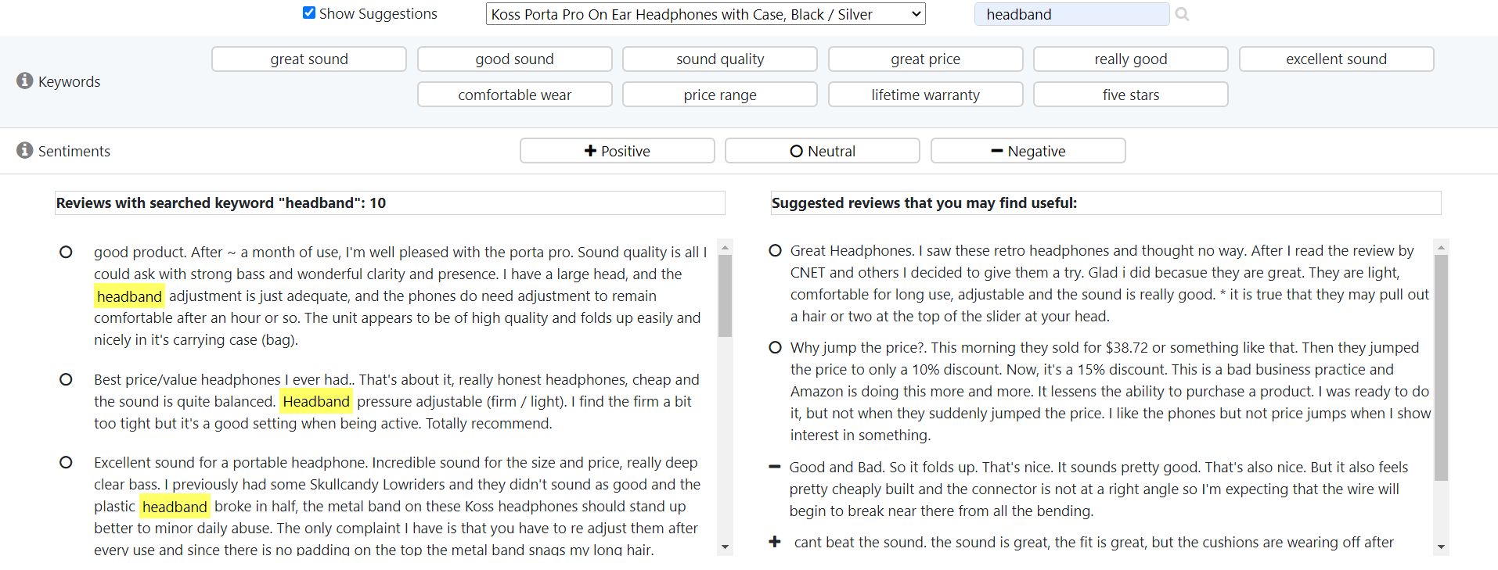

Slide 27
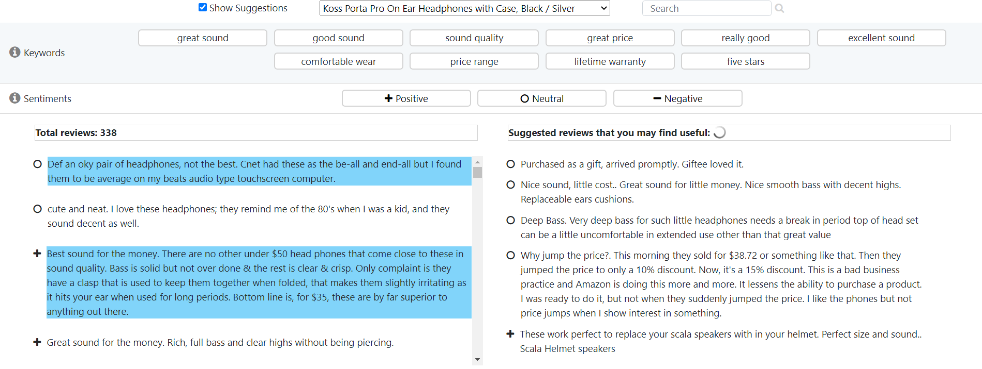

Slide 28


