Slide 1
Colloquium
Gruppe1
Niklas Heiber, Michael Jathe, Jonas Gerken, Benedikt Lipinski

Slide 2
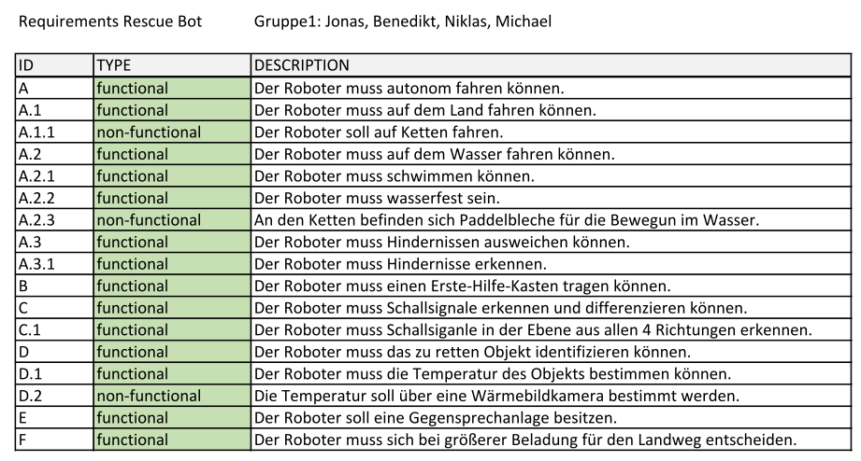
Requirements

Slide 3
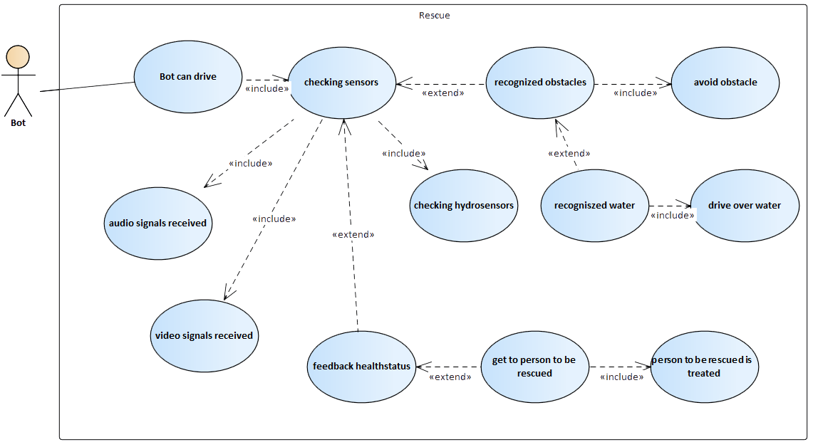
Use Case
Notes:
Jonas

Slide 4
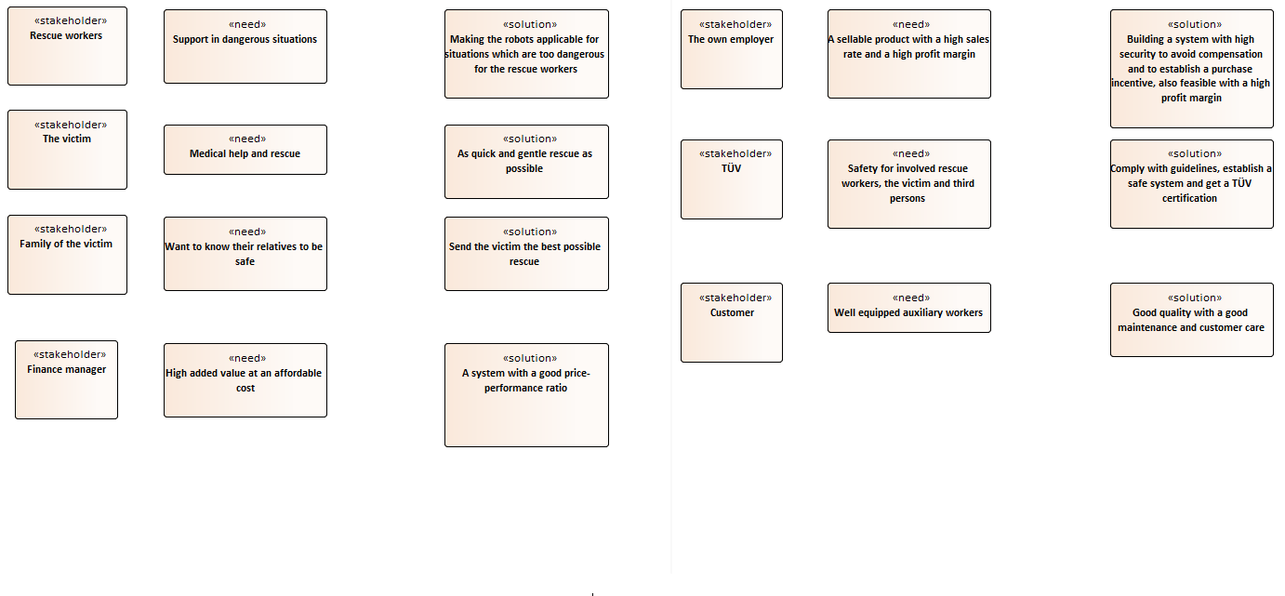
Stakeholder

Slide 5
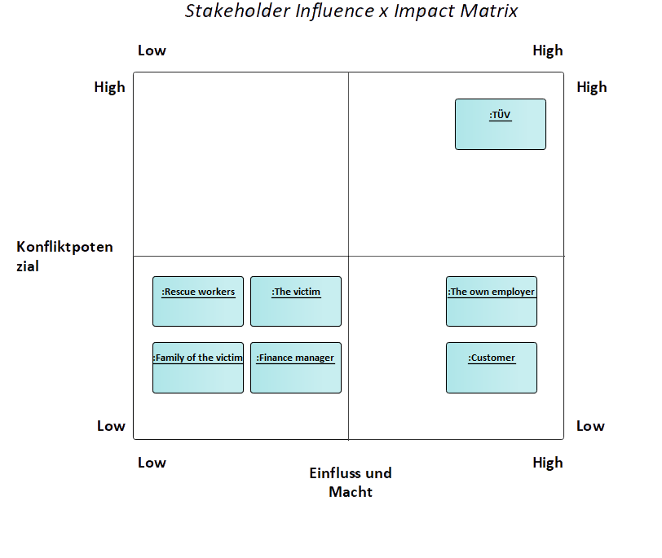
Stakeholder-Matrix

Slide 6
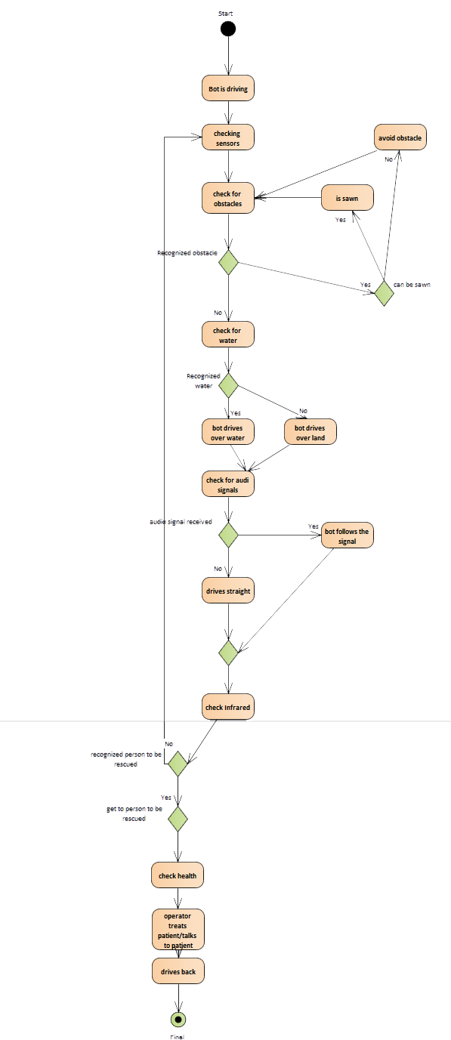
Aktivitätsdiagramm
Notes:
Jonas

Slide 7
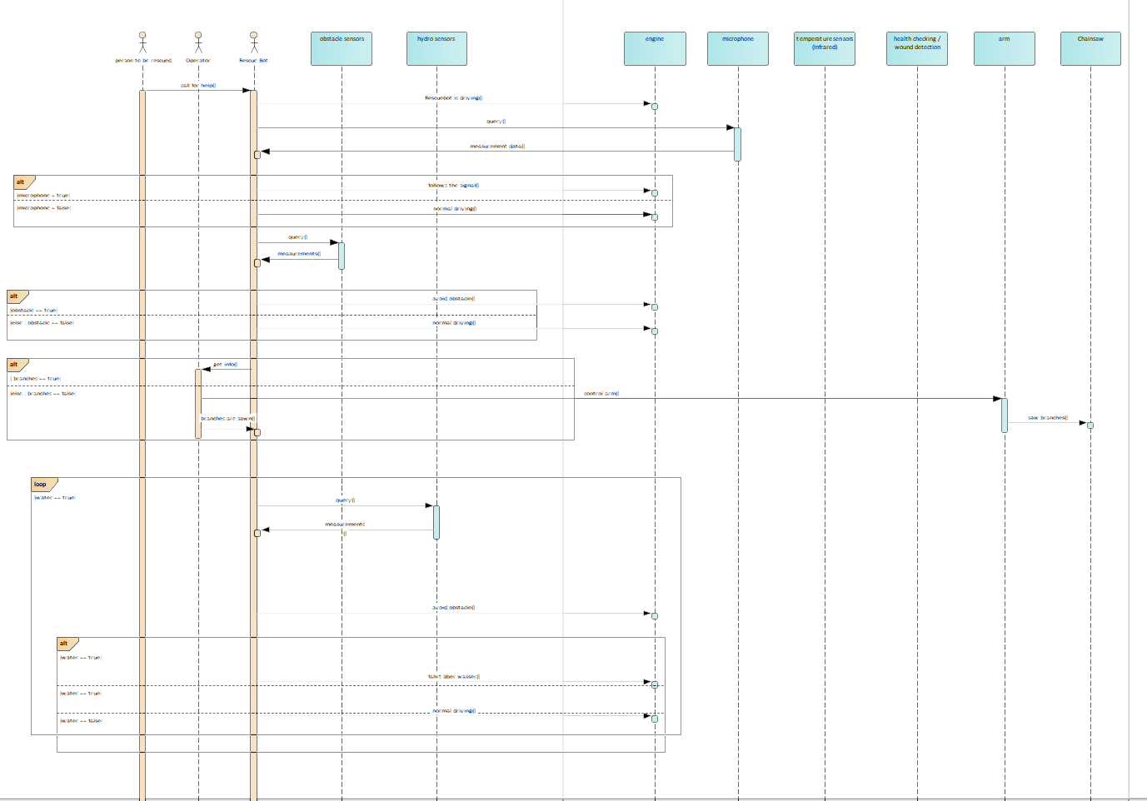
Sequencdiagramm

Slide 8
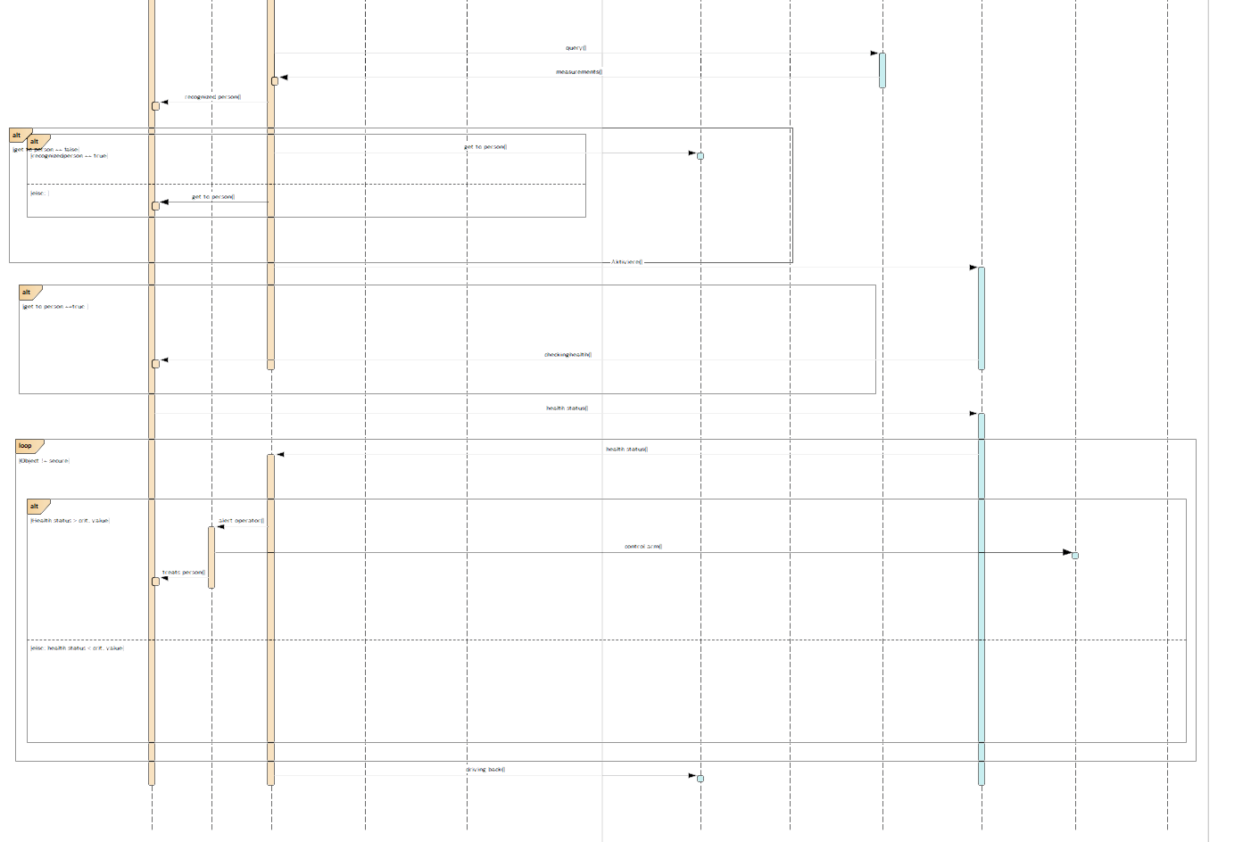
Sequencdiagramm

Slide 9
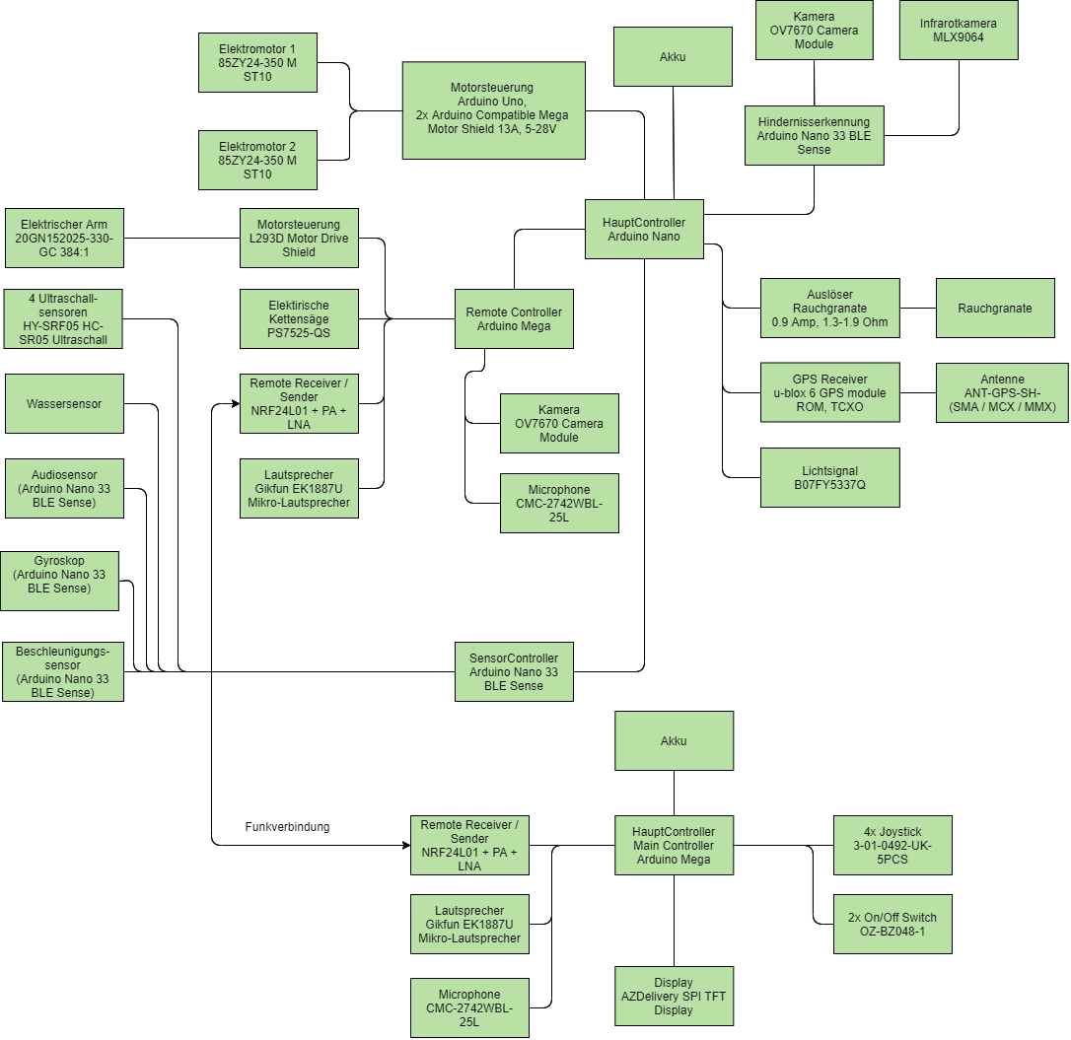
Architekturmodell

Slide 10
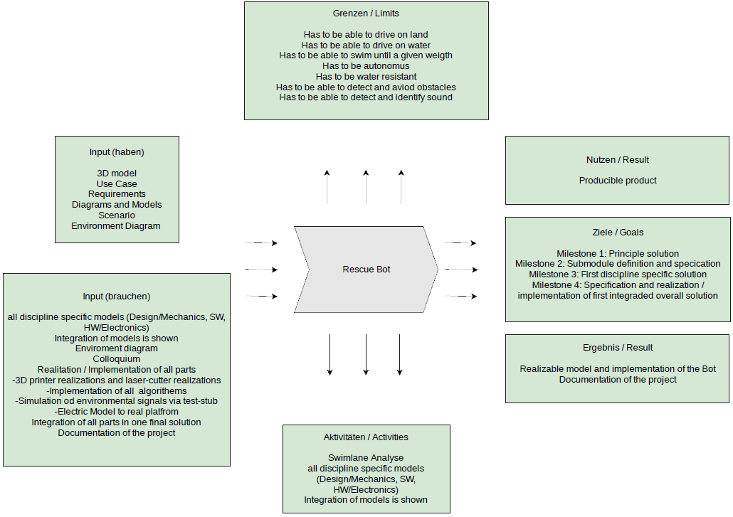
Context modell

Slide 11
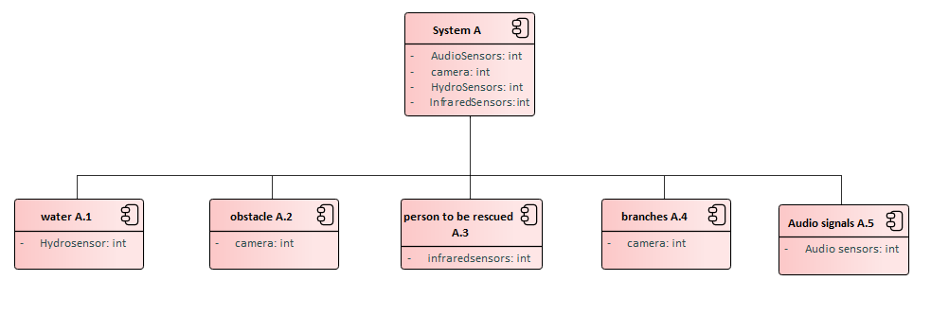
Umgebungsdiagramm
Notes:
Jonas

Slide 12
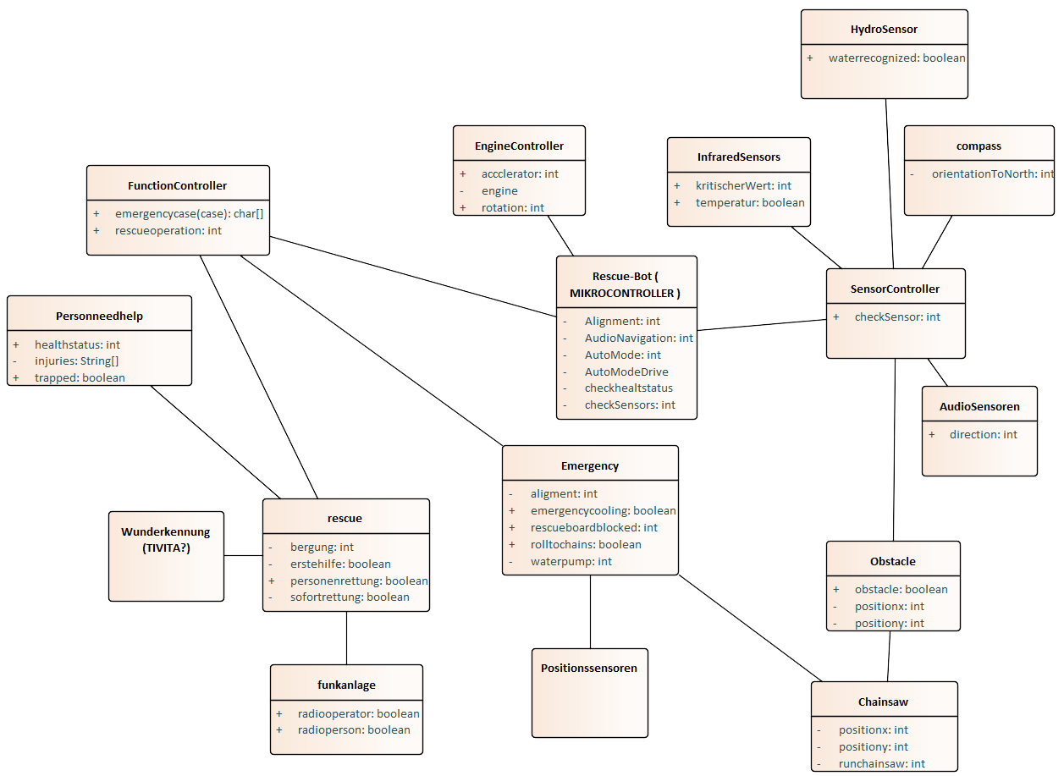
Class diagramm

Slide 13
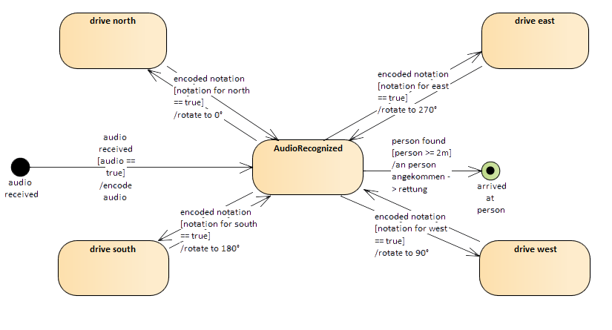
State machine Audio Navigation

Slide 14
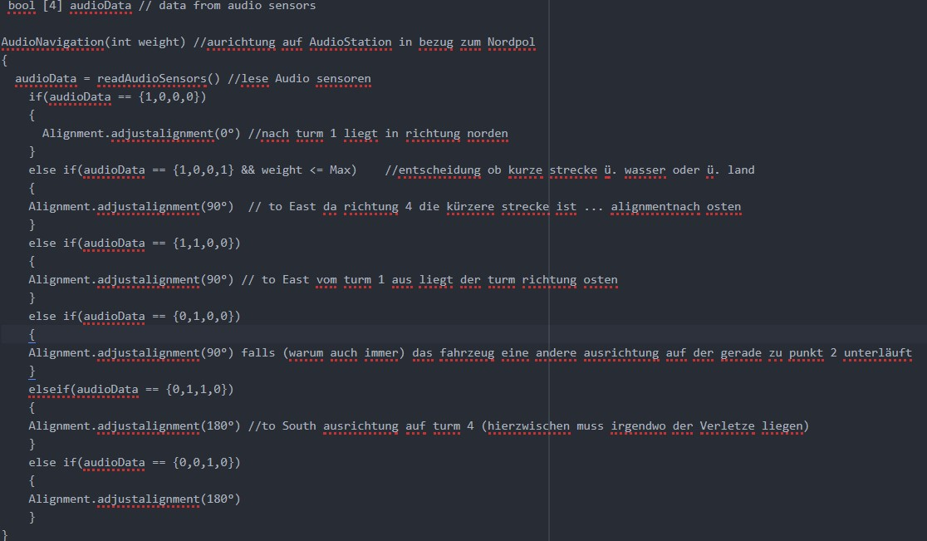
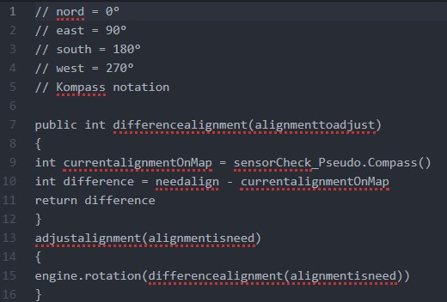
Audio Navigation - Code

Slide 15
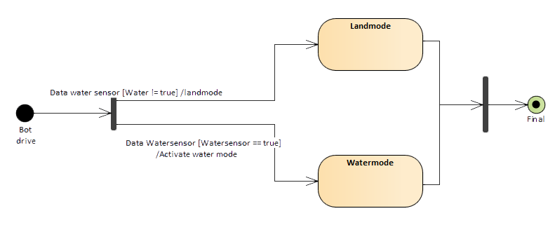
State machine water

Slide 16
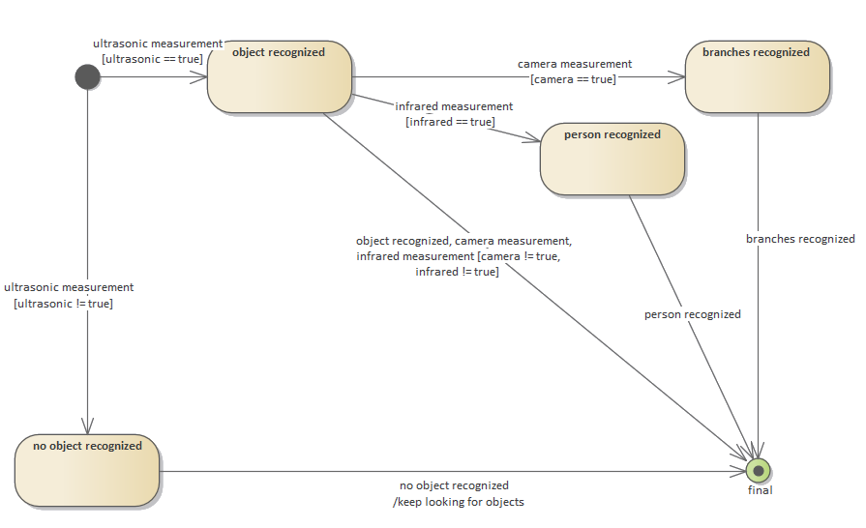
State machine object recognition
Notes:
Jonas

Slide 17
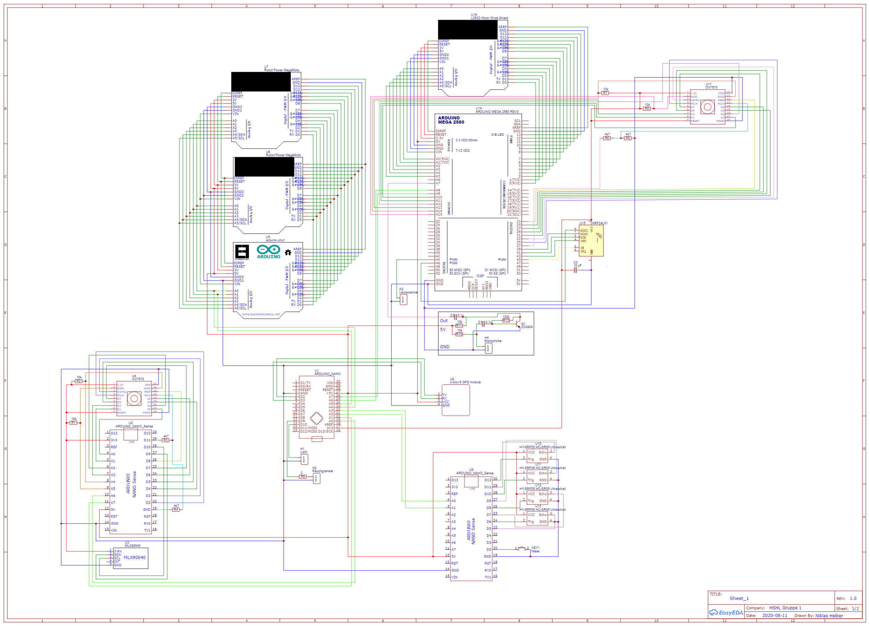
Schematic rescue bot

Slide 18
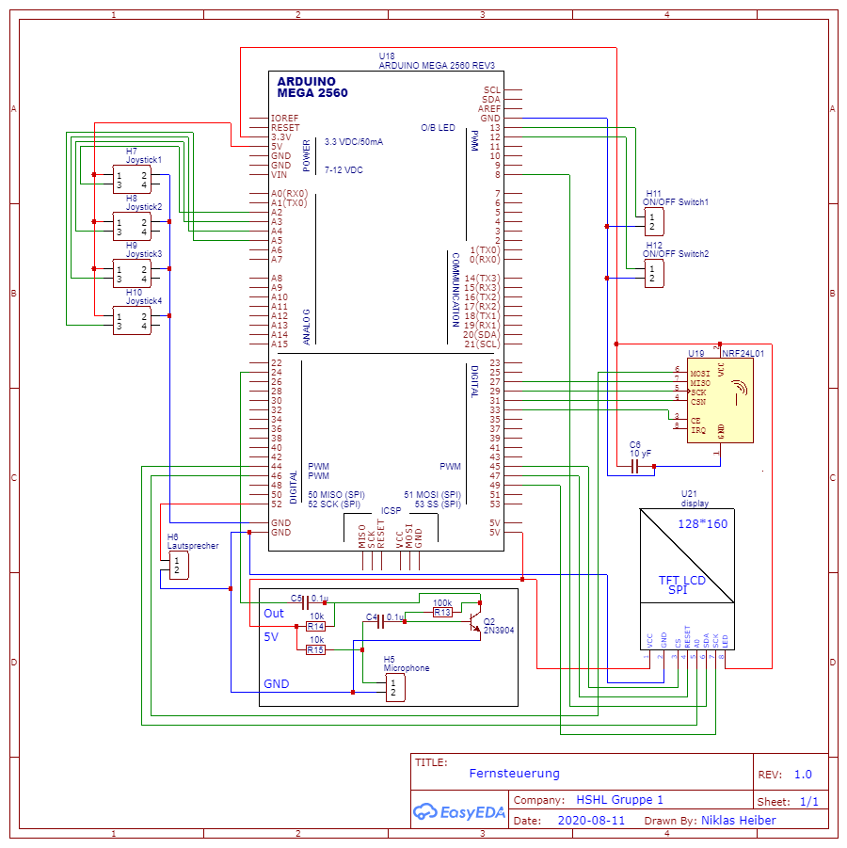
Schematic Remote Control

