Slide 1
Search Documents Algorithm
An Efficient Document Search System
Name: M Jawad Haider
Roll no: 2021-CS-149

Slide 2
Agenda
Introduction
Goals
Implementation Plan
Approach
Backend Concept
Index Creation
Search Functionality
Conclusion

Slide 3
Introduction
The project is designed to provide a streamlined way to index and search through document files.
It focuses on creating Indexes of documents in the given path and search the query to retrieve the relevant documents.
Key Features:
Title & Content based search
Case-insensitive matching
Removal of verbs, unnecessary punctuation, and stop words

Slide 4
Goals
Primary Objectives:
Create an efficient index structure to support fast keyword searches.
Focus on storing nouns in the index, as they are often the most informative keywords in a search.
Implement flexible search functionalities, including case-insensitive search and punctuation handling.
Design a scalable solution that performs well as the number of documents grows.

Slide 5
Implementation Plan
Step-by-Step Development:
File Reading:
Access and read all text files within a designated directory.
Word Filtering:
Remove common stop words (e.g., "the," "is," "and") and verbs (identified by suffixes) to focus on essential nouns.
Index Creation:
Store each unique noun as a key in a dictionary, linking it to the files where it appears.
Search Functionality:
Enable users to input search terms and retrieve files containing those terms.

Slide 6
Approach
Indexing Strategy:
Use a dictionary to map keywords to the files they appear in.
Normalize keywords by converting to lowercase and removing punctuations and verb-like endings.
Data Processing:
Verbs are identified based on suffixes such as “-ing,” “-ed,” and “-ize,” which are excluded from the index.
Index only nouns from both file names and file contents for more comprehensive search results.
Data Structure:
Use a dictionary for fast lookup and retrieval during searches.

Slide 7
Backend Concept
Index Creation:
The program iterates over all text files in a folder and reads the content.
Each word is checked against the list of stop words and verb suffixes.
Only relevant nouns are indexed, with each word mapped to a list of files it appears in.
Search Functionality:
When a search is conducted, the query is split, normalized, and compared against the dictionary.
Matched keywords return a list of documents containing the terms.
Results are then displayed.

Slide 8
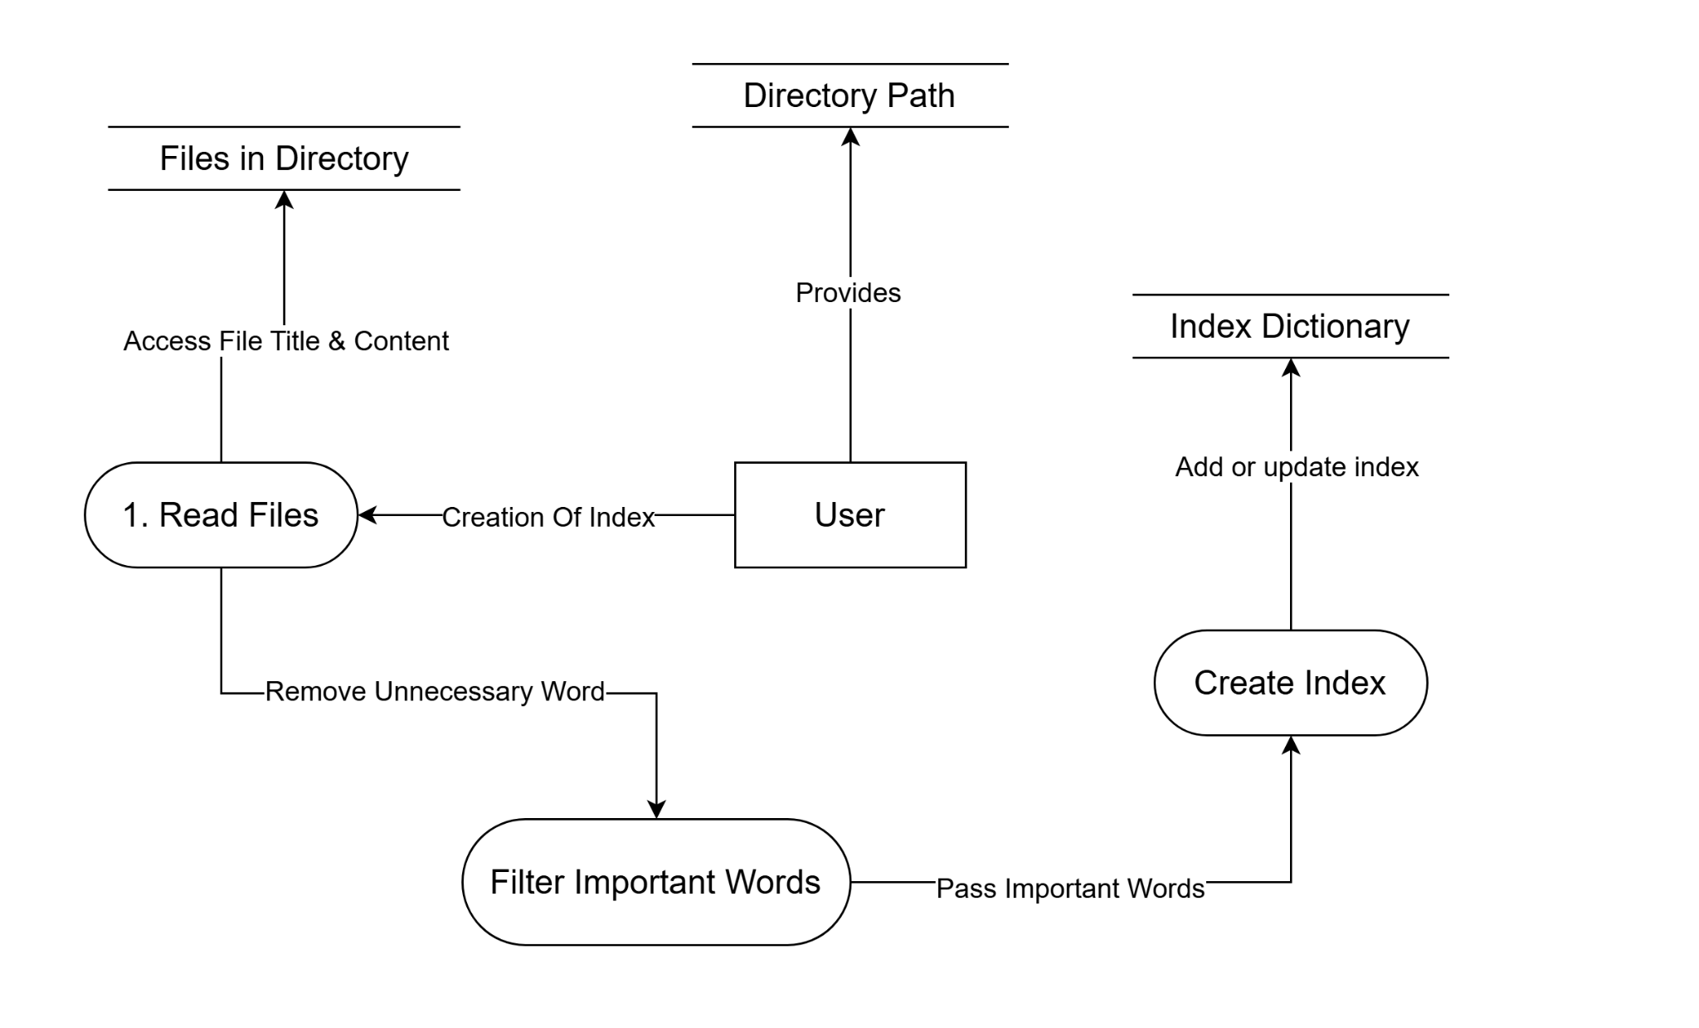
DFD - Creation of Indexes

Slide 9
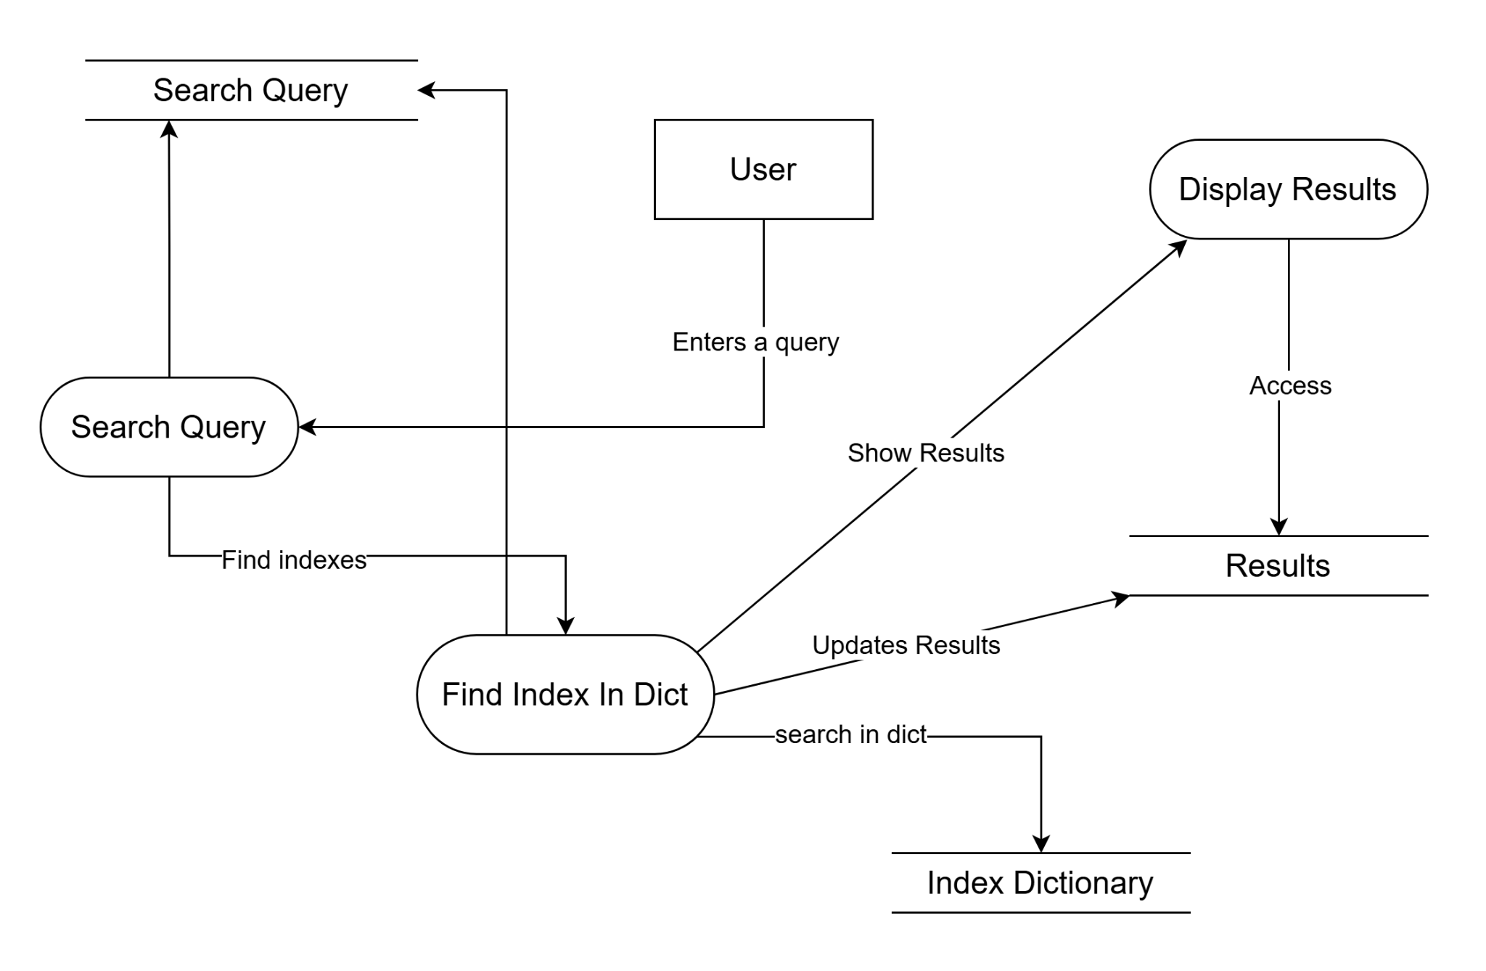
DFD - Search Functionality

Slide 10
Conclusion
The algorithm successfully enables efficient indexing and searching for documents.
Current functionality provides keyword search, case insensitivity, and punctuation handling.
Future Enhancements:
Extend indexing to other file types (e.g., PDFs, web pages).
Implement advanced ranking algorithms to prioritize more relevant search results.

