Slide 1

Capstone Project
IBM on Coursera by
Jessica Obot

Slide 2



OUTLINE
Executive Summary
Introduction
Methodology
Results
  Visualization – Charts
  Dashboard
Discussion
  Findings & Implications
Conclusion
Appendix

Slide 3
03
Executive summary
WHAT THE DATA SAYS AT A GLANCE
66.0%
39.3%
55.6%
$130.8k
27,005
JavaScript current use
Python desired next
PostgreSQL current use
Highest scraped salary
Job records
The signal
Decision takeaway
•
JavaScript, HTML/CSS and SQL lead current use.
Build durable fundamentals first — then add Python, PostgreSQL, Rust or Go according to the role you want next.
•
Python is the strongest “next skill” signal.
•
PostgreSQL leads both current and desired database use.
•
The job sample is directional, not a labor-market census.
This is the through-line across the survey, job sample and salary table.
Source: Stack Overflow Developer Survey 2025, Technology + Developers pages (official published results).
DATA ANALYST CAPSTONE • 2025 SURVEY EDITION
3

Slide 4
04
Introduction
PURPOSE, AUDIENCE AND VALUE
Question
Audience
Learners, early-career analysts, hiring teams and program instructors.
Which technologies and skills are most useful to learn next?
Value 01
Value 02
Translate a large survey into an actionable learning path.
Separate broad popularity from forward-looking demand.
The analysis joins three perspectives:
• what developers use
• what they want next
• what appears in a job sample
Scope note: Stack Overflow’s latest published survey in this analysis is 2025; the two IBM lab datasets are smaller teaching datasets.
Source: Stack Overflow Developer Survey 2025, Technology + Developers pages (official published results).
DATA ANALYST CAPSTONE • 2025 SURVEY EDITION
4

Slide 5
05
Methodology
THREE SOURCES, ONE DECISION FRAME
01
02
03
04
Collect
Clean
Compare
Communicate
Official 2025 survey pages + two lab datasets
Normalize names, parse percentages and correct one location typo
Current use vs desired use; jobs vs salary
Charts, dashboard views and implications
Guardrail
Use the survey for broad developer signals; use the job and salary labs as directional examples, not like-for-like market estimates.
Sources: Official Stack Overflow 2025 pages; IBM Skills Network Jobs API lab; IBM Skills Network Web Scraping lab.
DATA ANALYST CAPSTONE • 2025 SURVEY EDITION
5

Slide 6
06
Results
FROM RAW RECORDS TO PATTERNS
The results combine popularity, momentum and employability signals.
The next four sections move from the two lab exercises into the official survey’s technology and demographic views.
01
02
03
04
Jobs
Salary
Technology
People
Where the API sample is concentrated.
Which scraped languages top the table.
Current use versus desired next.
Who answered the survey.
DATA ANALYST CAPSTONE • 2025 SURVEY EDITION
6

Slide 7
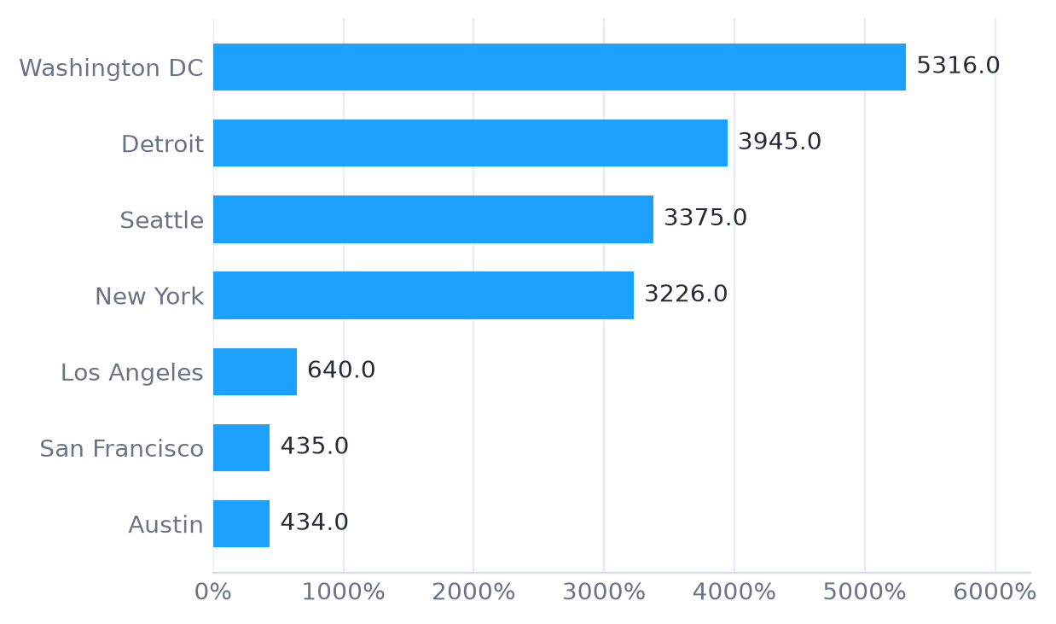
07
Job postings by location
API LAB RESULT — DESCENDING ORDER
Largest location
Washington DC • 5,316 postings
Read this carefully
•
Washington DC and Detroit are the largest locations.
•
This is a teaching subset, not a live job board.
•
The ranking is useful for practicing visualization.
Source: IBM Skills Network Jobs API lab; 27,005 records from jobs.json (location typo “New Your” corrected to New York).
DATA ANALYST CAPSTONE • 2025 SURVEY EDITION
7

Slide 8
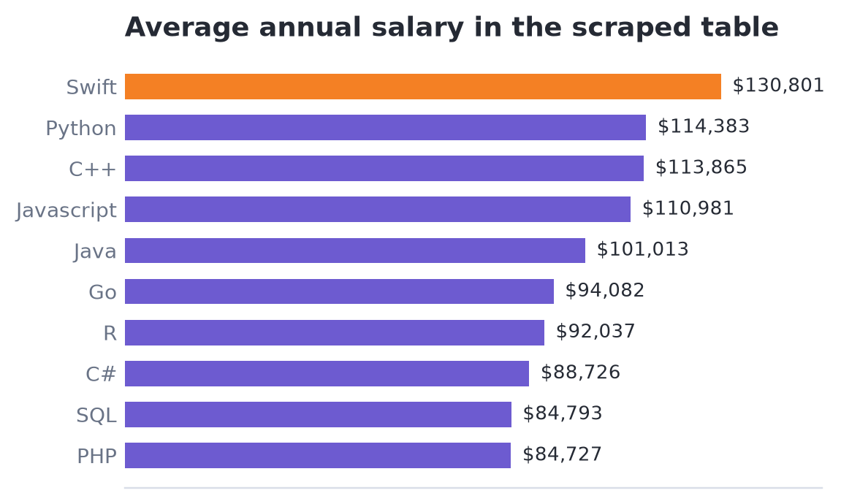
08
Popular languages by salary
WEB-SCRAPING LAB RESULT — DESCENDING SALARY
Top in the scraped table
Swift • $130,801
Interpretation
•
Swift is the highest-paying language in this small table.
•
Role, level, geography and industry also shape salary.
•
Treat this as a scraping exercise, not a benchmark.
Source: IBM Skills Network Web Scraping lab; Programming_Languages.html, 10-language salary table.
DATA ANALYST CAPSTONE • 2025 SURVEY EDITION
8

Slide 9
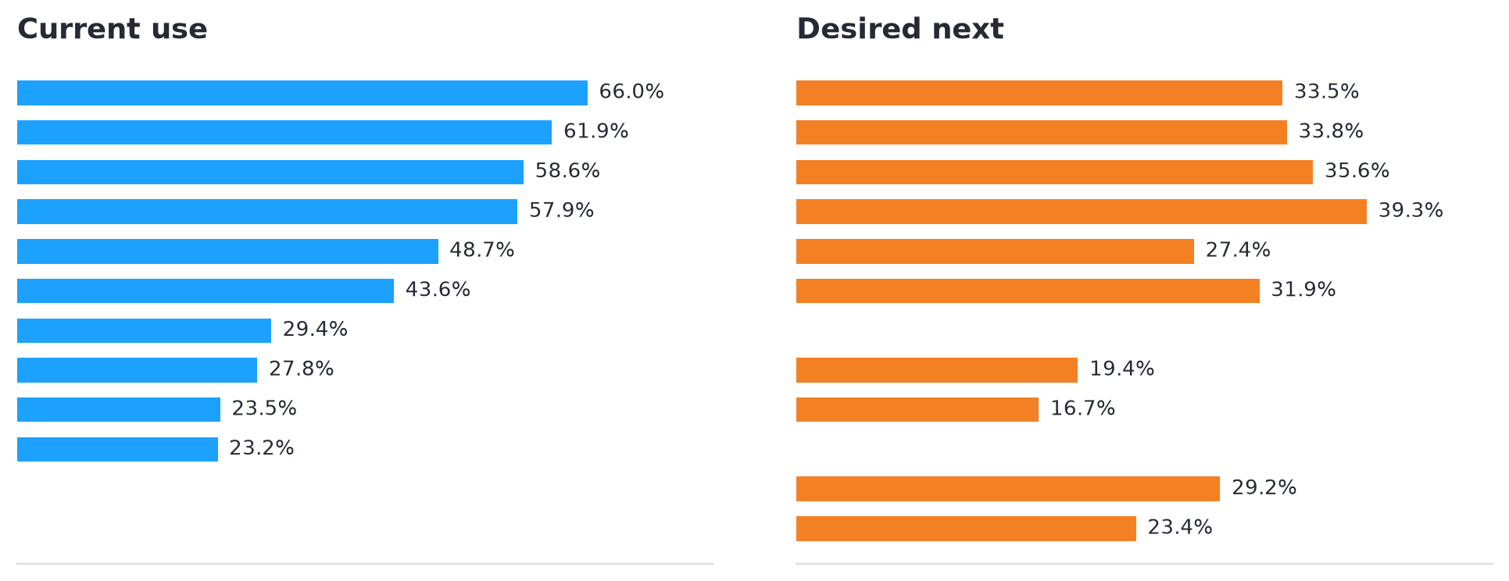
09
Programming language trends
CURRENT USE VS DESIRED NEXT-YEAR USE
Biggest forward signal
Python leads desired use at 39.3%.
What changes
•
Rust and Go rank higher in desired use than current use.
•
JavaScript leads current use, not next-skill intent.
•
Python connects AI, data and backend work.
Source: Stack Overflow Developer Survey 2025, Technology + Developers pages (official published results).
DATA ANALYST CAPSTONE • 2025 SURVEY EDITION
9

Slide 10
10
Programming trends — findings & implications
TURNING RANKINGS INTO ACTION
Findings
Implications
01
Core languages still dominate
•
Teach SQL and web fundamentals as the base layer, not as optional extras.
JavaScript, HTML/CSS and SQL are the top current-use technologies.
02
Python is the clearest growth bet
•
Use Python projects to connect data analysis, automation and AI.
It ranks fourth in current use but first in desired use.
03
Systems languages are aspirational
•
Offer Rust or Go as a deliberate specialization after learners have shipped with one mainstream stack.
Rust and Go have stronger desired positions than current-use positions.
Source: Stack Overflow Developer Survey 2025, Technology + Developers pages (official published results).
DATA ANALYST CAPSTONE • 2025 SURVEY EDITION
10

Slide 11
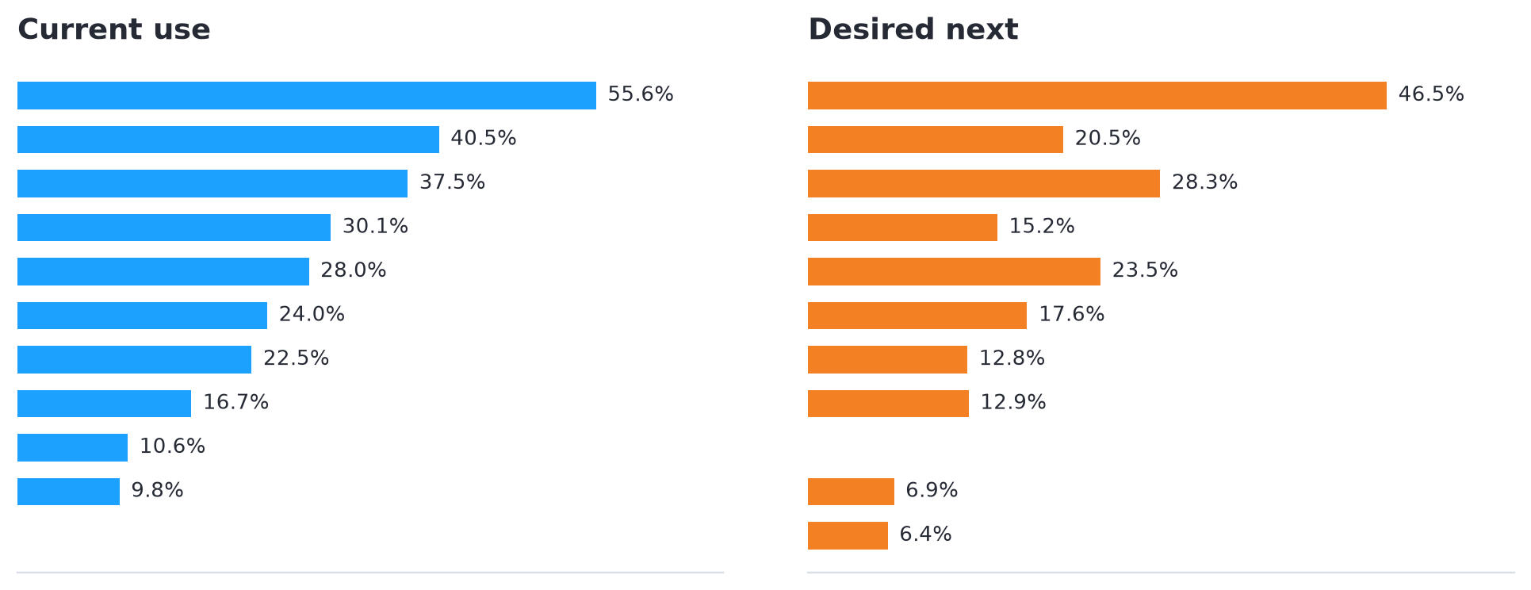
11
Database trends
CURRENT USE VS DESIRED NEXT-YEAR USE
Anchor technology
PostgreSQL leads both sides.
What changes
•
Stack Overflow highlights Redis usage growth.
•
SQLite and Redis rise in desired use relative to MySQL.
•
PostgreSQL is the safest common denominator for a modern data stack.
Source: Stack Overflow Developer Survey 2025, Technology + Developers pages (official published results).
DATA ANALYST CAPSTONE • 2025 SURVEY EDITION
11

Slide 12
12
Database trends — findings & implications
DURABLE DATA SKILLS BEAT TOOL CHASING
Findings
Implications
01
Relational skills remain central
•
Make relational modeling, joins and indexing the baseline.
PostgreSQL, MySQL and SQLite form the current-use core.
02
PostgreSQL has unusual strength
•
Add PostgreSQL as the default portfolio database for learners.
It is both the most used and most desired database.
03
Caching and lightweight stores matter
•
Teach Redis and SQLite as focused tools with clear use cases, not as replacement fundamentals.
Redis and SQLite show strong forward interest.
Source: Stack Overflow Developer Survey 2025, Technology + Developers pages (official published results).
DATA ANALYST CAPSTONE • 2025 SURVEY EDITION
12

Slide 13
13
Dashboard
THREE VIEWS FOR THREE DECISIONS
A dashboard should answer a question, not just display a chart.
These tabs separate what is widely used, what developers want next and who is represented in the survey.
TAB 01
Current technology usage
What is already common enough to be a baseline?
TAB 02
Future technology trends
Where is learning interest moving next?
TAB 03
Demographics
Who answered, and what context matters?
Source: Stack Overflow Developer Survey 2025, Technology + Developers pages (official published results).
DATA ANALYST CAPSTONE • 2025 SURVEY EDITION
13

Slide 14
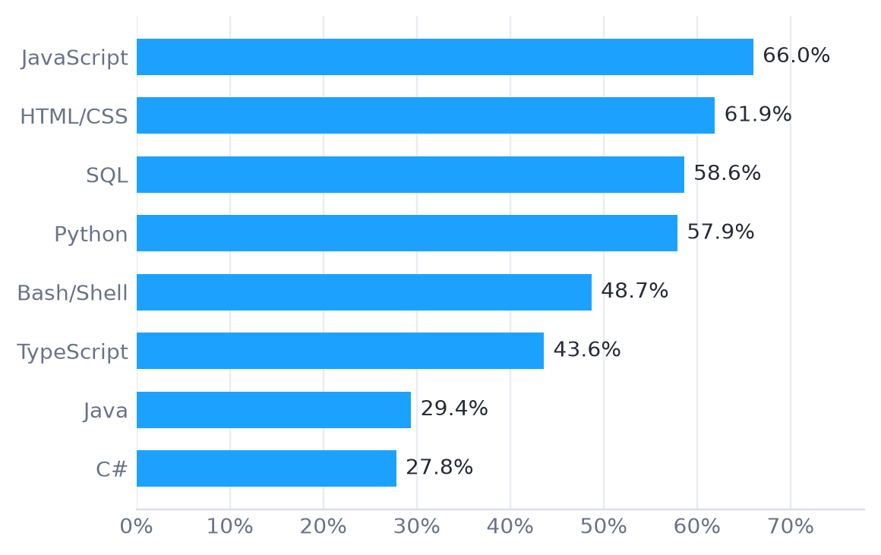
14
Dashboard tab 1: Current technology usage
WHAT FORMS THE BASELINE
66.0%
55.6%
58.6%
57.9%
JavaScript
PostgreSQL
SQL
Python
Dashboard insight
Baseline = web + data: JavaScript, HTML/CSS and SQL, with Python close behind.
Design implication: teach across the stack.
Source: Stack Overflow Developer Survey 2025, Technology + Developers pages (official published results).
DATA ANALYST CAPSTONE • 2025 SURVEY EDITION
14

Slide 15
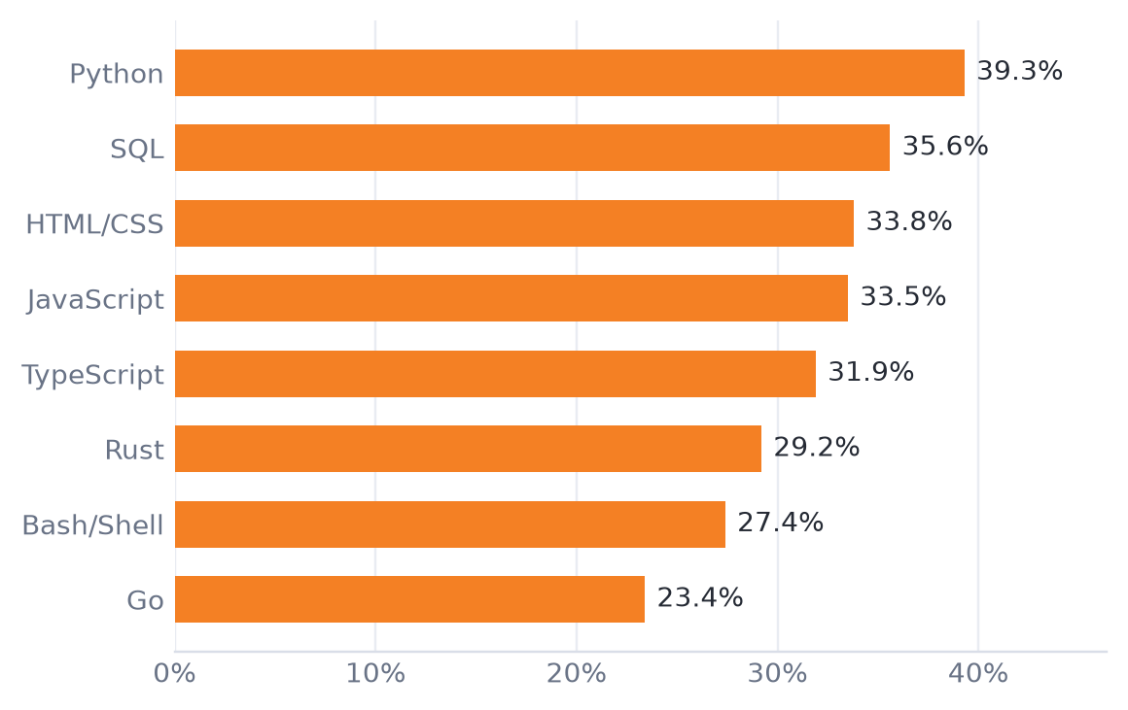
15
Dashboard tab 2: Future technology trends
WHAT DEVELOPERS WANT NEXT
Strongest next-skill bets
Python • SQL • Rust
Dashboard insight
Interest is not simply following current popularity. Developers are reaching toward Python for AI/data work and toward Rust/Go for systems and backend depth.
Source: Stack Overflow Developer Survey 2025, Technology + Developers pages (official published results).
DATA ANALYST CAPSTONE • 2025 SURVEY EDITION
15

Slide 16
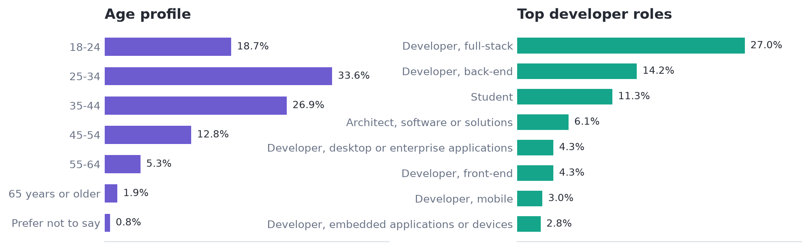
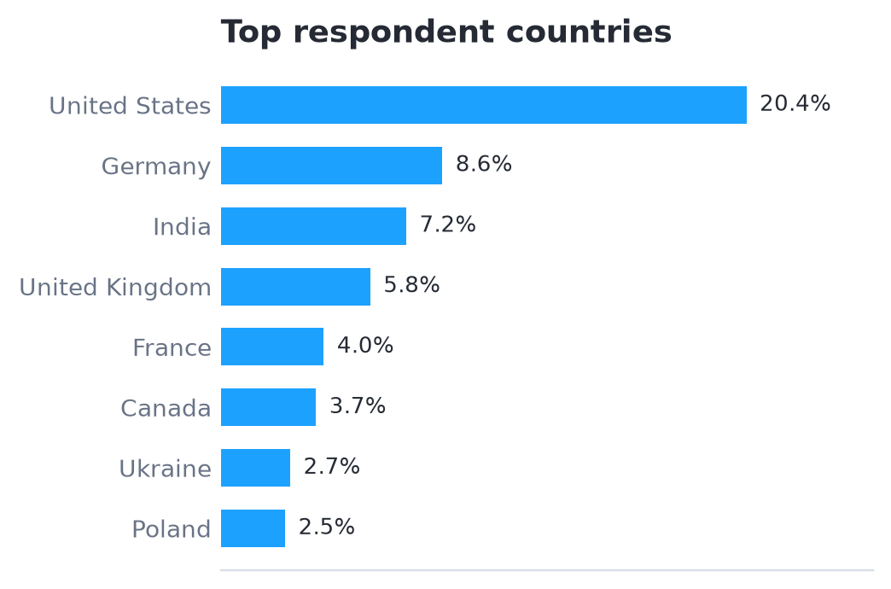
16
Dashboard tab 3: Demographics
WHO ANSWERED THE SURVEY
Context
The largest age band is 25–34 (33.6%). The United States is the largest country group (20.4%).
Source: Stack Overflow Developer Survey 2025, Developers page; age n=49,019, country n=35,307, roles n=43,560.
DATA ANALYST CAPSTONE • 2025 SURVEY EDITION
16

Slide 17
17
Discussion
HOW THE SIGNALS FIT TOGETHER
SIGNAL
WHAT WE SEE
WHAT TO DO
Baseline
JavaScript, HTML/CSS, SQL and PostgreSQL are widely used.
Build fundamentals around web + data.
Momentum
Python leads desired language use; Redis is highlighted for growth.
Use project-based Python and data work.
Specialization
Rust and Go sit higher in desired use than current use.
Offer focused pathways after the core.
Context
The job and salary labs are smaller and older teaching datasets.
Use them to practice analysis, not to overclaim.
Best interpretation: learn what is common, then differentiate with skills that are gaining intent.
Source: Stack Overflow Developer Survey 2025, Technology + Developers pages (official published results).
DATA ANALYST CAPSTONE • 2025 SURVEY EDITION
17

Slide 18
18
Overall findings & implications
THREE FINDINGS WORTH CARRYING FORWARD
01
02
03
Fundamentals compound
Intent points to Python
Depth creates differentiation
The most-used technologies are still foundational. SQL, web skills and relational databases remain high-leverage.
Python is the clearest bridge between today’s stack and emerging AI, data and automation work.
Rust, Go, Redis and PostgreSQL show where developers are adding depth beyond the baseline.
IMPLICATION
IMPLICATION
IMPLICATION
Recommendation: teach the common core, make Python the applied bridge, and let specialization follow the learner’s target role.
Source: Stack Overflow Developer Survey 2025, Technology + Developers pages (official published results).
DATA ANALYST CAPSTONE • 2025 SURVEY EDITION
18

Slide 19
19
Conclusion
A PRACTICAL LEARNING PATH
Start broad. Build depth. Make the next step visible.
1
2
3
Build the core
Apply with Python
Specialize deliberately
SQL + web fundamentals + one mainstream language
Data, automation, APIs and AI-enabled workflows
PostgreSQL depth, Redis, Rust or Go by target role
The data does not point to one perfect technology. It points to a sequence: fundamentals → applied Python → role-specific depth.
DATA ANALYST CAPSTONE • 2025 SURVEY EDITION
19

Slide 20
20
Appendix
SOURCES, DEFINITIONS AND LIMITATIONS
Sources used
Definitions
•
Stack Overflow Developer Survey 2025 — Technology page
•
Current use = extensive development work in the past year.
•
Desired use = wants to work with the technology in the next year.
•
Stack Overflow Developer Survey 2025 — Developers page
•
Survey percentages are response shares, not market share.
•
IBM Skills Network Jobs API lab — jobs.json (27,005 records)
Limitations
•
IBM Skills Network Web Scraping lab — 10-language table
•
The survey is self-reported and global; response coverage varies.
•
The job and salary data are teaching datasets, not live market estimates.
•
Use rankings to guide questions and learning priorities, not make career choices alone.
DATA ANALYST CAPSTONE • 2025 SURVEY EDITION
20

